Slide 1
Introduction to Machine Learning
Week 1

Slide 2
Overview of Machine Learning Concepts
Machine Learning (ML) is a subset of artificial intelligence (AI) that focuses on building systems capable of learning from data, identifying patterns, and making decisions with minimal human intervention. ML algorithms use statistical techniques to enable machines to improve their performance on a given task through experience

Slide 3
Supervised Learning
Supervised learning involves training a model on a labeled dataset, which means that each training example is paired with an output label.
Examples: Classification (e.g., spam detection), Regression (e.g., predicting house prices).
Algorithms: Linear Regression, Logistic Regression, Support Vector Machines, Decision Trees, Neural Networks.

Slide 4
Unsupervised Learning
Unsupervised learning deals with unlabeled data. The goal is to identify underlying patterns or structures in the data.
Examples: Clustering (e.g., customer segmentation), Dimensionality Reduction (e.g., Principal Component Analysis).
Algorithms: K-Means Clustering, Hierarchical Clustering, Gaussian Mixture Models, Autoencoders.

Slide 5
Reinforcement Learning
Reinforcement learning involves training an agent to make a sequence of decisions by rewarding it for desirable actions and/or punishing it for undesirable ones.
Examples: Game playing (e.g., AlphaGo), Robotics, Autonomous Driving.
Algorithms: Q-Learning, Deep Q-Networks (DQN), Policy Gradients, Actor-Critic Methods.

Slide 6
Features in Machine Learning
In machine learning, features are the individual measurable properties or characteristics of the data being analyzed.
Features play a critical role in the performance of machine learning models as they provide the necessary input information that the model uses to learn patterns and make predictions.

Slide 7
Types of Features
Numerical Features
Features that represent quantitative data and can be measured on a numerical scale.
Examples: Age, salary, temperature, distance.
Properties: Can be continuous (e.g., temperature) or discrete (e.g., number of children).

Slide 8
Types of Features
Categorical Features
Features that represent qualitative data and describe categories or groups.
Examples: Gender, blood type, color, product category.
Properties: Can be nominal (no inherent order, e.g., color) or ordinal (inherent order, e.g., education level)

Slide 9
Types of Features
Boolean Features
Features that have binary values, typically representing true/false or yes/no conditions.
Examples: Is student (yes/no), has diabetes (true/false).

Slide 10
Types of Features
Text Features
Features derived from textual data, often requiring specialized processing techniques.
Examples: Customer reviews, news articles, social media posts.
Techniques: Tokenization, stop word removal, stemming, lemmatization.

Slide 11
Types of Features
Time-Series Features
Features that represent data points collected or recorded at specific time intervals.
Examples: Stock prices over time, daily weather data, sensor readings.
Properties: Can include temporal patterns, seasonality, and trends.

Slide 12
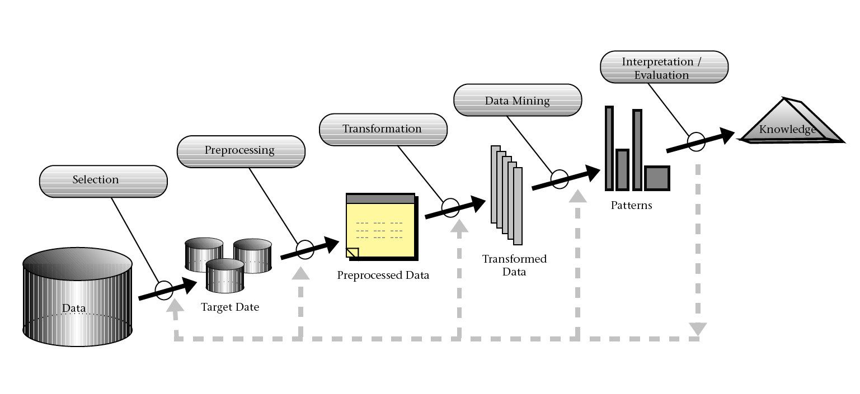
Knowledge Discovery in Databases (KDD process)

Slide 13
Knowledge Discovery in Databases (KDD)
Data Selection : Identify and retrieve relevant data from various data sources.
Data Preprocessing: Clean and prepare the data for further analysis.
Data Transformation: Transform the data into suitable formats for analysis.
Data Mining: Apply algorithms and techniques to extract patterns from the data.
Data Evaluation: Assess the patterns and models to ensure they are valid and useful.
Interpretation and Reporting: Interpret the discovered knowledge and present it in an understandable format.

Slide 14
Data Ingestion
Data ingestion is the process of collecting and importing data from various sources into a storage system where it can be accessed, managed, and analyzed.
This is a critical step in data processing pipelines and analytics workflows, ensuring that data is available for further processing and analysis.

Slide 15
Data Exploration
Data exploration is the initial phase of data analysis where analysts and data scientists investigate datasets to understand their characteristics, detect patterns, identify anomalies, and form hypotheses.
This phase involves visualizing and summarizing the data, which helps in making informed decisions for further data processing and modeling steps.

Slide 16
Data Exploration
Understanding Data Structure: Get a sense of the data types, ranges, and distributions.
Identifying Patterns and Relationships: Discover correlations and trends within the data.
Detecting Anomalies: Find outliers and inconsistencies that may affect the analysis.
Formulating Hypotheses: Generate initial assumptions and insights that guide deeper analysis.

Slide 17
Introduction to Pandas
Pandas is a powerful and flexible open-source data manipulation and analysis library for Python. It provides data structures and functions needed to manipulate structured data seamlessly. Pandas is widely used in data analysis, data science, and machine learning projects.
Key Features
Data Structures: Pandas introduces two primary data structures:
Series: A one-dimensional labeled array capable of holding any data type.
DataFrame: A two-dimensional labeled data structure with columns of potentially different types, similar to a table in a database or a spreadsheet.
Data Handling: Efficient handling of missing data, alignment of data, and reshaping.
Data Operations: Powerful data operations such as merging, joining, and aggregation.
Time Series: Robust support for time series data manipulation and analysis.
Data Input/Output: Tools for reading and writing data between in-memory data structures and different file formats (e.g., CSV, Excel, SQL databases).

Slide 18
Introduction to Pandas
Installation
pip install pandas
Importing
import pandas as pd
Series
s = pd.Series([1, 3, 5, 7, 9])
print(s)
DataFrame
df = pd.DataFrame(data)
print(df)

Slide 19
Introduction to Pandas
Viewing Data
print(df.head())
print(df.tail())
Data Selection
print(df['Name'])
Data Filtering
print(df[df['Age'] > 25])
Data Aggregation
print(df['Age'].mean())
Reading and Writing Data
df = pd.read_csv('data.csv’)
df.to_csv('output.csv', index=False)

Slide 20
Introduction to Numpy
NumPy (Numerical Python) is a fundamental package for scientific computing in Python. It provides support for arrays, matrices, and a wide range of mathematical functions to operate on these data structures. NumPy is highly optimized for performance and is a core component in the data science and machine learning ecosystems, serving as the base for many other libraries, including pandas, SciPy, and scikit-learn.

Slide 21
Introduction to Numpy
Installation
pip install numpy
Importing Numpy
import numpy as np
Creating arrays
arr = np.array([1, 2, 3, 4, 5])
print(arr)

Slide 22
Introduction to Numpy
Basic operations with numpy
import numpy as np # Sample data array data = np.array([10, 20, 30, 40, 50]) # Compute standard deviation std_dev = np.std(data) print(f'Standard Deviation: {std_dev}’) # Compute mean mean = np.mean(data) print(f'Mean: {mean}’) # Compute minimum value min_value = np.min(data) print(f'Minimum Value: {min_value}’) # Compute maximum value max_value = np.max(data) print(f'Maximum Value: {max_value}’) # Compute variance variance = np.var(data) print(f'Variance: {variance}')

Slide 23
Assignment 1
Ingest the Iris Data from UCI
Conduct basic exploration on Iris Data using pandas and numpy

