Slide 1


Understanding Big Data
Welcome to the fascinating world of Big Data, a term that has revolutionized the way organizations manage, process, and leverage a vast amount of information in this digital age. The concept of Big Data goes beyond simple large quantities; it encompasses the complexity, speed, and diversity of data that are beyond the capabilities of traditional databases to capture, store, analyze, and visualize without specialized technologies. Let's dive into the intricate details that characterize Big Data and explore its profound impact on various industries.
Ga
by Gugulothu Bhavana

Slide 2
The Five V's of Big Data
Volume
Velocity
Variety
At its core, Big Data starts with Volume, the sheer scale of data encompassing terabytes to exabytes, originating from endless sources such as sensors, social networks, and business interactions.
Velocity highlights the unprecedented speed of data creation and the pressure on systems to deal with streaming data like financial ticks or GPS signals in near real-time.
Variety refers to the myriad types of data, from neatly organized numbers in spreadsheets to unstructured text and images, each demanding different approaches for effective processing.
Variability
Veracity
Variability confronts the inconsistency in data flows, challenging systems to handle the fluctuations in data format, structure, and quality.
Lastly, Veracity underlines the importance of the reliability of data, necessitating innovative means to ensure accuracy amidst the noise and uncertainty of Big Data sources.

Slide 3

Technologies Paving the Way
1
Hadoop
2
Apache Spark
Hadoop's open-source framework enables the parallel processing of significant data sets, underpinned by its two main components: the Hadoop Distributed File System (HDFS) and MapReduce.
Complementing Hadoop, Apache Spark offers in-memory processing capabilities, significantly accelerating analysis tasks, and supporting complex algorithms.
3
NoSQL Databases
NoSQL databases are designed to store, retrieve, and manage large quantities of non-relational data with dynamic schema, offering nimble handling of variable Big Data.

Slide 4
Big Data Analytics
Decision-Making
Business Intelligence
Big Data analytics empowers organizations with advanced decision-making capabilities by uncovering hidden patterns and forecasting trends.
It plays a pivotal role in business intelligence, optimizing operations, and pushing the boundaries of market strategies.
Healthcare Impact
Scientific Breakthroughs
In healthcare, predictive analytics save lives by personalizing patient treatment plans and managing public health data.
Analyzing Big Data facilitates scientific discoveries that once seemed unreachable, multiplying research opportunities and innovation.

Slide 5
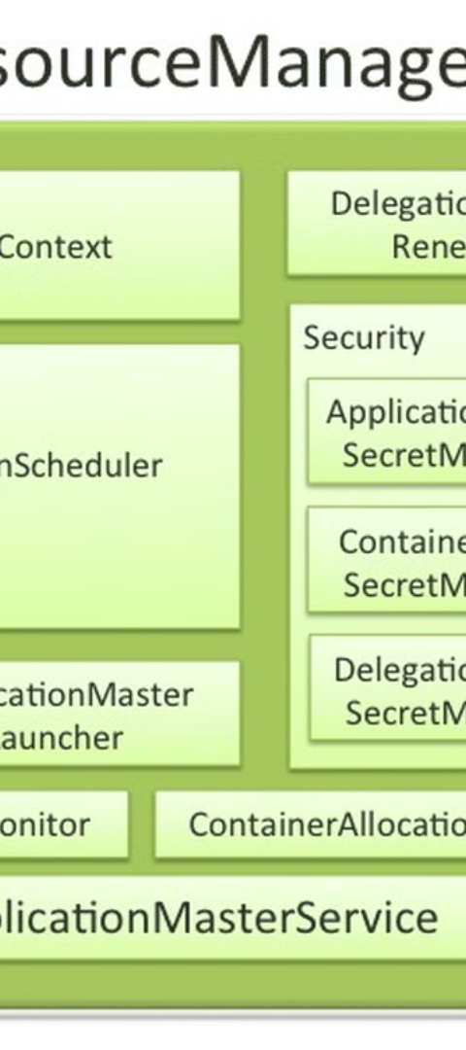


Exploring Hadoop's Core Components
HDFS
Hadoop Distributed File System (HDFS) offers a reliable storage solution, distributing chunks of data across a cluster of machines to ensure parallel processing and fault tolerance.
MapReduce
MapReduce complements HDFS by providing a powerful programming model, facilitating the sorting and processing of Big Data through mapping and reducing functions across the cluster.

Slide 6
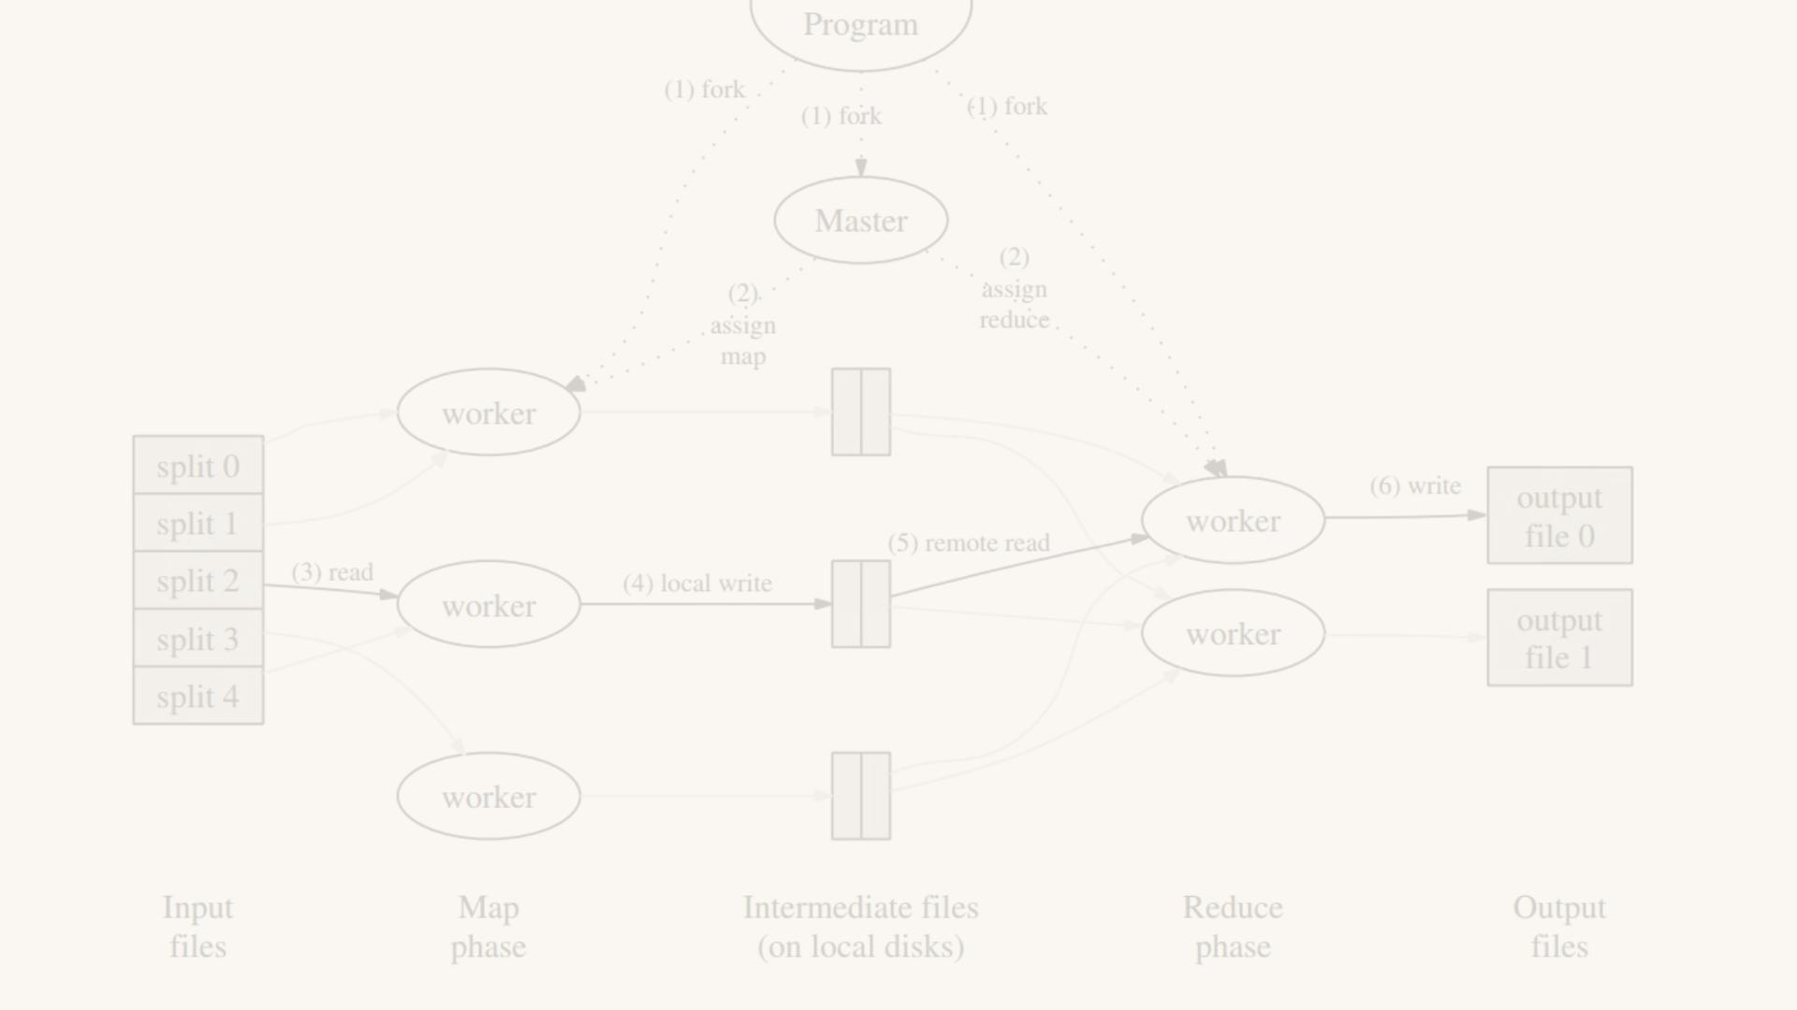
MapReduce in Action
1
Write Map Function
The Map function takes input pairs and produces intermediate key-value pairs, laying the groundwork for detailed analysis.
2
Shuffle & Sort
After mapping, the data is shuffled and sorted, preparing for the Reduce phase where related keys are grouped together.
3
Reduce Function
The Reduce function processes each group of intermediate keys, deriving a smaller set of values that encapsulate the results of complex data analysis.

Slide 7
HDFS: The Data Storehouse
Operation
Command
Create Directory
hadoop fs -mkdir -p /user/username/directory
Move to HDFS
hadoop fs -copyFromLocal /local/path /user/username/directory
View Contents
hadoop fs -cat /user/username/file
List Directory
hadoop fs -ls /user/username/
Copy to Local
hadoop fs -copyToLocal /user/username/file /local/path

Slide 8
The Power of MapReduce Programming
2
1000s
100%
Languages
Nodes
Efficiency
Program MapReduce jobs using multiple languages, including Java and Python, offering flexibility in processing and analysis.
MapReduce can scale to thousands of nodes, demonstrating its massive parallel computing power and storage capacity.
MapReduce significantly improves efficiency in Big Data analysis by splitting tasks and reducing the data volume at each stage.

