Slide 1

BIN BUSTER
BHAVANA K BABU
MES23MCA-2010
Department of Computer Applications
MES College of Engineering, Kuttippuram
01/10/2024

Slide 2
PRODUCT OWNER Mr. BALACHANDRAN K.P ASSOCIATE PROFESSER DEPARTMENT OF COMPUTER APPLICATIONS MES COLLEGE OF ENGINEERING, KUTTIPPURAM

Slide 3
TABLE OF CONTENTS
Introduction
Objective
Motivation
Functionalities
Module Description
Developing Environment
Sprint Backlog
Product Backlog
User Story
Project Plans
Data Flow Diagrams
ER Diagram

Slide 4
BIN BUSTER
The Bin Buster system is a comprehensive platform designed to streamline waste management.
Users can easily register complaints about bin issues, which are managed by the admin and assigned to drivers for resolution.
The admin oversees bin management, driver profiles, and task assignments. Once tasks are completed, drivers update the status for the admin to monitor, ensuring transparency and accountability.
This integrated system optimizes waste management, promoting a cleaner and more sustainable environment.

Slide 5
OBJECTIVES
The objective of bin buster system is to efficiently collect, manage and dispose of waste in a manner that minimize environmental pollution.
The admin manage the systems and it is fully online based monitoring The admin can be any local authority such as panchayath member etc.
This project focus on reducing human intervention.
Helps to reduce human time and effort.
It result in healthy and waste ridden environment.
The system can send notifications to users regarding the status of their complaints, bin collection schedules, and any relevant updates, ensuring effective communication and transparency.
Users can conveniently pay the required fees for complaint registration and other services directly through the platform, eliminating the need for physical payments.

Slide 6
MOTIVATIONS
Sustainability and Regeneration Focus: The system aims to create a sustainable, regenerative society by minimizing waste, protecting the environment, and fostering innovation in waste treatment.
Community Engagement: Users are empowered to lodge complaints about overflowing or unattended bins, promoting community engagement and accountability in waste management.
User-Friendly Interface: The system provides an intuitive interface, enabling users to easily report concerns and complaints regarding waste management.
Efficient Complaint Management: User complaints are promptly directed to the admin for review and resolution, ensuring efficient complaint management.

Slide 7
FUNCTIONALITIES
Driver Management: Administrators can create and update driver profiles to ensure an organized waste management workforce.
Task Status Update: Drivers update the status of tasks upon completion, keeping administrators informed.
Activity Monitoring: Administrators can monitor the tasks and activities of drivers, ensuring transparency and accountability.
Optimized Waste Management: The system streamlines the waste management process, promoting efficiency and environmental sustainability.
Online payment mechanism: Users can conveniently pay the required fees for complaint registration and other services directly through the platform, eliminating the need for physical payments.

Slide 8
FUNCTIONALITIES
Complaint Registration: Users can register complaints about bin issues (overflowing bins, uncollected waste) through a user-friendly interface.
Complaint Management: Administrators can access, manage, and monitor complaints lodged by users.
Task Assignment: Administrators can assign tasks related to complaints to designated drivers for resolution.
Bin Management: Administrators can create, update, and delete bin information as needed.
Notification system: The system can send notifications to users regarding the status of their complaints, bin collection schedules, and any relevant updates, ensuring effective communication and transparency.

Slide 9
MODULE DESCRIPTION
ADMIN
The admin can log in to manage various tasks. They can create, update, or delete waste bins and driver profiles, view work reports submitted by drivers, and address public complaints by updating their status. Additionally, the admin can view user details for better system.
Login : In login page, admin can login to garbage application
Create bin : Admin can create garbage bin in various locations.

Slide 10
MODULE DESCRIPTION
Update/Delete bin : Admin can update and delete the details of garbage bin created in various locations.
Register/create account Driver : Admin can driver.
User details : Admin can view the user details oversight.
Update/Delete driver : Admin can update and delete driver details.
View work Report : Admin can View work report of garbage collection which is updated by driver.
View complaints : Admin can View the complaint from public and update status of the complaint.

Slide 11
MODULE DESCRIPTION
USER
In the Bin Buster application, users can register and log in to the system. They can submit complaints and later view the status of their registered complaints through the application.
Registration : User can register to the application.
Login : User can login to the application.
Register complaint : User can register the complaints.
My complaint and status : User can view the status of the complaints.
Online Payment: User can pay online .

Slide 12
MODULE DESCRIPTION
DRIVER
In the Bin Buster application, drivers can log in to access their tasks. They can check daily work updates and provide status updates on their progress to the admin.
Login : Drive can login to the application.
View daily updates : Driver can view the work details and can update the status of the work to the admin.
Send Notification: Driver can send Notification to the user.

Slide 13
DEVELOPING ENVIRONMENT
Operating System –Windows
Front end -Html, CSS, Bootstrap
Back End -Python
Data Base -SQLite
Framework -Django
IDE-Vs code

Slide 14
SPRINT BACKLOG
Backlog tem | Status And Completion Date | Original Estimation in Hours | Day 1 hrs | Day 2 hrs | Day 3 hrs | Day 4 hrs | Day 5 hrs | Day 6 hrs | Day 7 hrs | Day 8 hrs | Day 9 hrs | Day 10 hrs
SPRINT1
Login / Reg Design | 07/08/2024 | 3 | 1 | 1 | 0 | 1 | 0 | 0 | 0 | 0 | 0 | 0
Login/Reg Backend | 08/08/2024 | 5 | 0 | 0 | 1 | 0 | 1 | 0 | 2 | 1 | 0 | 0
Database Design | 09/08/2024 | 6 | 1 | 1 | 0 | 2 | 0 | 1 | 0 | 0 | 0 | 1
SPRINT 2
User Complaint | 19/08/2024 | 4 | 1 | 1 | 0 | 1 | 0 | 1 | 0 | 0 | 0 | 0
Admin receive Complaint | 22/08/2024 | 3 | 1 | 0 | 0 | 2 | 0 | 0 | 0 | 0 | 0 | 0

Slide 15
SPRINT BACKLOG
Backlog tem | Status And Completion Date | Original Estimation in Hours | Day 1 hrs | Day 2 hrs | Day 3 hrs | Day 4 hrs | Day 5 hrs | Day 6 hrs | Day 7 hrs | Day 8 hrs | Day 9 hrs | Day 10 hrs
SPRINT3
Admin Bin Management | 25/09/2024 | 5 | 1 | 1 | 0 | 1 | 2 | 0 | 0 | 0 | 0 | 0
Admin Driver Management | 27/09/2024 | 4 | 0 | 0 | 1 | 0 | 1 | 0 | 2 | 0 | 0 | 0
SPRINT 4
Basic UI design | 14/10/2024 | 5 | 1 | 1 | 0 | 1 | 0 | 0 | 1 | 0 | 1 | 0
Payment | 13/10/2024 | 6 | 1 | 0 | 0 | 2 | 0 | 1 | 1 | 0 | 1 | 0

Slide 16
SPRINT BACKLOG
Backlog tem | Status And Completion Date | Original Estimation in Hours | Day 1 hrs | Day 2 hrs | Day 3 hrs | Day 4 hrs | Day 5 hrs | Day 6 hrs | Day 7 hrs | Day 8 hrs | Day 9 hrs | Day 10 hrs
SPRINT5
User Notification | 25/09/2024 | 4 | 1 | 1 | 0 | 1 | 1 | 0 | 0 | 0 | 0 | 0
Driver Notification Management | 27/09/2024 | 4 | 0 | 0 | 1 | 0 | 1 | 0 | 2 | 0 | 0 | 0
SPRINT 6
Driver View User Details | 14/10/2024 | 6 | 1 | 1 | 0 | 1 | 0 | 1 | 0 | 1 | 1 | 0
Testing | 13/10/2024 | 5 | 1 | 0 | 0 | 2 | 0 | 1 | 1 | 0 | 0 | 0
TOTAL |  | 60 | 10 | 7 | 3 | 14 | 6 | 5 | 9 | 2 | 3 | 1

Slide 17
PRODUCT BACKLOG
ID | NAME | PRIORITY <high/medium/low> | ESTIMATE (Hours) | STATUS <Planned/In progress/Completed>
1 | Admin Login | High | 6 | inprogress
2 | Create bin & driver, Update/delete bin & driver, View complaint , View work report ,View use details, Update complaint status | High | 24 | inprogress
ID | NAME | PRIORITY <high/medium/low> | ESTIMATE (Hours) | STATUS <Planned/In progress/Completed>
1 | REGISTER
2 | LOGIN
3
4

Slide 18
PRODUCT BACKLOG
ID | NAME | PRIORITY <high/medium/low> | ESTIMATE (Hours) | STATUS <Planned/In progress/Completed>
3 | User register , login, Register complaint , view complaint status | high | 12 | planned
4 | Driver login , check daily work, update work status | high | 8 | planned
5 | Deployment, Testing and Validation | high | 10 | planned

Slide 19
USER STORY
User Story ID | As a type of User | I want to <Perform some task> | So that i can <Achieve Some Goal>
1 | Admin , User , Driver | Login | Access the account
2 | Admin | Create bin , Create driver, Update Bin , Update driver | Manage bin and driver details
3 | Admin | Delete bin ,Delete driver | Remove bin or driver details
4 | Admin | View work report, View complaint , view user details | Access and monitor relevant data

Slide 20
USER STORY
User Story ID | As a type of User | I want to <Perform some task> | So that i can <Achieve Some Goal>
5 | User | User registration, Register complaint | Submit my details and complaints
6 | User | My complaint | Check the status and progress of my complaint
7 | Admin | Update status | Provide updates on tasks or issue
8 | Driver | Update status | Provide updates on tasks or issue
9 | Driver | Check daily work | View my assigned tasks and work for the day

Slide 21
PROJECT PLAN
User StoryID | Task Name | Start Date | End Date | Days | Status
1 | Sprint 1 | 05/08/2024 | 09/08/2024 | 10 | Completed
8 |  | 05/08/2024 | 09/08/2024 |  | Completed
9 |  | 05/08/2024 | 09/08/2024 |  | Completed
3 | Sprint 2 | 13/08/2024 | 19/08/2024 | 10 | In Progress
4 |  | 13/08/2024 | 19/08/2024 |  | In Progress
5 |  | 15/08/2024 | 22/08/2024 |  | Completed
14 | Sprint 3 | 28/08/2024 | 01/09/2024 | 10 | Planned
16 |  | 25/08/2024 | 29/08/2024 |  | Completed

Slide 22
PROJECT PLAN
User StoryID | Task Name | Start Date | End Date | Days | Status
13 | Sprint 4 | 06/09/2024 | 10/09/2024 | 10 | Planned
6 |  | 08/09/2024 | 12/09/2024 |  | Completed
7 | Sprint 5 | 19/09/2024 | 25/09/2024 | 10 | In Progress
11 |  | 19/09/2024 | 25/09/2024 |  | In Progress
12 |  | 21/09/2024 | 27/09/2024 |  | In Progress
2 | Sprint 6 | 08/10/2024 | 13/10/2024 | 10 | In Progress
10 |  | 07/10/2024 | 14/10/2024 |  | Planned
15 |  | 08/10/2024 | 13/10/2024 |  | In Progress

Slide 23
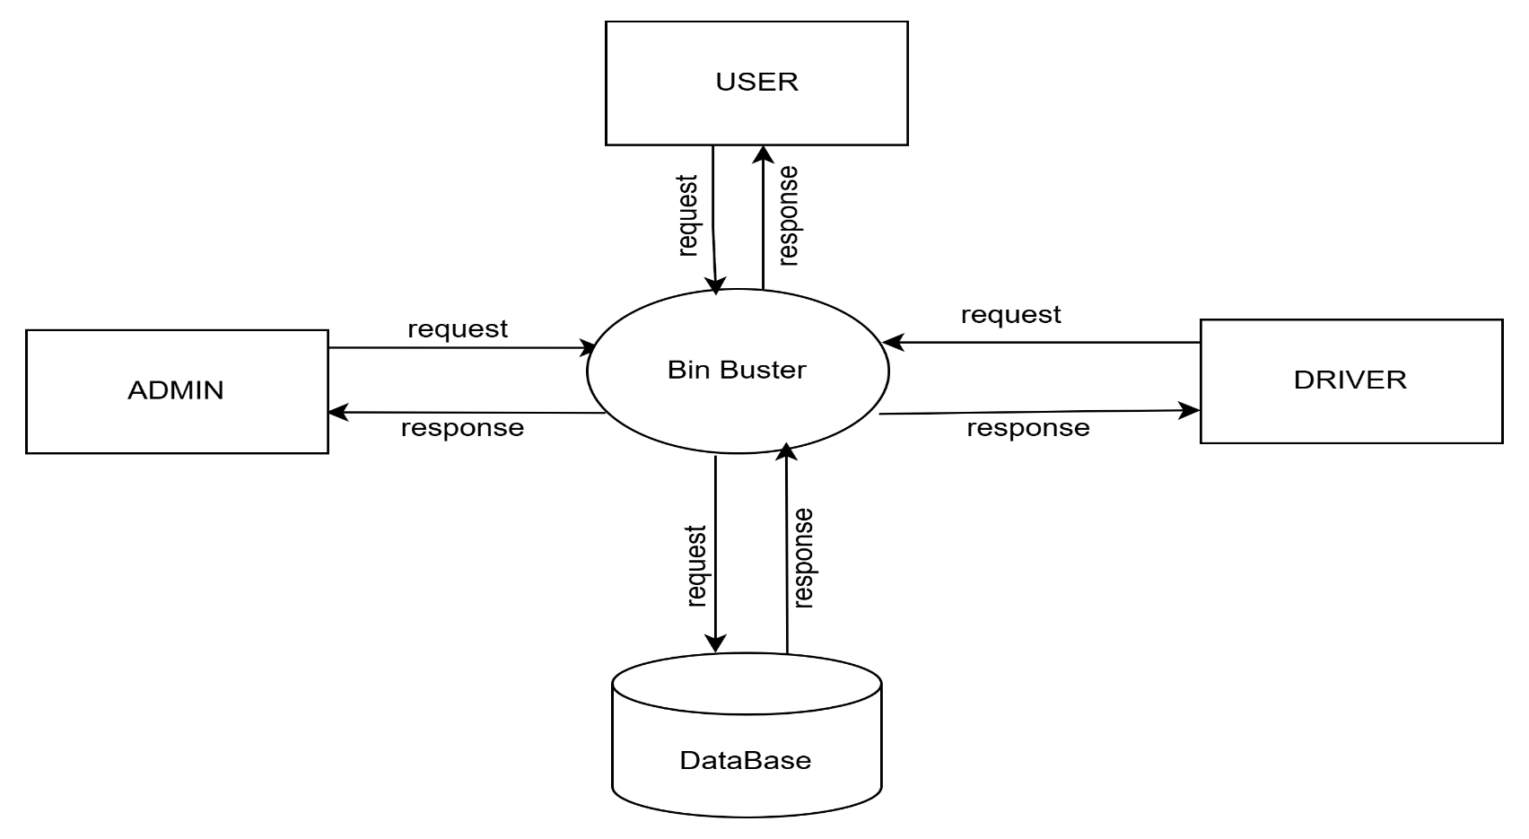
DATA FLOW DIAGRAM
LEVEL 0

Slide 24
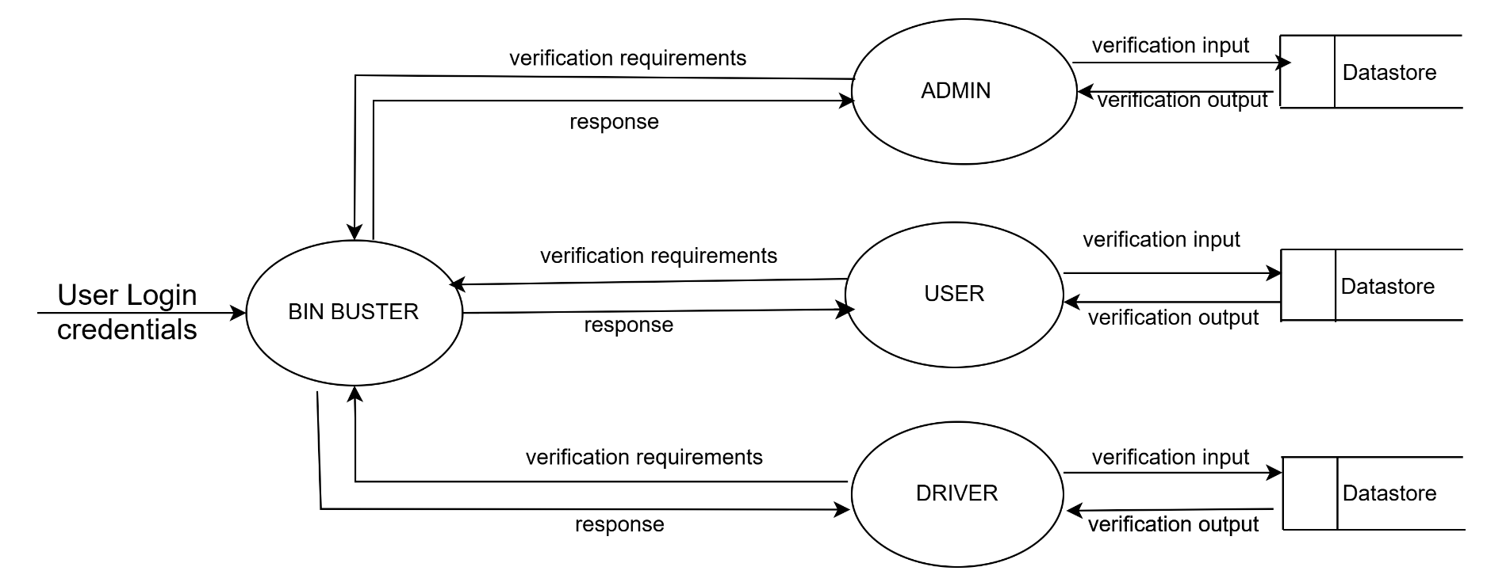
DATA FLOW DIAGRAM
LEVEL 1

Slide 25
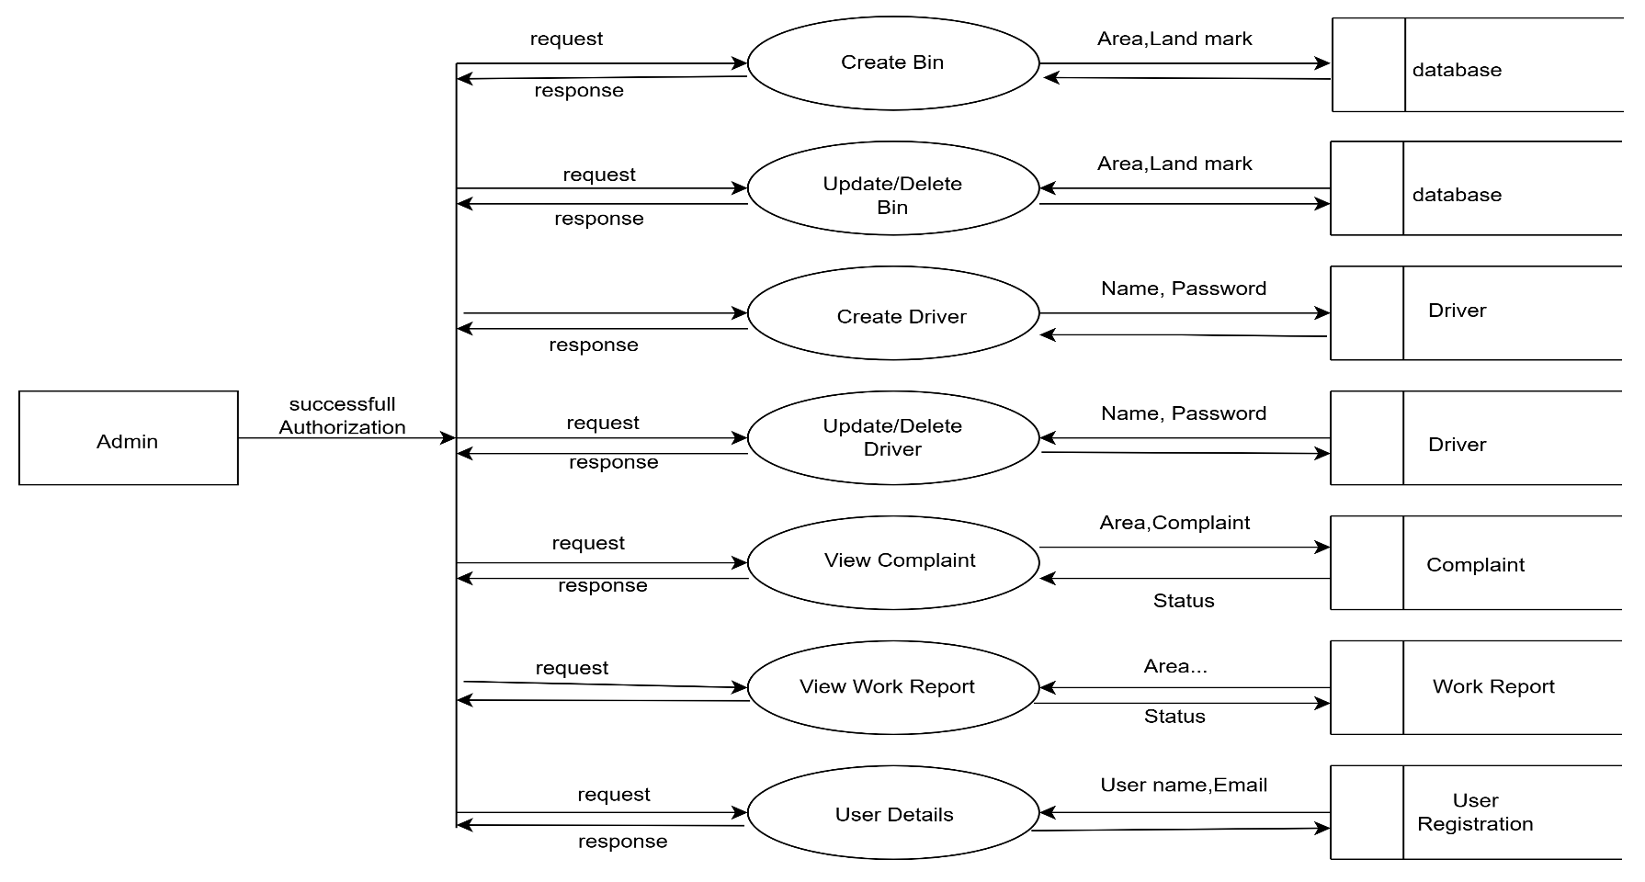
DATA FLOW DIAGRAM
LEVEL 2.1

Slide 26
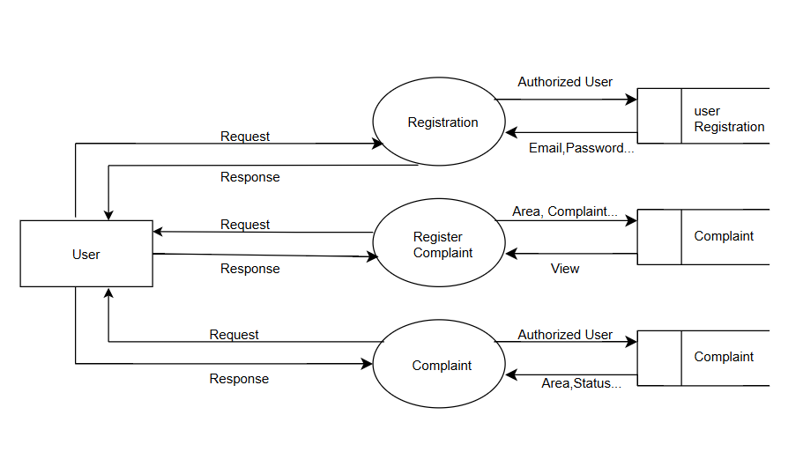
DATA FLOW DIAGRAM
LEVEL 2.2

Slide 27
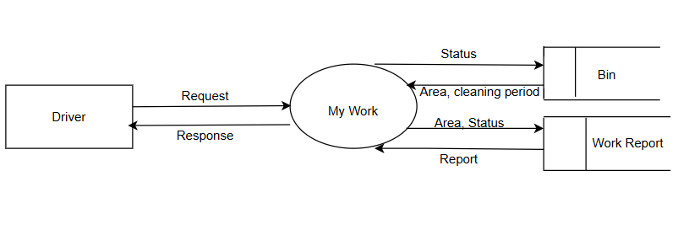
DATA FLOW DIAGRAM
LEVEL 2.3

Slide 28
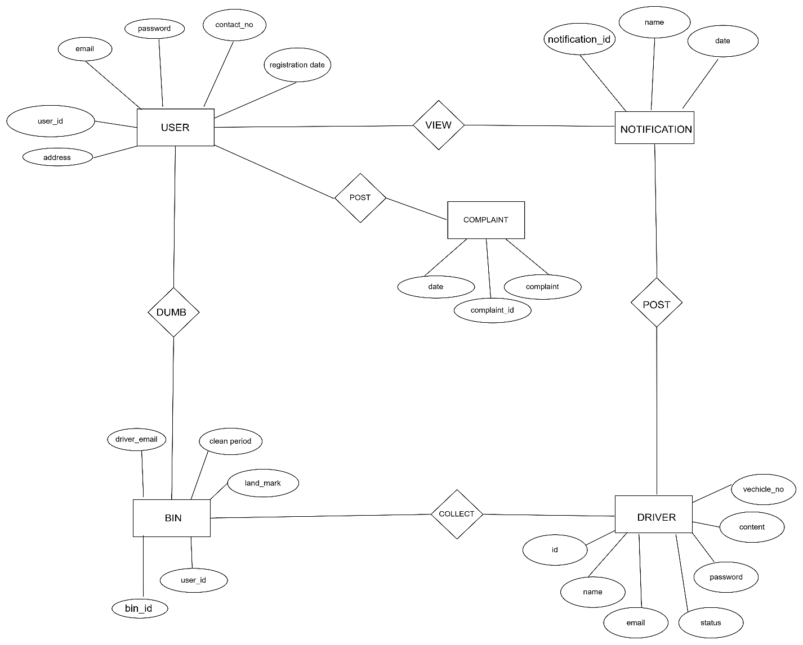
ER DIAGRAM

Slide 29
THANK YOU

