Slide 1

DATABASE SYSTEMS ENGINEERING AND DISTRIBUTED BACKEND
DEVELOPMENT
INVENTORY & WAREHOUSE
MANAGEMENT SYSTEM
Section - 1
2520030601 Billakanti Siri
2520030082 Bhavana Kondakrindi
2520030184 Aniketh Pani

Slide 2
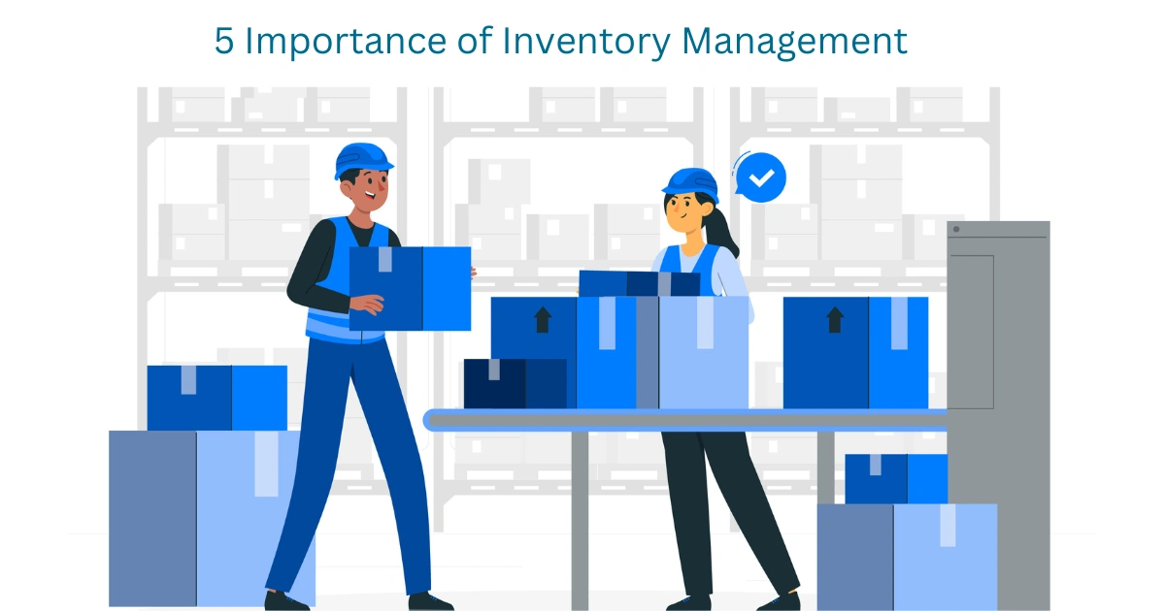

Introduction
Inventory management is essential for businesses handling products across multiple warehouses.
Our system provides a centralized platform to manage:
  Manage products & stock
  Track multiple warehouses
  Monitor stock movement
  Improve inventory visibility
The system aims to make inventory management more accurate, organized, and efficient.

Slide 3
abstract
The Inventory & Warehouse Management System is a database-driven web application designed to streamline inventory operations across multiple warehouses. A MySQL relational database maintains structured relationships between products, warehouses, suppliers, purchase orders, and stock movements.
It incorporates reorder-level automation to identify low-stock products and support timely replenishment.
The system aims to reduce manual errors, improve stock visibility, and support efficient inventory decisions through centralized data management and reporting.

Slide 4
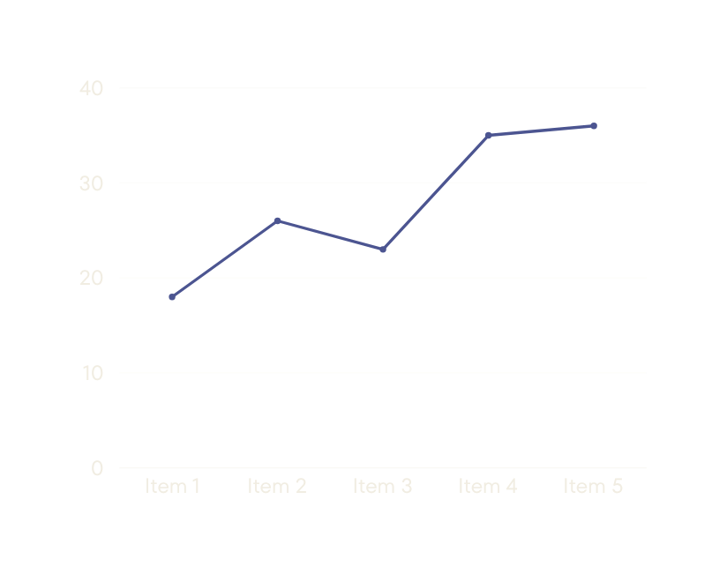


PROBLEM STATEMENT
Existing Challenges
  Manual inventory records can lead to stock inaccuracies and human errors.
  Disconnected records make multi-warehouse tracking difficult.
  Stock transfers and movements may be difficult to monitor.
Our Approach
A centralized database-driven system to improve stock accuracy, visibility, and warehouse operations.

Slide 5
MODULES
Warehouse & Inventory Management
  Track stock levels and product availability across multiple warehouses.
Stock In / Stock Out
  Record incoming and outgoing inventory with accurate stock updates.
Warehouse Transfer
  Transfer products between warehouses while maintaining updated stock records.
Supplier & Purchase Orders
  Manage supplier information and create and track purchase orders.
Reorder Level Automation
Identify products below their defined reorder level and support timely replenishment.
Stock Audit & Reports
Monitor stock activity and generate reports for inventory analysis and decision-making.

Slide 6
Hardware requirements
  Processor: Intel i3 / equivalent or higher
  Memory: 4 GB RAM or higher
  Storage: 10 GB available space
  Display: 1366 × 768 or higher
Software Requirements
  Frontend - React.js
  Backend - Node.js + Express.js
  Database - MySQL
  Visualization - Chart.js
  Platform - Windows / macOS / Linux

Slide 7
CONCLUSION
The Inventory & Warehouse Management System provides a centralized platform for managing inventory across multiple warehouses.
Key Outcomes
  Accurate stock tracking
  Efficient warehouse operations
  Timely inventory replenishment
  Centralized supplier & purchase management
  Inventory monitoring and dashboard insights

Slide 8
THANK YOU

