Slide 1

Regression Diagnostics On Cryptocurrency Volatility Bhavana Reddy

Slide 2

Project Overview
This project aims to model and analyze the volatility of bitcoin using multiple linear regression, based on predictors such as trading volume and S&P 500 log returns, and to identify potential outliers and influential observations using regression diagnostics by focusing on bitcoin-specific features—reducing market noise and improving predictive power.

Slide 3
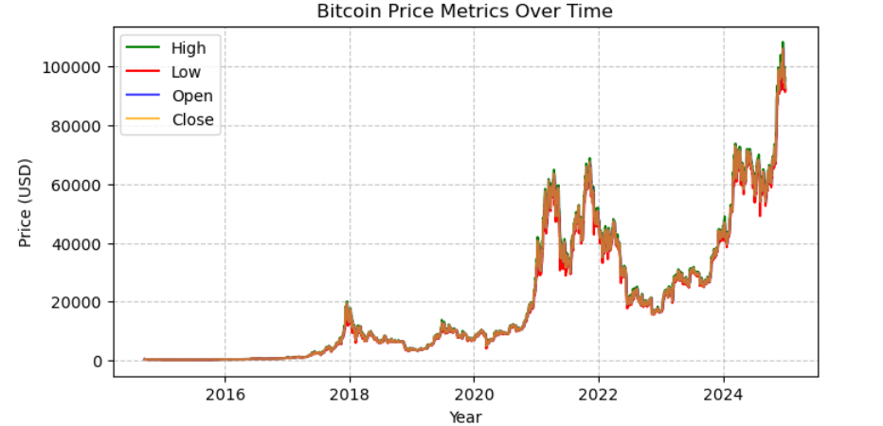
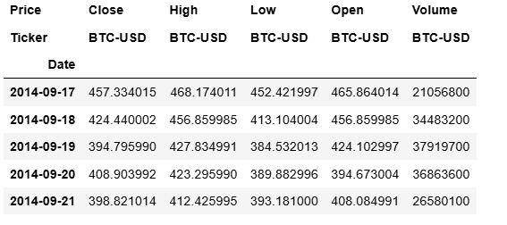
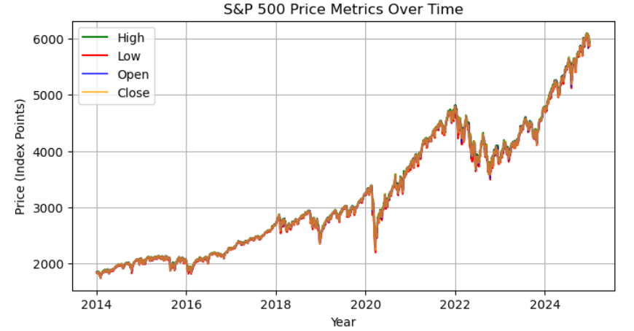
Data Description / Data Overview
Data Source: yahoo finance
Time period: 2014 - 2025
Variables: Open, High, Low, Close, Volume

Slide 4
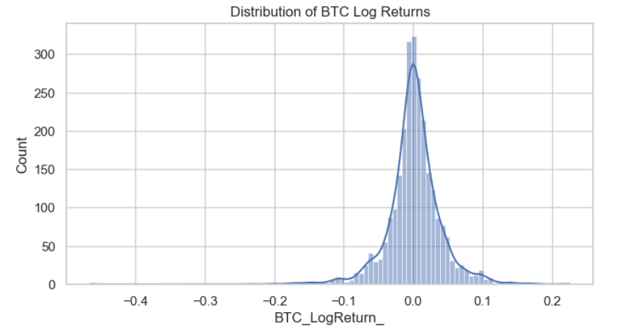
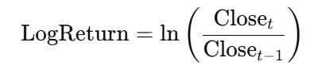
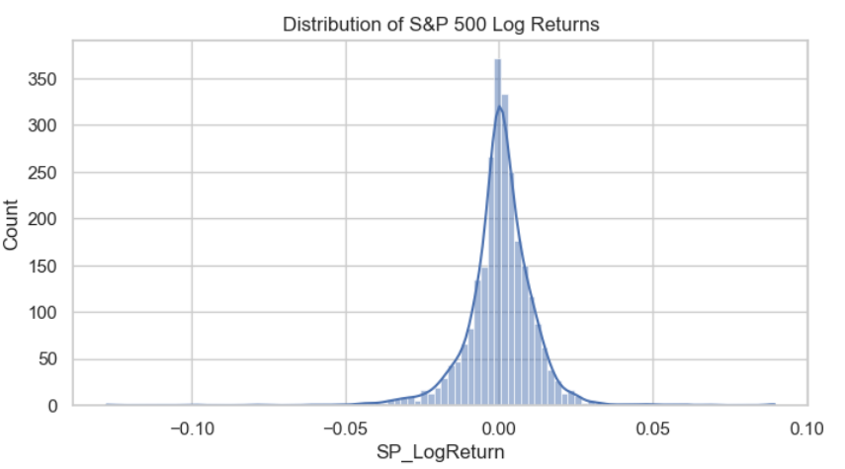
Data Preprocessing
calculated log returns for btc and s&p 500 close prices
Type conversions
Data merging
Handling null values
Data distribution graphs
Handling outliers using Z score

Slide 5
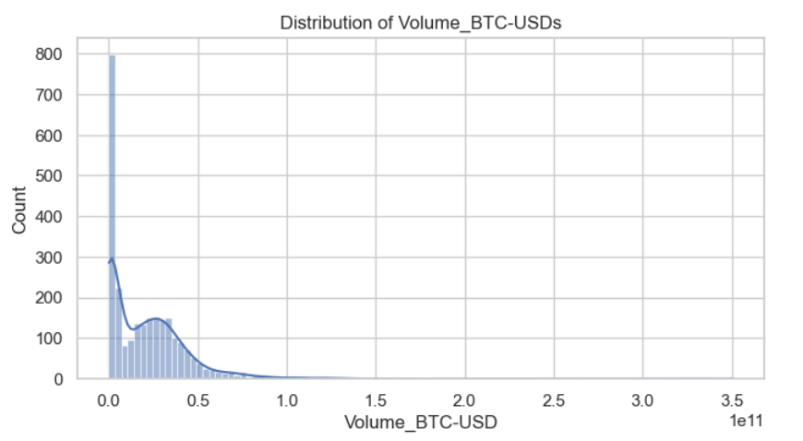
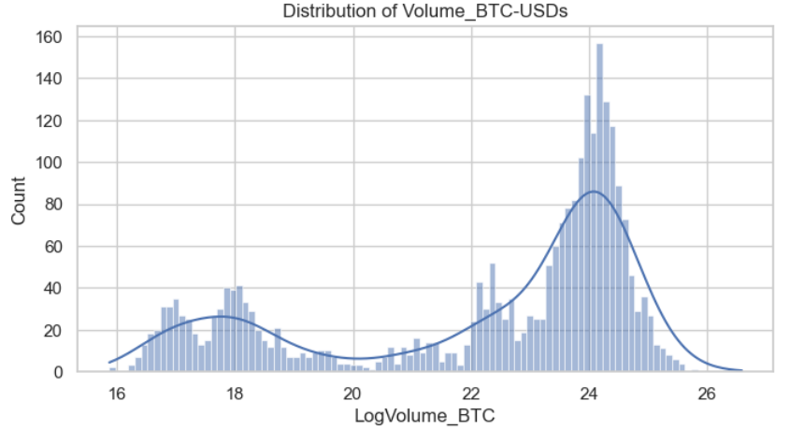
Volume before and after applying logarithm

Slide 6
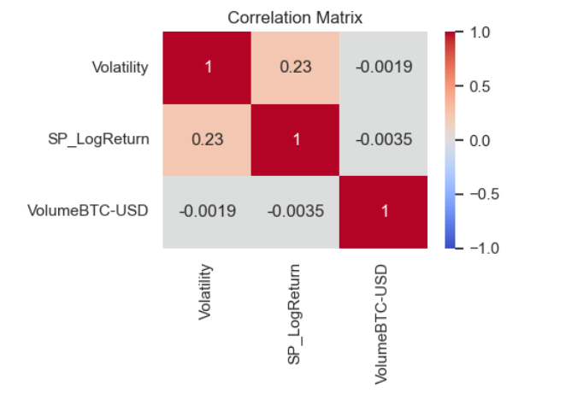
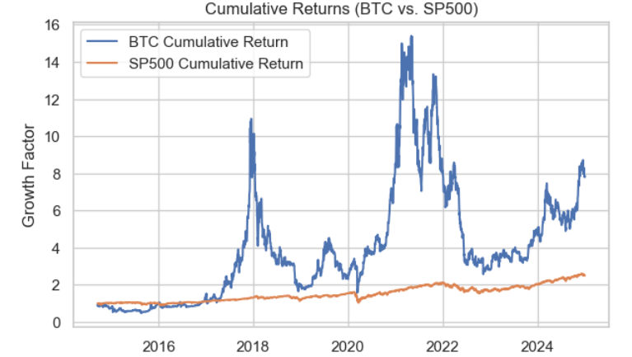
Visualizations

Slide 7
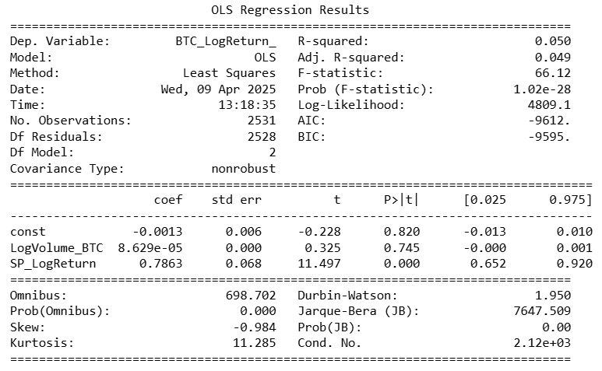
Regression Model Development
Dependent Variable: Btc Log return
Independent Variables: SP Log return, Volume
Model:
Initial Model summary:

Slide 8
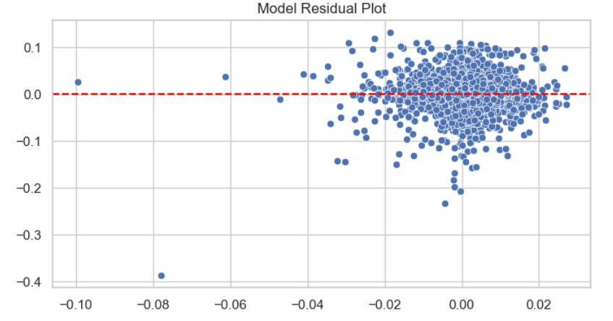
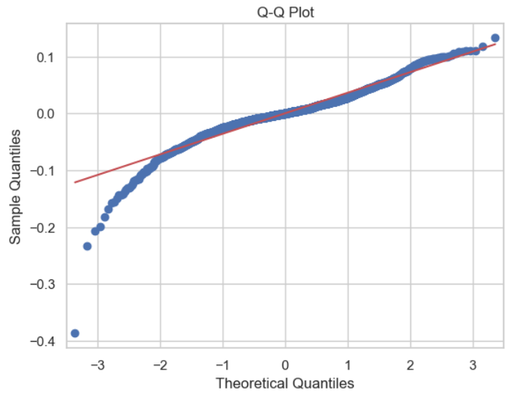
Regression Diagnostics for initial model
Residual plot(Homoscedascicity) & Q-Q Plot(Linearity)

Slide 9
Model Improvisation
Removed noisy external variables (VIX, S&P 500 returns) to reduce irrelevant market noise.
Focused on Bitcoin-centric features:
Lagged BTC Log Returns – to capture autocorrelation.
Log Volume – reflects direct market activity.
Rolling Volatility – tracks BTC return variability.
BTC Trend Indicator – moving average to smooth short-term noise.
Switched to Weekly Data – reduces daily volatility and overfitting risk.
Simplified Models – optimized OLS and reduced complexity in LSTM/Random Forest.
Result: Improved stability and interpretability, with R² rising from ~0.26 to ~0.29
using cleaner, targeted predictors.

Slide 10
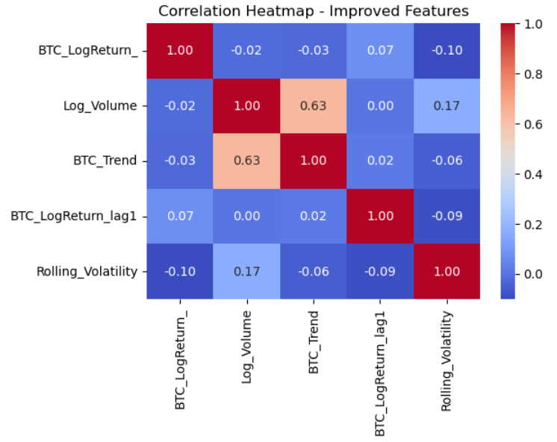
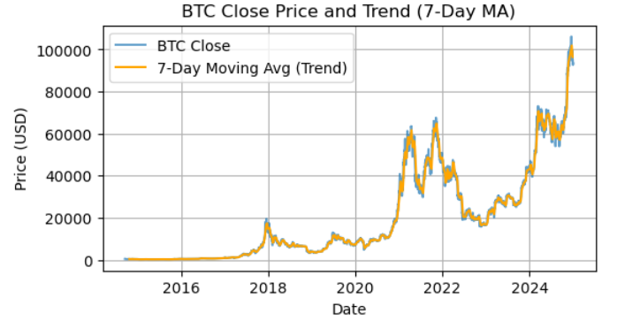
Visualizations

Slide 11
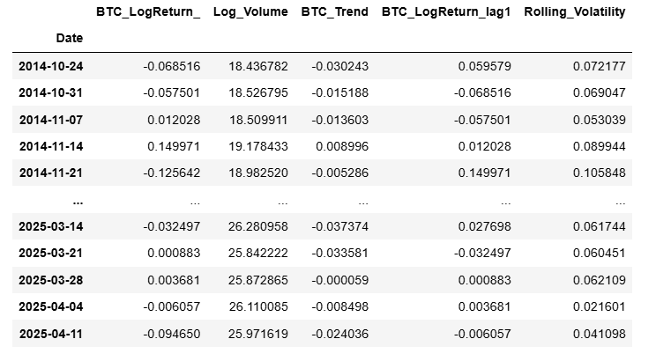
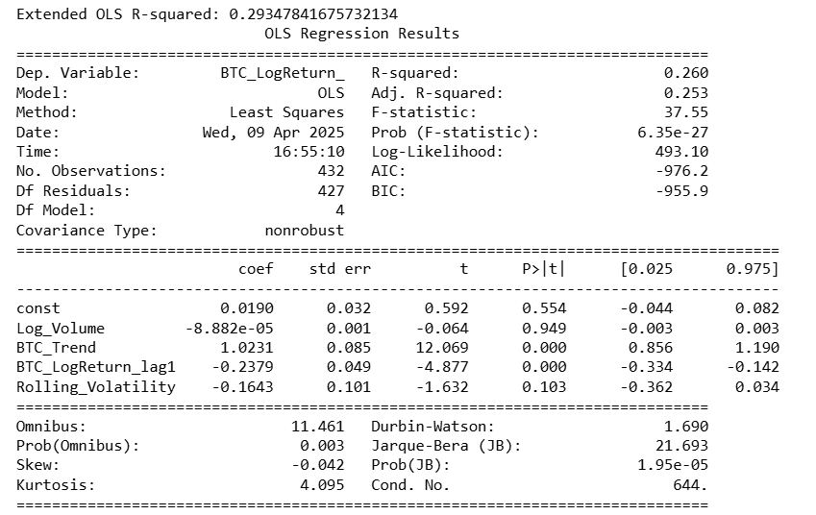
Improvised Data & Model Summary Predictors: Log Volume, Trend Score, Lagged Returns, Rolling Volatility

Slide 12
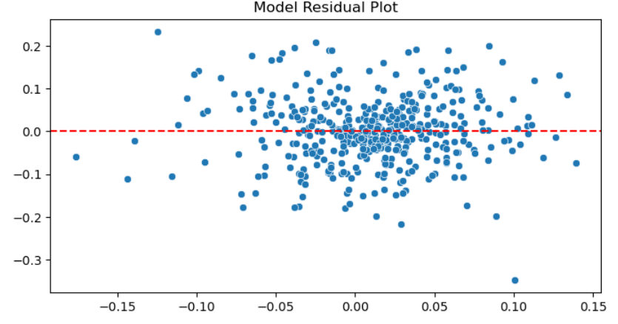
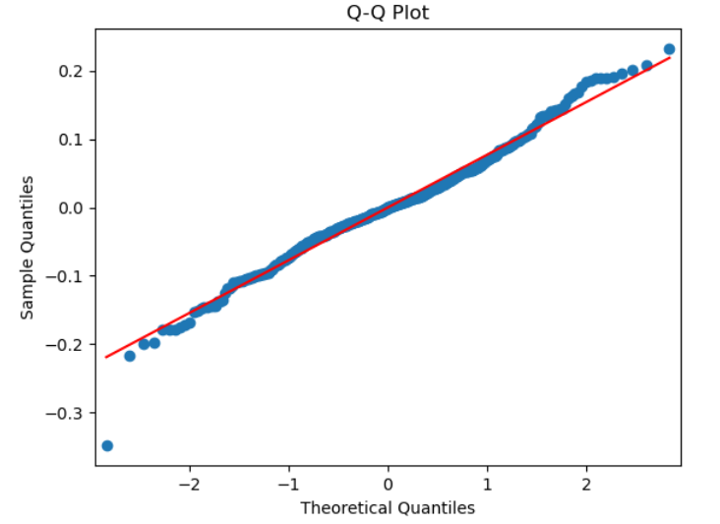
Regression Diagnostics for improvised model
Residual plot: Random Scatter – Linearity OK
Q-Q Plot: slight deviations from normality at tails

Slide 13
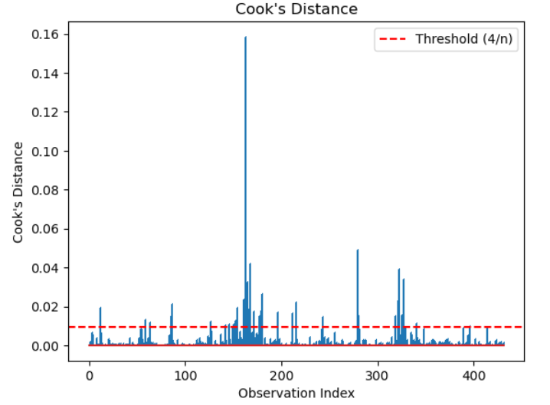

Regression Diagnostics
Durbin-Watson : Autocorrelation
1.68 < 2 → Mild autocorrelation
~2 = No autocorrelation (ideal)
VIF : Multicorrelation
VIF ~ 1 : No multicollinearity (ideal)
Cooks Distance : Influential point

Slide 14
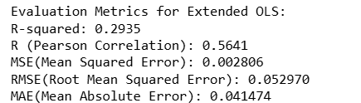
Model Evaluation
R Squared : explains ~29.35% of the variation in BTC returns.
Pearson Correlation : moderate positive correlation
MSE (Mean Squared Error)
RMSE (Root Mean Squared Error)
MAE (Mean Absolute Error)
errors are relatively small

Slide 15
Key Findings & Insights
BTC trend and lagged returns
Importance of feature selection
Bitcoin-specific features : trend, volume, lagged returns, and Volatility
Bitcoin’s volatility is influenced by a complex mix of factors—including global sentiment, regulation, macroeconomic shifts, and social media trends
R² of ~0.29 demonstrates that, even a simplified model can offer valuable insights into short-term price behavior, while leaving room for future improvements using non-linear models

Slide 16
Thank You

