Slide 1



Flight
Delay
Analysis

Slide 2


Flight delays are a persistent, multi-billion dollar operational challenge impacting the US air travel system. Our core objective is to develop a supervised regression model to accurately predict the average arrival delay (in minutes) for aggregated flight groups. This model provides quantified, proactive lead time, enabling airlines and airport operations to dynamically optimize resource allocation, mitigate delay propagation, and significantly enhance overall system efficiency and passenger experience.
OBJECTIVE

Slide 3




WORKFLOW
DATA SOURCING
DATA PREPROCESSING
DATA VISUALIZATIONS
ML
MODELS

Slide 4
DATA
SOURCING
Source: US Bureau of Transportation Statistics (BTS) On-Time Performance Data
Timeframe: June 2003 - July 2025
Scale: Over 400,000 monthly aggregated records (Carrier x Airport x Month). (409612 * 21)
Key Variables:
Target Variable: arr_delay (Total Arrival Delay Minutes, later transformed to Average Arrival Delay).
Operational Inputs: arr_flights, arr_del15, airport, carrier.
Delay Attribution: carrier_delay, weather_delay, nas_delay, late_aircraft_delay (critical features for prediction).

Slide 5
DATA PREPROCESSING
Data Cleaning & Imputation
Targeted Imputation: Missing values in numerical delay and count columns (weather_ct, nas_delay, etc.) are imputed with zero (0).
Categorical Handling: Missing values in categorical columns (carrier, airport) are replaced with the column's statistical mode.
Negative Values: Any remaining negative values (e.g., in delay minutes) are replaced with zero, ensuring physical feasibility.
Critical Filtering: Rows where arr_flights (Total Arriving Flights) is null or zero are dropped.

Slide 6
FEATURE ENGINEERING
Target Transformation: Total delay minutes (arr_delay) is transformed into the target, Average Arrival Delay (minutes per flight).
Total Delay Causes: carrier_delay + weather_delay + nas_delay + security_delay + late_aircraft_delay.
Operational Rate: Delay_rate = (arr_del15 / arr_flights).
Volume Estimation: Flights_per_day = ['arr_flights'] / 30.0.

Slide 7
DATA
ANALYSIS/VISUALIZATIONS
What is the average delay time for each airline?
Which are the top 10 airlines with the most delay time?
What is the most common cause of delays?
How does distance relate to delay time?
Which airport experiences the highest flight volume?
What is the average delay time by day of the week?
What is the average delay time by month?

Slide 8
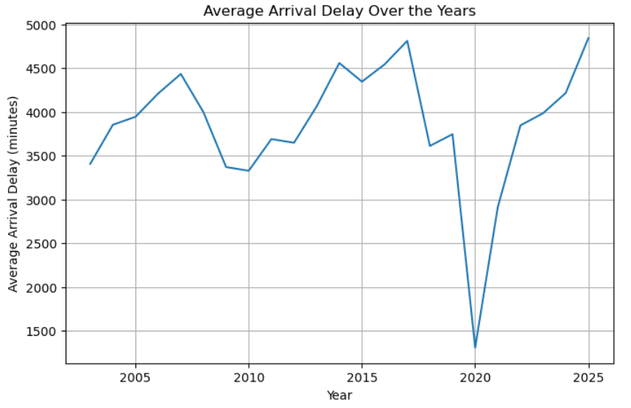
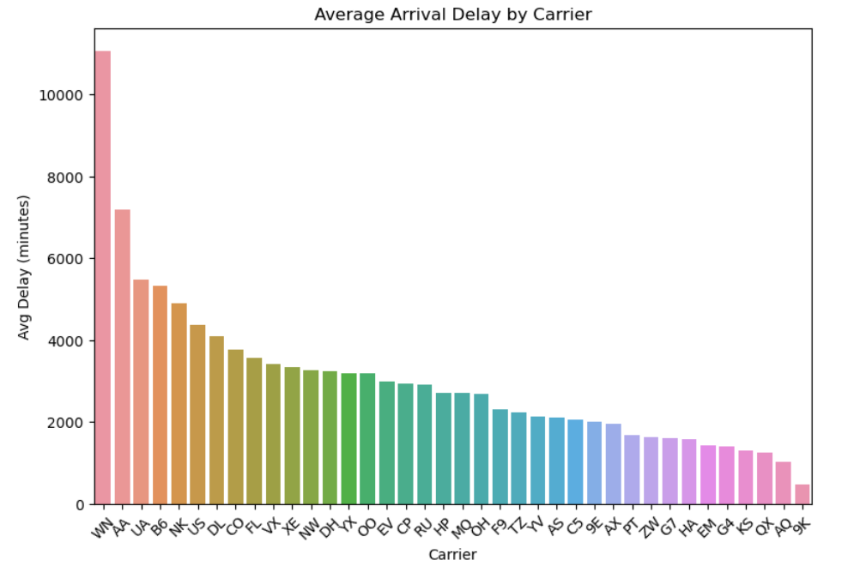
Trend of Flight Delays Over the Years
Airlines that Have the Most Delays

Slide 9
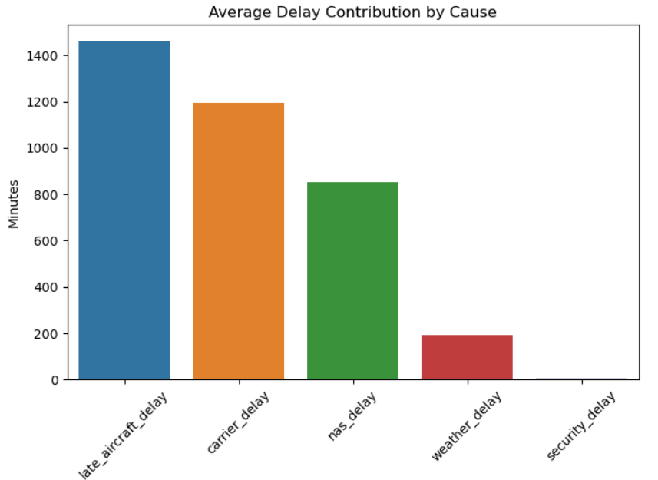
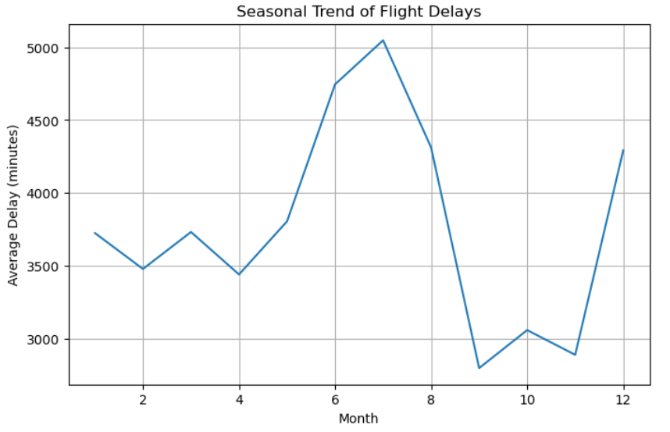
Delay Factors Breakdown
Monthly Seasonality of Delays

Slide 10
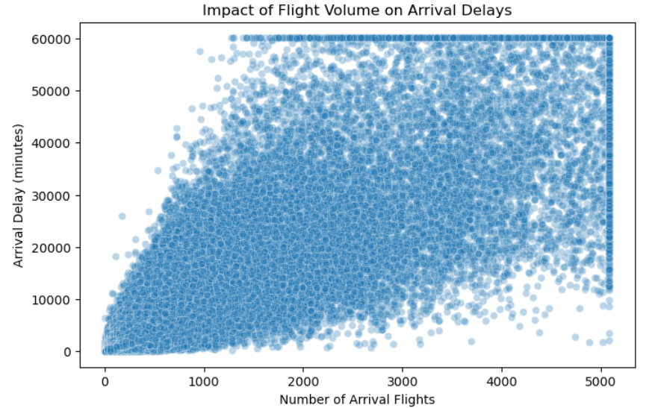
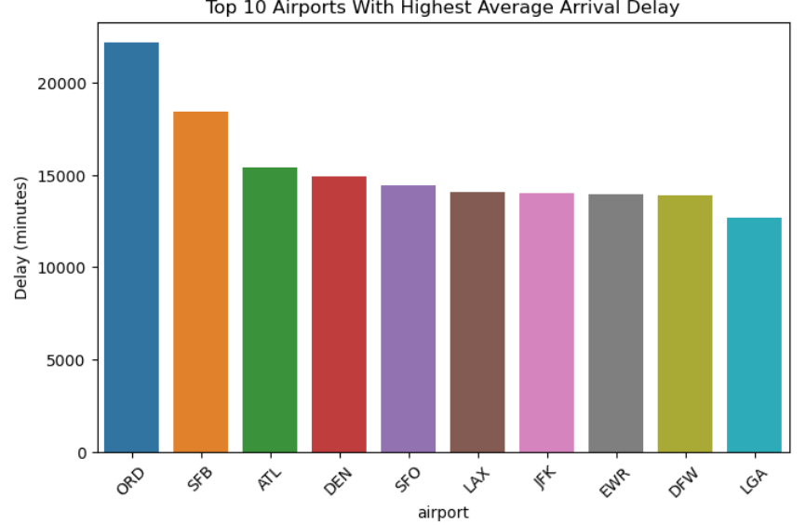
Relationship Between Number of Flights
and Delays
Top 10 Airports With Highest Average
Delays

Slide 11
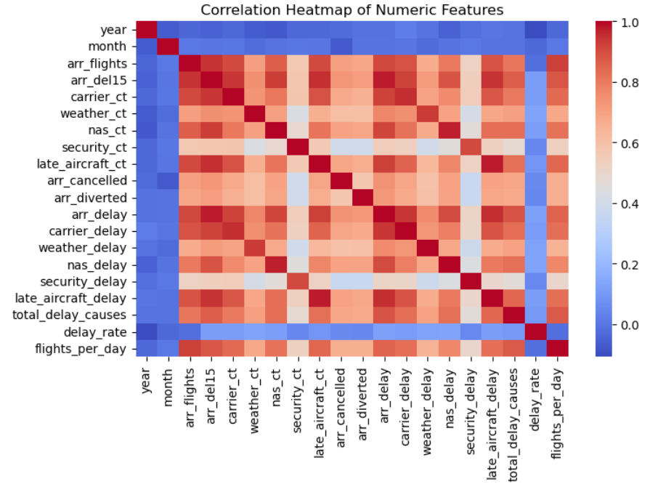
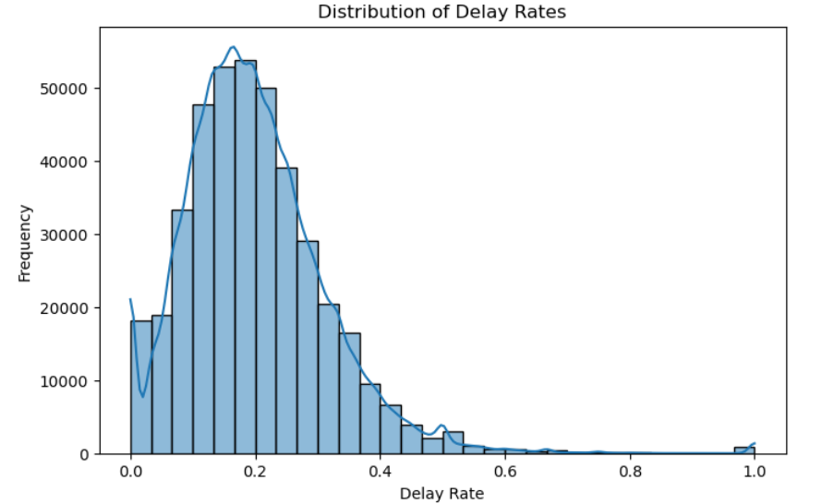
Heatmap of Feature Correlations
Delay Rate Distribution

Slide 12
DATA
Modelling
Linear Regression : Baseline; cannot model nonlinear delays
Random Forest : Better accuracy, slow training. Doesn’t handle high-dimensional sparse one-hot data efficiently
XG Boost Regressor : Best among baseline models
LightGBM : needs label encoding for categorical variables
CatBoost : No one-hot encoding needed

Slide 13
MODEL COMPARISION/ METRICS
Model | RMSE | MAE | R² | Interpretation
Linear Regression | 1517.37 | 752.98 | 0.9691 | Weak model. Cannot capture non-linear interactions (weather, traffic volumes, etc.).
Random Forest | 1105.19 | 474.29 | 0.9836 | Captures non-linearity but not optimal. Struggles when data dimension is high (450+ features).
XGBoost | 872.68 | 396.13 | 0.9898 | Learns non-linear effects and interactions very well
LightGBM | 880.38 | 408.24 | 0.9896 | Performs close to XGBoost; faster training
CatBoost | 849.28 | 390.96 | 0.9903 | Handles categorical variables very well. More stable without extensive tuning

Slide 14
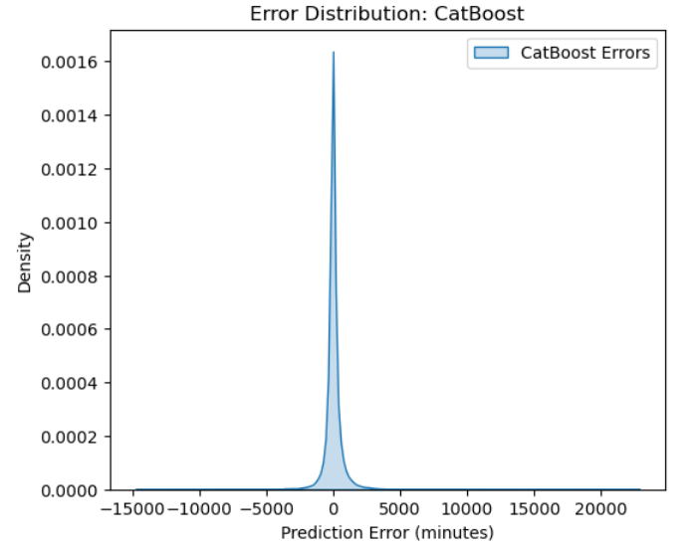
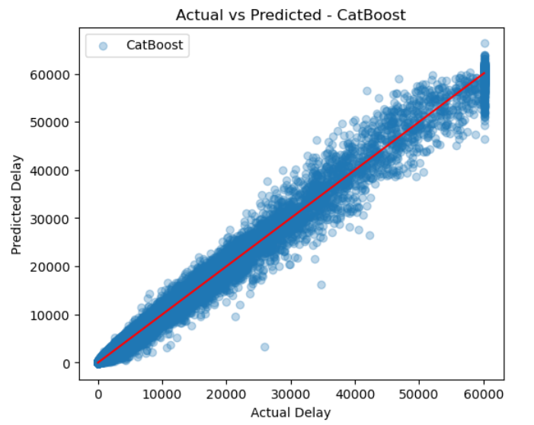
Error Distribution Plot
Actual Vs Predicted

Slide 15
The model accurately predicts arrival delay minutes, with CatBoost achieving R² ≈ 0.99, meaning near-perfect explanatory power.
Low RMSE/MAE show that predictions closely match real delays, making the model reliable for real-world use.
Helps airlines anticipate delays earlier and plan staffing, gate assignments, and schedules more efficiently.
Enables better passenger communication and overall improvement in operational decision-making.
CONCLUSION

Slide 16

Thank you
Questions?

