Slide 1

REAL TIME RESEARCH PROJECT
ACCIDENT DETECTION USING CNN
Presented By:(Batch-D18)
S. BHAVANA-247R1A05Q1
G. CHARUNYA-247R1A05L8
G. KRUPA-257R5A0519
UNDER THE GUIDENCE BY: B. Aditya Assistant Professor

Slide 2
1. INTRODUCTION:
Road accidents are a major global issue, causing over 1.3 million deaths every year, mostly in developing countries. In India, around 13 people die every hour due to accidents. Many deaths happen due to delay in medical help. Accidents occur in three phases: immediate death, the golden hour (where quick treatment can save lives), and later deaths due to injuries.

Slide 3
2.ABSTRACT
Accidents are a major cause of deaths in India, mainly due to delay in timely medical help. On highways, victims may remain unattended for a long time. This project proposes a system that detects accidents using CCTV video. It analyzes each frame using a CNN model to classify accident or non-accident. CNN provides high accuracy and fast image classification with less preprocessing.

Slide 4
3. Existing System
we have tried to compare our work with other accident detection techniques. Most of the studies in this field revolve around the enhancement of tangible infrastructure rather than on Intelligent Transportation Systems (ITS) which include traffic congestion detection, accident detection, detecting the occurrence of an event etc. Even the few existing studies in the domain lack implementation details and are terrain specific i.e. there are constraints both in the geographical as well as demographic aspects

Slide 5
4. Disadvantages of Existing System:
1. More than 80% of accident-related deaths occur not due to the accident itself but the lack of timely help reaching the accident victims

Slide 6
5. Proposed System
The proposed model is a fusion of CNN and LSTM layers for continuous video classification taken from a camera. The CNN part of the proposed model was mainly inspired by the Inception v3, but with certain tweaks it has fitted well to our training images. The LSTM layers were added to the existing Convolution Network to take into account temporal features along with spatial features. This is further divided into the convolution and recurrent parts of the model. In a CNN-LSTM network, the CNN is primarily used for feature extraction from the images, which is passed on to the LSTM for sequence prediction. They are widely used in tasks similar to Activity Recognition, Image Description, Video Description etc.

Slide 7
6. Advantages of Proposed System:
1.Initially, the model had difficulties in predicting the right class since the only difference between cars and broken cars were dents, broken headlights etc.
2.Thus, random noise was being accounted during the prediction since not all the accident images were of high clarity.

Slide 8
7. HARDWARE REQUIREMENTS:
System : Pentium Dual Core.
Hard Disk : 120 GB.
Monitor : 15’’ LED
Input Devices : Keyboard, Mouse
Ram : 1 GB
7.1. SOFTWARE REQUIREMENTS:
Operating system : Windows 10
Coding Language : python
Tool : PyCharm
Database : MYSQL
Server : Flask

Slide 9
8.Novelty of Accident detection:
Accident detection using CNN is an emerging approach that applies deep learning and computer vision techniques to automatically identify road accidents from video footage. The novelty of such systems lies in the advanced detection models, real-time monitoring capability, and fast emergency response. Some innovative aspects include:
Deep Learning Models: Using architectures like CNN and CNN-LSTM to analyze video frames and accurately classify accident and non-accident events.
Real-Time Video Analysis: Processing live CCTV or camera footage to detect accidents instantly.
Temporal and Spatial Feature Learning: Combining spatial image features with temporal video patterns to improve detection accuracy.
Automated Alert System: Sending immediate notifications to nearby hospitals and police stations when an accident is detected.
Smart Traffic Monitoring Applications: Assisting traffic authorities in monitoring highways and improving road safety by reducing response time.

Slide 10
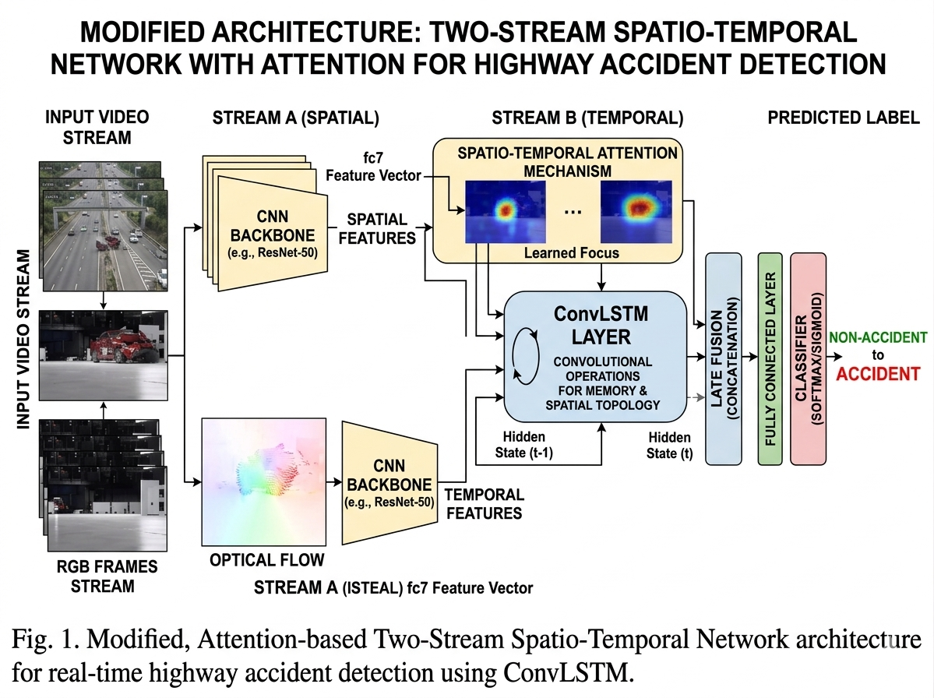
9.Architecture

Slide 11
10.Modules
1.Load & Generate CNN Model
In this module we load and trained CNN with dataset.
2. Browse System Video
In this module user upload video to the system.
3. Start Accident Detector
In this module uploaded video is loaded, start video play and detect accident.

Slide 12
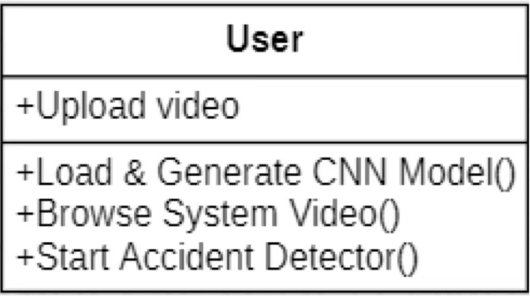
11.UML DIAGRAMS
UML (Unified Modeling Language) is a standardized modeling language used in object-oriented software engineering. It is managed by the Object Management Group (OMG) and is used to visualize, design, and document software systems. UML mainly uses graphical diagrams to represent the structure and behavior of complex systems.
CLASS DIAGRAM:
The Class Diagram shows the structure of the system and its functions.
The main class is User, which interacts with the accident detection system.
The user can upload video, load the CNN model, browse system videos, and start the accident detection process.

Slide 13
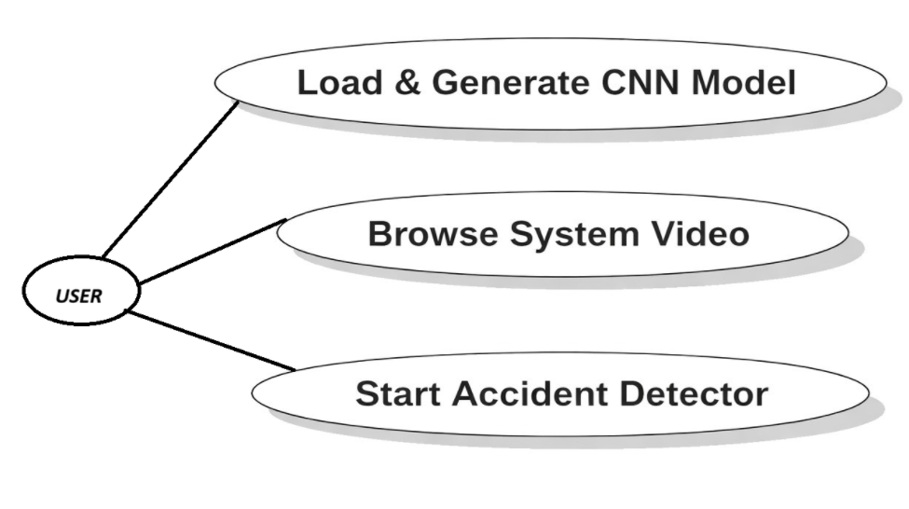
USECASE DIAGRAM
A use case diagram in the Unified Modeling Language (UML) is a type of behavioral diagram defined by and created from a Use-case analysis. Its purpose is to present a graphical overview of the functionality provided by a system in terms of actors, their goals (represented as use cases), and any dependencies between those use cases. The main purpose of a use case diagram is to show what system functions are performed for which actor. Roles of the actors in the system can bedepicted.

Slide 14
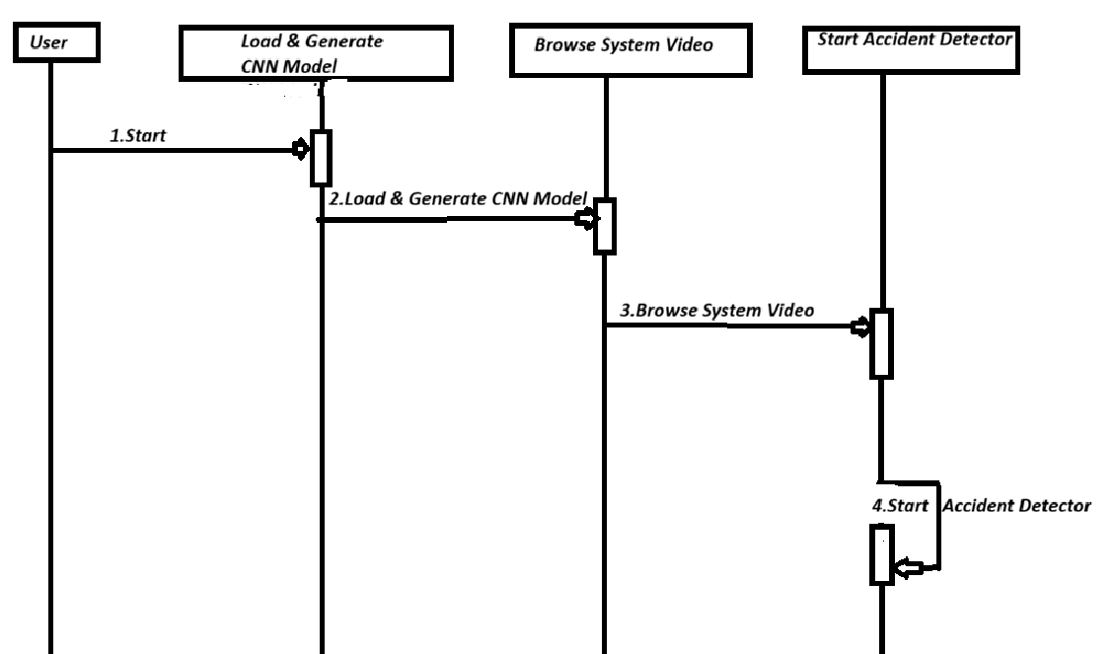
SEQUENCE DIAGRAM
A sequence diagram in Unified Modeling Language (UML) is a kind of interaction diagram that shows how processes operate with one another and in what order. It is a construct of a Message Sequence Chart. Sequence diagrams are sometimes called event diagrams, event scenarios, and timing diagrams.

Slide 15
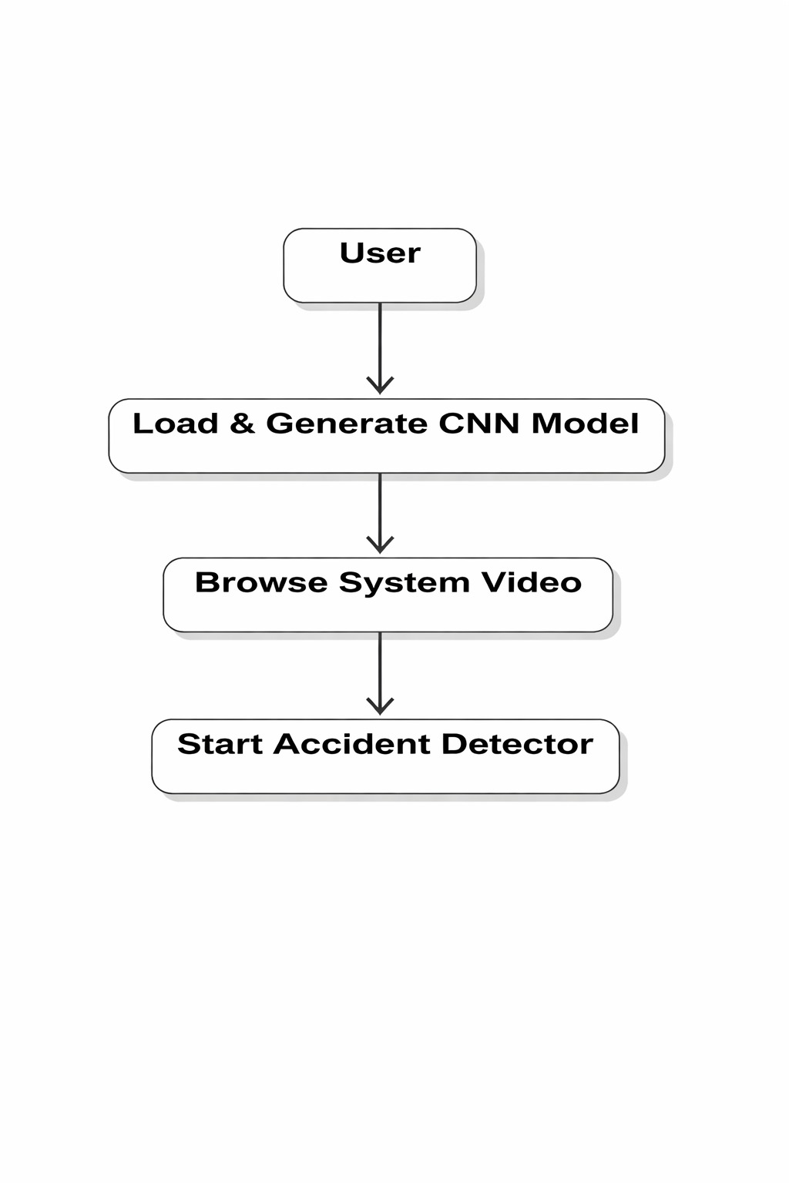
ACTIVITY DIAGRAM:
Activity diagrams are graphical representations of workflows of stepwise activities and actions with support for choice, iteration and concurrency. In the Unified Modeling Language, activity diagrams can be used to describe the business and operational step-by-step workflows of components in a system. An activity diagram shows the overall flow of control.

Slide 16
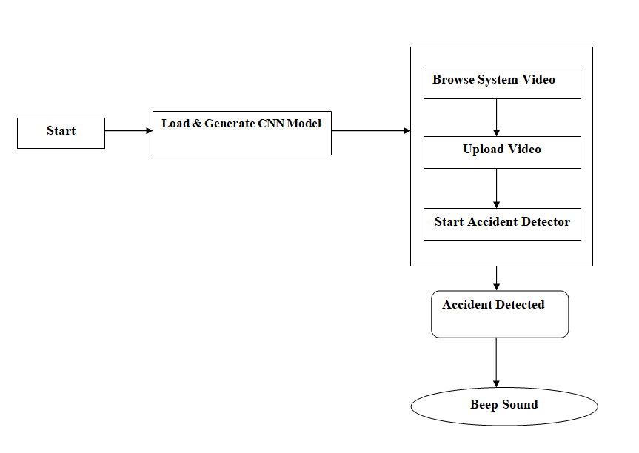
Data flow :
The Data Flow Diagram (DFD) shows how data moves through the accident detection system.
First, the system loads and generates the CNN model required for detection.
The user can browse and upload a video to the system.
The accident detector analyzes the video frames using the CNN model.
If an accident is detected, the system generates a beep sound as an alert.

Slide 17
14.CONCLUSION:
Accidents are a major problem causing loss of life and property daily, and the proposed system offers an effective solution by detecting accidents instantly and sending alerts to nearby hospitals and police with location details. It is cost-effective as it avoids expensive sensors and extra hardware, and uses a model-based approach to achieve higher accuracy and reliability. Experimental results show improved performance, making it suitable for real-time implementation on highways.

Slide 18


