Slide 1
Face Image Inpainting using GANs
Bhavana Talluri
Sai Jahnavi Shanvitha Pasumarthy
Lavanya Konda
Guide: Dr. Himangshu Sarma

Slide 2
Overview
Problem statement
Applications of Inpainting
Traditional methods and Drawbacks
Motivation
Proposed approach
Dataset description
Training
Results
Future work

Slide 3
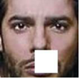
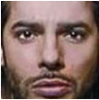
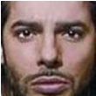
Problem statement - Face Image Inpainting
Face image inpainting (or face completion) is the task of generating plausible facial structures for missing pixels in a face image.
Aim: To recover or fill in missing information in occluded images. The goal is to produce more legible and visually realistic face images from an image with a masked region that has missing content.
Input Result Groundtruth
Image source : Predicted by our model

Slide 4
Applications
Image restoration or completion
Removal or replacement of selected objects
Completing corrupted video frames due to over-compression

Slide 5
Traditional method
Navier-Stokes method:
Introduces smoothness priors via Partial differential equations
Models image inpainting as a third-order Partial differential equations
To estimate missing pixels, take normalized weighted sum of pixels from a neighbourhood of the pixels.
To estimate color of the pixels, gradient of the neighbourhood pixels are used.
source : Bertalmio, Marcelo, Andrea L. Bertozzi, and Guillermo Sapiro. "Navier-stokes, fluid dynamics, and image and video inpainting." Proceedings of the 2001 IEEE Computer Society Conference on Computer Vision and Pattern Recognition. CVPR 2001. Vol. 1. IEEE, 2001.

Slide 6
Traditional method - drawback
Navier-Stokes method:
Well suited for filling geometrical shapes and completing small regions in the image.
Unable to recover the texture of large areas, which tend to blur in these situations.
source : Yuan, Liuchun, Congcong Ruan, Haifeng Hu, and Dihu Chen. "Image inpainting based on patch-GANs." IEEE Access 7 (2019): 46411-46421.

Slide 7
Traditional method
Texture synthesis by non-parametric sampling:
Common idea: missing areas can be learned from similar regions in a sample
Some variations include using a quickly approximating nearest neighbour patch search algorithm and employ the best matching patches for reconstruction.
Other variations include combining the copy-and-paste texture synthesis, geometric partial differential equation and coherence neighbouring pixel to obtain better image inpainting result.
source : A.A.EfrosandT.K.Leung,‘‘Texturesynthesisbynon-parametricsam- pling,’’ in Proc. ICCV, Sep. 1999, pp. 1033–1038.

Slide 8
Traditional method - drawback
Texture synthesis by non-parametric sampling:
Works well for simple task like background completion, such as sky (implying similar pattern of the missing part should be contained in the existing regions)
These methods become invalid if the missing region is vast.
source : Yuan, Liuchun, Congcong Ruan, Haifeng Hu, and Dihu Chen. "Image inpainting based on patch-GANs." IEEE Access 7 (2019): 46411-46421.

Slide 9
Motivation
Conditional GANs for inpainting:
Applying high-level features (extracted using CNN) to reconstruct damaged images based on the deep convolution networks.
cGANs have some conditional settings and they learn the image-to-image mapping under this condition, whereas basic GANs generate images from a random distribution vector with no condition applied.
This method proved to be more effective than prior methods.

Slide 10
Proposed Approach
Pix2Pix GAN (variation of CGAN) + Attention mechanism
Pix2Pix GAN:
Produces an output classification that classifies multiple patches in the input image pairs (patchGAN), producing an output of NxN dimension
Has generator and discriminator just like a normal GAN, but it’s more supervised than GAN as it has target images as output labels.

Slide 11
Proposed Approach
Pix2Pix GAN (variation of CGAN) + Attention mechanism
Attention mechanism:
For GAN models trained with ImageNet, they are good at classes with a lot of texture (landscape, sky) but perform much worse for structure.
While convolutional filters are good at exploring spatial locality information, receptive fields may not be large enough to cover larger structures.
Filter size or depth of deep network can be increased, but training gets harder. Alternatively, attention concept can be applied

Slide 12
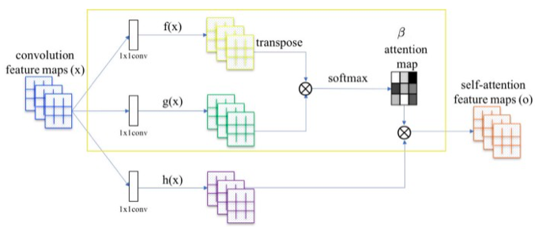
Proposed Approach
Attention mechanism:
source : Zhang, Han, et al. "Self-attention generative adversarial networks." International Conference on Machine Learning. 2019.

Slide 13
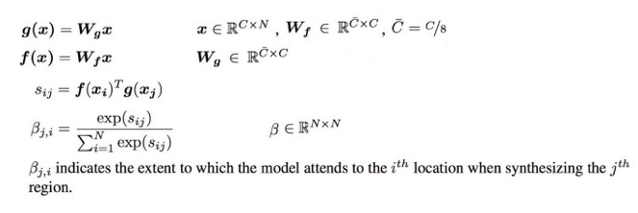
Proposed Approach
Attention mechanism:
source : Zhang, Han, et al. "Self-attention generative adversarial networks." International Conference on Machine Learning. 2019.

Slide 14


Proposed Approach
Attention mechanism:
Final output of convolution layer:
source : Zhang, Han, et al. "Self-attention generative adversarial networks." International Conference on Machine Learning. 2019.

Slide 15
Dataset Description
Dataset chosen: CelebA (CelebFace Attributes Dataset)
Consists of 2,02,599 face images and included large pose variations and clutter background.
We applied MTCNN to tightly crop the face images to get accurate results.
We then wrote a python script to generate patches of different shapes, sizes and textures to be superimposed on the images in CelebA dataset.
source : Liu, Ziwei, et al. "Large-scale celebfaces attributes (celeba) dataset." Retrieved August 15 (2018): 2018.

Slide 16
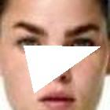
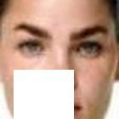
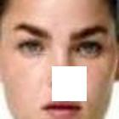
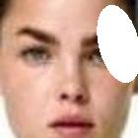
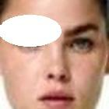
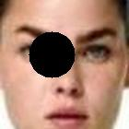
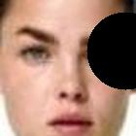
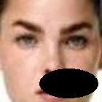
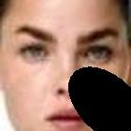
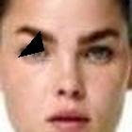
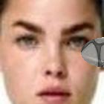
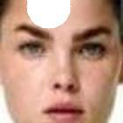
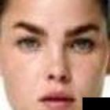
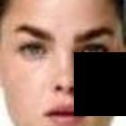
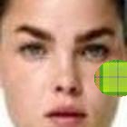
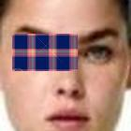
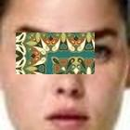
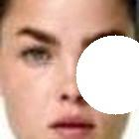

Slide 17
Training
Model: Pix2Pix GAN + attention mechanism
Training images: 1098 (white square only)
Batch_size: 1
Epochs: 100
Total training steps: 109800
GPU: GeForce GTX 1080

Slide 18
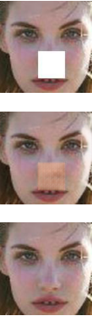
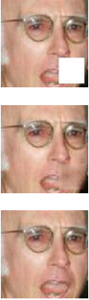
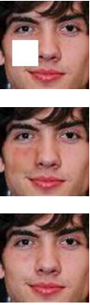
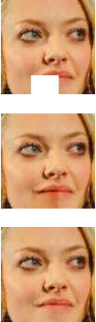
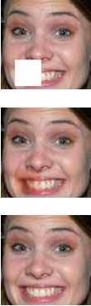
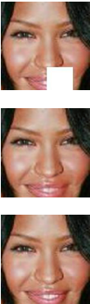
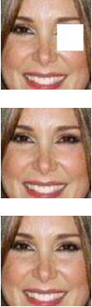
Results
10 epochs 30 epochs 40 epochs 60 epochs 80 epochs 90 epochs 100 epochs

Slide 19
Results
PSNR: computes the “peak signal-to-noise ratio”, in decibels between two images. Higher the PSNR, the better is the similarity.
SSIM: “Structural Similarity Index” is a method for measuring similarity between two images. Higher the SSIM, better is the similarity.
Model | Dataset | PSNR | SSIM
Patch GANs (IEEE) | CelebA | 23.07 | 0.923
Ours | CelebA | 21.567 | 0.889

Slide 20
Future Work
Currently the experimentation has only been done using images with white square patches only. We would further like to train the model on the entire dataset to obtain a robust model.
Currently, the training process for Cycle GAN with attention mechanism is under process, we would like to perform similar analogy on this model too once the training is completed.
We also want to explore how other Generative Adversarial Networks with attention mechanism will perform on the CelebA dataset

Slide 21
References
Yuan, Liuchun, Congcong Ruan, Haifeng Hu, and Dihu Chen. "Image inpainting based on patch-GANs." IEEE Access 7 (2019): 46411-46421.
Zhang, Han, et al. "Self-attention generative adversarial networks." International Conference on Machine Learning. 2019.
Isola, Phillip, et al. "Image-to-image translation with conditional adversarial networks." Proceedings of the IEEE conference on computer vision and pattern recognition. 2017.
Bertalmio, Marcelo, Andrea L. Bertozzi, and Guillermo Sapiro. "Navier-stokes, fluid dynamics, and image and video inpainting." Proceedings of the 2001 IEEE Computer Society Conference on Computer Vision and Pattern Recognition. CVPR 2001. Vol. 1. IEEE, 2001.
A.A.EfrosandT.K.Leung,‘‘Texturesynthesisbynon-parametricsam- pling,’’ in Proc. ICCV, Sep. 1999, pp. 1033–1038.

Slide 22
Thank you!!

