Slide 1



KONGU ENGINEERING COLLEGE
DEPARTMENT OF AI&DS
HCL PROJECT
ICU PATIENT MORTALITY RISK
PREDICTION SYSTEM
Project Members
BHAVANI A(24ADR021)
DARSHAAN R(24ADR027)
DIVAGAR D(24ADR041)
Notes:
8 September 2023
1-59
1

Slide 2


PROBLEM STATEMENT
ICU patients are monitored using vital signs.
Early detection improves survival.
Traditional methods miss time-based patterns.
Deep learning captures complex trends.
System gives real-time risk score and alerts.
Notes:
2

Slide 3
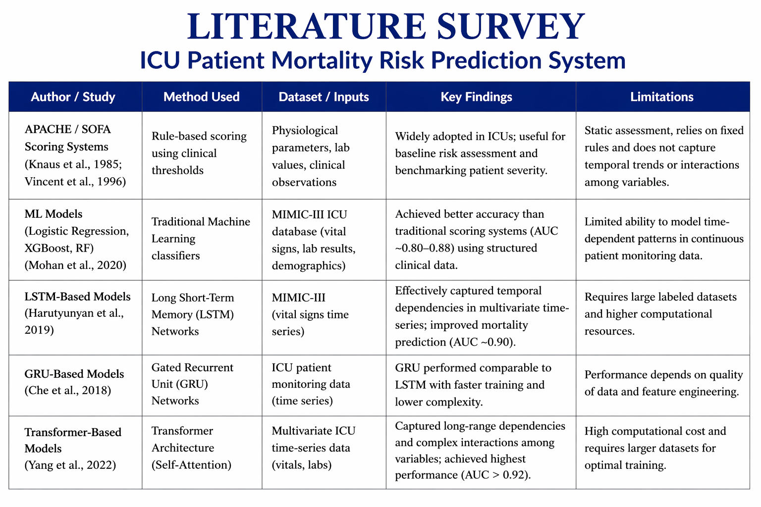
LITERATURE SURVEY
Notes:
2

Slide 4
RESEARCH GAP
Static scores (APACHE/SOFA) ignore time-based changes.
Missing ICU data is not properly handled.
Limited comparison between LSTM, GRU and Transformer models.
Most models predict only at admission.
No real-time early warning alerts.

Slide 5
OBJECTIVE
Simulate ICU time-series dataset with missing values
Handle missing data using imputation methods
Normalize data without leakage
Create sliding window sequences (24 timesteps, 5 features)
Train & compare LSTM, GRU Transformer models using metrics (ROC-AUC, Precision)
Notes:
2

Slide 6
PROPOSED WORK
Simulate ICU patient data using time-series vital signs.
Accept patient data as input for prediction.
Process data using LSTM, GRU and Transformer models.
Generate mortality risk score and health insights.
Display results with real-time alerts and dashboard
Notes:
2

Slide 7
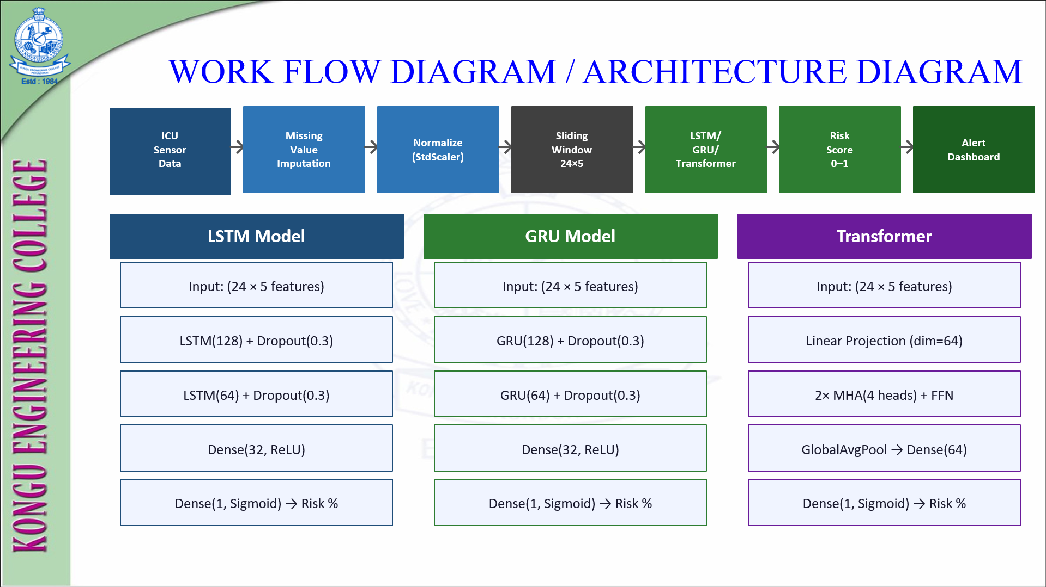
WORKFLOW DIAGRAM
Notes:
2

Slide 8
HARDWARE/SOTWARE
REQUIREMENTS
Processor: i5/Ryzen 5 (min), i7/Ryzen 7 (recommended)
RAM: 8 GB (min), 16 GB+ (recommended)
GPU: Optional (min), NVIDIA GPU (recommended)
Storage &OS: 10GB+Windows/Ubuntu(min),SSD+ Ubuntu/macOS
Software: Python, PyTorch, Pandas, NumPy, Scikit-learn, Flask
Notes:
2

Slide 9
MODULES
Generate ICU dataset with missing values
Preprocess data (imputation, scaling, windowing)
Train LSTM, GRU, Transformer models
Evaluate using ROC-AUC, Precision, Recall, F1
Backend API for real-time prediction
Frontend dashboard for visualization & alerts
Notes:
2

Slide 10
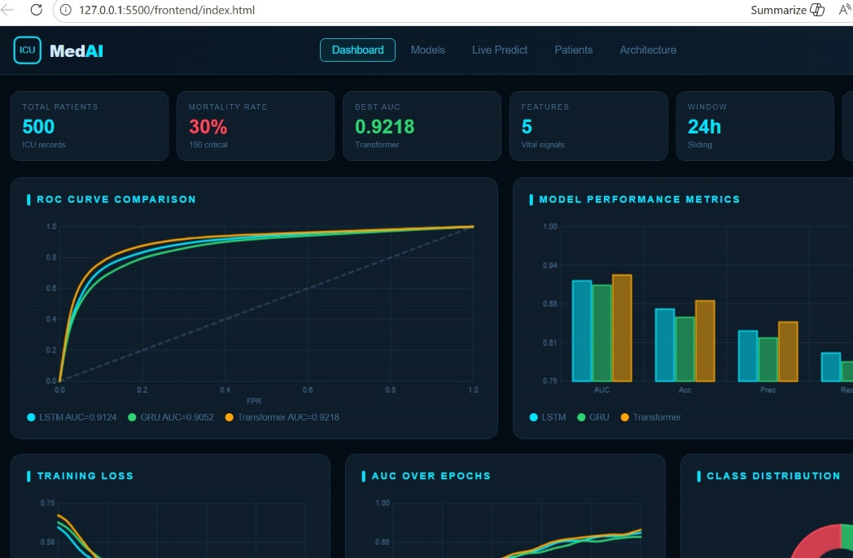
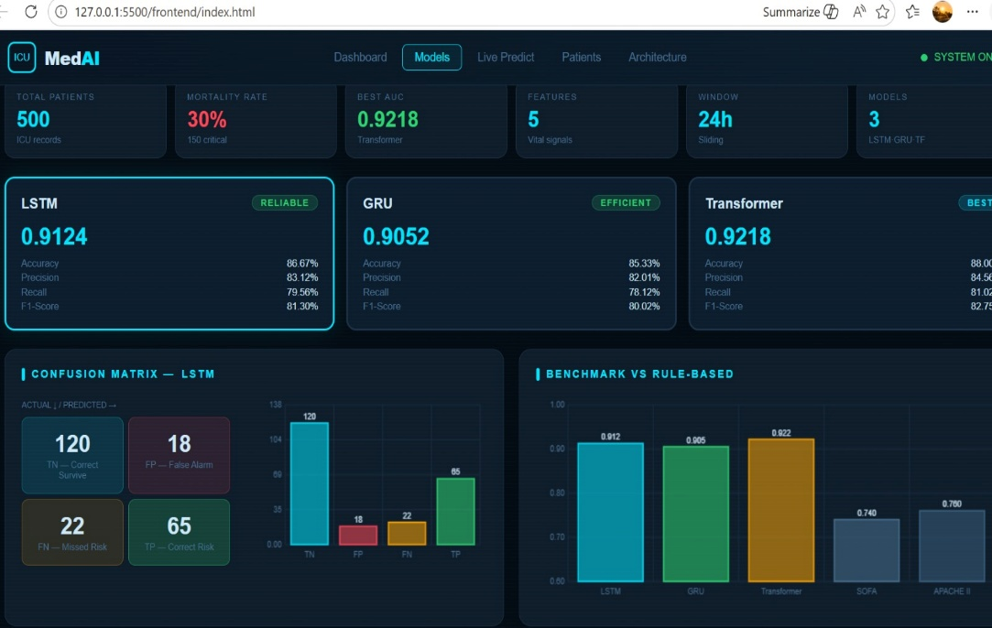
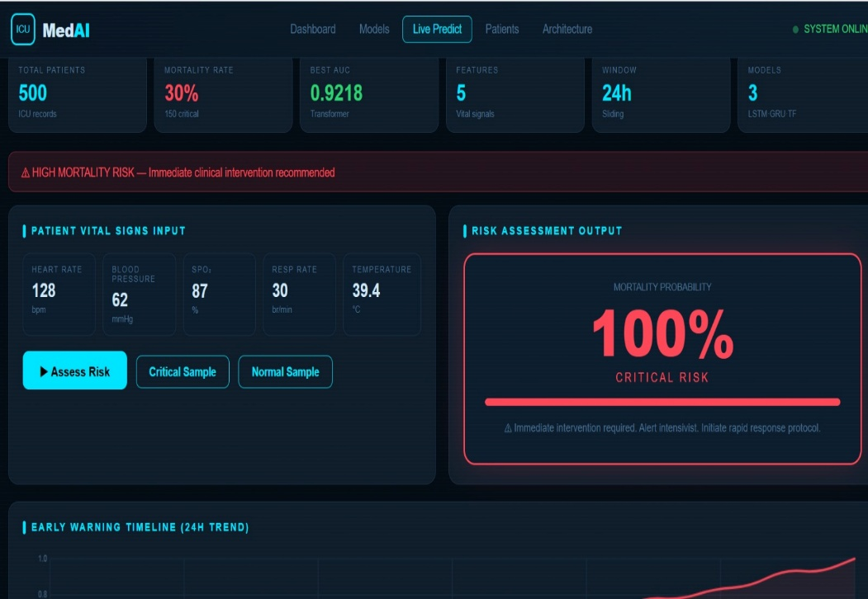
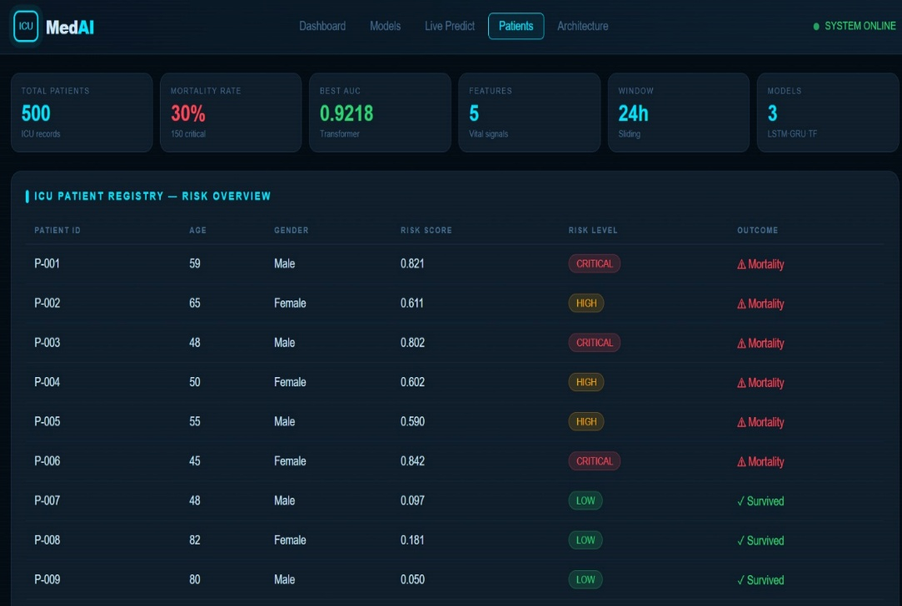
SCREENSHOTS
Notes:
2

Slide 11
REFERENCE
Yu, K. et al., “Monitoring ICU Mortality Risk with LSTM Models”, 2020.
Uses LSTM on EHR data for real-time mortality prediction.
Deng, Y. et al., “Explainable Time-Series Deep Learning Models for ICU Mortality Prediction”, 2022.
Applies LSTM, GRU on ICU time-series data.
Pang, K. et al., “ICU Mortality Prediction using Machine Learning Models”, 2022.
Compares ML models with APACHE scoring systems.
Baker, S. et al., “Continuous Mortality Risk Prediction using LSTM”, 2020.
Shows effectiveness of LSTM for ICU prediction tasks.
Zhao, Y. et al., “ML-Based ICU Mortality Prediction Pipeline”, 2026.
Large-scale dataset with high accuracy ML models.
Ashrafi, N. et al., “Deep Learning Model for ICU Mortality Prediction”, 2024.
Neural networks outperform traditional ML models.
Notes:
2

Slide 12
Thank You
Notes:
2

