Slide 1


Farm-to-Market Supply Chain Platform
BATCH - 05
Presented By
Under the Esteemed Guidance of
CH. BHAVANI 22AJ1A0516
MVS MANIKANTA 22AJ1A0546
M. JYOTHI 22AJ1A0558
B. VENKAT CHOWDARY 22AJ1A0508
MRS. BHAGYA LAKSHMI (M.Tech)
Assistant Professior

Slide 2

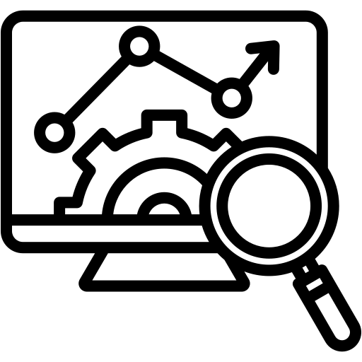
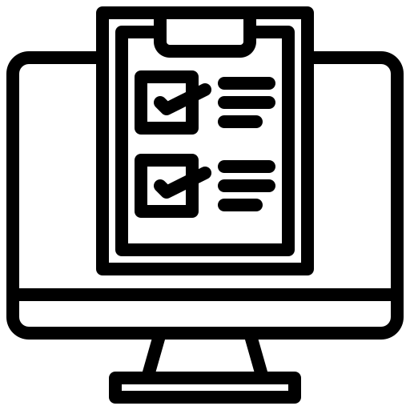
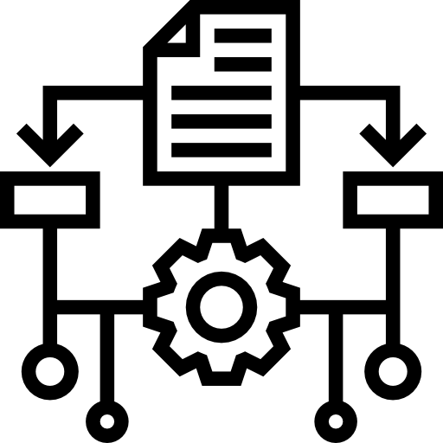
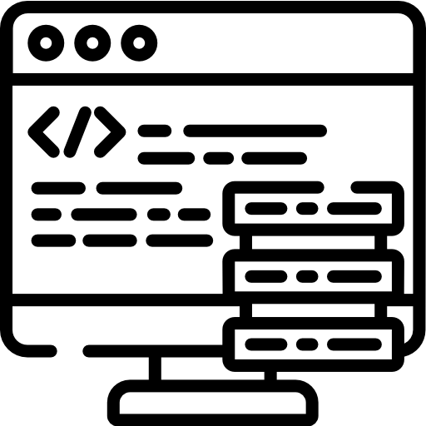



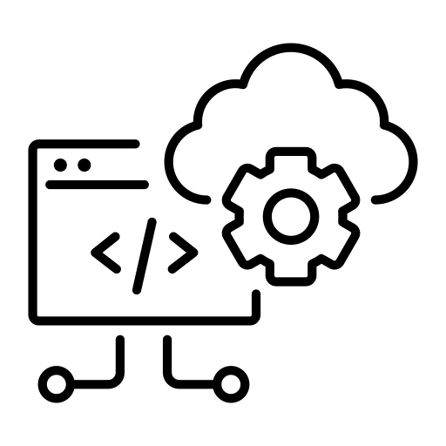
INDEX
TOOLS AND SOFTWARE REQUIREMENTS
SYSTEM
ANALYSIS
ALGORITHM
CONCLUSION
AND
REFERENCES
INTRODUCTION
ABSTRACT
LITERATURE
REVIEW
ARCHITECTURE
IMPLEMENTATION
CODE AND OUTPUT

Slide 3
ABSTRACT
Our final year project, "Farm-to-Market Supply Chain Platform," proposes a decentralized, blockchain-powered system designed to establish a direct, transparent, and equitable connection between small-scale farmers and end buyers. The platform aims to disrupt traditional, inefficient supply chains by eliminating the numerous intermediaries that currently capture most of the profit. At its core, the system leverages Ethereum smart contracts to automate transactions, enforce transparent pricing, and guarantee instant payments upon delivery verification. It integrates IoT sensors for real-time monitoring of product quality and conditions throughout the logistics process. By creating a trusted, peer-to-peer marketplace, our solution ensures that up to 80% of the final retail price reaches the farmers—a significant increase from the current 25-30%—while providing buyers with verifiable quality and origin data. The platform is architecturally built on a React-based frontend, a Node.js backend, and the Ethereum blockchain, forming a comprehensive technological stack for a modern, fair-trade agricultural ecosystem.

Slide 4
INTRODUCTION
The Farm-to-Market Supply Chain Platform is a blockchain-based agricultural marketplace designed to connect farmers directly with buyers through a secure, transparent, and efficient digital system. This project helps overcome common problems in the traditional agricultural supply chain, such as lack of transparency, involvement of middlemen, and difficulty in tracking products from farm to customer. By using blockchain technology, the platform records important activities like product listing, order processing, payment updates, and delivery tracking in a tamper-proof manner. The system improves trust, ensures traceability, and supports a smooth farm-to-consumer supply chain.

Slide 5
LITERATURE REVIEW
Tian (2016): Introduced a blockchain and RFID-based system for agri-food traceability to improve transparency and food safety. It showed how product information can be securely tracked across the supply chain.
Caro et al. (2018): Proposed a practical blockchain-based traceability solution for agri-food supply chains using IoT and smart contracts. Their work demonstrated secure and reliable monitoring of product movement.
Zhao et al. (2019): Reviewed blockchain applications in agri-food value chains and highlighted benefits like traceability, trust, and data security. The study also discussed challenges such as scalability, privacy, and implementation cost

Slide 6
EXISTING SYSTEM
The traditional farm supply chain depends on manual records and middlemen for product movement and sales. This leads to low transparency, poor traceability, delayed communication, and difficulty in verifying product origin.
Technical Analysis:
The traditional agricultural supply chain often relies on manual record-keeping or siloed digital databases, leading to several inefficiencies:
Lack of Transparency: Information regarding a product's origin, harvest date, and batch details is often lost as it moves through various intermediaries.
Traceability Gaps: Tracking the "farm-to-fork" journey is difficult for consumers, as there is no unified, public ledger to verify the stages of an order.
Fragmented Data: Farmers, buyers, and logistics providers maintain separate records, making it hard to resolve disputes regarding payment or delivery status.
Security Risks: Traditional centralized databases are vulnerable to unauthorized alterations, and there is often no immutable proof of a transaction or product listing.

Slide 7
EXISTING SYSTEM
Limitations Of The Existing System
The existed system represents traditional agricultural supply chain management, which typically relies on centralized databases or manual record-keeping.
Centralized Data Storage: Information is stored in private, siloed databases owned by individual companies or intermediaries, making it difficult for other stakeholders to verify data.
Limited Traceability: Consumers often have no way to verify the "farm-to-fork" journey, including specific batch codes, origin locations, or exact harvest dates.
Manual Order Tracking: Tracking often depends on manual updates from logistics providers, which can be delayed or prone to human error.
Trust Deficit: Transactions and product quality claims rely entirely on the reputation of the seller or intermediary without immutable proof.
Opaque Payment Cycles: Payment status and collection (especially for Cash on Delivery) are often tracked in spreadsheets or private ledgers, leading to potential disputes between farmers and buyers.

Slide 8
PROPOSED SYSTEM
The proposed system is a "local-first" agricultural marketplace that utilizes blockchain technology to create a transparent, immutable proof-of-concept for supply chain workflows.
Features of the Proposed System:
Farmer Module: Farmers can add, update, and manage agricultural products with details like batch code, harvest date, origin, quantity, and price.
Buyer Module: Buyers can view products, add them to cart, place orders, and choose online payment or cash on delivery.
Blockchain Integration: Important supply chain events such as product creation, order creation, payment updates, and delivery status are securely recorded on blockchain.
Order Tracking: The system provides public order tracking so users can check product movement and order status using the order number.
Admin Monitoring: Admin can monitor users, products, orders, and overall platform activities through a dashboard.
Payment Facility: The platform supports Razorpay test-mode online payment and COD for flexible transaction handling.
Delivery Monitoring: GPS-based delivery simulation is used to represent product movement during the delivery phase
Role-Based Access: Separate access is provided for farmer, buyer, and admin with different functionalities.

Slide 9
PROPOSED SYSTEM
Advantages of the Proposed System
Transparency: The platform improves visibility of product details, payments, and order status throughout the supply chain.
Traceability: Each product and order can be tracked from farm to buyer, improving trust and accountability.
Security: Blockchain provides tamper-proof storage of important transaction records and supply chain events.
Reduced Middlemen: Farmers can connect more directly with buyers, reducing dependency on intermediaries.
Better Trust: Buyers can verify product origin and progress, which increases confidence in the system.
Efficient Management: Digital records and automated workflows reduce manual errors and improve operational efficiency.
Improved Monitoring: Admin dashboards and tracking features help in better control of products and orders.
Modern Solution: The system combines web and blockchain technologies to create a smarter agricultural marketplace

Slide 10
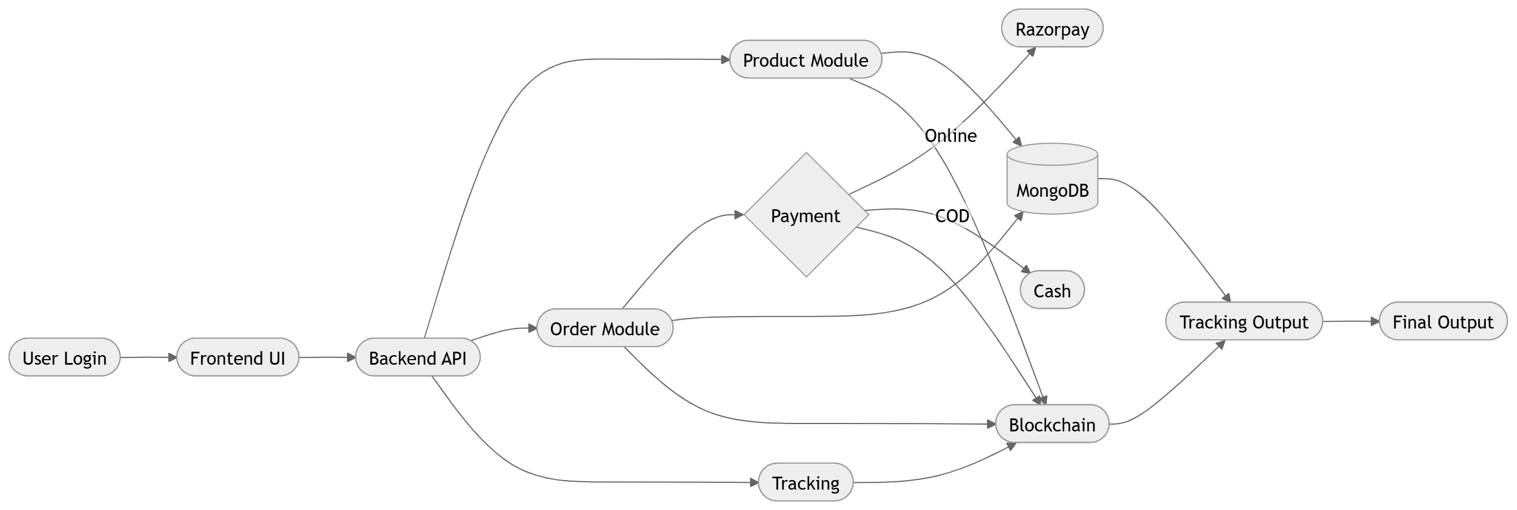
ARCHITECTURE

Slide 11
TOOLS AND SOFTWARE REQUIREMENTS
SOFTWARE SPECIFICATIONS:
Operating System: Windows 10/11, Linux, or macOS
Frontend: React.js, Vite
Backend: Node.js, Express.js
Database: MongoDB
Blockchain: Solidity, Truffle, Ganache, Web3.js
Programming Languages: JavaScript, Solidity, HTML, CSS
Authentication: JWT
Payment Gateway: Razorpay Test Mode
TOOLS USED:
Visual Studio Code for development
Git and GitHub for version control
npm for package management
Ganache for local blockchain environment
Truffle for smart contract deployment
MongoDB Compass for database management

Slide 12
HARDWARE REQUIREMENTS
Processor: Intel i3 or above
RAM: Minimum 4 GB, recommended 8 GB
Storage: Minimum 20 GB free space
System Type: 64-bit computer/laptop
Internet: Required for package installation and payment API testing

Slide 13
IMPLEMENTATION
Frontend Module: The user interface is developed using React.js to provide separate dashboards for farmer, buyer, and admin . It enables product browsing, order placement, profile management, and tracking features.
Backend Module: The backend is implemented using Node.js and Express.js to manage APIs and business logic.It handles authentication, product operations, order processing, and communication with other modules.
Database Management: MongoDB is used to store user details, product records, orders, and delivery information. It provides flexible and efficient data storage for managing the complete application workflow.
Authentication System: JWT authentication is implemented to provide secure login and role-based authorization. This ensures that each user accesses only the features allowed for their role in the system.
User Role Handling: The platform supports three main roles: farmer, buyer, and admin. Each role is provided with dedicated functions to improve usability and system management.

Slide 14
IMPLEMENTATION
Blockchain Integration: Solidity smart contracts are used to record major supply chain events securely on blockchain. This improves transparency and creates tamper-proof records for agricultural transactions.
Product and Order Recording: When products are added or orders are placed, the details are saved in MongoDB and blockchain. This helps maintain both application data and secure proof of each important activity.
Payment Implementation: The system supports Razorpay test-mode payments as well as Cash on Delivery options. Payment updates are processed through the backend and linked with order records for verification.
Tracking Mechanism: A public order tracking module is implemented to help users monitor order progress easily. GPS simulation is used to represent delivery movement during the transportation stage.
Admin Monitoring: The admin dashboard is implemented to supervise users, products, and order activities. It helps in monitoring platform performance and maintaining better control over the entire system.

Slide 15
ALGORITHM
Password Hashing Algorithm: bcrypt is used to encrypt user passwords before storing them in the database, which improves login security.
JWT Authentication Logic: JSON Web Tokens are generated for secure user authentication and role-based access control.
Order Number Generation Algorithm: A sequential format like ORD-0001, ORD-0002 is created using document count and zero-padding.
Batch Code Generation Algorithm: Product batch codes are generated using product name prefix, current date, and a random alphanumeric value.
Payment Reference Generation Algorithm: Unique payment IDs are created using payment mode, order number, timestamp, and retry count.
Blockchain Status Mapping Logic: Payment method, payment status, and order status are converted into smart contract enum values for blockchain recording.

Slide 16
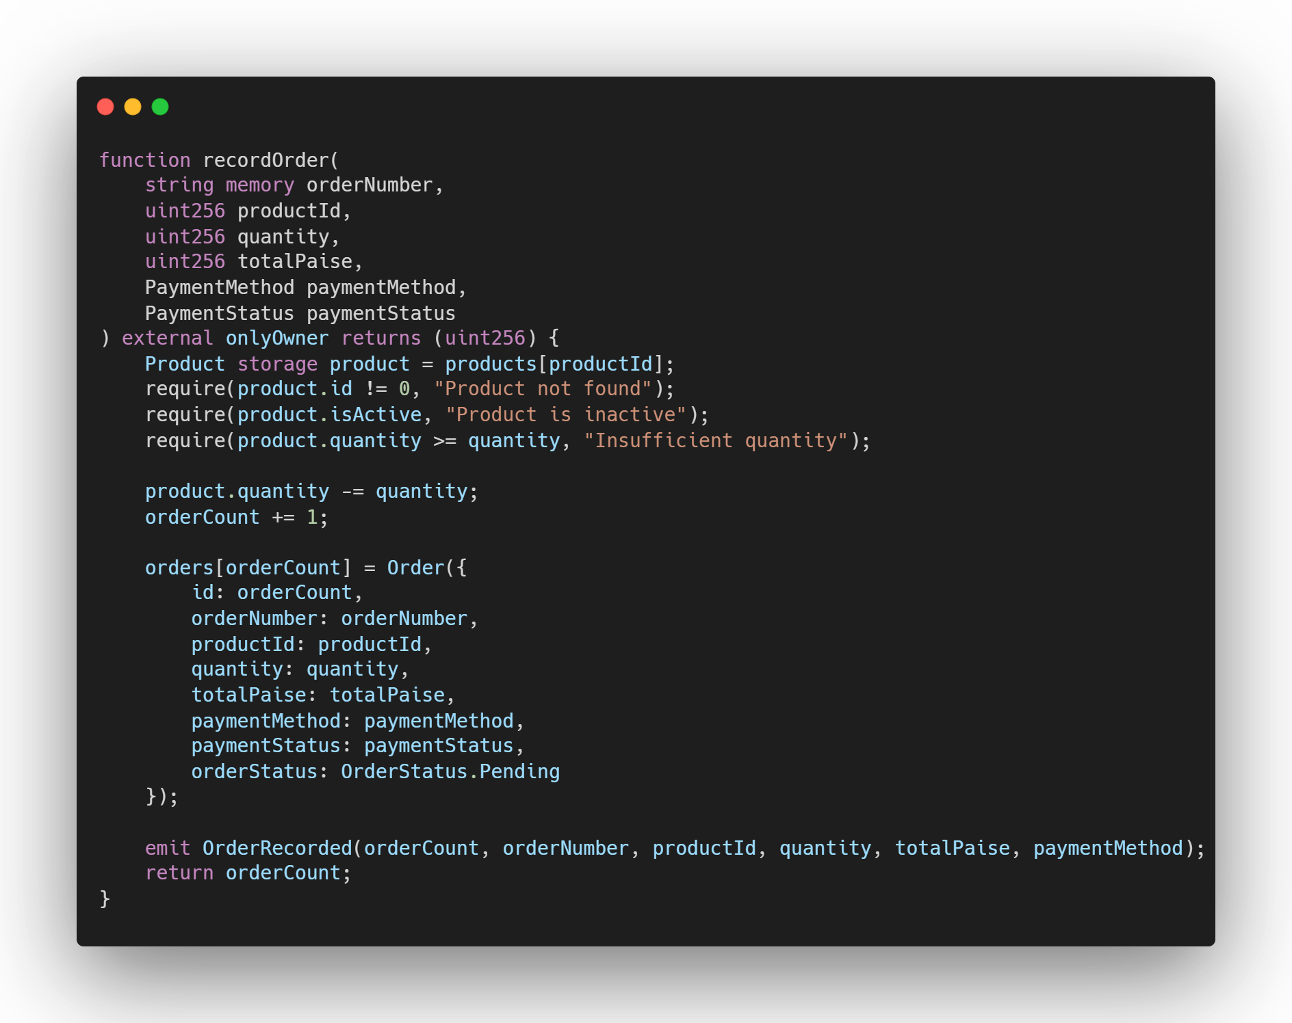
CODE:
1. Smart Contract: Record Order From FarmSupplyChain.sol

Slide 17
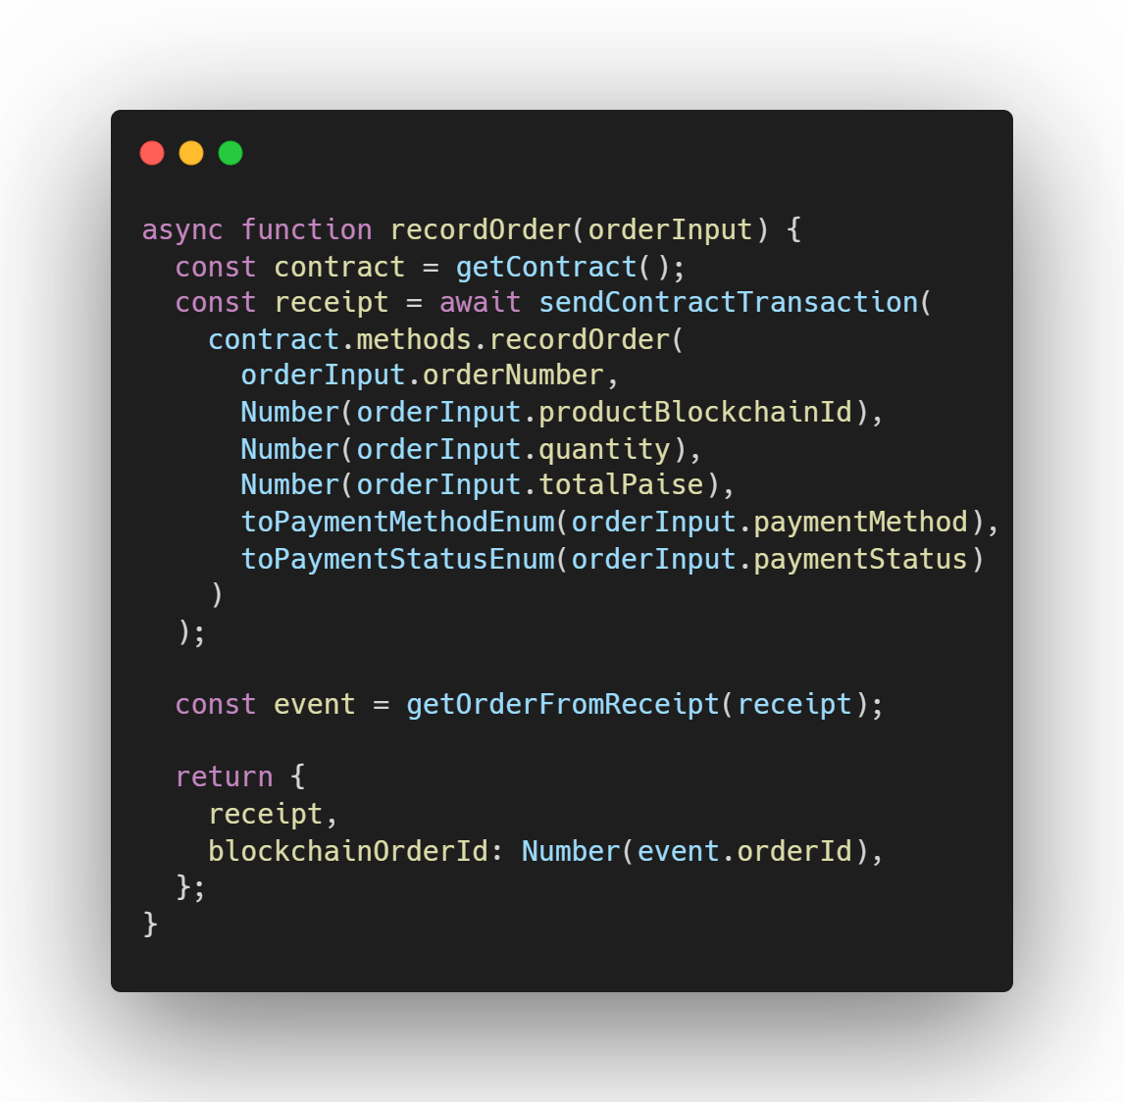
Backend to Blockchain Integration From blockchainService.js

Slide 18
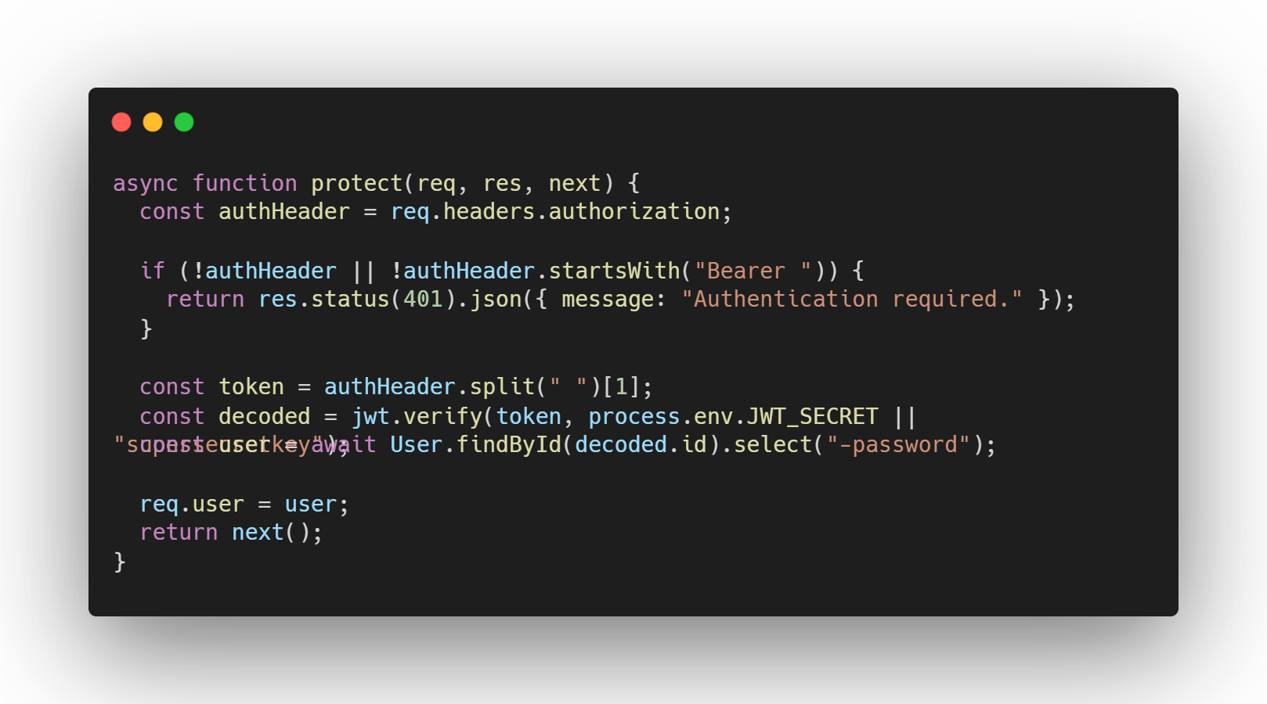
JWT Authentication Middleware From auth.js

Slide 19
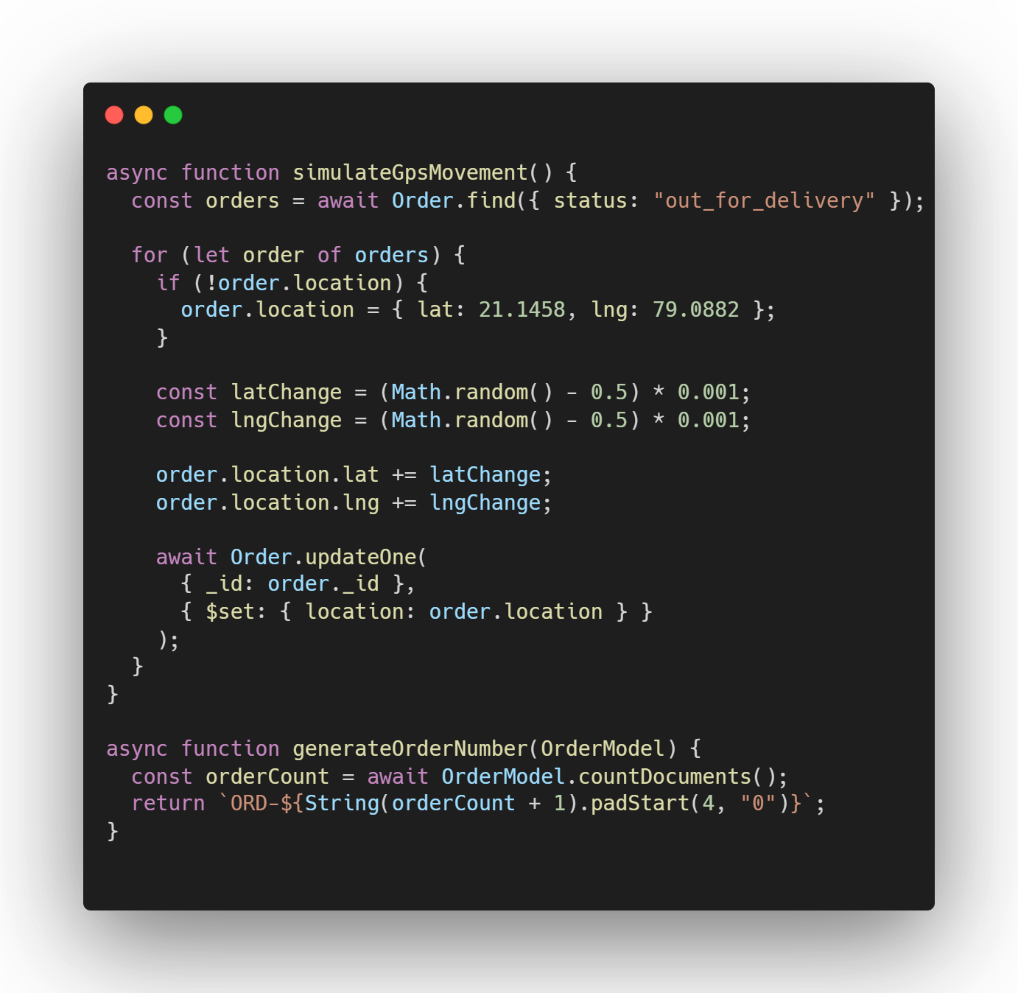
GPS Delivery Tracking Simulation From gpsSimulationService.js
&
5. From generateOrderNumber.js

Slide 20
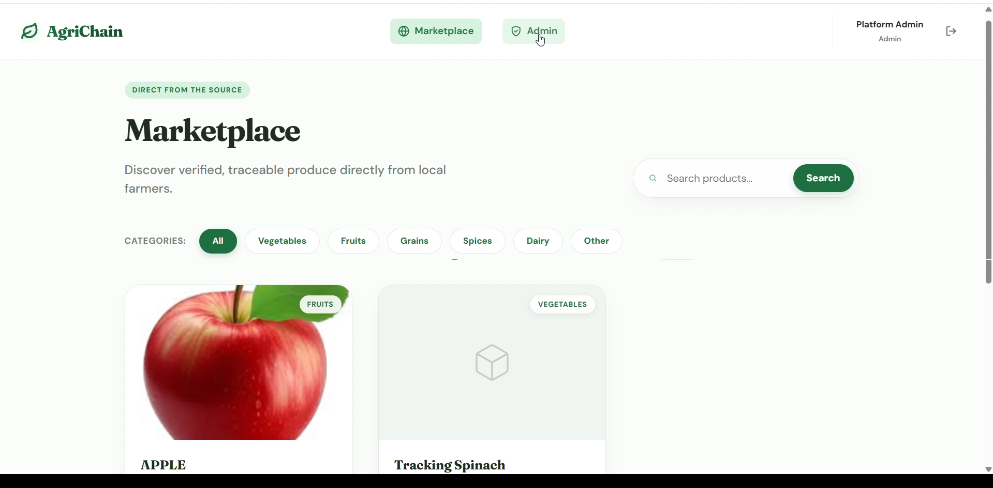
OUTPUT :

Slide 21
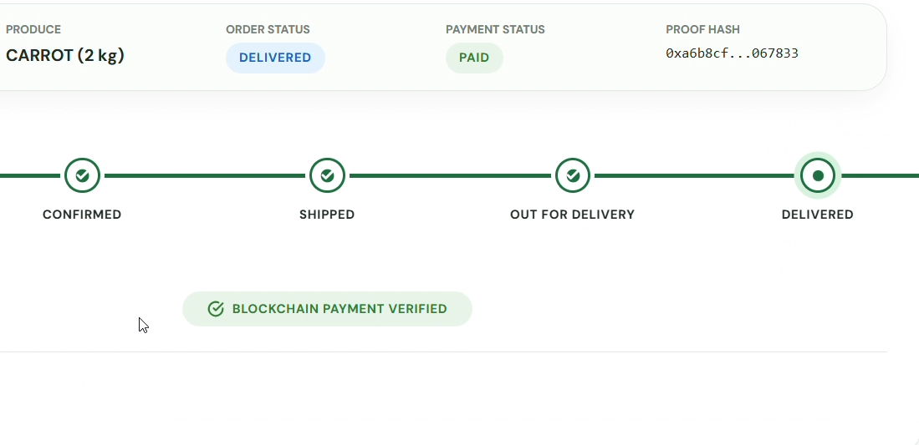
OUTPUT :

Slide 22
CONCLUSION
The Farm-to-Market Supply Chain Platform was developed to create a secure, transparent, and efficient agricultural marketplace that directly connects farmers and buyers. The project successfully combines web technologies with blockchain to reduce dependency on middlemen, improve product traceability, and maintain trusted records of supply chain activities. By integrating product listing, order management, payment handling, and tracking features, the system provides a practical digital solution for modern agricultural trade.
The implementation of blockchain in this project plays an important role in ensuring tamper-proof storage of important events such as product creation, order placement, payment updates, and delivery status changes. The use of React, Node.js, Express, MongoDB, Solidity, Truffle, and Ganache helped in building a complete prototype that demonstrates how technology can improve trust, accountability, and operational efficiency in farm-to-market transactions.
The system also supports multiple user roles such as farmer, buyer, and admin, making it more flexible and functional. Although the project is currently developed for local demonstration and academic purposes, it clearly shows the potential of blockchain-enabled agricultural systems in real-world applications. With further improvements such as live deployment, real GPS tracking, production blockchain integration, and advanced analytics, the platform can be expanded into a scalable and practical solution for the agricultural sector. Overall, this project proves that digital and blockchain-based systems can significantly enhance transparency, security, and traceability in the agricultural supply chain.

Slide 23
FUTURE SCOPE
The project can be extended to a real-time production environment using a public or private blockchain network.
Live payment integration can be implemented instead of Razorpay test mode for actual customer transactions.
The system can be connected with real GPS and IoT devices for accurate shipment and product monitoring.
Mobile application support can be added to improve accessibility for farmers and buyers.
Advanced analytics can be introduced to study sales trends, delivery performance, and market demand.

Slide 24
FUTURE SCOPE
Multi-language support can be implemented to make the system more user-friendly for rural users.
AI or machine learning features can be added for price prediction, crop demand forecasting, and sales analysis.
QR code integration can be used for easy product verification and traceability by customers.
The platform can be expanded to support wholesalers, retailers, and logistics providers in addition to farmers and buyers.

Slide 25
REFERENCES
Feng Tian, 2016: Proposed an RFID and blockchain-based traceability system for agri-food products.It improved transparency and secure tracking across the agricultural supply chain.
Caro et al., 2018: Presented a practical blockchain solution for agri-food traceability management.The system integrated blockchain with IoT for secure and reliable product monitoring.
Kamilaris et al., 2019: Reviewed the rise of blockchain technology in agriculture and food supply chains.The study highlighted benefits such as transparency, trust, and end-to-end traceability.
Zhao et al., 2019: Summarized blockchain applications and challenges in agri-food value chain management.It discussed issues like privacy, scalability, regulation, and implementation cost.

Slide 26
REFERENCES
Shahid et al., 2020: Developed a complete blockchain-based agri-food supply chain solution. Their work focused on secure transactions, smart contracts, and transparent supply chain management.
Marchese and Tomarchio, 2022: Proposed a blockchain-based traceability management system for agri-food supply chains.It emphasized secure architecture design and efficient tracking of food products.
Yogarajan et al., 2023: Conducted a systematic literature review on blockchain adoption in agri-food supply chains. The review explained research trends, adoption factors, and practical challenges.
Rashid et al., 2024: Demonstrated a blockchain-based web application for traceability and fair pricing in agriculture. The system showed how blockchain can improve farmer profitability and supply chain efficiency.

Slide 27
THANK YOU….

