Slide 1

A PRESENTATION ON “AI Virtual Mouse | Gesture Recognition | Voice Assistant”
Poornima Institute of Engineering & Technology, Jaipur
Department of Computer Science & Engineering
Submitted By:
Bhavani Shankar Purohit , Ayush jain, Dhruv Sevak.
Submitted to:
Deepak Moud sir
Hod , cs piet

Slide 2
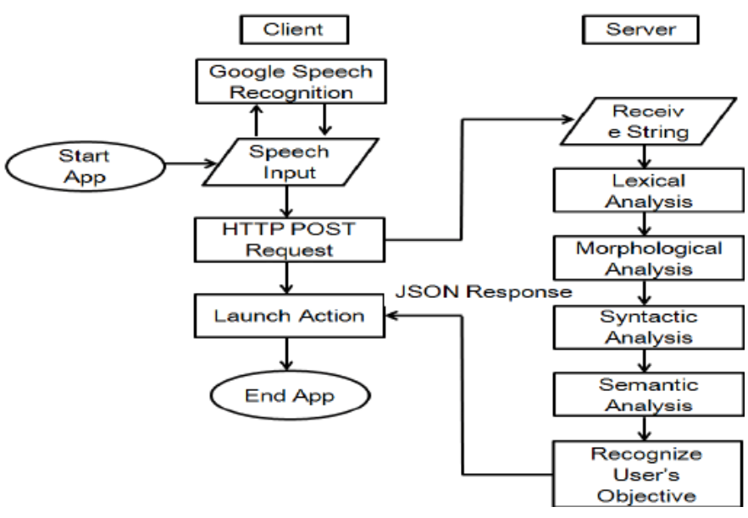
Data flow diagram of speech recognition

Slide 3
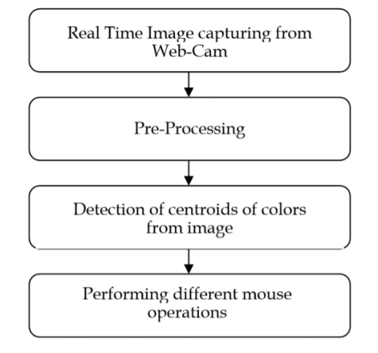
General Block Diagram

