Slide 1
KUBERNETES FAILURE PREDICTION & REMEDIATION AGENT
Building AI-Driven Solutions for Proactive Failure Mitigation in Kubernetes
TEAM: TRICODERS

Slide 2
PROBLEM STATEMENT
Kubernetes clusters can encounter failures such as pod crashes, resource bottlenecks, and network issues. The challenge in Phase 1 is to build an AI/ML model capable of predicting these issues before they occur by analyzing historical and real-time cluster metrics. Once issues are predicted, the next step is to automate or recommend actions for remediation. The challenge in Phase 2 is to create an agent or system capable of responding to these predicted issues by suggesting or implementing actions to mitigate potential failures in the Kubernetes cluster.

Slide 3
OUR SOLUTION: AI-DRIVEN FAILURE PREDICTION WITH AUTO-REMEDIATION
WE BUILT AN END-TO-END AI-OPS SYSTEM THAT:
Predicts pod-level failures before they occur
Explains why a pod is likely to fail (XAI)
Triggers auto-remediation actions
Works in both Streamlit UI and Kubernetes
FAILURE TYPES PREDICTED
oom_kill
pod_stuck
container_crash
cpu_throttle
dns_failure
disk_full
memory_leak
network_loss
kubelet_down
node_reboot
resource_starvation
image_pull_error
pod_eviction
filesystem_error
high_latency

Slide 4
DATASET & DATA COLLECTION
To simulate a production-grade dataset:
We designed a telemetry collection script that interacts with both the Kubernetes API and Prometheus, polling real-time pod metrics during both normal and faulty states.
Metrics gathered include: cpu_usage_cores, memory_usage_bytes, disk_io_read/write_bytes, network_rx/tx_bytes, latency_ms, restart_count, container_ready, and pod_scheduled.
Error and event logs were also simulated to reflect actual scenarios like oom_kill, container_crash, cpu_throttle, dns_failure, etc.
This script was designed to simulate failures, inject faults programmatically, and record metrics leading up to and after failure events.
Chaos Engineering Inspired Approach: We introduced faults such as CPU throttling, memory exhaustion, kubelet failures, and DNS issues to observe how the system behaves under stress. The system learns from chaos — adapting its model from fault-inducing episodes.

Slide 5
PREPROCESSING PIPELINE
Timestamp parsing & sorting for time-aware prediction
Label encoding for categorical features (namespace, failure_type)
StandardScaler normalization for numerical metrics
Train/test split: 80/20 with time-based shuffle=False

Slide 6
ML MODEL
Model: XGBoostClassifier
Chosen for: robustness with tabular ops data, high precision/recall tuning flexibility
Threshold tuning: optimized for high recall in rare-failure detection
Outputs: binary prediction (fail/no-fail) + probability
METRICS
Accuracy: ~60% (due to class imbalance)
Precision/Recall balanced with threshold tuning
F1-Score: Measures the balance between precision and recall, ensuring the model’s predictions are both accurate and comprehensive.
AUC-ROC: Evaluates the model’s ability to distinguish between classes (failure vs. non-failure).
Risk Levels: 🔴 High, 🔶 Medium, 🟡 Low, 🟢 None
Predictions paired with explanations and remediation suggestions

Slide 7
FROM PREDICTION TO PREVENTION: WHAT REALLY MATTERS
In real Kubernetes environments, failures are rare — meaning the dataset is highly imbalanced (most pods are healthy).
If we trained a model to simply predict "no failure," it could achieve high accuracy (~90%) by doing nothing useful.
ML helps detect patterns humans or rule-based systems miss — before failure actually happens. This is why ML still wins even at 60% accuracy
Instead, we:
✅ Tuned thresholds to maximize recall (how many true failures we catch)
✅ Prioritized early detection and safety-first predictions
✅ Focused on actionability — every prediction comes with reasons + remediation
Our goal isn't to be perfect — it’s to be proactive.
What Really Matters:
Recall: Catching true failures early
Risk Scoring: Helping teams triage intelligently
Explainability: Showing why a pod may fail
Remediation: Fixing the issue before it causes downtime
This is an AI-Ops system, not just a prediction model. The value is in:
Knowing something’s wrong before it breaks
Knowing why it might break
Knowing how to fix it
We don’t need 99% accuracy — we need to catch the right 1% before it becomes 100% downtime.

Slide 8
REAL-WORLD SCENARIOS WHERE THIS MATTERS
1. OOM Kill in ML Pods
-Inference pods processing large models hit memory limits.
-K8s terminates them with oom_kill — our agent predicts this early based on memory usage spikes.
2. DNS Failure in Microservices Mesh
-A microservice fails to resolve another service name due to CoreDNS crash.
-Predicted as dns_failure, our system suggests restarting CoreDNS or updating DNS policy.
3. Image Pull Errors During Deployment
-CI/CD pushes wrong image tag → deployment fails.
-Detected as image_pull_error, our agent advises tag rollback or registry check.
4. Pod Eviction Due to Node Pressure
-Node runs out of disk space → K8s evicts non-critical pods.
-Predicted as pod_eviction, our system suggests proactive cleanup or node scaling.
5. CPU Throttling in High-Traffic Apps
-Web pods under traffic surge hit CPU limits.
-Model predicts cpu_throttle, triggers recommendation to scale replicas or increase CPU limits.

Slide 9
EXPLAINABLE AI (XAI)
Lightweight XAI built-in: explains every prediction in natural language
Example: "Likely failure due to high CPU usage, OOM kill occurred, and too many restarts"
Used both SHAP-style local feature analysis + rule-based reasoning
Displayed clearly in the app, downloadable per-pod

Slide 10
REMEDIATION SYSTEM (PHASE 2)
Based on predicted failure_type, recommends action:
pod_stuck → Restart pod
cpu_throttle → Scale CPU
memory_leak → Increase memory
disk_full → Clean storage
Default: Alert admin
Triggers:
In UI: shows simulated kubectl or YAML command
Optionally sends webhook (e.g., Slack/Discord)

Slide 11
STREAMLIT APP
Real-time prediction (manual input)
Batch prediction (CSV upload)
Exports predictions with reasons, risk level, and remediation
Threshold tuning slider
Simulated automation: shows remediation commands
KUBERNETES PACKAGING
Dockerized Streamlit app with Dockerfile
K8s-ready via deployment.yaml + service.yaml
Helm chart created for versioned deployment
Tested on Minikube

Slide 12
CHALLENGES & HOW WE OVERCAME THEM
Imbalanced dataset: Most pods don't fail → tuned model for recall, used threshold tuning, and stratified failure simulation
Lack of real telemetry: Simulated both normal and faulty conditions using synthetic data generators and fault injectors
Model interpretability: Used explainable rules to describe predictions in plain language (XAI)
Actionability: Bridged ML with DevOps by generating remediation steps (kubectl commands, YAML edits)
Kubernetes integration: Built Docker image, YAML configs, and Helm chart to deploy in Minikube or any cluster
Recall tradeoff with accuracy: Chose to prioritize early detection and actionable insights over raw accuracy, as done in safety-critical systems

Slide 13
CHAOS-TO-CONTROL: RESILIENCE VIA LEARNING
Our pipeline is inspired by chaos engineering
Faults are injected, metrics are collected, model is trained
The system learns from induced stress — then reacts in production
We simulate "failure as a feature" to strengthen recovery logic

Slide 14
UNIQUENESS
Full AI-Ops loop: predict → explain → act
XAI: readable, insightful explanations per pod
Realistic metrics: Streamlit, Minikube, Helm
Automation simulated + easily real-world extendable
Designed for scalability: can be deployed cluster-wide
Modular: each component reusable & maintainable
Helm packaging for production readiness
Chaos Engineering principles applied for resilient ML

Slide 15
FEASIBILITY & SCALABILITY
Docker + K8s ready → Cloud native
Lightweight model → Fast inferencing
Can integrate with Prometheus/Grafana for real-time telemetry
Helm charts make deployment repeatable + versionable
Can scale to multi-cluster with minimal config change
Extendable to real-time pipelines (Kafka + Prometheus metrics)

Slide 16
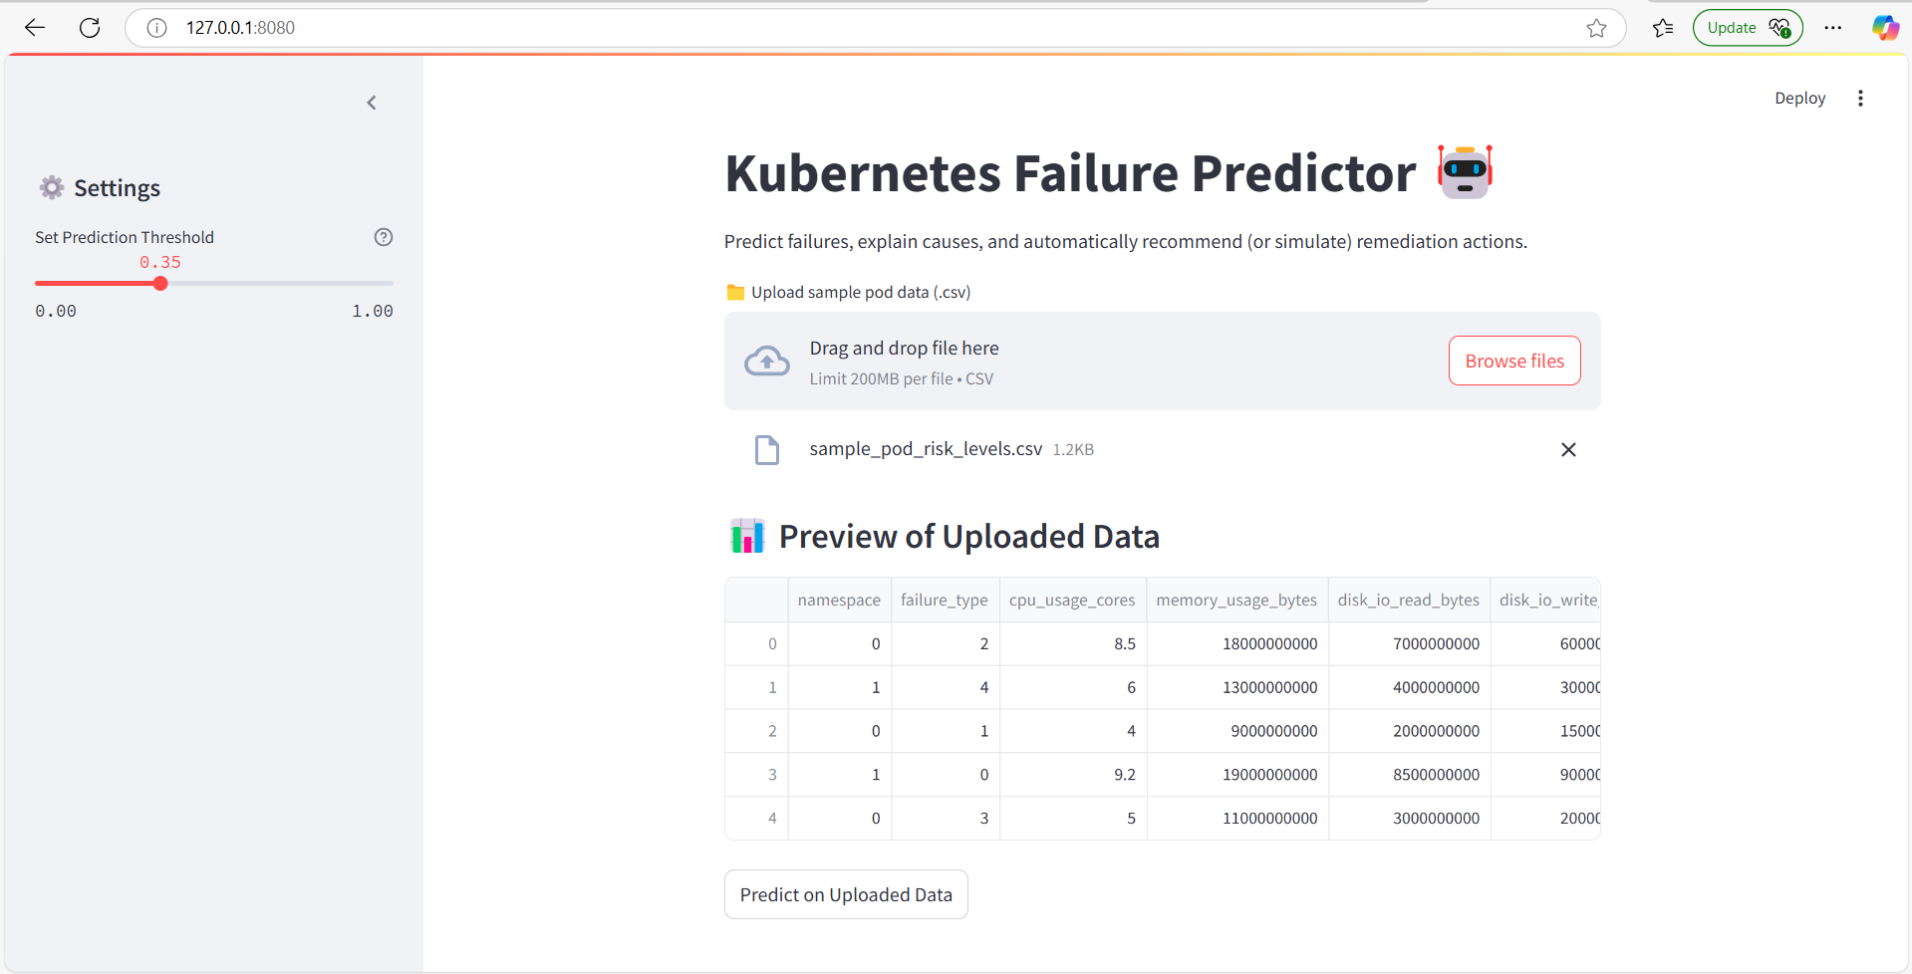
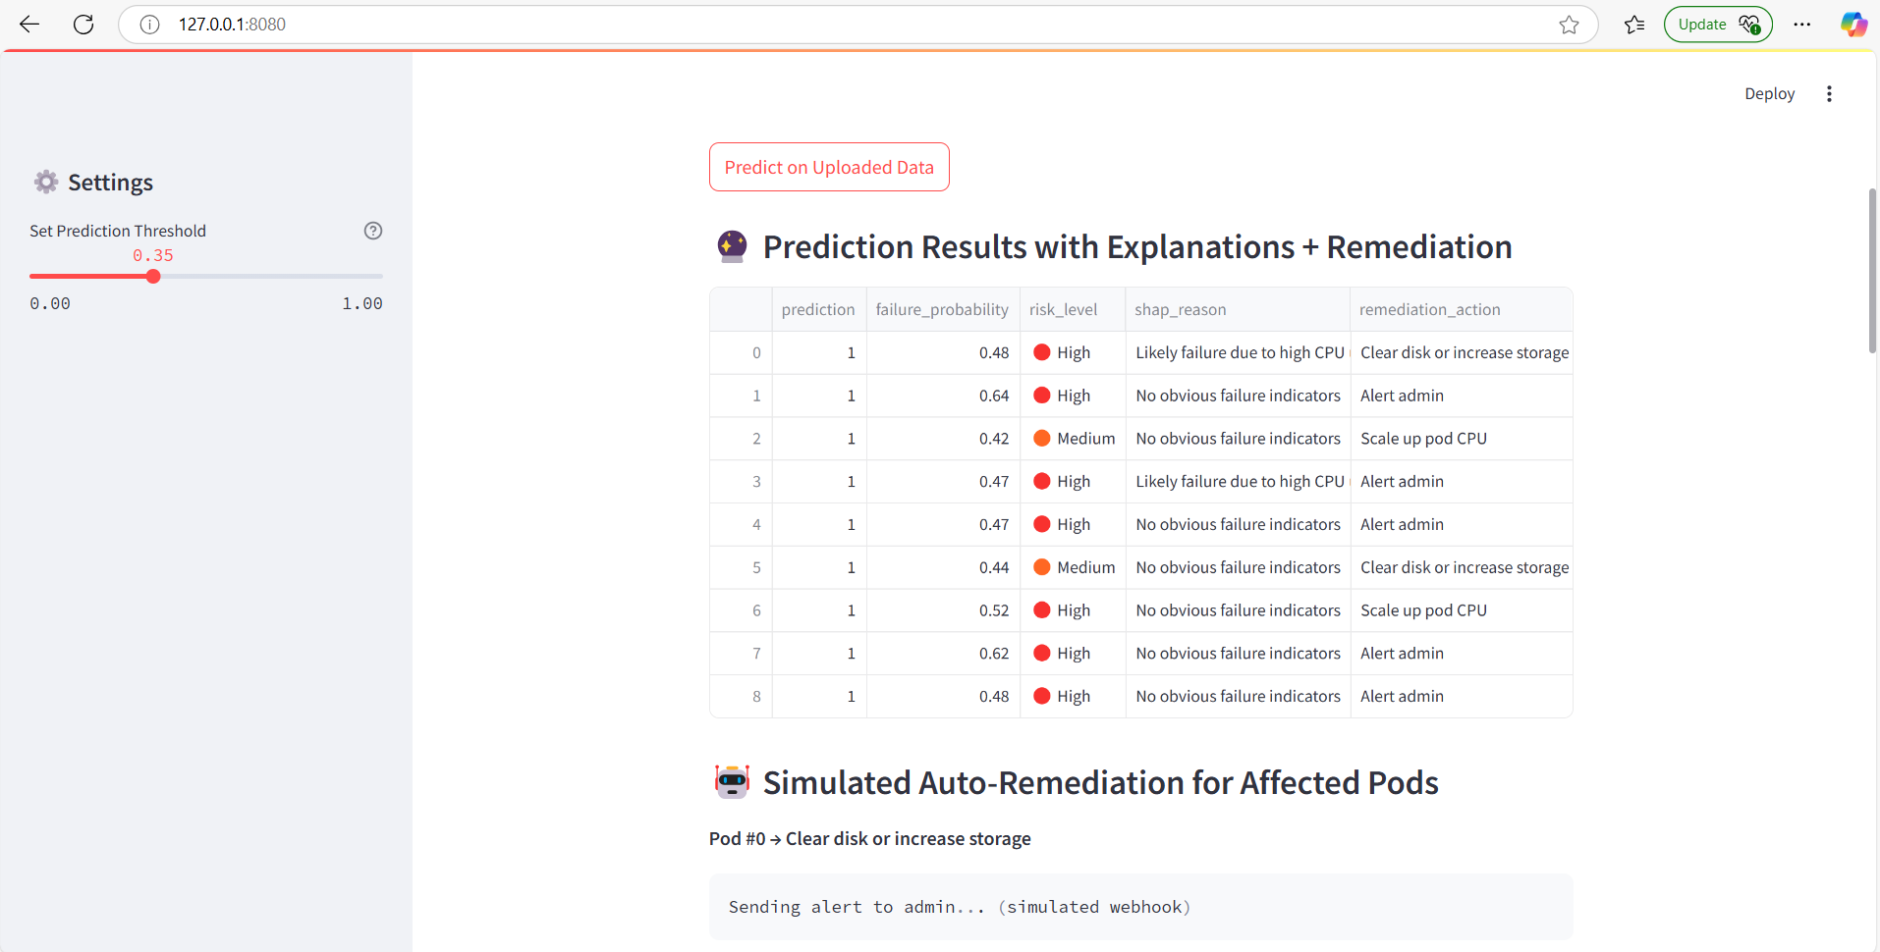
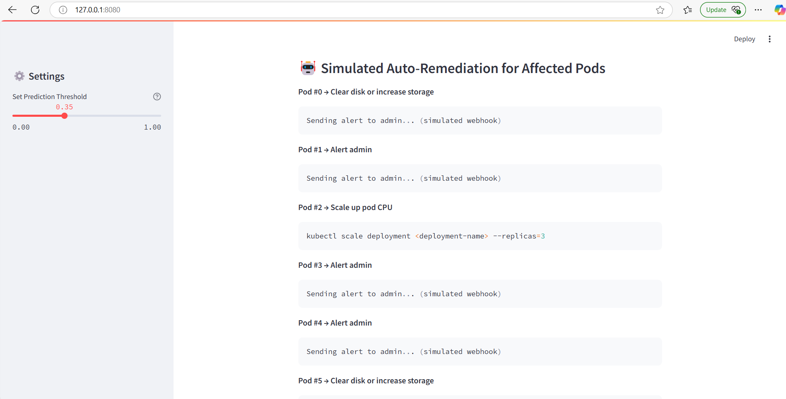
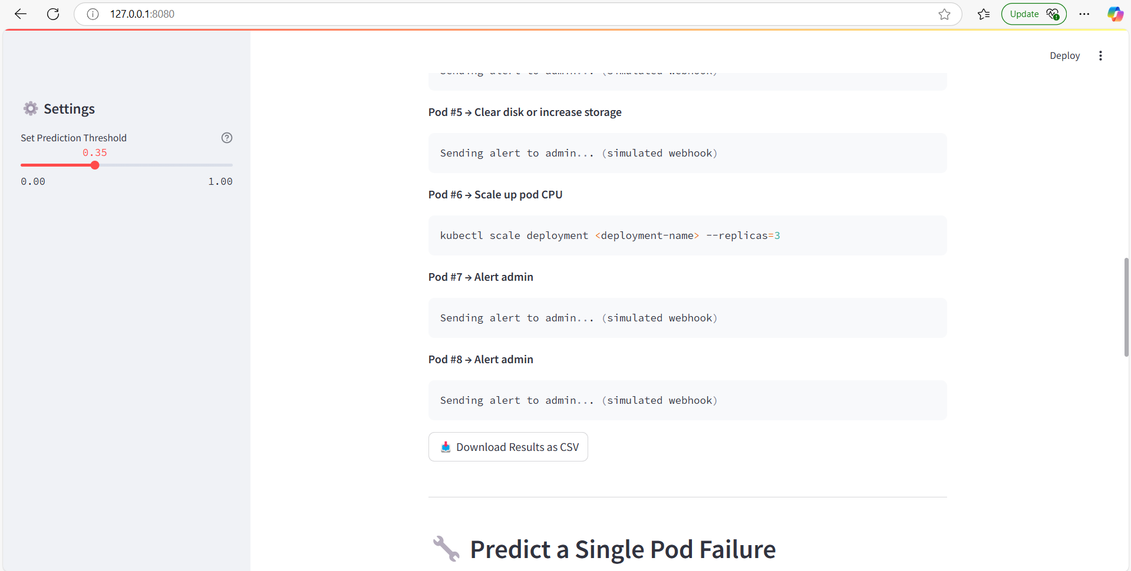
UPLOADED POD DATASET → INSIGHTS AND ACTIONS

Slide 17
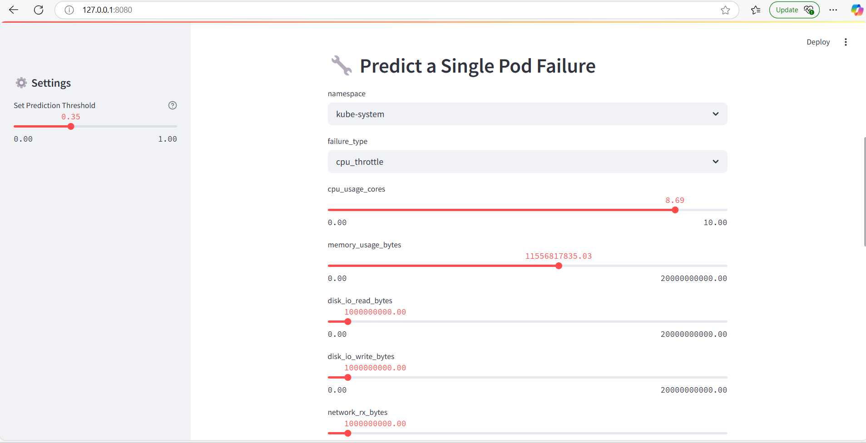
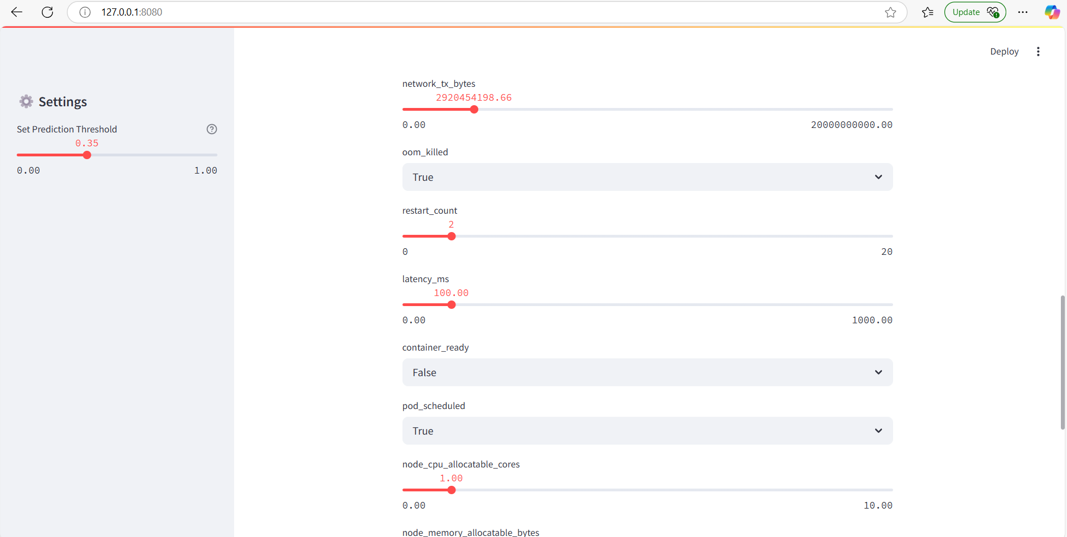
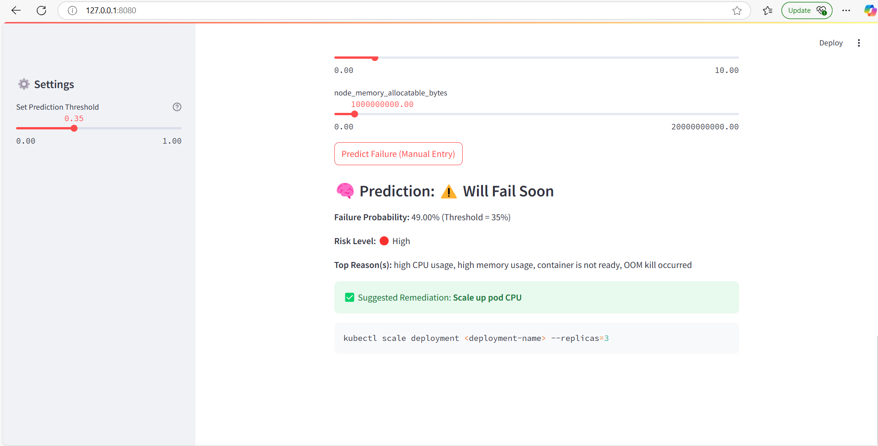
MANUAL INPUT → REAL-TIME PREDICTION

Slide 18
THANK YOU! LET’S BUILD SELF-HEALING CLUSTERS

