Slide 1
01
EXCELERATE · DATA TEAM 1
AI-Powered Data Analysis
Remote Internship — Final Presentation
RIT 1307 — AI Data Team 1
Oladapo Abimbola Team Lead
Sindiwe Rana
Tshepiso Kelebogile Rampete
Kevin Kipyator Kapyemit
Amalapurapu Durga Bhavani
Oyedijo Comfort
Yare Phenyle Mpella
Desmond Aziega
Ojigbani Cherish
EXCELERATE · RIT 1307 AI DATA TEAM 1
01 / 14

Slide 2
FINDINGS RECAP · 01
Funnel & Registration Trends
INFLUX DYNAMICS & MAJOR FOCUS
SEVERE DROP-OFF & QUALITY GAPS
8,558 Total Records
41.7% Rejection Rate
Analyzed learner engagement across 23 opportunities in 5 distinct categories.
3,569 applicants rejected versus only 9.0% Started (767 learners).
Demand Concentration
Conversion Gap
63.4% of total applicants apply for Internships (5,421 records), followed by Courses (23.8%).
Massive drop-off between candidate allocation and active engagement.
Peak Influx Cycles
Data Anomalies Identified
Application surges cluster predictably around academic term breaks in January and August.
44.3% of records lacked Opportunity Start Dates; 3,281 records had apply timestamps prior to sign-up date.
Field Concentration
Standardization Overhead
Over 70% of applicants belong to CS and Information Systems disciplines.
6+ spelling variations found for source institutions (e.g., Saint Louis University).
EXCELERATE · RIT 1307 AI DATA TEAM 1
02 / 14

Slide 3
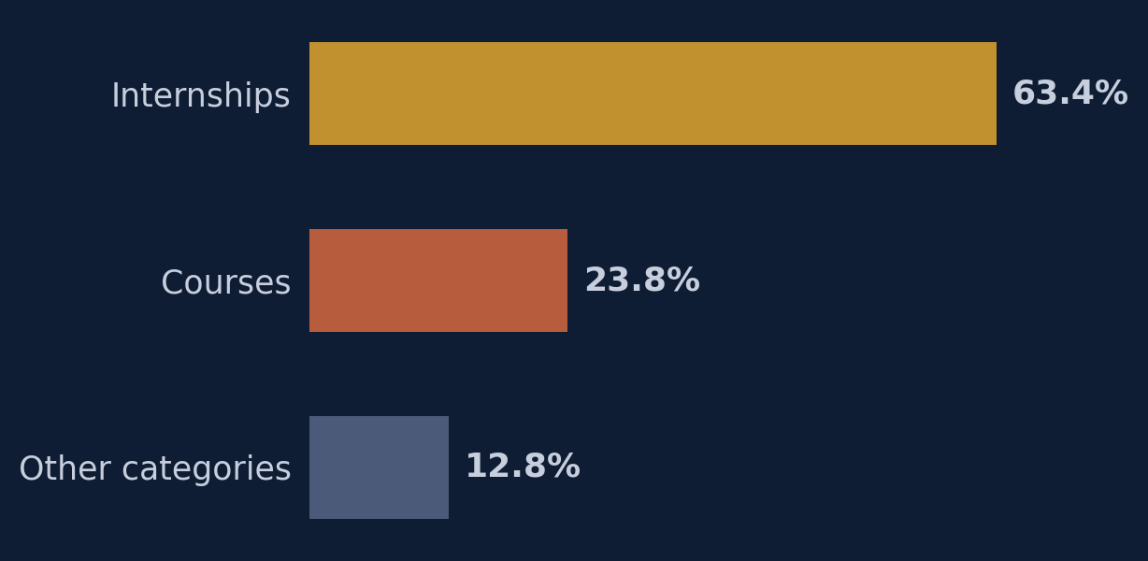
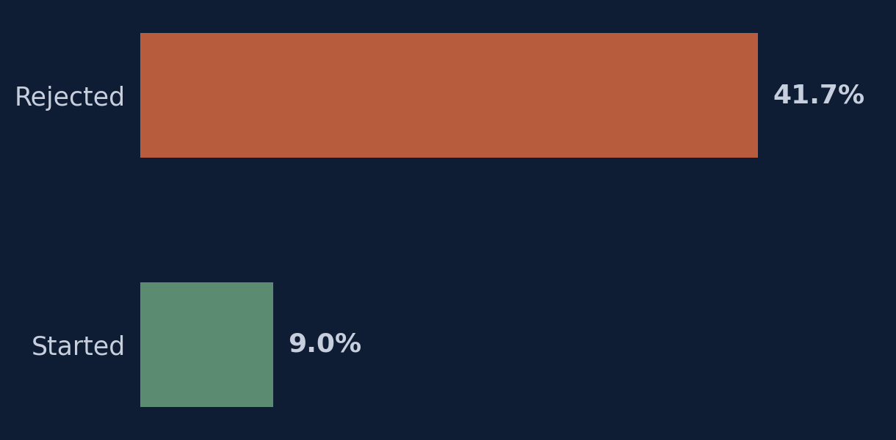
FINDINGS RECAP · 01B
Demand & Rejection at a Glance
Demand Concentration
Application Outcomes
63.4% of total applicants apply for Internships (5,421 records), followed by Courses (23.8%).
3,569 applicants (41.7%) were rejected, versus only 9.0% who started (767 learners).
EXCELERATE · RIT 1307 AI DATA TEAM 1
03 / 14

Slide 4
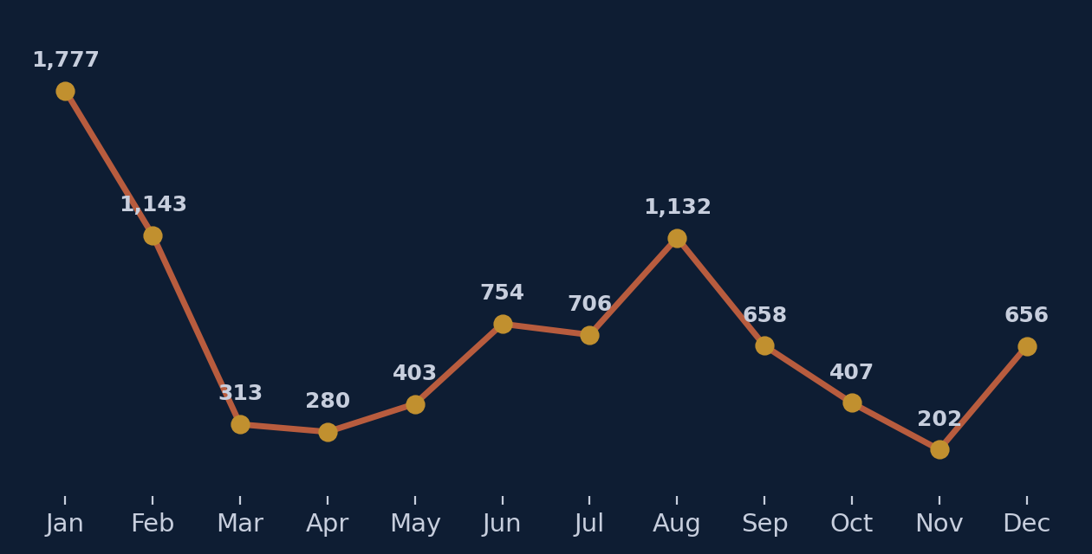
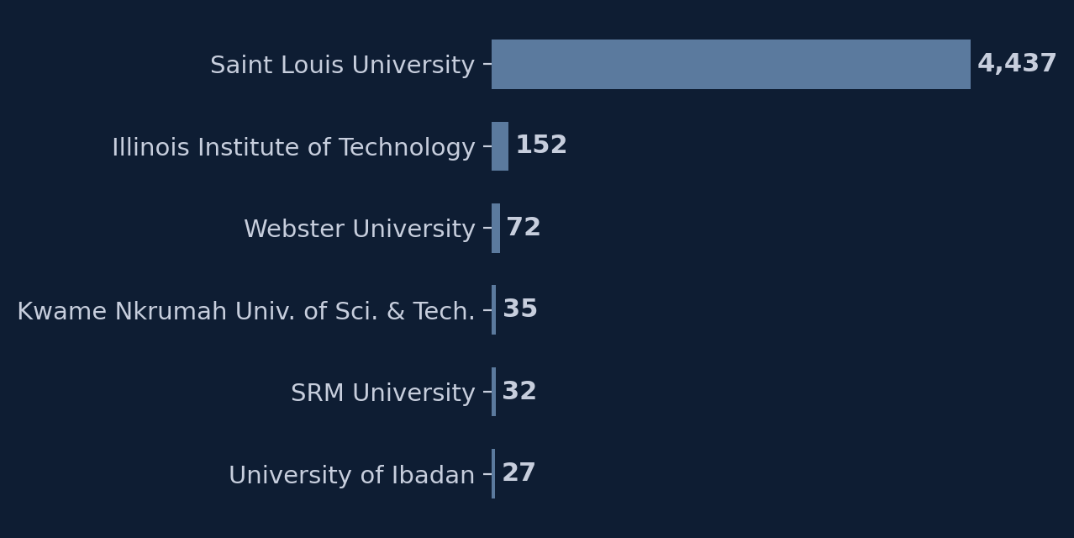
FINDINGS RECAP · 01C
Registration Timing & Institutional Reach
Registration Peaks
Institutional Representation
Sign-ups cluster around academic term breaks — January (1,777) and August (1,132) are the clearest peaks.
Saint Louis University dominates with 4,437 learners — the next-highest institution has just 152.
EXCELERATE · RIT 1307 AI DATA TEAM 1
04 / 14

Slide 5
FINDINGS RECAP · 02
The Internship Retention Crisis
99%
ROOT CAUSES & PROGRAM CONCENTRATION
Digital Marketing
75%
Innovation & Entrepreneurship
73%
of total dropouts isolated in just 4 programs
Data Visualization
71%
Cohort analysis: 608 of 617 total program dropouts occur almost exclusively within four formal internship tracks.
Project Management
67%
Demographic factors (age/gender) are weak predictors of dropout. The primary drivers are structural onboarding friction, rigid expectations, and lack of scaffolded milestones.
EXCELERATE · RIT 1307 AI DATA TEAM 1
05 / 14

Slide 6
FINDINGS RECAP · 03
Model Predictions & Drivers
High Tier (Workshops / Events)
95% Avg Acceptance
Middle Tier (Certifications)
68% Avg Acceptance
Low Tier (Formal Internships)
16% - 37% Acceptance
MODEL PERFORMANCE
TOP PREDICTIVE FEATURES
Logistic Regression achieved 80.7% test accuracy. Random Forest (78.3%) captured complex feature interactions and drove feature importance rankings.
Age is the strongest single predictor, followed by Country (US > India) and Category_Internship (strongest negative factor).
EXCELERATE · RIT 1307 AI DATA TEAM 1
06 / 14

Slide 7
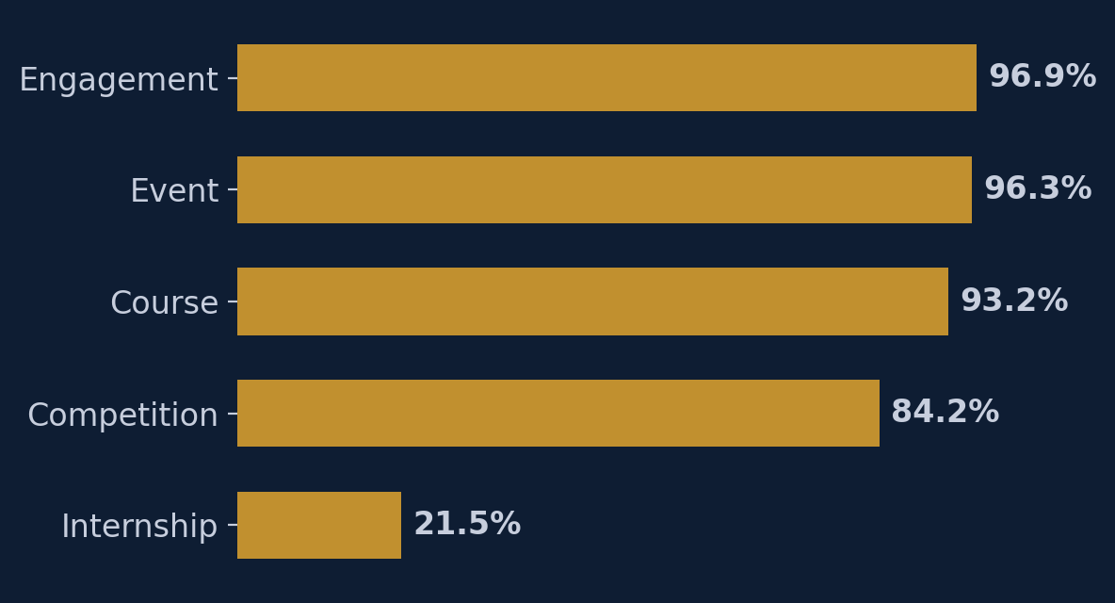
FINDINGS RECAP · 03C
Prioritize High-Conversion Categories
Positive outcome rate by opportunity category
Engagement, Event, and Course opportunities convert 4–5x more often than formal Internships.
EXCELERATE · RIT 1307 AI DATA TEAM 1
07 / 14

Slide 8
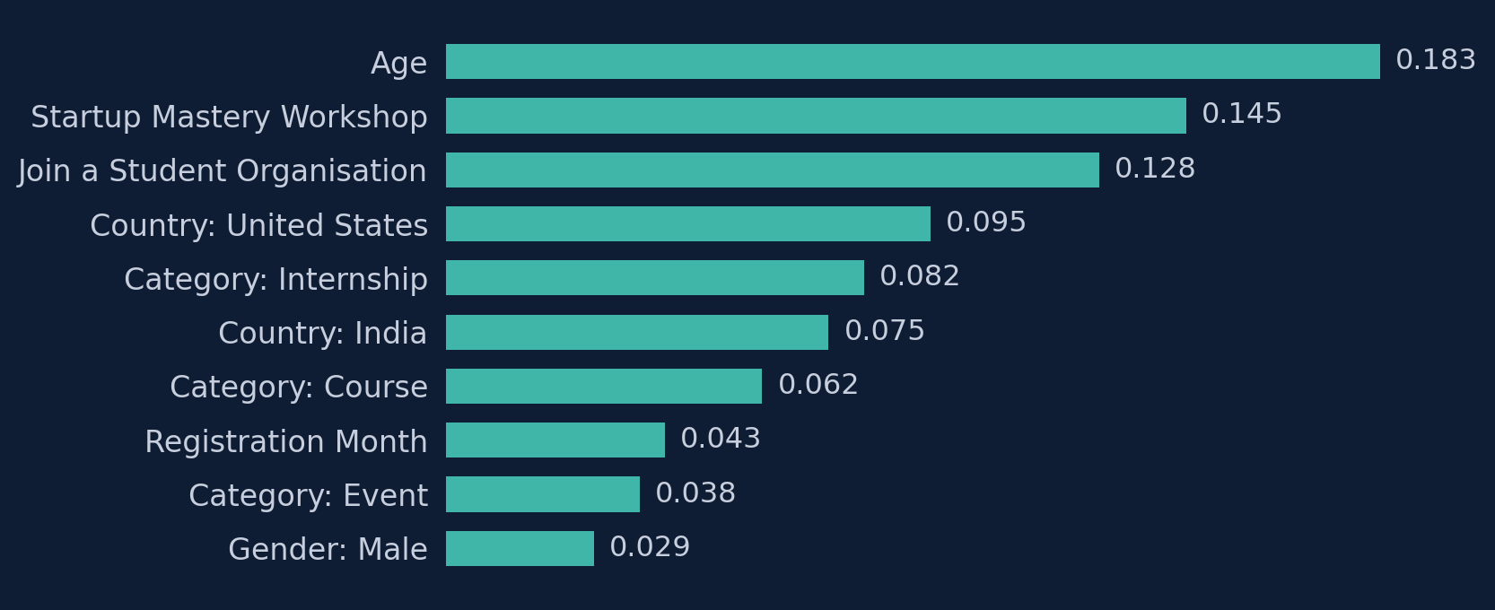
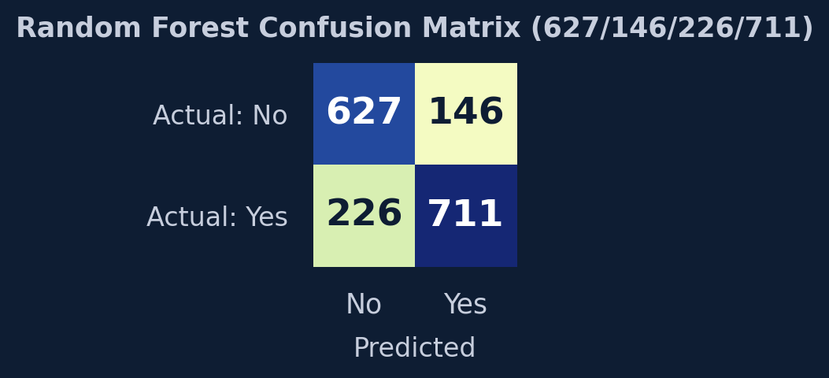
FINDINGS RECAP · 03B
How the Models Work
Logistic Regression — 80.70% accuracy
Assigns each feature a weighted coefficient showing whether it raises or lowers acceptance odds, then combines them into a probability. Our most accurate model, with clean, signed results.
Random Forest — 78.25% accuracy
Random Forest feature importance — Age ranks highest
200 decision trees vote on each outcome. Slightly less accurate, but captures non-linear patterns Logistic Regression misses. Chosen as our core model since its feature importance rankings explain why predictions land the way they do.
BOTH MODELS AGREE
Age ranks as the top predictor in both models — worth investigating further rather than assumed as causal.
Random Forest confusion matrix, 78.25% accuracy — more false negatives than false positives
EXCELERATE · RIT 1307 AI DATA TEAM 1
08 / 14

Slide 9
RECOMMENDATION ONE
Re-engineer Low-Group Funnels
Action Plan for Low Acceptance Roles. Tied to prediction: Formal Internships exhibit lowest predicted acceptance (16%–37%) and highest dropout (99%).
1
Scaffolded Modules
Restructure high-dropout internships into 2-week modular phases with early victory milestones.
2
Prerequisite Self-Assessments
Deploy guided warm-up sessions before allocation to align skill expectations.
3
Pre-Emptive Staffing
Scale mentor capacity 30 days prior to the January & August registration surges.
Measure: 25%–30% reduction in dropouts for these 4 programs; completion-to-application ratio.
EXCELERATE · RIT 1307 AI DATA TEAM 1
09 / 14

Slide 10
RECOMMENDATION TWO
Algorithmic Fairness & Governance
1
2
3
Decouple Demographics
Fairness Board
Dual-Model Safety
Remove raw age and country attributes from rejection logic, evaluating candidates strictly on competency rubrics.
Establish an algorithmic fairness review board prior to deploying automated screening filters into production pipelines.
Use Logistic Regression as a safety check to flag qualified applicants rejected by Random Forest's high false-negative rate.
How we'll measure it: Demographic parity ratio across age cohorts and regions; false-negative equity for under-represented groups.
EXCELERATE · RIT 1307 AI DATA TEAM 1
10 / 14

Slide 11
RECOMMENDATION THREE
Scale High-Engagement Formats
Expansion & Operational Cleanliness. Tied to prediction: Short workshops/events achieve 95%–98% predicted acceptance and minimal friction.
1
Expand High-Viability Formats
Increase marketing and capacity for workshops like Startup Mastery and Design Hackathons.
2
Peer Collaboration Networks
Integrate student-led peer structures to sustain engagement as cohort sizes expand.
3
Controlled Intake Dropdowns
Replace open-text institution fields on portal forms to eliminate spelling variants and data corruption.
Measure: Volume of successful completions per quarter; resource efficiency ratio vs. formal internships.
EXCELERATE · RIT 1307 AI DATA TEAM 1
11 / 14

Slide 12
IMPACT MEASUREMENT
Program Operations
Key Metric | Target Benchmark | Measurement Method | Strategic Focus
Mid-program dropout rate (4 core tracks) | 25% - 30% Reduction | Track quarterly completion ratios | Onboarding Scoping
Onboarding Latency & Response Time | Zero degradation in Jan/Aug | Audit time-to-first-mentor contact | Peak Intake Capacity
Certified completions per quarter | +40% YoY Growth | Certification issue log count | Short Format Scaling
Schema-compliant intake records | 100% Data Cleanliness | Automated database validation script | Portal Redesign
EXCELERATE · RIT 1307 AI DATA TEAM 1
12 / 14

Slide 13
IMPACT MEASUREMENT
Governance & AI Safety
Governance Domain | Key Metric | Target Benchmark | Measurement Method
Algorithmic Parity | Demographic Parity Ratio | Equitable across age cohorts | Disparate impact audit on screening outputs
Dual-Model Safety | Manual Review Recovery Rate | Salvage 15%-20% candidates | Track candidates rescued via LogReg baseline
Upstream Integrity | Clean Application Intake Rate | 100% Valid Timestamps | Front-end error logging & schema checks
Regional Watchlist | Multi-Cohort Retention Tracking | Statistically valid samples | Longitudinal tracking (Pakistan & Ethiopia)
EXCELERATE · RIT 1307 AI DATA TEAM 1
13 / 14

Slide 14
NEXT STEPS
Next Steps for Program Managers
1
2
3
4
Days 1–30
Days 31–60
Days 61–90
Ongoing
Implement mandatory drop-downs on portal; enforce required start dates.
Deploy automated email/SMS nudge sequences for early drop-off risk groups.
Scale mentor allocation and intake capacity ahead of peak intake months (Jan/Aug).
Review monthly operational dashboards and retention metrics with leadership.
EXCELERATE · RIT 1307 AI DATA TEAM 1
14 / 14

Slide 15
Appendix
Presentation Link
https://docs.google.com/presentation/d/1H-0UzrInAAeXJ3JMiXcS4UlT9-y12jZk/edit?usp=drivesdk&ouid=104059332352391893240&rtpof=true&sd=true
Thank You

