Slide 1
Git / GitHub - Overview

Slide 2
What is Git?
Git is a Distributed Version Control Tool.
What is version control and why should I use it?
Version control systems are a category of software tools that help a software team manage changes to source code over time.
Version control software keeps track of every modification to the code in a special kind of database.
If a mistake is made, developers can turn back the clock and compare earlier versions of the code to help fix the mistake while minimizing disruption to all team members.
The complete history of commits for a particular project and their metadata make up a repository.
Repositories can be kept in sync across different computers, facilitating collaboration among different people.

Slide 3
Benefits of Version Control Tool
A complete long-term change history of every file - This means every change made by many individuals over the years. Changes include the creation and deletion of files as well as edits to their contents.
Branching and merging - Allows team members to work concurrently.
Traceability - Being able to trace each change made to the software and connect it to project management and bug tracking software such as Jira

Slide 4
Branching and Merging

Slide 5
Distributed Version Control Tool
These systems do not necessarily rely on a Central Server to store all the versions of a project file.
In Distributed VCS, every contributor has a local copy or “clone” of the main repository i.e. everyone maintains a local repository of their own which contains all the files and metadata present in the main repository.

Slide 6
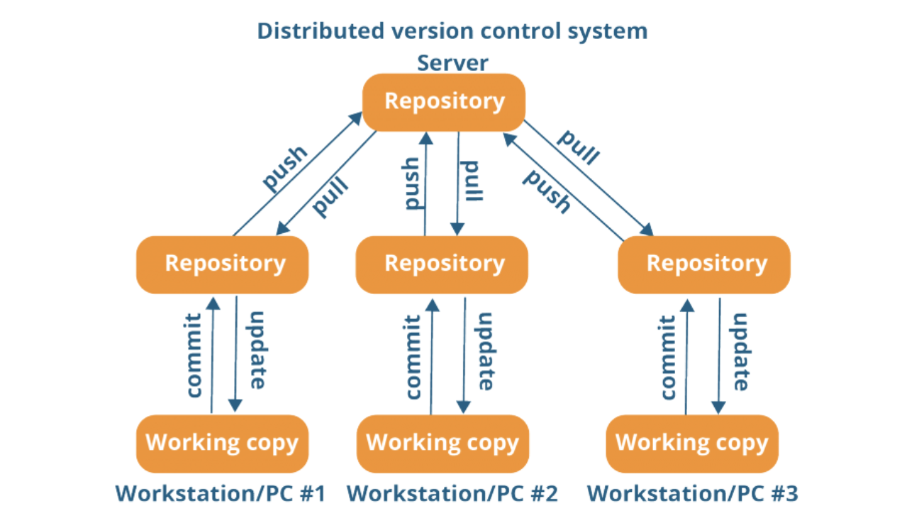
Distributed Version Control Tool

Slide 7
Git vs GitHub

Slide 8
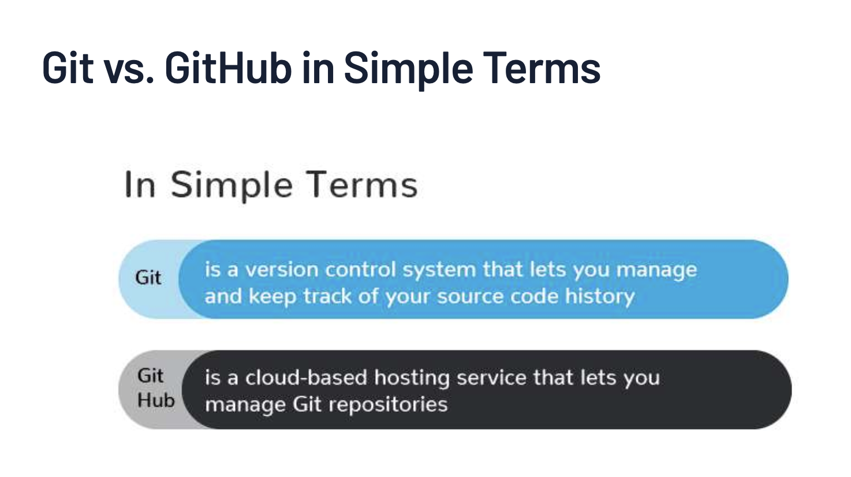
Git vs GitHub

Slide 9
Setup
Signup - https://github.com/
Login to GitHub
Install Git Client on Local - https://carpentries.github.io/workshop-template/#git
Git Config
$ git config --global user.name "Vlad Dracula"
$ git config --global user.email “vlad@tran.sylvan.ia”
$ git config --global color.ui "auto"
$ git config --global —list
$ git config -h
$ git config --help

Slide 10
Creating a Repository
Create a repository locally
$ mkdir gitdemo1
$ cd gitdemo1
$ git init
$ ls -al
$ git status

Slide 11
Create a file and commit
Create file; commit changes; check git history
$ touch myfile.txt
$ echo “First Line” >> myfile.txt
$ git status
$ git add myfile.txt
$ git status
$ git commit -m “Initial Commit”
$ git log

Slide 12
Update file and Track changes
Update file; track changes and commit
$ echo “Second Line” >> myfile.txt
$ git status
$ git diff
$
$ git add myfile.txt
$ git status
$ git commit -m “Second Commit”
$ git log

Slide 13
Git - checkout and revert
git checkout - over-write working directory changes with commit history
$ echo “Third Line” >> myfile.txt
$ git status
$ git diff
$
$ git checkout [HEAD / COMMIT ID] myfile.txt
$ git status
$ git diff
git revert - Revert already committed changes in public repository; creates a new commit for the reverted changes
$ git revert HEAD
$ git log
$

Slide 14
Git - Track commit history
git show - It shows the log message and textual diff for Commits
$ git show [HEAD]
$ git show HEAD~1
git log - Shows the commit logs
$ git log
$ git log —patch

Slide 15
Git - Ignore Files
We do this by creating a file in the root directory of our project called “.gitignore”
$ touch a.dummy b.dummy
$ git status
$
$ touch .gitignore
$ vi .gitignore
$ git status
$ git add .gitignore
$ git commit -m “Added git ignore file”

Slide 16
GitHub Remote Repository
Login to GitHub
Create empty remote repository
Link local repository to remote repository
$ git remote add origin https://github.com/gitusername/gitdemo1.git
$ git push -u origin master
$
$ git remote -v
$ git pull

Slide 17
GitHub - Settings
Manage Access
Branching

