Slide 1
PYTHON
CRASH COURSE

Slide 2
AGENDA
WHY IS CODING REQUIRED?
WHAT IS HIGH LEVEL LANGUAGE?
PROGRAMMING LANGUAGE HIGHLIGHTS
PYTHON CRASH COURSE

Slide 3
WHY IS CODING REQUIRED?
Computers don’t understand human language and in order for us to see some results (like display a web page), we have to write it in a way that the computer would understand.
Think of your code as a translator between English (or whatever language you speak) and Binary. If you can do this, it will suddenly become much easier to grasp the basics of what is coding.

Slide 4
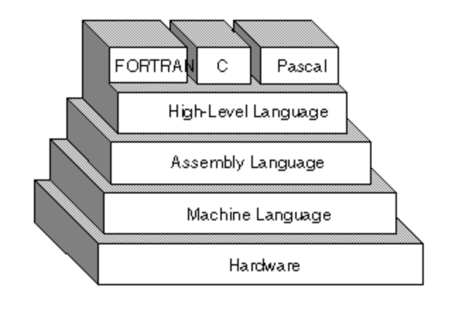
WHY IS CODING REQUIRED?
COMPUTER
ENGLISH
(PSEUDO CODE)
PYTHON
CODE
(HIGH LEVEL LANGUAGE)
CPU
(MACHINE / BINARY LANGUAGE)
010100100…
10101001000….
MEMORY
(TEMPORARY STORAGE)
CONVERT
COMPILER / INTERPRETER

Slide 5
WHAT IS HIGH LEVEL LANGUAGE?
A high-level language (HLL) is a programming language such as C, Java, Python that enables a programmer to write programs that are independent of a particular type of computer. Such languages are considered high-level because they are closer to human languages and further from machine languages.

Slide 6
PROGRAMMING LANGUAGE
Basic parts of any Programming Language are -
Data Types
Operators
Statements
Functions
Class, Objects and Methods

Slide 7
PYTHON - DATA TYPES
Data Types to store data
Data Types
Primitive Data Types
None - None
Integer Numbers - int
Floating Point Numbers - float
Strings - str
Booleans - bool
(Type Conversion)
(Variable Assignment)
(Printing)
Collection Data Types
Lists - list
Sets - set
Tuples - tuple
Tuple Unpacking
Dictionaries - dict

Slide 8
PYTHON - OPERATORS
Operators are used to perform operations on the data
Operators
Arithmetic operators
Assignment operators
Comparison operators
Logical operators
Membership Operator

Slide 9
PYTHON - STATEMENTS
Statements to perform an action to process the data
Statements
Sequential Statements
Printing
Conditional Statements
if, elif, else
Loop Commands
for Loops
(list comprehension)
while Loops

Slide 10
PYTHON - FUNCTIONS
A function in a programming language is a program fragment that 'knows' how to perform a defined task. For example a function may be written that finds the average of three supplied numbers. Once written, this function may be used many times without having to rewrite it over and over.
Functions
functions
e.g. range()
lambda expressions
e.g. map() and filter()

Slide 11
Classes, Objects, Methods
In Object-Oriented language, Classes provide a means of bundling data (to maintain the state) and functionality (methods) together.
A Class is like an object constructor, or a “template / blueprint” for creating objects.
Instances of the Class are called Objects.
Python is an Object-Oriented programming language.

Slide 12
PYTHON OVERVIEW

