Slide 1
Data science week 2
Winter 2020 Data Science Cohort

Slide 2

Attendance Code
Attendance code time!

Slide 3
Quick notes!
Way to use slack for help! Keep it up!
Remember: don’t be shy about questions!
Especially call me out on programmer jargon!

Slide 4
Welcome to Python!
Today’s Agenda:
Why Python
Install Anaconda
Review Homework
Odds and Evens
Functions
Other questions?
Github
In-Class Assignment

Slide 5
Welcome to Python!
What is Python?
General-purpose programming language
Designed to be “readable”, fast to develop, quick to debug
Lots of open-source packages and modules

Slide 6
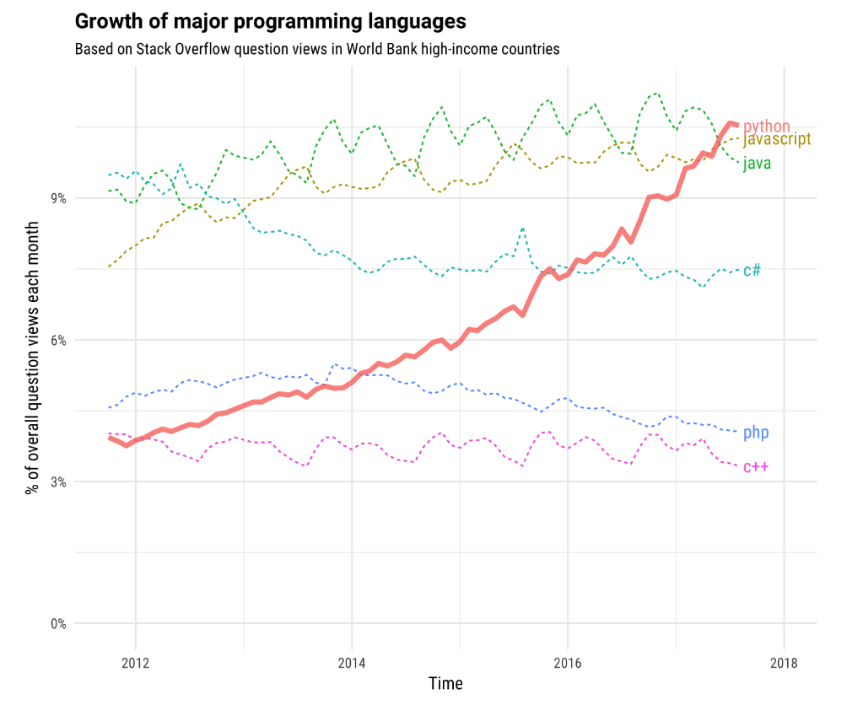
Why are we teaching you python?
Python is the fastest growing language on Stackoverflow
Source: https://stackoverflow.blog/2017/09/06/incredible-growth-python/
Notes:
2017 Stackoverflow data

Slide 7
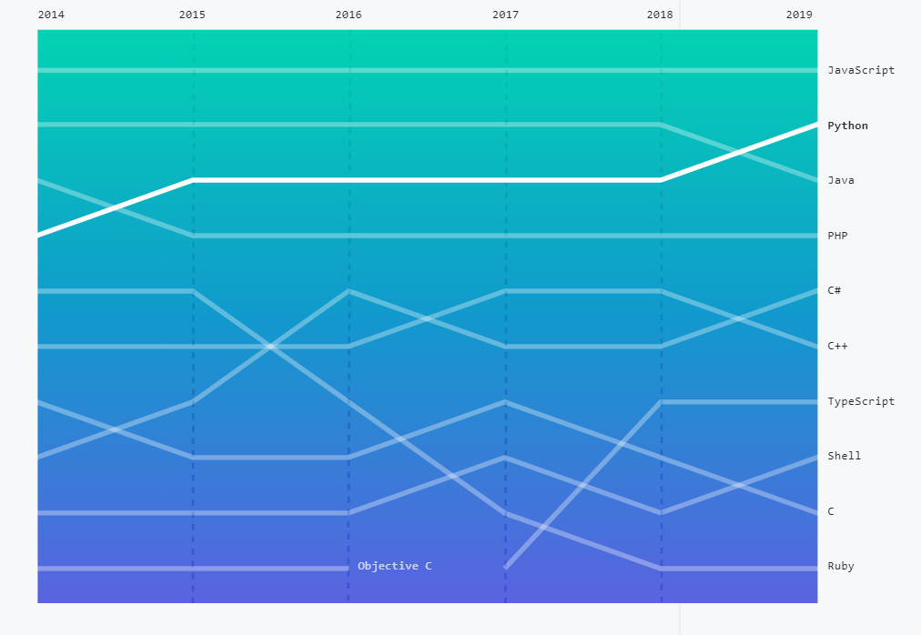
Why are we teaching you python?
Python is the 2nd most popular language in Github Repositories
Source: https://octoverse.github.com/
Notes:
Top 10 primary languages over time, ranked by number of unique contributors to public and private repositories tagged with the appropriate primary language. 2019 github data

Slide 8
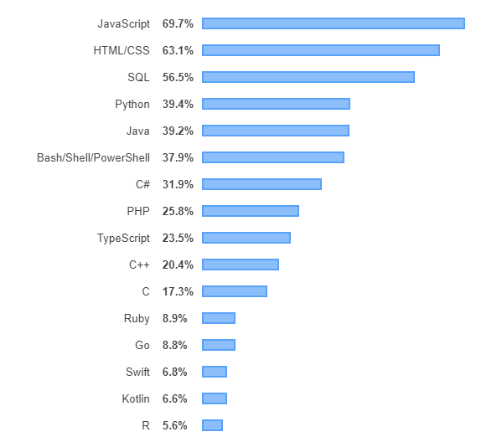
Why are we teaching you python?
Professional developers use Python
Source: https://insights.stackoverflow.com/survey/2019#technology
Notes:
2019 Stackoverflow survey data – this is ~70,000 professional developers stating what languages they use

Slide 9
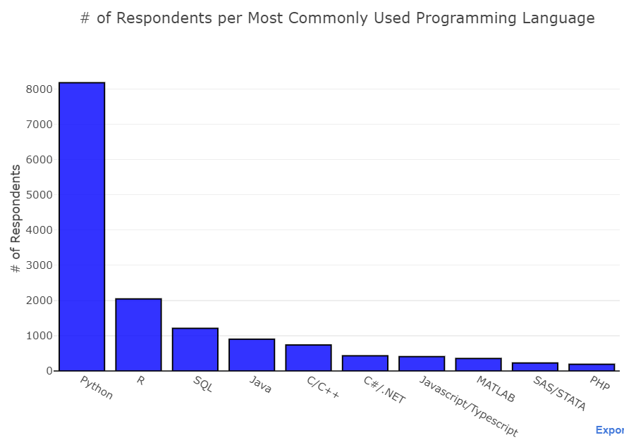
Why are we teaching you python?
Python is the most popular Data Science language
Source: https://www.kaggle.com/paultimothymooney/2018-kaggle-machine-learning-data-science-survey

Slide 10
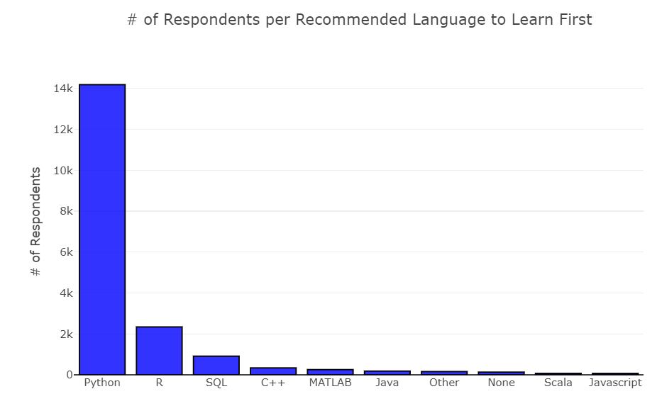
Why are we teaching you python?
Python is the most popular Data Science language
Source: https://www.kaggle.com/paultimothymooney/2018-kaggle-machine-learning-data-science-survey

Slide 11
What can you do with python?
Data science!
Libraries for data handling, visualization, machine learning, statistics, web scraping, etc., etc.
Can work for big tech companies
Instagram, Google, Facebook, Spotify, Netflix, etc., etc.
Build all kinds of projects quickly
Data mining, automation, Raspberry PI IOT devices, web applications…

Slide 12
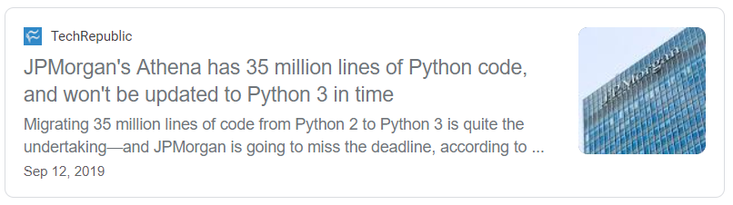
A note on python 2 vs python 3
Python 3:
Introduced in 2008
Python 2 officially no longer supported as of 01/01/2020
You should use Python 3, but you might encounter 2 in the wild
“Print x” vs “Print(x)”

Slide 13
Welcome to Python!
Today’s Agenda:
Why Python
Install Anaconda
Review Homework
Odds and Evens
Functions
Other questions?
Github
In-Class Assignment

Slide 14



So how do I run python? (when I’m not on a homework website?)
https://www.anaconda.com/distribution/

Slide 15
IDE DEMO: spyder and jupyter lab

Slide 16
Welcome to Python!
Today’s Agenda:
Why Python
Install Anaconda
Review Homework
Odds and Evens
Functions
Other questions?
Github
In-Class Assignment

Slide 17
Homework review 1
Hackerrank: If-else
How to program “if a number is odd”?
https://www.hackerrank.com/challenges/py-if-else/problem

Slide 18
Homework review 2
Hackerrank: String manipulations
What the heck is that block of code doing?
https://www.hackerrank.com/challenges/python-string-split-and-join/problem
First, let’s talk about functions

Slide 19
What is a function?
Functions are a set of instructions for what you want the program to do when it gets some input and what output to send back
You’ve already learned lots of functions – you just didn’t have to write them yourself
E.g.: abs(), string.split()
Writing the function code DOES NOT MEAN the function automatically runs. Functions only run when you call them.

Slide 20
Anatomy of a function
Function name (should be descriptive)
Inputs (what you send in)
“Def” means define, tells Python
this is a function, don’t run it yet
def greet(name):
greeting = "Hello " + name + ", it's nice to meet you"
return greeting
All the code saying what is gonna happen to the inputs (indent it)
Return [variable] says what you are going to return when you call this function. If you say a = greet(name), a will be equal to what you return here, which is greeting. You do not have to name this the same as the variable you’re assigning it to in your main code

Slide 21
CODE DEMO: GREETING FUNCTION

Slide 22
Homework review 2
Hackerrank: String manipulations
What the heck is that block of code doing?
https://www.hackerrank.com/challenges/python-string-split-and-join/problem

Slide 23
WHY FUNCTIONS ARE IMPORTANT
Why do we care about functions?
You’ll use functions other people have written a lot – that’s one of the strengths of Python
Any time you find yourself copy/pasting the same code several times – make it a function!

Slide 24
CODE DEMO: saving time with functions

Slide 25
Homework review 3
Other Hackerrank questions before we move on to Github?

Slide 26
What is git/github?
What is Git?
Git is a version control system.
It can tell when you’ve made changes to a file and lets you manage those changes
What is Github?
Github is an interface for tracking and storing and sharing changes
There are other interfaces that run on top of Git (e.g. Bitbucket) but Github is free and most widely used
Why should I care?
Jobs often ask if you know how to use this tool. Will come up in code reviews and collaborating with teams
Can save you the headaches of v1, v2, final_v2…. And trying to revert to a version of your code that used to work
Can share your code with other people (employers?) and can download other people’s projects

Slide 27
CODE DEMO: github!

Slide 28
Step 0
Create a repository
(If you had issues with the Github homework and you aren’t set up, let us know now and we’ll help while everyone is working on this)

Slide 29
Step 1
Write some code

Slide 30
Step 2
Commit it and push it

Slide 31
Step 3
Change your code

Slide 32
Step 4
Commit your changes and push it

Slide 33
Step 5
Fork and clone your neighbor’s repo

Slide 34
Step 6
Change it, commit it, push it!

Slide 35
Welcome to Python!
Today’s Agenda:
Why Python
Install Anaconda
Review Homework
Odds and Evens
Functions
Other questions?
Github
In-Class Assignment

Slide 36
In-class assignment: see github

Slide 37
Notes on homework
Getting deeper into Python
Lambda functions, etc. can be tricky
Sometimes even I get confused
Stay with it, use slack, now would be a good time to use study groups

