Slide 1

AWS Identity
& Access
Management

Slide 2
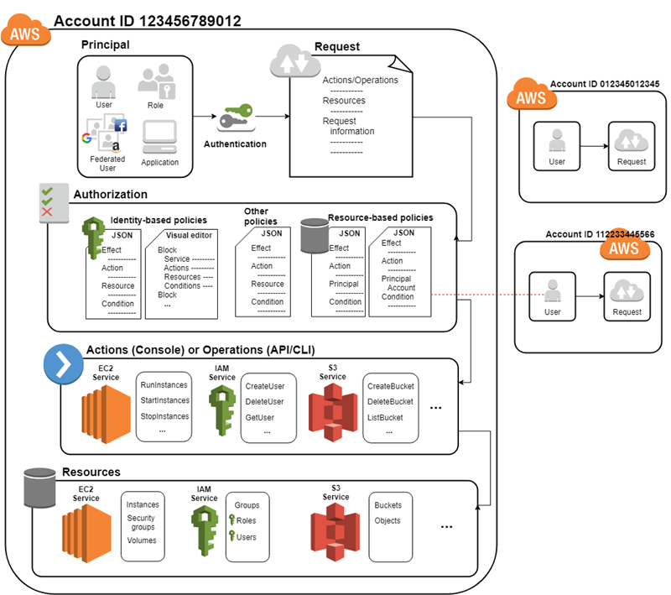
IAM
What is IAM?
AWS Identity and Access Management (IAM) enables to manage access to
AWS services and resources securely. Using IAM, you can create and manage AWS users
Groups and role, and use permissions to allow and deny their access to AWS resources.

Slide 3
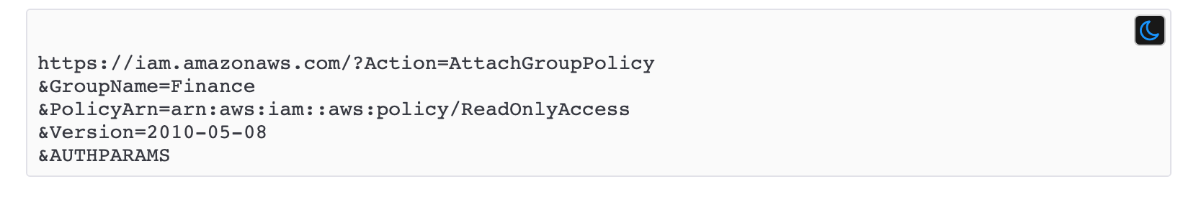
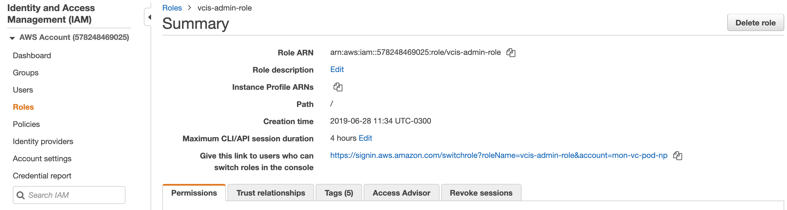
IAM

Slide 4
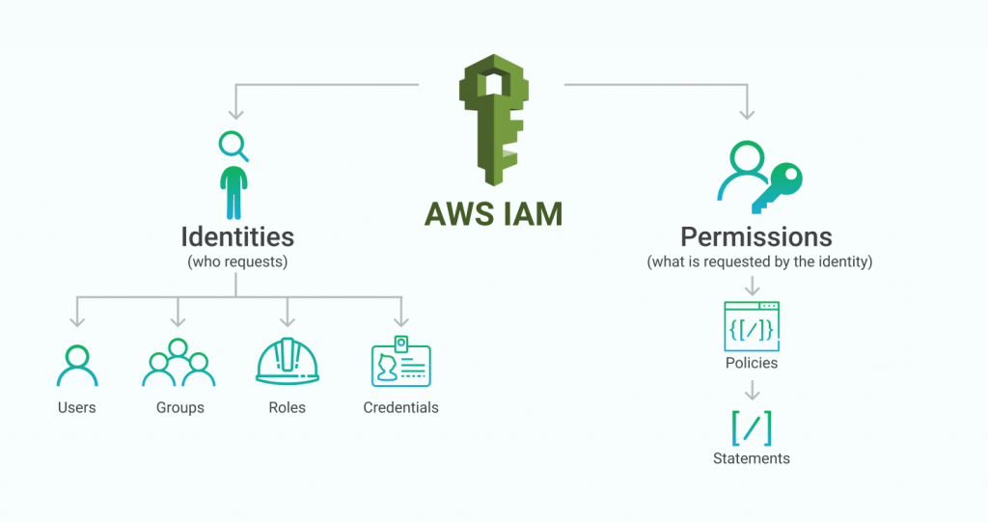
IAM
IAM user management

Slide 5
IAM
IAM user management
User:
An IAM user is an entity that you create in AWS. The IAM user represents the person or service
who uses the IAM user to interact with AWS. When you create an IAM user, you grant it
permissions by making it a member of a group that has appropriate permission policies attached
(recommended), or by directly attaching policies to the user
Group:
An IAM group is a collection of IAM users. You can use groups to specify permissions for a
collection of users, which can make those permissions easier to manage for those users
Role:
An IAM role is very similar to a user, in that it is an identity with permission policies that
determine what the identity can and cannot do in AWS.
However, a role does not have any credentials (password or access keys) associated with it.
Instead of being uniquely associated with one person, a role is intended to be assumable by
anyone who needs it

Slide 6
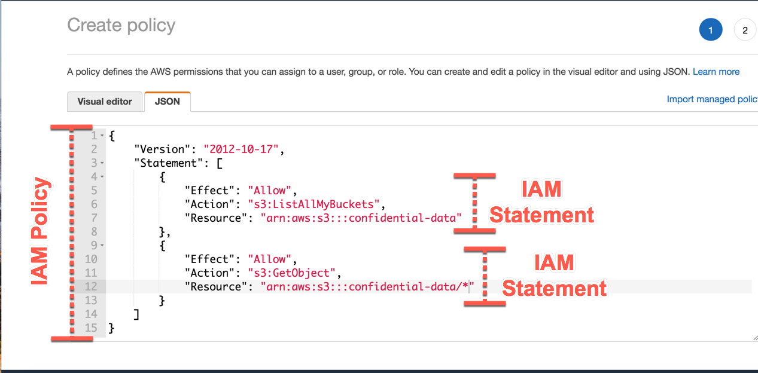
IAM
Policy & Permissions
IAM is an AWS service for managing both authentication and authorization in determining
who can access which resources in your AWS account.
At the core of IAM’s authorization system is an IAM policy

Slide 7
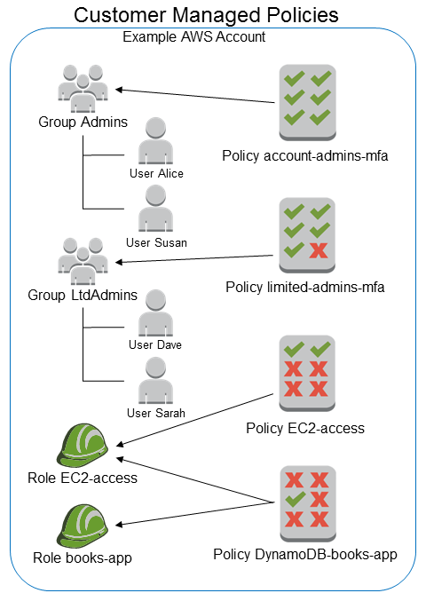
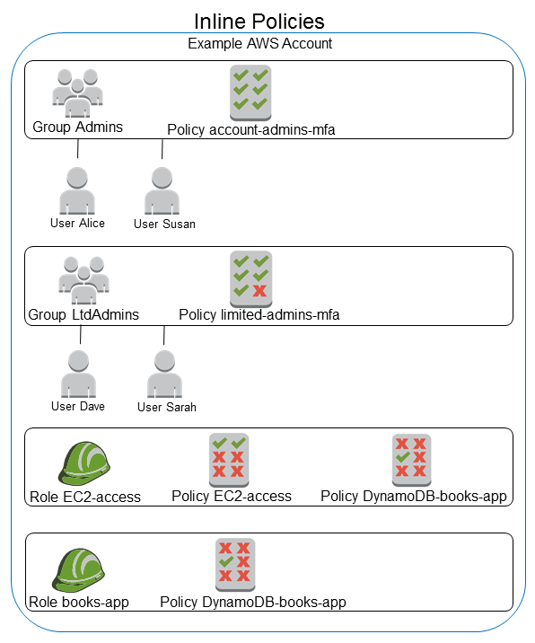
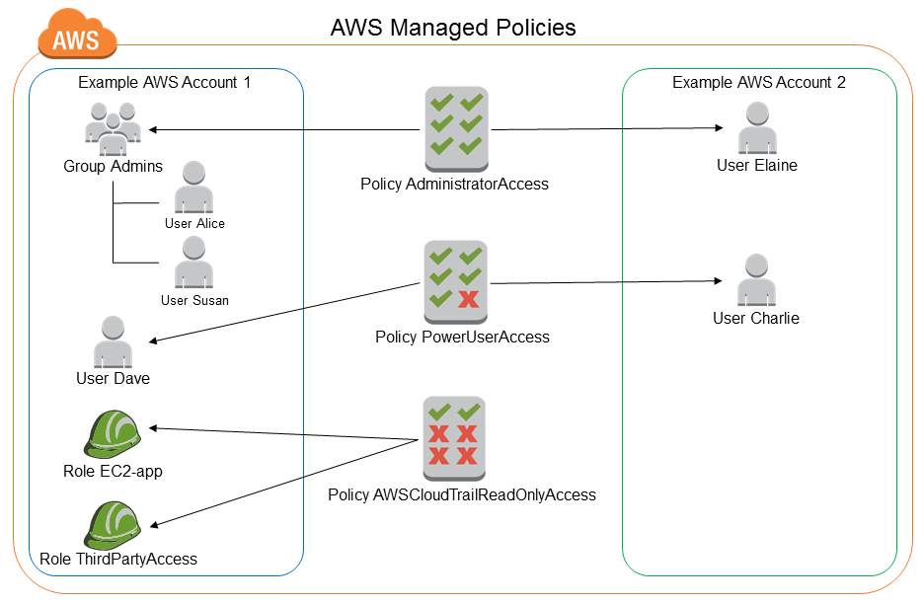
IAM
Manage Policies
When you need to set the permissions for an identity in IAM, you must decide whether to use:
AWS Managed Policies
Customer Managed Policies
Inline Policies

Slide 8
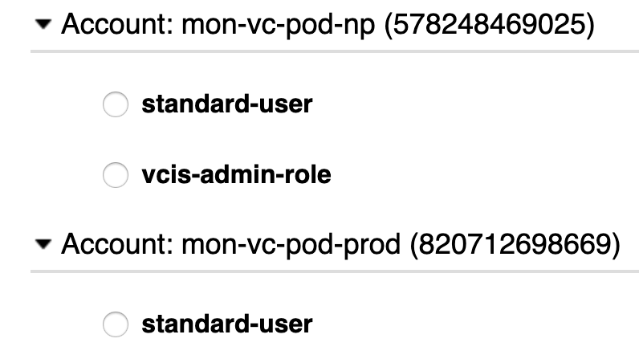
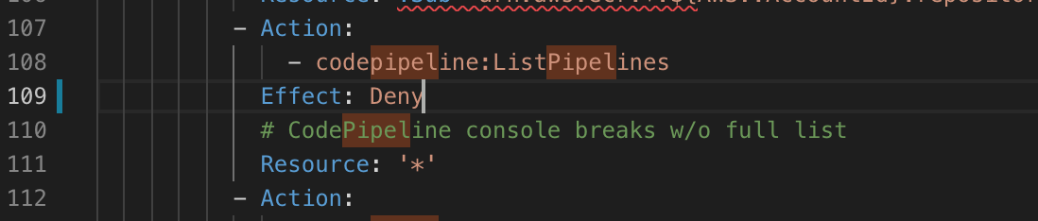
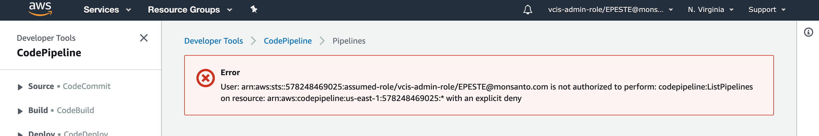
IAM
How we are managing IAM in Mystery Machine
We are creating the admin role in order to allow or deny
permissions to the AWS resources or services
We are using CloudFormation Template in
Order to create the admin role
In this example we are
Deny the access to
Pipeline for all the
resources

