Slide 1
PYTHON
CRASH COURSE

Slide 2
AGENDA
WHY IS CODING REQUIRED?
WHAT IS HIGH LEVEL LANGUAGE?
PROGRAMMING LANGUAGE HIGHLIGHTS
PYTHON CRASH COURSE

Slide 3
WHY IS CODING REQUIRED?
Computers don’t understand human language and in order for us to see some results (like display a web page), we have to write it in a way that the computer would understand.
Think of your code as a translator between English (or whatever language you speak) and Binary. If you can do this, it will suddenly become much easier to grasp the basics of what is coding.

Slide 4
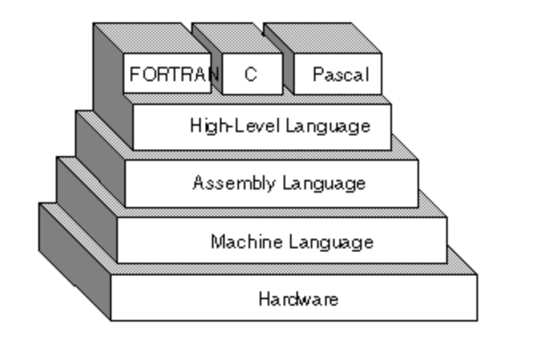
WHY IS CODING REQUIRED?
COMPUTER
ENGLISH
(PROTOTYPE)
PYTHON
CODE
(HIGH LEVEL LANGUAGE)
CPU
(MACHINE / BINARY LANGUAGE)
010100100…
10101001000….
MEMORY
(TEMPORARY STORAGE)
CONVERT
COMPILER / INTERPRETER

Slide 5
WHAT IS HIGH LEVEL LANGUAGE?
A high-level language (HLL) is a programming language such as C, Java, Python that enables a programmer to write programs that are independent of a particular type of computer. Such languages are considered high-level because they are closer to human languages and further from machine languages.

Slide 6
PROGRAMMING LANGUAGE
Basic parts of any Programming Language are -
Data Types to store data
Operators to perform operations on the data
Statements to perform an action to process the data
Class and methods - In object-oriented programming (Python is Object-Oriented Language), a class is an extensible program-code-template / blueprint for creating objects (a.k.a instances of class), providing initial values for state (member variables) and implementations of behavior (member functions or methods)
Functions - A function in a programming language is a program fragment that 'knows' how to perform a defined task. For example a function may be written that finds the average of three supplied numbers. Once written, this function may be used many times without having to rewrite it over and over.

Slide 7
PYTHON OVERVIEW

