Slide 1
HTML5 GAM -Test Approach (Strategy)+ Roles and Responsibilities
Nasir Khan
Test Lead-OS
02-Jul-2014

Slide 2
Test Approach
The test approach in this project will purely follow BDD methodology.
It's highly recommended to use BDD tool to fulfil this testing approach. Main objective is to have a high level of automation to support the proposed deployment process and also support regression testing. All possible functional tests will be automated with a BDD/TDD approach using Cucumber and Selenium Web Driver.

Slide 3
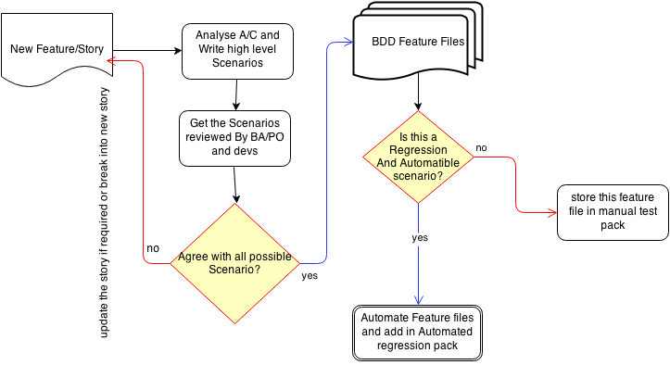
Story life cycle in Testing

Slide 4
Build deployment on OS Environments
The suggested approach is to have automated build deployment through Jenkins server. This means on build deployment on Jenkins, it will first execute unit tests (will be provided by Intelliscan) and on all pass, it will trigger smoke Test( this will be provided by Intelliscan and OS). Once all the tests are passed it will deploy the new code on CI environment. If in case of build failure, Intelliscan may have to look into and fix the unit tests or functionality.

Slide 5
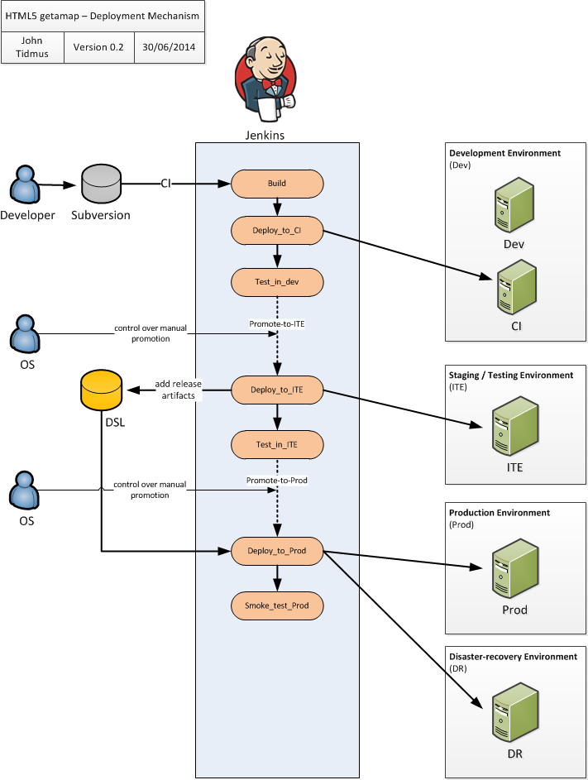

Slide 6
Defect Reporting
Issues identified in testing will be reported through JIRA either as a new bug and relate to the story or by reopening the development story that has failed testing according to the following rules
Story as Blocked
When a story under test fails some aspect of testing then the story will be set to 'Blocked' and a defect raised and assigned to the last developer to work on the story (or task), subject to discussion with the developer. This is the case where the failure is fundamental to the story and needs to be fixed for the story to be accepted as done. This will be the default behaviour. Return story to Dev When the story catastrophically fails in testing then it may be appropriate to return the story itself back to the development team as it is clear that it is likely that the story has fundamentally been incorrectly implemented.

Slide 7
Re-Open a Story
When a defect is detected that relates to another story that was developed in the current sprint (but has already been marked as 'Resolved', i.e. testing passed), then the story should be reopened and assigned back to the last developer. This is the case where the failure is fundamental to the story and needs to be fixed for the story to be accepted as 'done'.
New JIRA Tickets
Any faults detected relating to stories in the current sprint that we decide to not fix in the current sprint should be raised as new JIRA Bugs and assigned to a future sprint (e.g. a minor severity issue detected on the last day of the sprint or in the demo). We don't want to carry over whole stories that have a minor defect associated with them.
Regression Bug
When a defect is detected that relates to a piece of functionality (Story) completed in a previous sprint then a new JIRA Bug should be opened, as this is a regression in previously working software.

Slide 8
Roles and Responsibilities
Responsibility | Sub-actions (if split) | Owner
Test Strategy |  | OS
Test Plan |  | OS & Intelliscan
Unit tests | creation & maintenance | Intelliscan
 | execution | OS
Code Quality tests | configuration | Intelliscan
 | execution | OS
Functional tests | creation & maintenance | Intelliscan
 | execution | OS

Slide 9
Responsibility | Sub-actions (if split) | Owner
Integration tests | creation & maintenance | Intelliscan
 | execution | OS
Story Acceptance tests | creation & maintenance(TDD) | Intelliscan
 | execution(through Jenkins) | OS
User Acceptance tests |  | OS & OSL
Compatibility tests |  | OS
Usability tests |  | OS
Test data | supply | OS & OSL
 | preparation | Intelliscan and OS

Slide 10
Responsibility | Sub-actions (if split) | Owner
Performance tests |  | OS
Data Quality tests |  | Intelliscan
Security tests |  | OS
Test reporting |  | OS
Test environments | setup & maintenance | OS
Continuous Integration |  | OS
Defect tracking | tooling setup & maintenance | OS
 | defect reporting | all

Slide 11
Communication with in team
As core implementation team (Dev and QA) are split at different location, its quite important to communicate effectively at different stages of sprint.
Need to agree a standard interaction.
Sprint early Stage
Dev –Qa may have to review the list of acceptance criteria scenarios supplied by Tester at OS. This would result bug free implementation to a great extent.
Review can always be kept short either on IM or conference call.
During Implementation(possible frequent Interaction)
While devs working on implementation, if anything unclear its always recommended to speak tester/PO on IM and confirm before implementing.

Slide 12
Jira ticket update/comments
Frequent ticket update will let team understand the progress and also reflect the board status to management.
Documentation on wiki
Its quite important for team to keep confluence documentation up to date after every new implementation.

Slide 13
Nasir Khan
[nasir.khan@ordnancesurvey.co.uk

