Slide 1


AtliQ Hardware
HOME
ABOUT
CONTACT ME
CONSUMER-AD-HOC
INSIGHTS
PRESENTED BY : BHAVANI

Slide 2
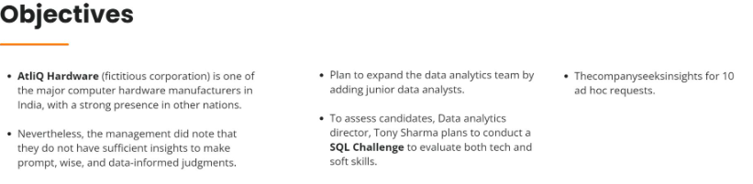
AtliQ Hardware
HOME
ABOUT
CONTACT ME
CONSUMER-AD-HOC
INSIGHTS
PRESENTED BY : BHAVANI

Slide 3
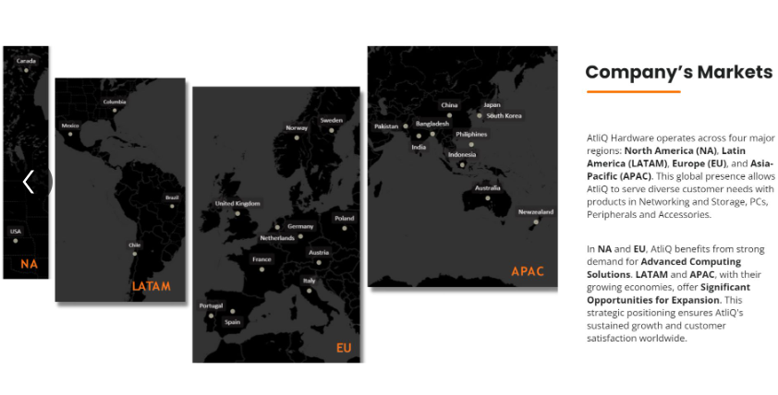
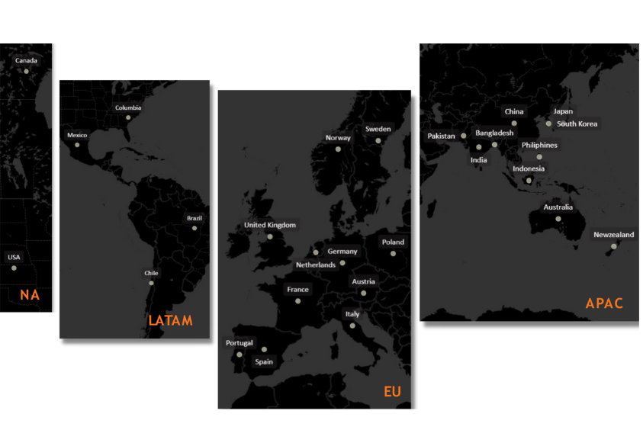
AtliQ Hardware
HOME
ABOUT
CONTACT ME
PRESENTED BY : BHAVANI

Slide 4
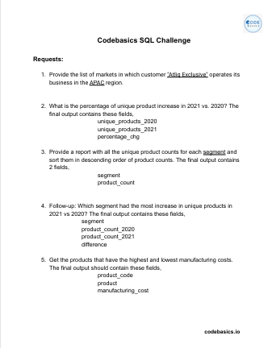
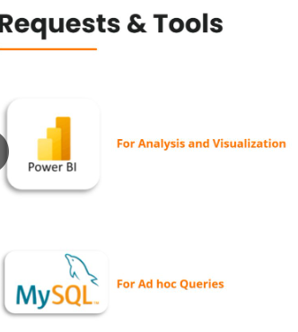
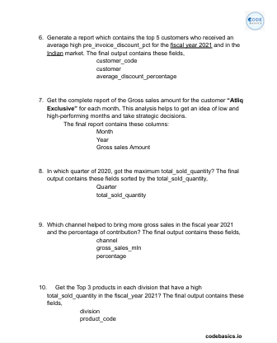


AtliQ Hardware
HOME
ABOUT
CONTACT ME
For Analysis and Visualisations
For Ad Hoc Queries
10 Ad Hoc Requests
PRESENTED BY : BHAVANI

Slide 5
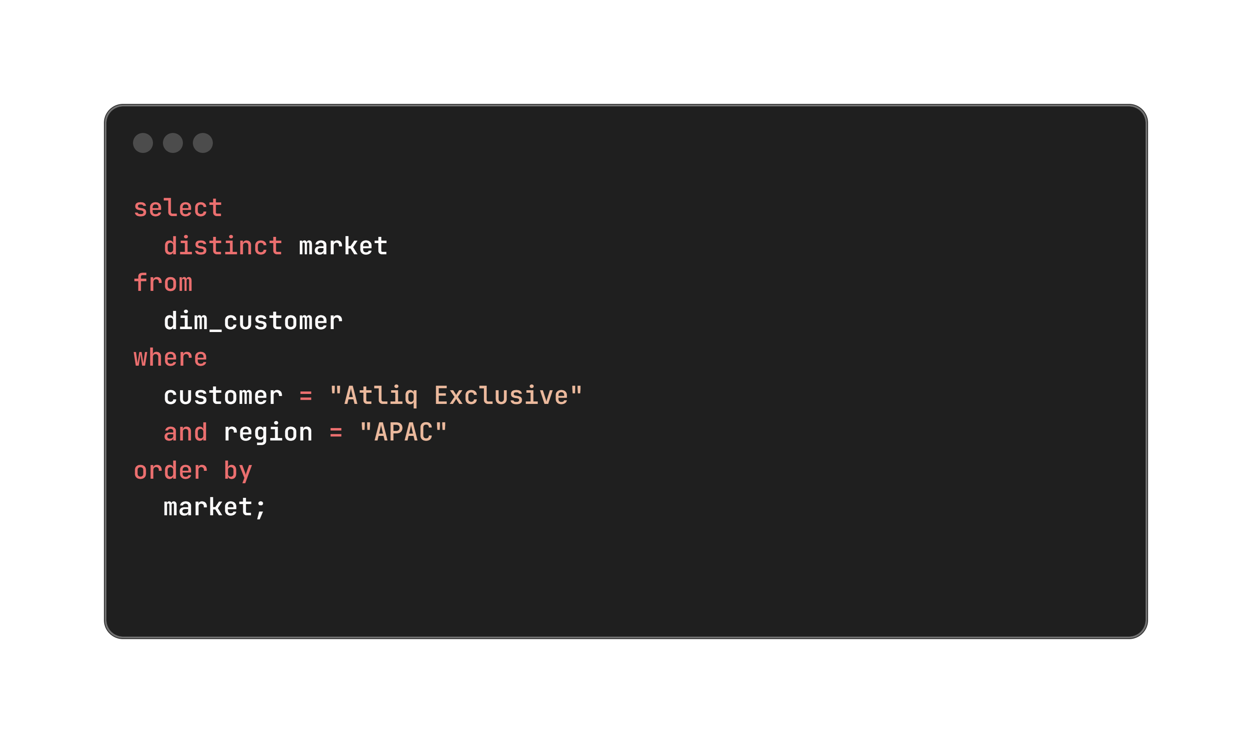
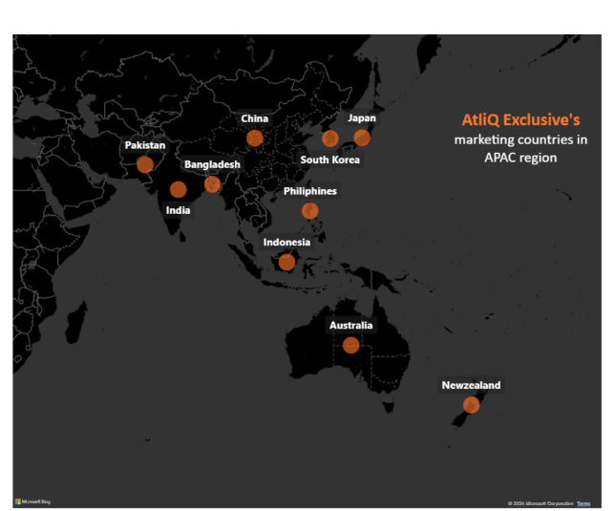
AtliQ Hardware
HOME
ABOUT
CONTACT ME
1Q. Provide the list of markets in which customer "Atliq Exclusive" operates its business in the APAC region.
CONSUMER-AD-HOC
INSIGHTS
PRESENTED BY : BHAVANI

Slide 6
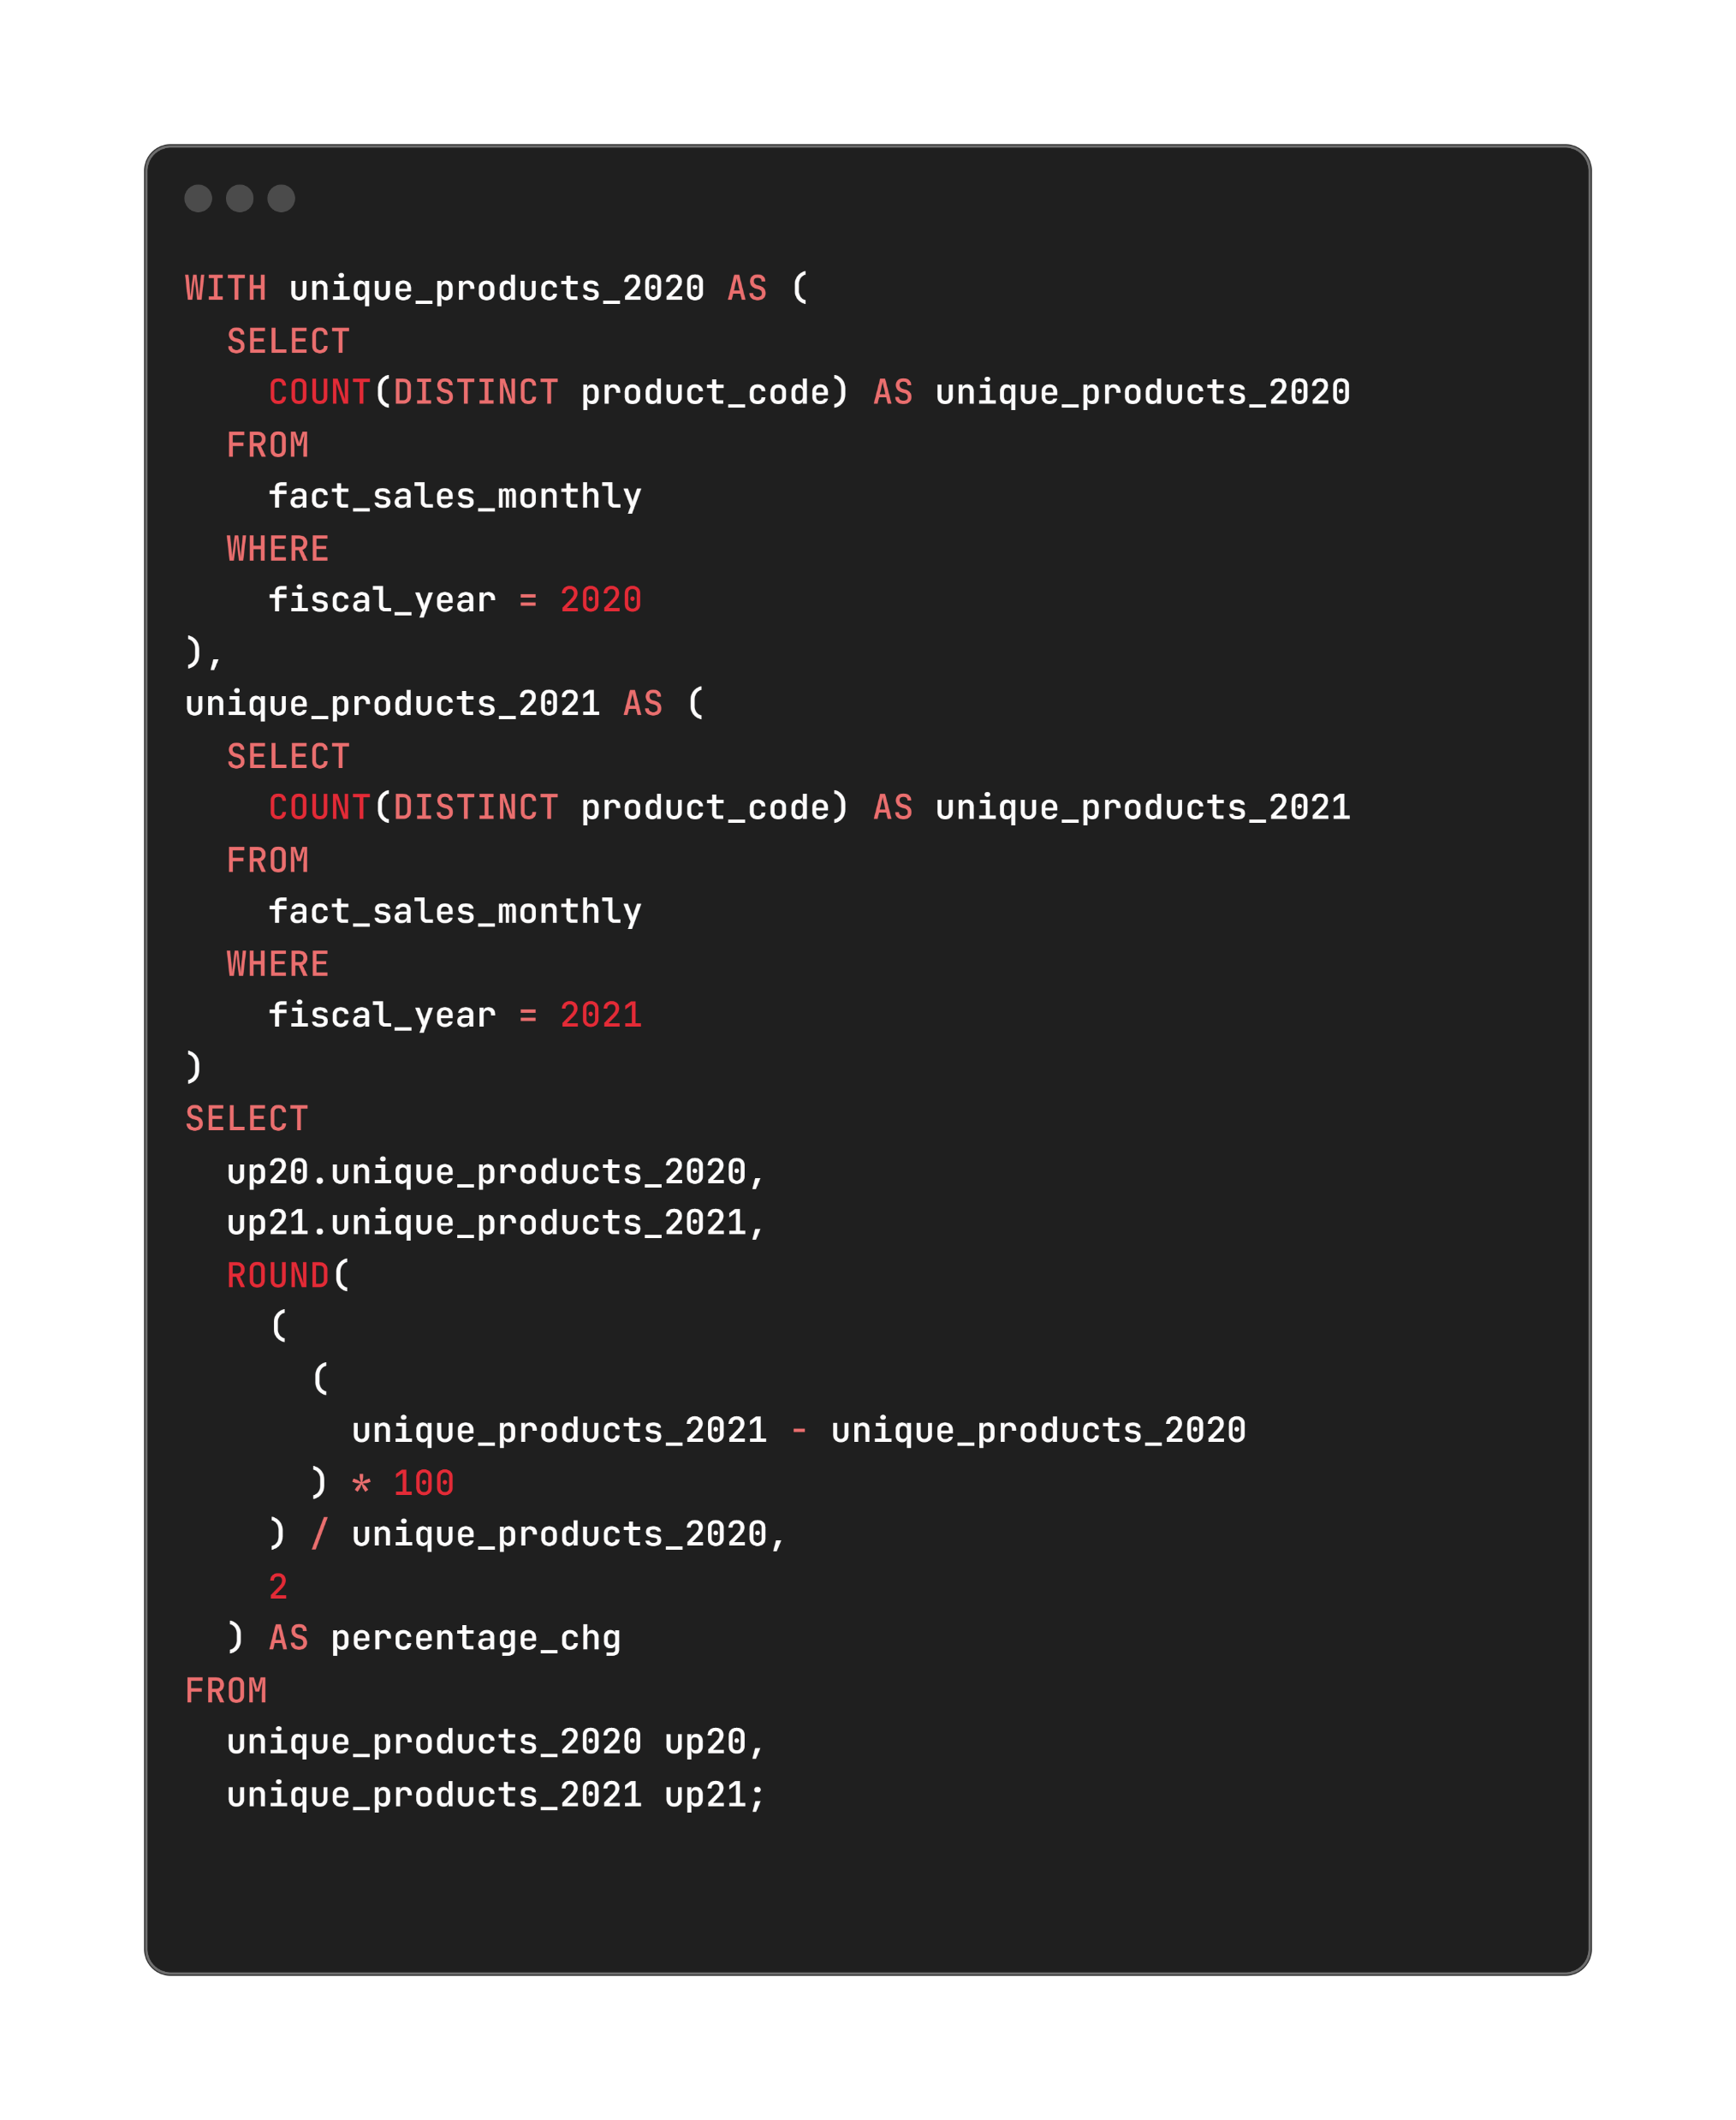
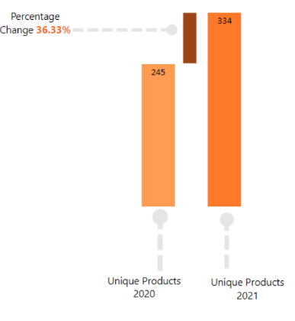
AtliQ Hardware
HOME
ABOUT
CONTACT ME
2Q. What is the percentage of unique product increase in 2021 vs. 2020? The final output contains these fields,unique_products_2020 ,unique_products_2021,percentage_chg.
CONSUMER-AD-HOC
INSIGHTS
PRESENTED BY : BHAVANI

Slide 7
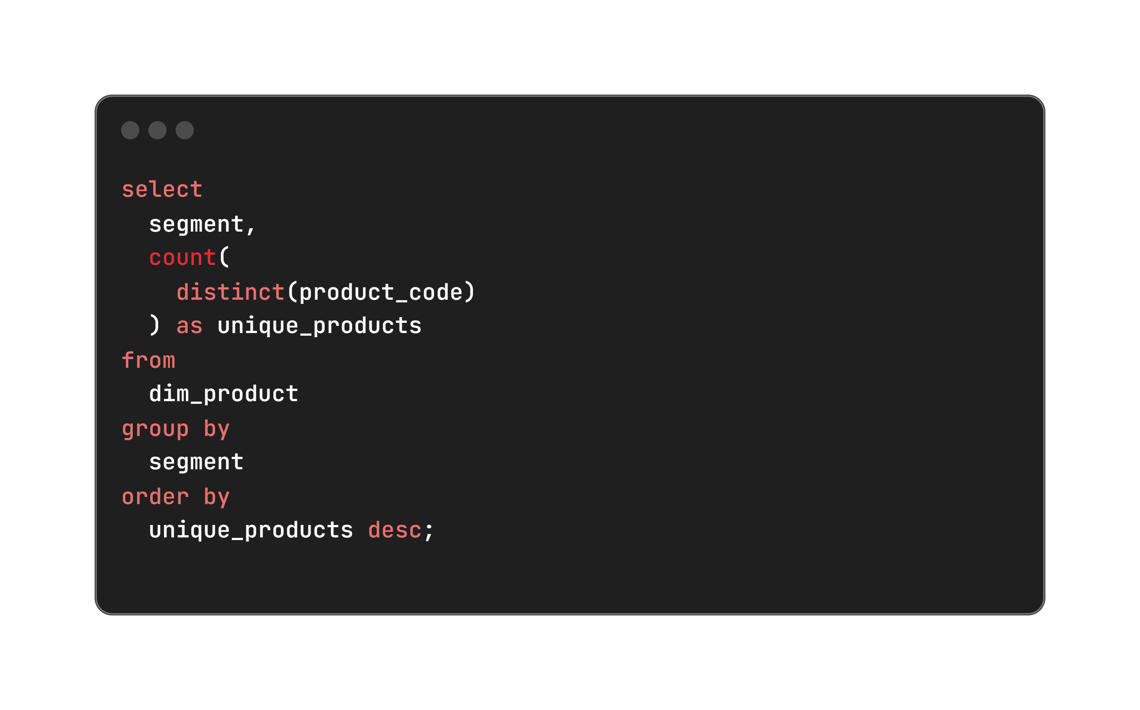
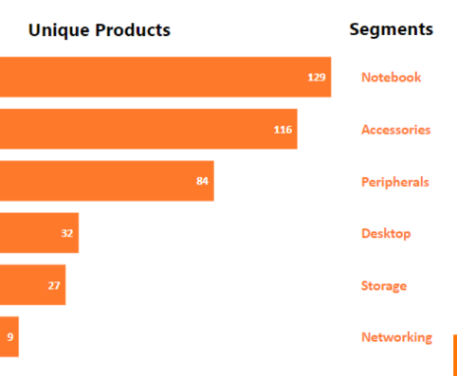
AtliQ Hardware
HOME
ABOUT
CONTACT ME
3Q. Provide a report with all the unique product counts for each segment and sort them in descending order of product counts. The final output contains 2 fields- segment, product_count
CONSUMER-AD-HOC
INSIGHTS
PRESENTED BY : BHAVANI

Slide 8
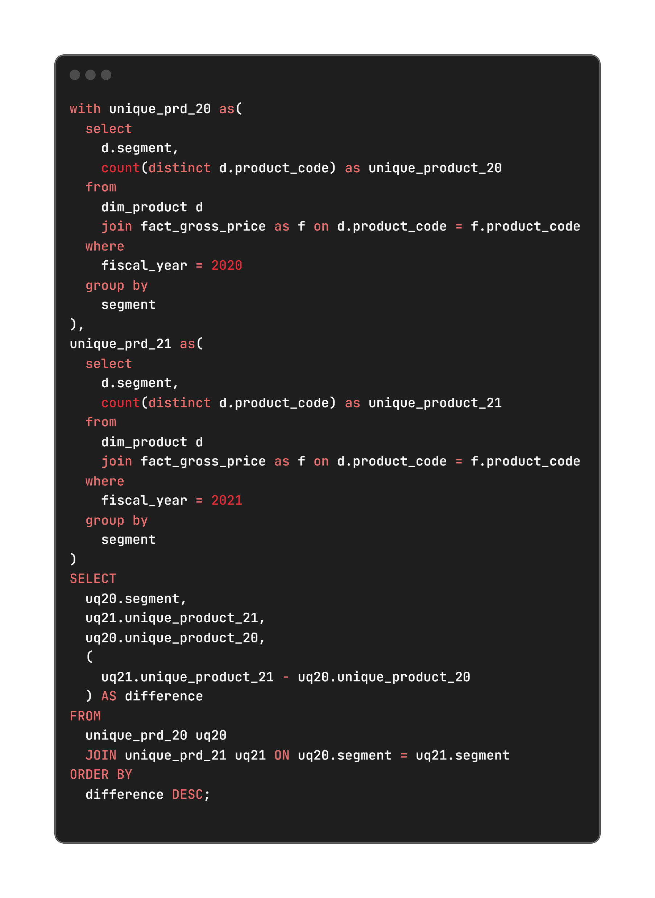
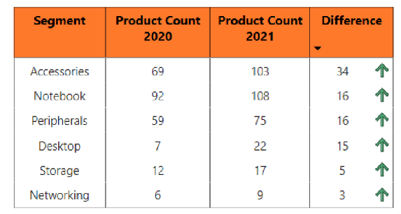
AtliQ Hardware
HOME
ABOUT
CONTACT ME
4Q. Follow-up: Which segment had the most increase in unique products in 2021 vs 2020? The final output contains these fields –segment,product_count_2020,product_count_2021 difference.
CONSUMER-AD-HOC
INSIGHTS
PRESENTED BY : BHAVANI

Slide 9
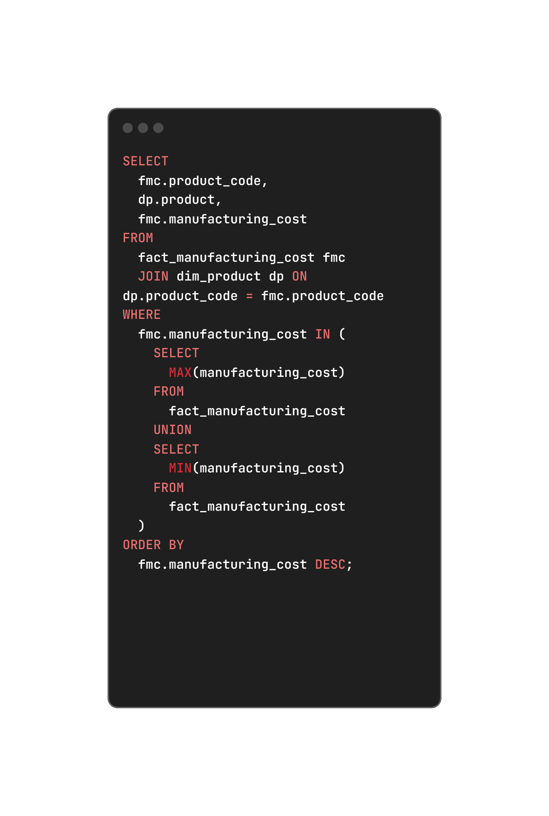
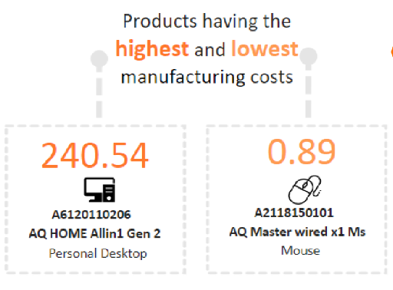
AtliQ Hardware
HOME
ABOUT
CONTACT ME
5Q.Get the products that have the highest and lowest manufacturing costs.The final output should contain these fields, product_code,product, manufacturing_cost.
CONSUMER-AD-HOC
INSIGHTS
PRESENTED BY : BHAVANI

Slide 10
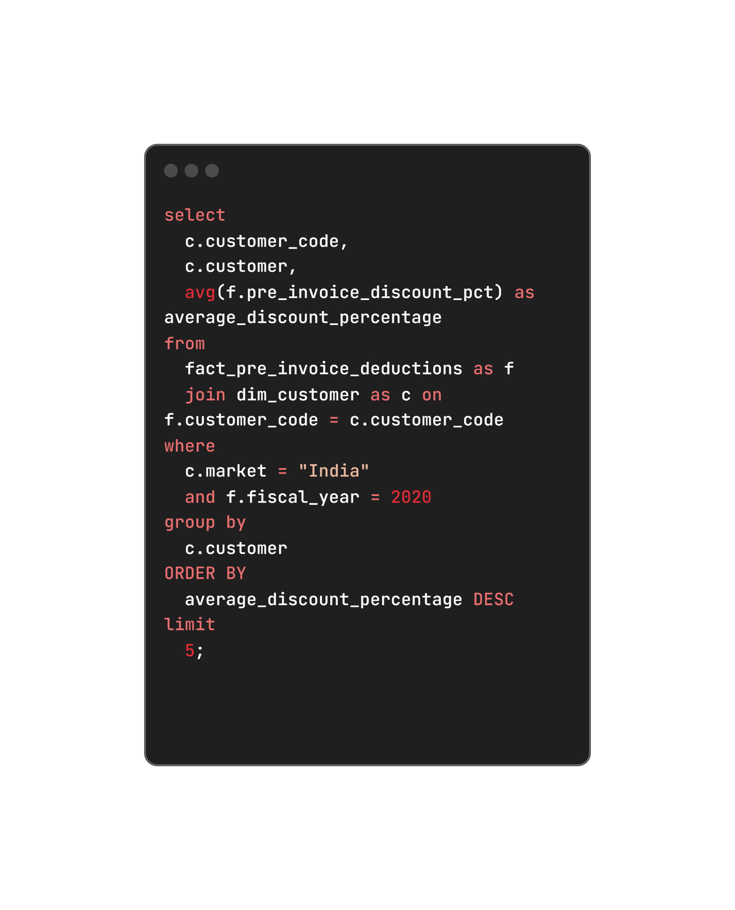
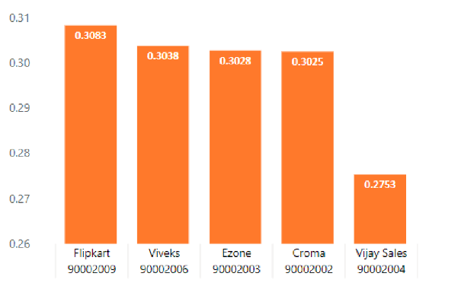
AtliQ Hardware
HOME
ABOUT
CONTACT ME
6Q.Generate a report which contains the top 5 customers who received an average high pre_invoice_discount_pct for the fiscal year 2021 and in the Indian market. The final output contains these fields,customer_code,customer, average_discount_percentage.
CONSUMER-AD-HOC
INSIGHTS
PRESENTED BY : BHAVANI

Slide 11
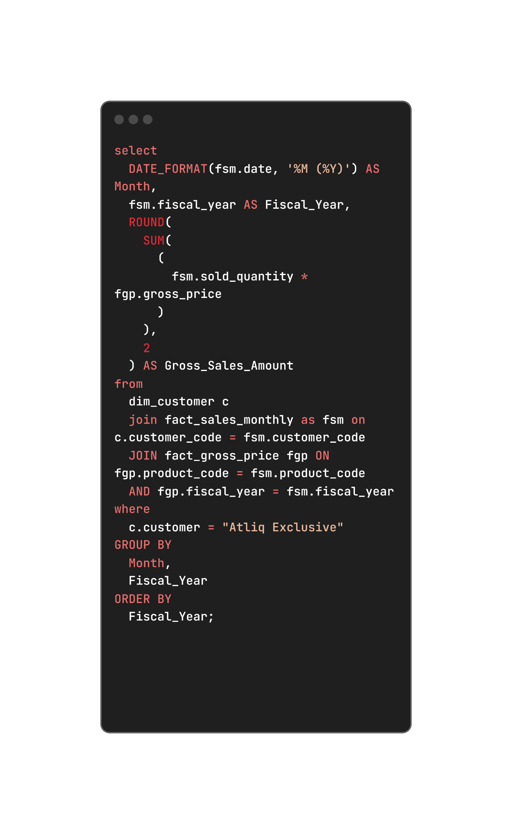
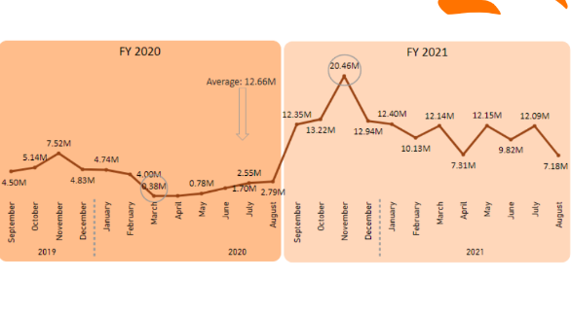
AtliQ Hardware
HOME
ABOUT
CONTACT ME
7Q. Get the complete report of the Gross sales amount for the customer “Atliq Exclusive” for each month. This analysis helps to get an idea of low and high-performing months and take strategic decisions. The final report contains these columns:Month,Year,Gross sales Amount.
CONSUMER-AD-HOC
INSIGHTS
PRESENTED BY : BHAVANI

Slide 12
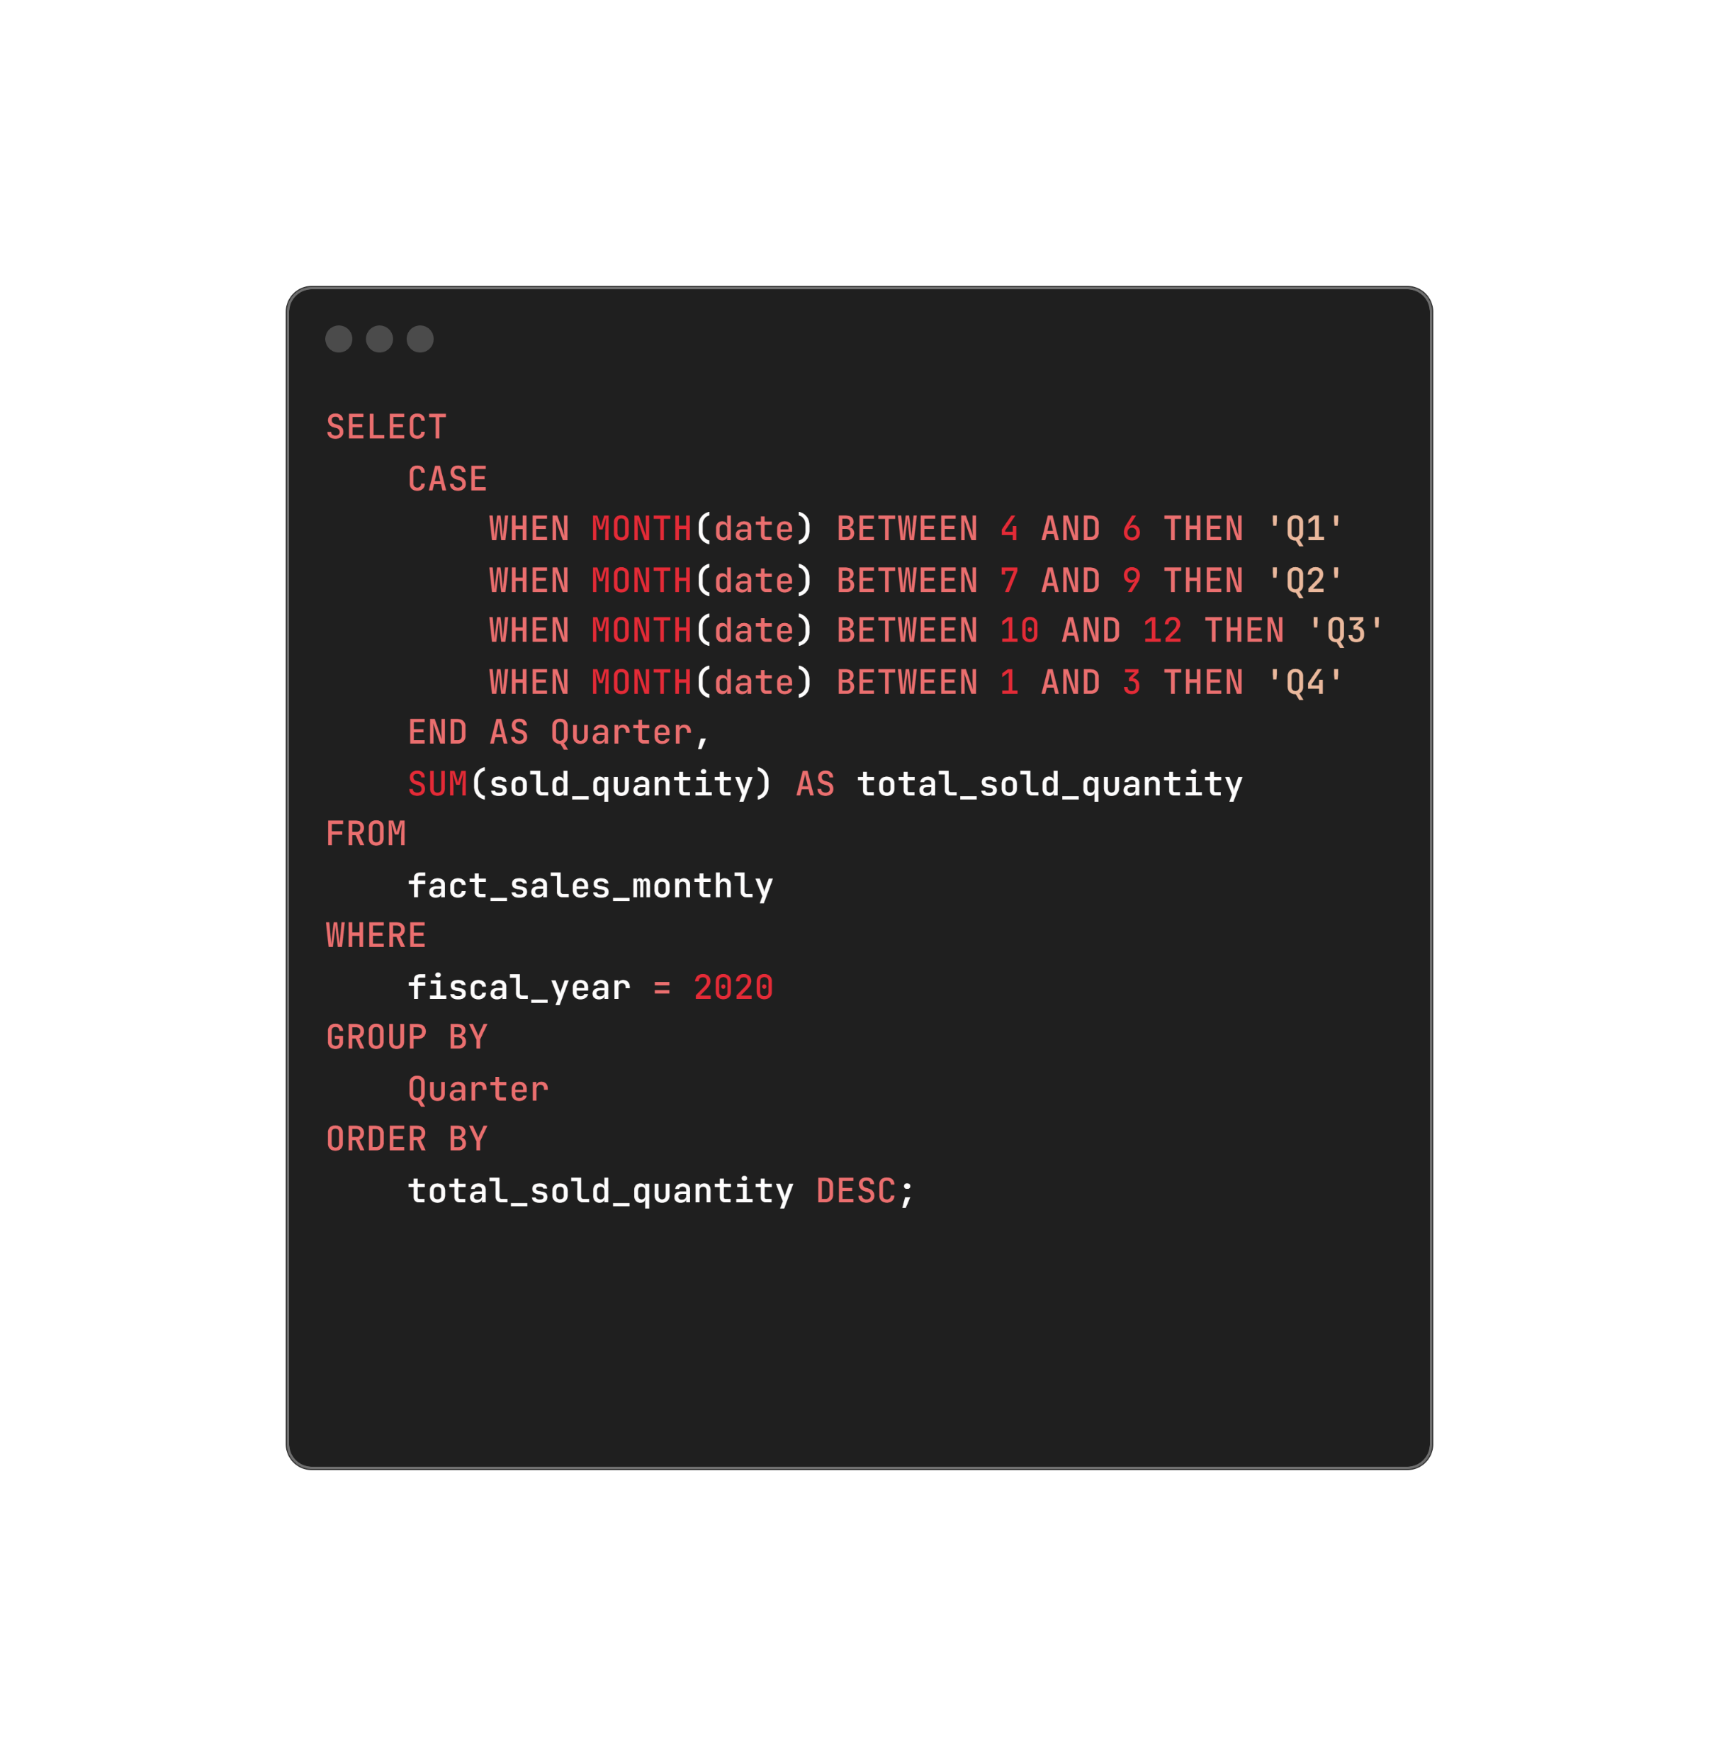
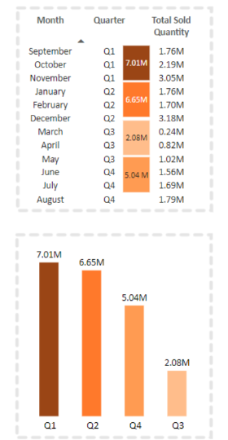
AtliQ Hardware
HOME
ABOUT
CONTACT ME
8Q.In which quarter of 2020, got the maximum total_sold_quantity? The final output contains these fields sorted by the total_sold_quantity,Quarter,total_sold_quantity
CONSUMER-AD-HOC
INSIGHTS
PRESENTED BY : BHAVANI

Slide 13
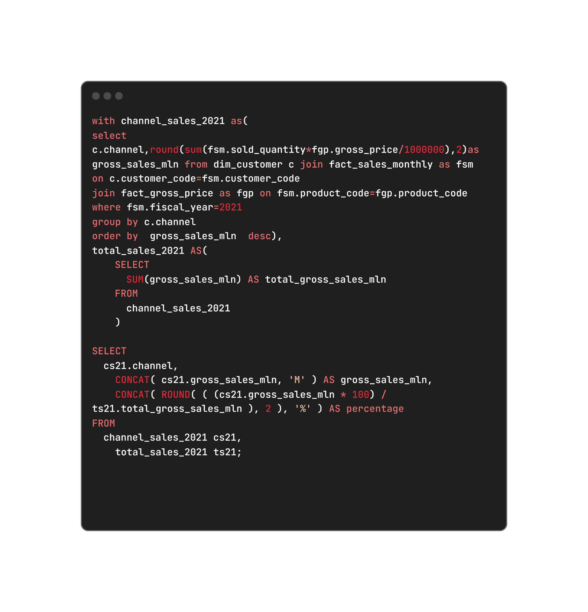
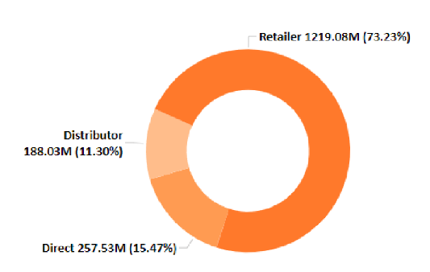
AtliQ Hardware
HOME
ABOUT
CONTACT ME
9Q.Which channel helped to bring more gross sales in the fiscal year 2021 and the percentage of contribution? The final output contains these fields,channel,
gross_sales_mln,percentage
CONSUMER-AD-HOC
INSIGHTS
PRESENTED BY : BHAVANI

Slide 14
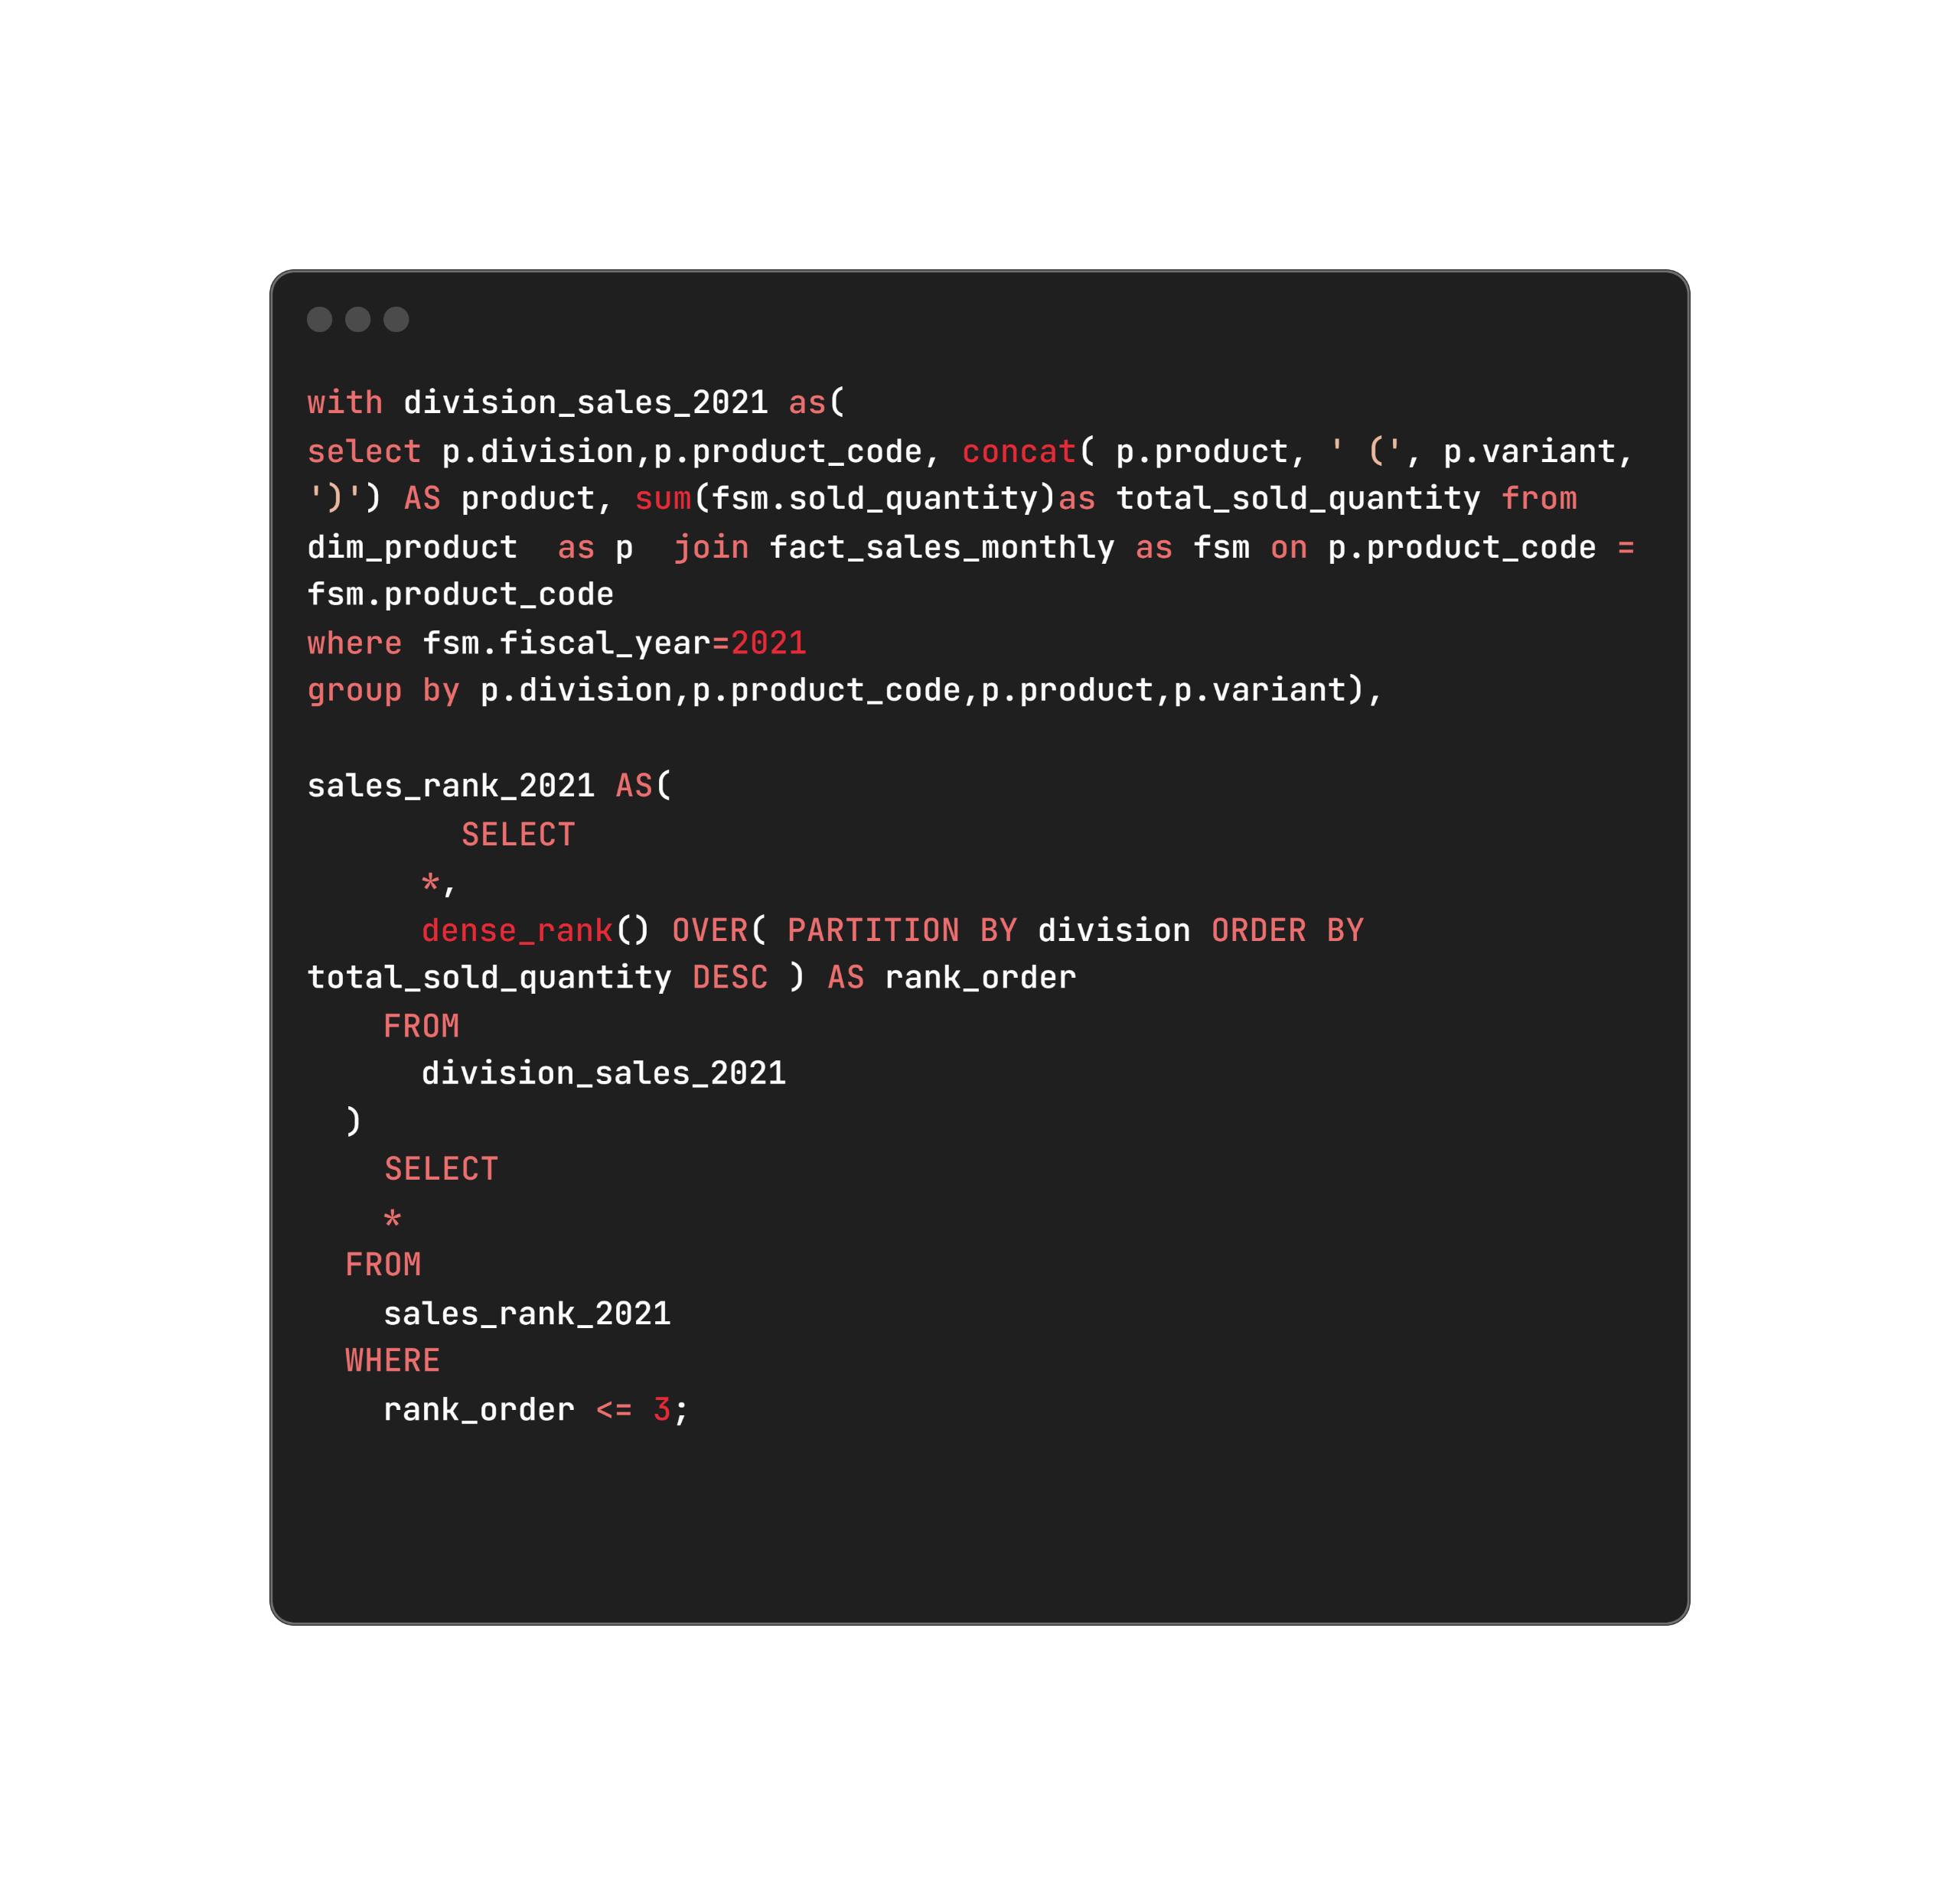
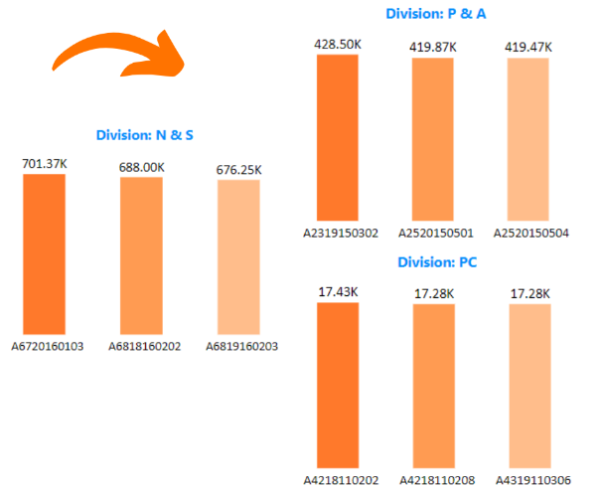
AtliQ Hardware
HOME
ABOUT
CONTACT ME
10Q. Get the Top 3 products in each division that have a high total_sold_quantity in the fiscal_year 2021? The final output contains these fields,division, product_code, product,total_sold_quantity,rank_order
CONSUMER-AD-HOC
INSIGHTS
PRESENTED BY : BHAVANI

Slide 15
AtliQ Hardware
HOME
ABOUT
CONTACT ME
Thank you
PRESENTED BY : BHAVANI

