Slide 1
Computer Systems Management CSE 131 Instructor: Sambuddho Chakravarty
(Semester: Monsoon 2017)
Week 1: Aug 2 – Aug 4

Slide 2
Introduction – Course in a Nutshell
Learn about PC – assembling one, formatting, installing OS, making boot drive, etc.
Understanding Linux – OS, commands, shell, scripts, etc.
Understanding network – setup WiFi, DNS, DHCP, etc.
Understanding advanced network tools – firewalls, tcpdump, nmap, ifconfig etc.
Setting up your own website
Writing documents in LaTeX
Basically, instill confidence that you can deal with technology to your benefit.

Slide 3
Instructor
Name: Sambuddho Chakravarty
Designation: Assistant Professor
Email: sambuddho@iiitd.ac.in
Tel: x478
Room: A406
Office hours: Friday 4-5 PM or by appointment
TAs: TBA

Slide 4
Instructor
Name: Sambuddho Chakravarty
Designation: Assistant Professor
Email: sambuddho@iiitd.ac.in
Tel: x478
Room: A406
Office hours: Friday 4-5 PM or by appointment
TAs: TBA

Slide 5
Class Timings
Section A:
Days: Tue+Fri
Location: C01
Time: 10:00 – 11:30 PM
Section B:
Location: C11
Time: 12:30 – 2:00 PM (Tue)
12:00 – 1:30 PM (Fri)

Slide 6
Lab Timings
Section A:
Days: Mon (Gp 1, 2, 5)
Location: L21,L22,L23
Time: 1:00 PM – 3:00 PM
Days: Fri (Gp 3,4,6)
Location: L21,L22,L23
Time: 1:00 PM – 3:00 PM
Section B:
Days: Mon (Gp 4, 5)
Location: L21,L22
Time: 3:00 PM – 5:00 PM
Days: Tue (Gp 1,2,3)
Location: L21,L22,L23
Time: 3:00 PM – 5:00 PM
Days: Fri (Gp 6)
Location: L21
Time: 3:00 PM – 5:00 PM

Slide 7
Online presence - We will be on backpack – a home grown LMS. - All material will be posted there. - Lecture notes. - Extra reading material. - All quiz papers, lab sheets, etc. - Questions can be asked there. - Upload any assignments. - All announcements will be made there.

Slide 8
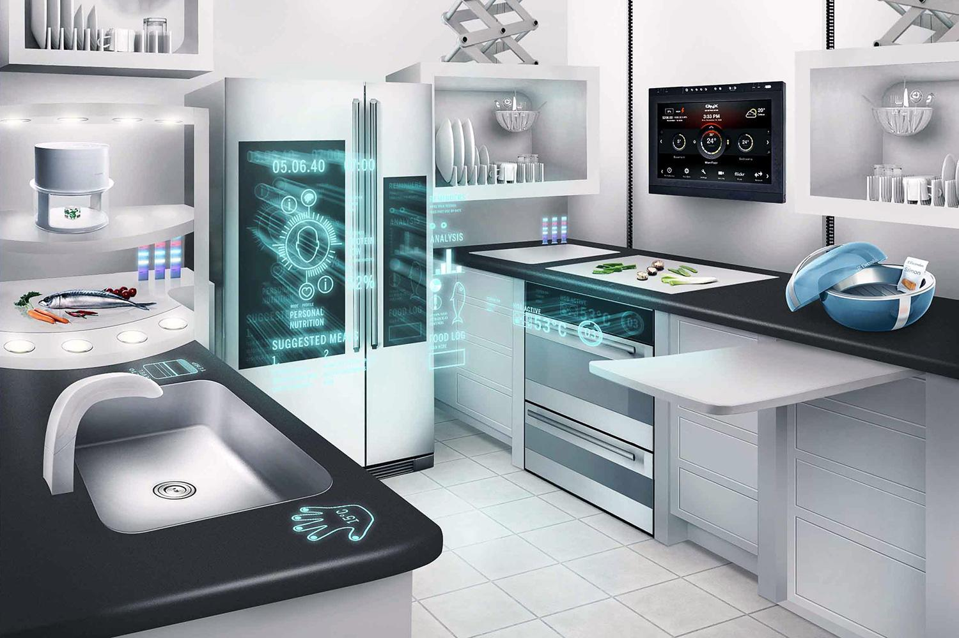
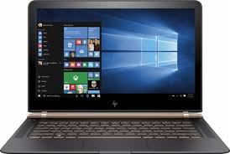
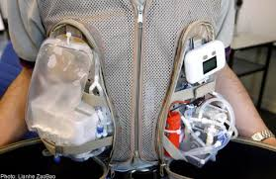
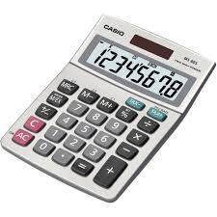
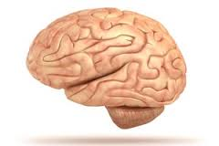
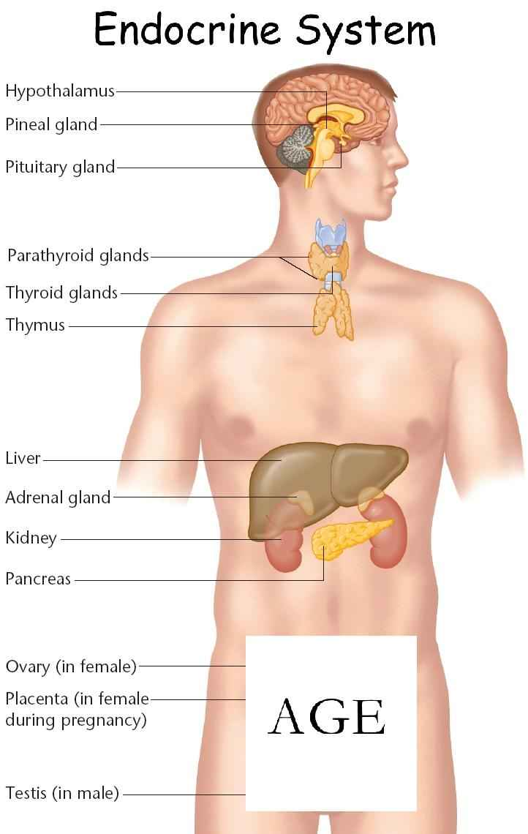
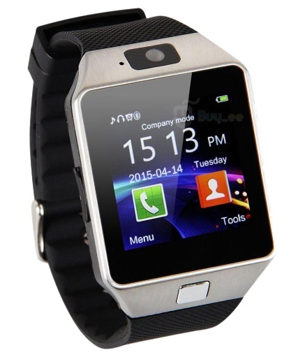
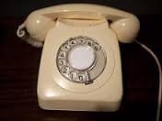
Exactly What is a Computer

Slide 9
Most Basic Computer aka Turing Machine
Proposed by Alan Turing (circa. 1936)
Model consists of infinite tape divided into cells which contain input symbols.
Head reads the top of the symbol and changes the internal state of the machine when the symbol is something that is not unexpected.
The machine thus moves to the next state until it reaches a terminal state which makes that the input is invalid…

Slide 10
Evolution of Computers
Abacus – Chinese, Roman and Russian – ancient form of calculator.
Relies on a series of beads and their movements to perform calculations.
Homework : Read and describe how the Abacus works (would be graded)

Slide 11
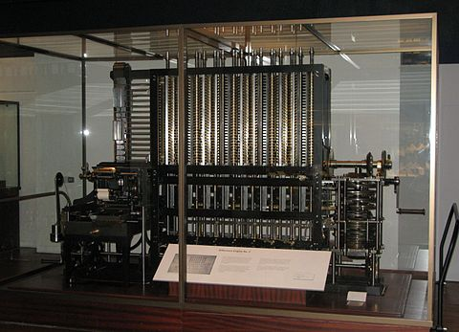
Babbage Analytical Machine
Mechanical form of the Abacus used for calculating polynomial
functions.
Separation of storage and processing…

Slide 12
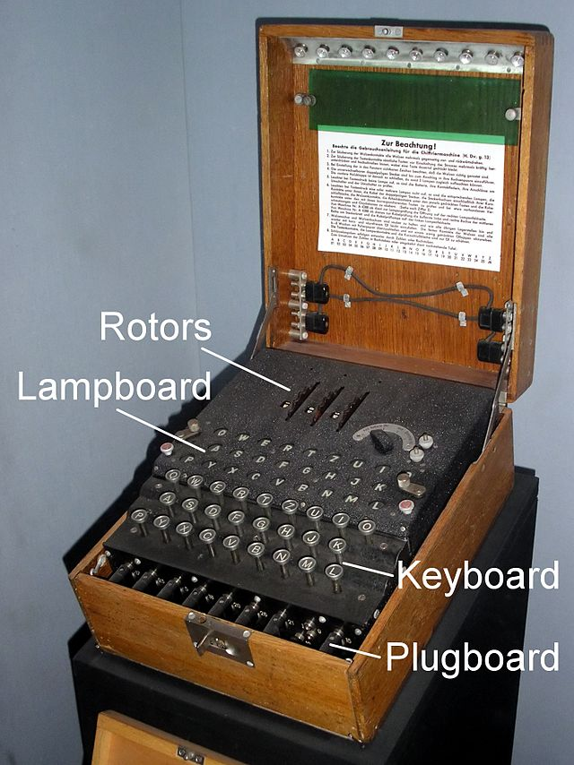
20th Century – Enigma Machine
Designed by Arthur Scherbius (Axis Germany) towards end of WW1 to send encrypted messages
Used during WW2

Slide 13
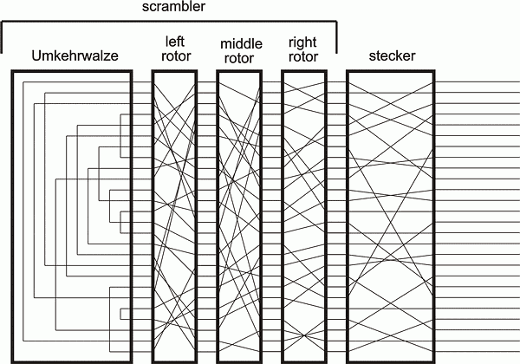
Inside the Enigma
Input
Output
(via
Glowlamps)

Slide 14
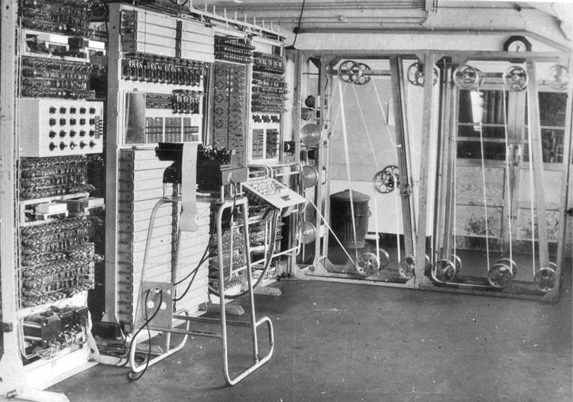
Collosus Machine
Designed by Britain (Allied) to break encrypted messages of enigma...

Slide 15
Post WW2 – Electronic Numerical Integrator and Computer (ENIAC)
-Designed by Univ of Pennsylvania, in Feb 15, 1946.
-General purpose computer designed based on Turing Machine principle
Operation time samples: 10-digit num x 10-digit num took 2800 µsec,
https://www.youtube.com/watch?v=rO2SScF6rrM

Slide 16
Post WW2 – General Purpose Computers Post 1960s
-Greatest invention for computing world – Transistor – improvement in size and speed of operation – lower power consumption
Majority of general purpose mainframes evolved in this era – the PDP (Programmed Data Processors) – PDP 1 .. PDP 16
Different processing capabilities
UNIVAC (UNIVersal Automatic Computer) – Mid 1960s. Used as general purpose mainframes – quite ahead of their times 36-bit word size (modern Intel x86_64 – 64bit word size).
Big challenge in increasing word size in computers…
-

Slide 17
Era of IC based design 1970s
- Jack Kilby (Noble laureate), father of IC semi-conductors.
- Integrated circuits – semi-conductors were ``grown’’ over silicon substrates. Faster than ordinary BJTs.
Many ``fast’’ transistors could be integrated into a single physical ``chip’’
Beginning of VLSI age..
Computer chips become even smaller, faster and consume lesser power (overall faster computation speeds).
ICs had combinations of transistors arranged to form series of logic gates – the building blocks of modern computers – can be used for all kinds of operations but the classical ones are for storage (aka memory).
More advanced – microcontrollers and microprocessors.

Slide 18
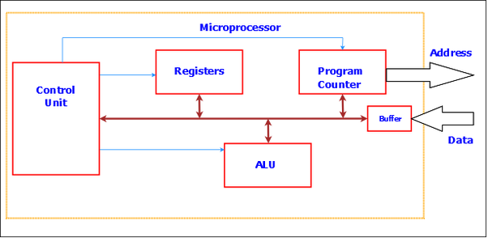
Era of Digital Computers
ICs used to design a microcontrollers and microprocessors.
Main parts – registers, ALU, control unit, PC, I/O buffers, address bus
and data bus

Slide 19
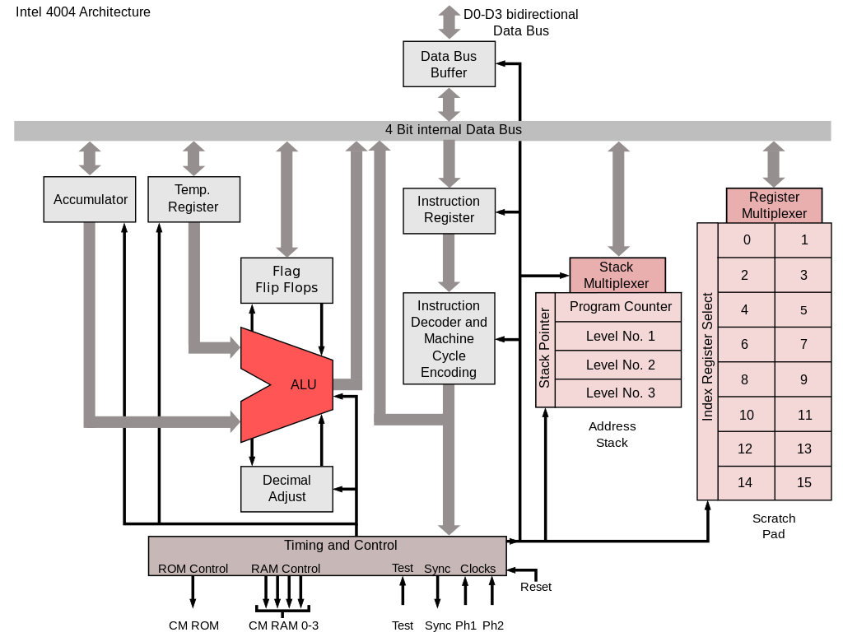
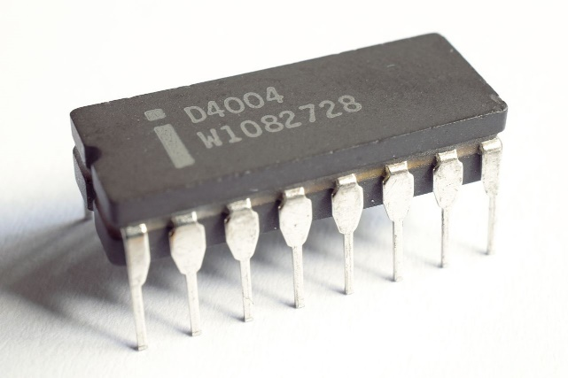
Intel – 1970s and Beyond
-First microprocessor by Intel – 4044 (4-bit microprocessor) – release date: Nov 15, 1971
-The first commercial product to use a microprocessor was the Busicom calculator 141-PF.
- The 4004 was also used in the first microprocessor-controlled pinball game, a prototype produced by Dave Nutting Associates for Bally in 1974

Slide 20
Rise of the Desktops
Xerox Alto (by Xerox PARC) developed in 1973, the first PC ever designed – used, mouse keyboard etc.
Closely correlated to the rise of microprocessors.
Series of systems by IBM using IBM PALM processor, running
and interpretive language (BASIC).
Altair 8800 – spawned several computer manufacturers to start to produce
personal computers – Processor : Zilog Z80 or Intel 8085, running CP/M-80
operating systems.
Home computing:
- IBM PC – Intel 8088 microprocessor
- 8 bit microprocessor, booted using floppy disks…
- 5MB HDDs with 640KB of RAM
- PC-DOS operating system.
Apple Lisa and Macintosh – GUI based interface.
Motorola 68000 microprocessor with about 128 KB of RAM (upgraded to 512 KB of RAM)
Newer faster processors evolved post 1990s – Intel 80386/486/Pentium processor – 32-bit
RAM sizes increased to 16MB → 32 MB → 64 MB

Slide 21
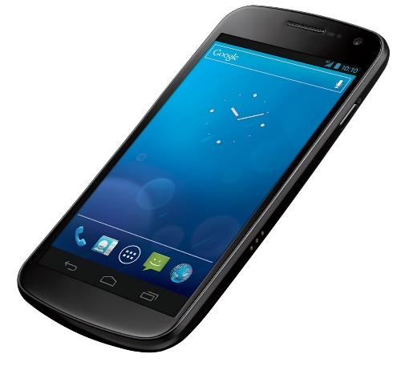
Cellular Communication Married to Computers – Smart Phones
-A different revolution was brewing since the 1970s… (??)
-ARPANET – 1969 – connection established
First message transmitted – “Login”
Wireless communication has been there since 19th century.
Telephony (1876, Bell)
Wireless telephony – Cellular communication – 1970s.
Computers

Slide 22
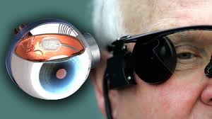

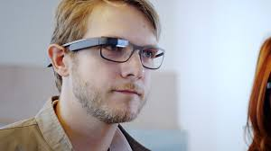
Age of wearables and implantables…
Microprocessors are now fitted into wearable devices (e.g. watches)
Watches + smartphones = smart-watches
Temperature and vital statistics monitoring
Implantables….
- Often specific purpose (not so generic…)

Slide 23
The Microprocessor (µP)
A silicon chip which has various millions of transistors etched onto it and those that are organized into gates which are further grouped into sequential circuits – ALU, CU, registers, FPU.
Microcontroller: Microprocessor + Memory + I/O controller
Microprocessor or CPU is more useful for general purpose computing while a microcontroller is more specific to individual tasks.
Two types of architectures – Harvard Architecture and Von Neuman Architecture.
Von Neuman – Shared memory for instructions and data input/output. System would be either reading instruction or reading data.
Harvard – Different memory for data and instructions. Allows simultaneous instr/mem read and write.
Hybrid Harvard: Modern CPUs (e.g. Intel x86 series): Separate instr and data memory locations but still the CPU is either reading instructions or writing to memory.

Slide 24
The Microprocessor (µP)
ALU : Arithmetic Logic Unit (Performs ALL logical and arithmetic operations)
FU: Floating point unit (used for floating point operations)
Control Unit: Controls processor operation – e.g. identifying memory location to fetch instructions.
Registers: Memory locations within the CPU where all the computation happens. E.g. used as individual operands of an arithmetic/logical operation.
Accumulator: Register that stores results of an arithmetic operation.
Flag registers: Used for checking logical conditions (e.g. was the previous logical operation TRUE or FALSE).
Interrupt registers: Used to signal the CPU to switch operations.

Slide 25
Inside PC
What do you see inside a PC?
Motherboard
CPU
RAM Chips
Display adaptors (GPGPU cards optional)
Network interfaces
Multimedia boards

Slide 26
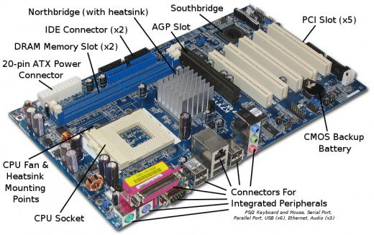
Motherboard (~ 2005)

Slide 27
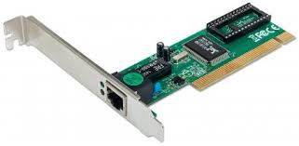
Peripherals Components Interconnection (PCI) Card
Ethernet (LAN) card (PCI)
Connects to LAN → Internet
Uses Direct Memory Access (DMA)
to transfer data between
the network and the CPU

Slide 28
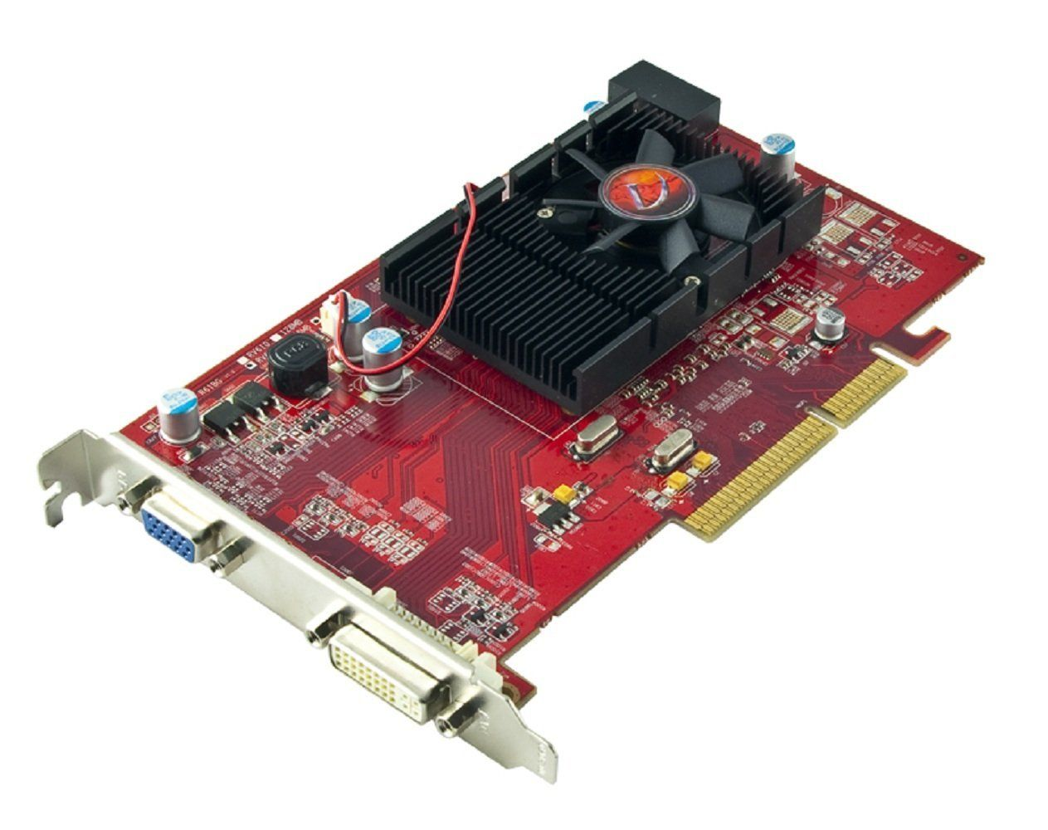
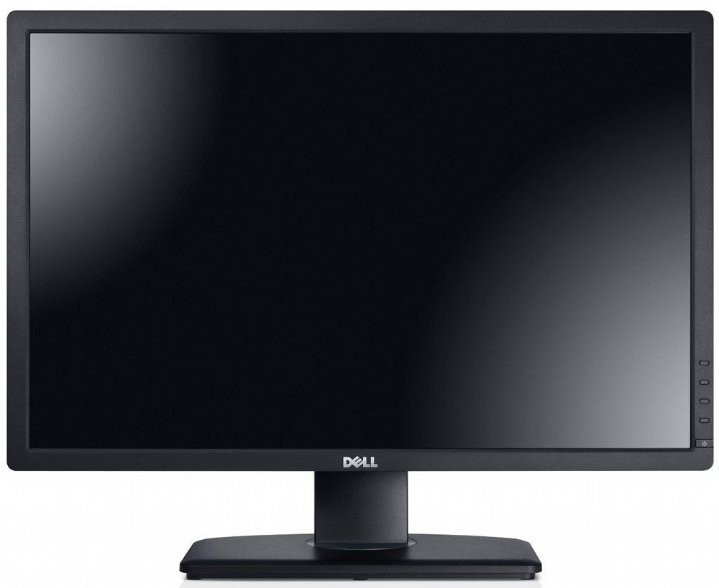
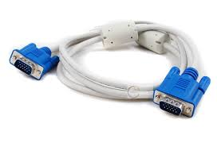
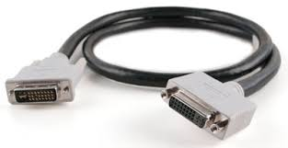
Accelerated Graphics Port (AGP)
Graphics Processors
With heatsink
AGP Card
VGA
DVI
VGA-cable
DVI-cable

Slide 29
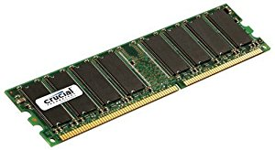
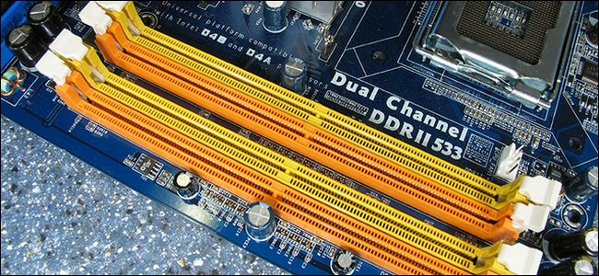
Random Access Memory (RAM) Chips
RAM: Used for
ALMOST EVERYTHING
That the CPU does…
Aka Main memory

Slide 30
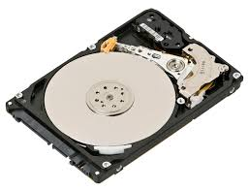
Hard Disk Drive
-Secondary Memory (Permanent storage)
-Everything is saved here permanently (until you delete the data or destroy the drive)
Disk Platter
Moving Arm
Chassis
Data and
Power sockets
Motor

Slide 31
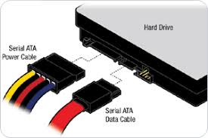
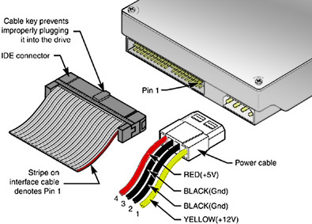
IDE vs SATA
-Two kinds of disk data transfer interfaces – Integrated Drive Electronics vs Serial AT Transfer (SATA)
SATA
IDE

Slide 32
IDE vs SATA
-IDE: “The IDE interface contains two IDE device connections and two motherboard connectors for two data cables. An IDE-integrated controller sends an array of 512-byte blocks between the drive and motherboard, which houses up to four chipset-controlled IDE devices within one system. ”
-SATA: Designed in 2003. Replaced the IDE for most practical purposes. Much faster (1.5 Gbit/s → 6 Gbit/s).

Slide 33
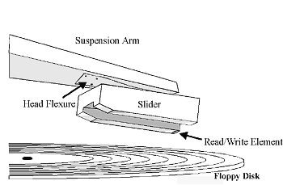
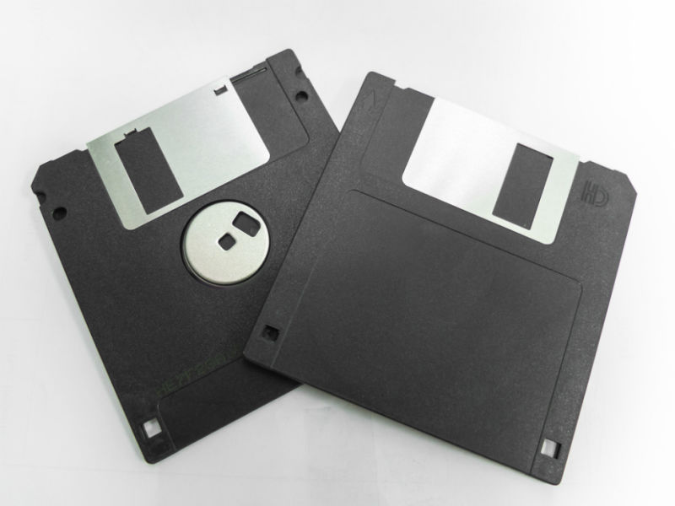
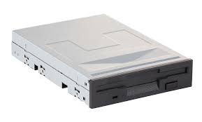
Secondary Storage Devices
Floppy Disks: Magnetic discs (just like tapes) which are written on and read from using magnetic head

Slide 34
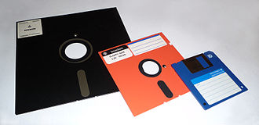
Secondary Storage Devices
Floppy Disks: 8” ( late 1960s) with approx. 175kB storay → 5.25” (mid 1970s), 1.2 MB → 3.5” 1.44MB Floppy Disk.
Initially used to load the microcode for IBM S/370 mainframe while in the 80s and 90s used for storage and loading up the operating system (MS-DOS or MS-Windows 3.1 and even Linux initially…)

Slide 35
Secondary Storage Devices
Compact Discs (CD-ROMs): Compact Disc Read Only Memory
Was used to extensively distribute software.
“Discs are made from a 1.2 mm thick disc of polycarbonate plastic, with a thin layer of aluminium to make a reflective surface.”
Pits and lands – groves on the surface that are read through laser.
Pits (1), lands (0)

Slide 36
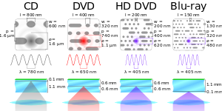
Secondary Storage Devices
DVD and Blu Ray: No different from CDs. Differ in the wavelength of laser used and thus encoding and decoding capacity (aka storage capacity aka bandwidth)

Slide 37
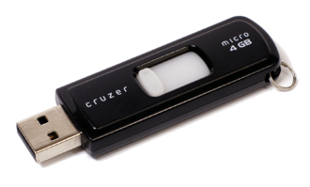
Tertiary Storage
USB Drives (aka USB flash drive, pendrive, thumb drive etc.):
Storage capacity: 8GB – 256 GB.
EPROM and EEPROM memory
Uses high speed USB serial interface for data transfer.
Higher lifespan – fewer moving parts, lesser chance of wear and tear damage.

Slide 38
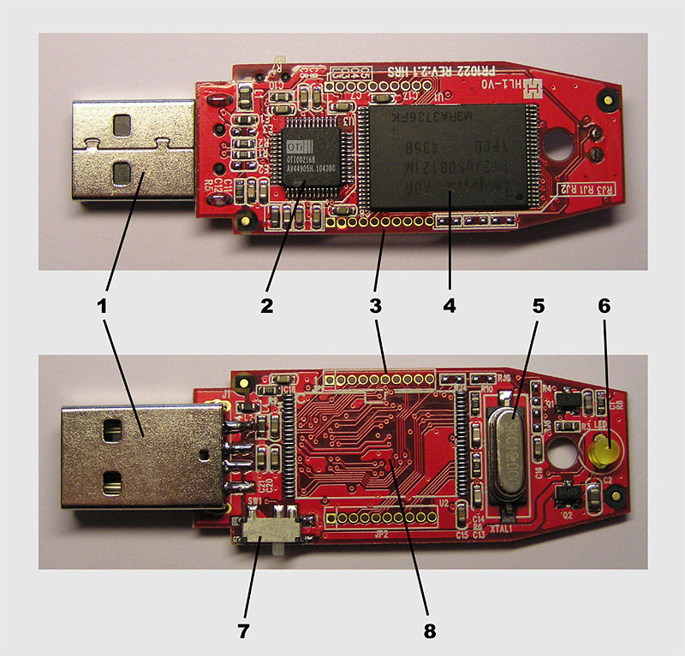
Tertiary Storage
1 | USB Standard-A, "male" plug
2 | USB mass storage controller device
3 | Test point
4 | Flash memory chip
5 | Crystal oscillator
6 | LED (Optional)
7 | Write-protect switch (Optional)
8 | Space for second flash memory chip

Slide 39
Northbridge and South Bridge Chips
Aka the board chipset.
Controls the motherboard, and the various peripheral connectors and slots.
Package the most important components to generate the clock(s),
DMA operations, interrupt handlers, I/O port controllers etc.
Additionally also packages various onboard devices such as audio codec/modules, wifi controllers etc.

Slide 40
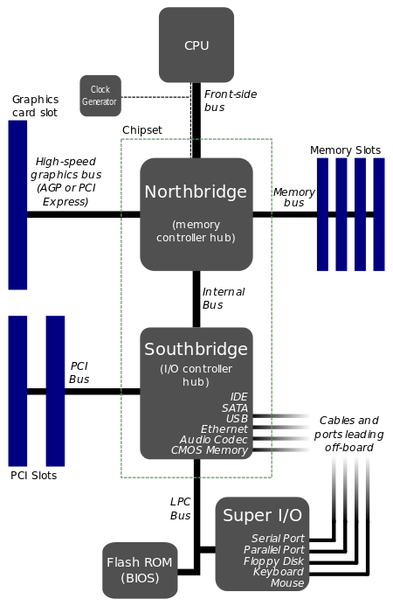
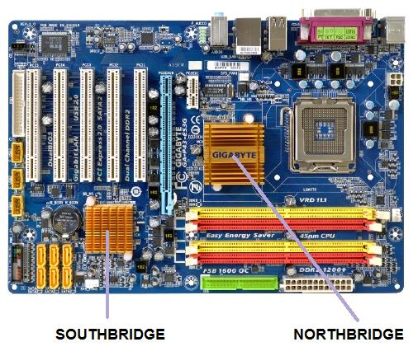
Northbridge and South Bridge Chips

Slide 41
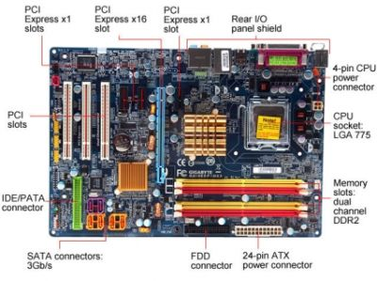
Motherboard (Latest)

Slide 42
Motherboard (Latest)
PCI EXpress: Faster transfer rate than the usual PCI card. (aka transfer bandwidth)
SATA: Serial AT Attachment. Newer form of faster data transfer rates.
IDE: Integrated Drive Electronics. Older form of slower transfer rate drive interface.

Slide 43
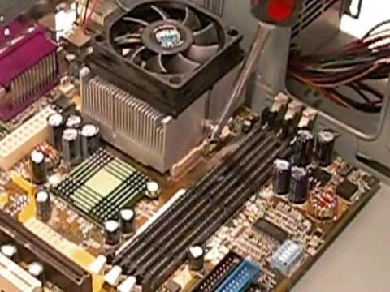
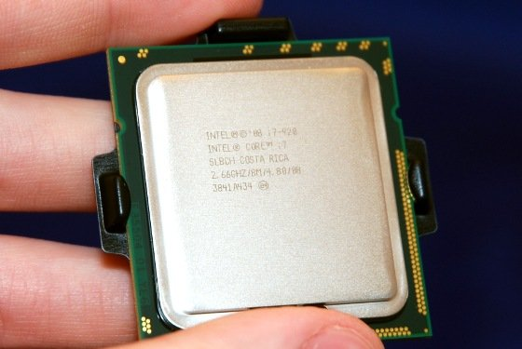
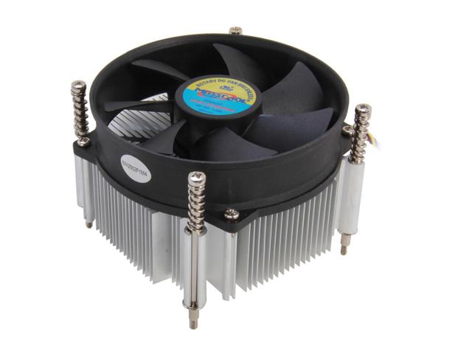
Central Processing Unit (The CPU)
Heatsink
CPU+Heatsink
CPU

Slide 44
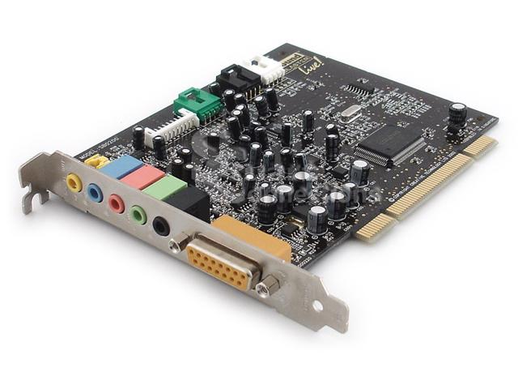
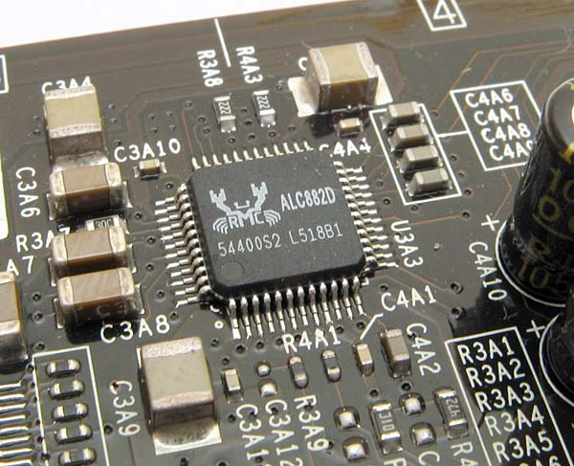
Audio and Multimedia Boards
Multimedia and audio cards connected via the PCI slot (aka Sound Card)
Most newer systems have it already installed on motherboard as a sound module/chipset…sometimes integrated into the north and southbridge chipsets directly.
Advanced sound cards for
specialized multimedia applications
also available.

Slide 45
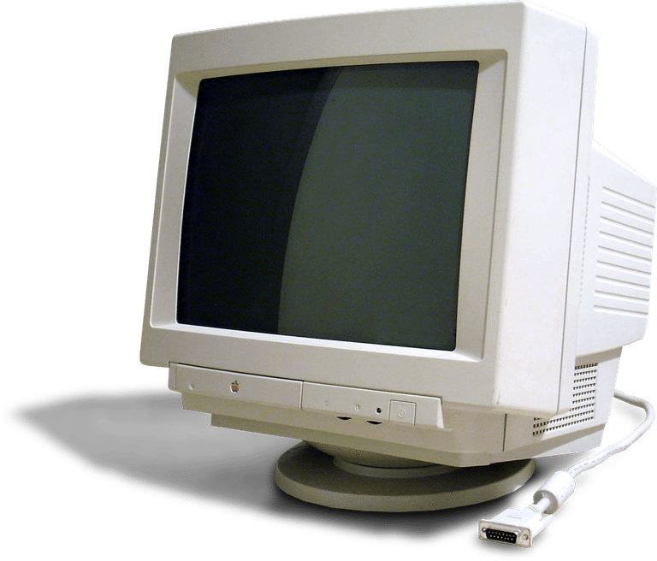
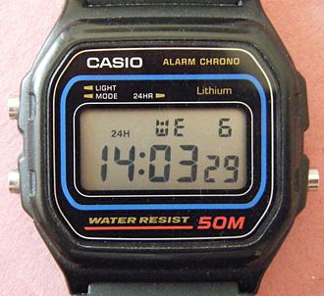
Monitor (Display)
CRTs: Over a century old.
LCD: Liquid crystal displays– uses crystals that reflect light from a backlight source (often a CCFL source)
LED: Light Emitting Devices – LCDs with light emitting diodes as the source.

