Slide 1
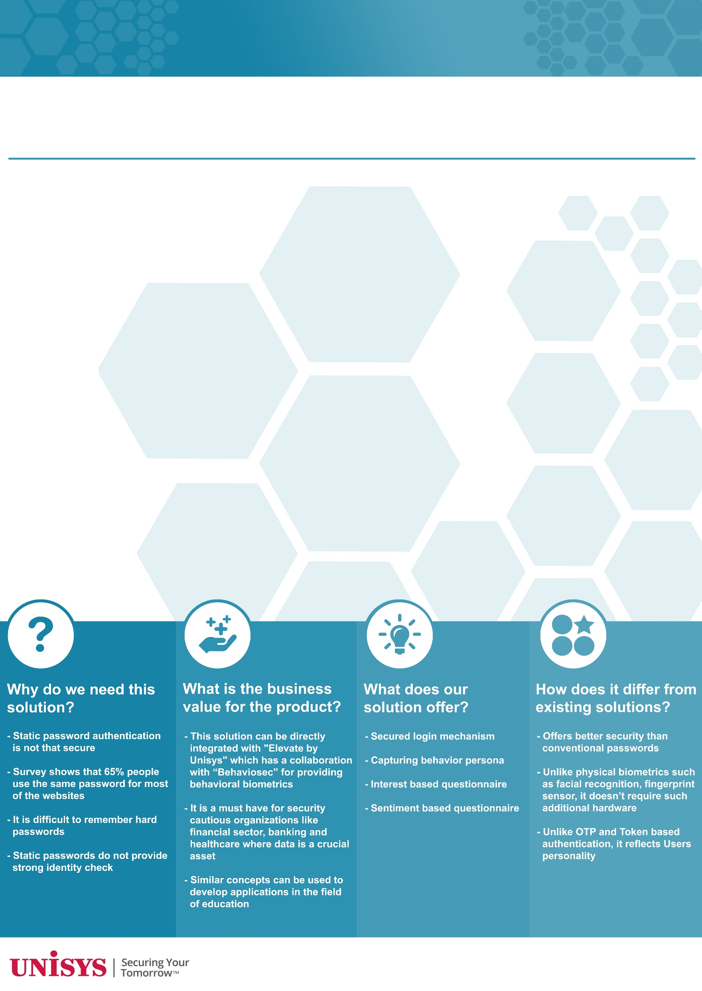



SENTIMENT: KEY TO USER IDENTIFICATION
Making conventional passwords more secure by randomizing it based on the various interests of a person and corroborating whole process by Passive Behavioral Biometrics.
User Input
Persona Database
Digital Thumbprint/persona
- Key Stroke Dynamics
- Mouse use characteristics
- Movement Patterns
- Gesture Patterns
Question Generation
Multiple Entity Sentences
Single Entity Sentence
Sentence Selection
Stanford NER
Named Entity Recognition
Named Entity Recognition
Stanford NER
Sentence Separation
Relation Detection
Sentiment Analysis
(Cross check with
Persona DB)
POS Tagging
Stanford POS Tagger
(Entity, Relation, Entity)
(Person, Entity, Sentiment)
Feature Extraction
(Cross check with the Tuple DB)
Selected Sentences
Question Word Identification
Output Question
Rearrange sentence to generate question
Users answer to the Question
- Bhavdeep
- Dipak
- Hemant

