Slide 1
SHRI MANEKLAL M.PATEL INSTITUTE OF
SCIENCE & RESEARCH
M.SC(INFORMATION TECHNOLOGY)
SEM-4
PROJECT REPORT: PROJECT BASE
COMPANY NAME :CEREBULB PVT.LTD
LANGUAGE : PHP
STUDENT NAME: Patel Zalak S.
ENROLLMENT NO: 21MSCIT22023

Slide 2
Academic Year: 2022 - 2023
“Customer Relationship Management”
Presented By:- Guide Name:-
Zalak S Patel Bhavesh Katariya

Slide 3
INDEX
Introduction
Project Summery
Aim and Objectives
Tools & Technologies
Implementation
Conclusion
Progress report with result Pictures
Attendance log book

Slide 4
Introduction
In this internship, I am working on Customer Relationship Management.
Customer Relationship Management using php and many concepts of the php framework like laravel.
The main goal to develop this project are to combines client data into single repository, so client can better organize and manage relationships, automates common processes, and provides tools to monitor performance and productivity..
php was used in this project and many different php Libraries like Magento, Laravel, etc. were used.

Slide 5
Project Summery
Customer Relationship Management using php laravel.
The primary focus of CRM is to manage deals and monitor deal status.
This project gives clients functionality to organize and manage tasks, events, and performance.
Includes features for automated task, event, and call management, as well as customized dashboards and workflows.
In this internship included a many small project like websites using wordpress.

Slide 6
Aim and Objectives
Aims:-
  Using this introductory knowledge and skills in real-life applications
  Gain a better insight of the field of php and the scope of it in the industry.
  To get an overview of the field of php-Laravel.

Slide 7
Tools & Technologies
Tools:-
  Vs Code
  Notepad++
  phpMyAdmin
  MySQL
Technologies:-
  HTML
  CSS
  JavaScript
  Bootstrap
  Php(Laravel)

Slide 8
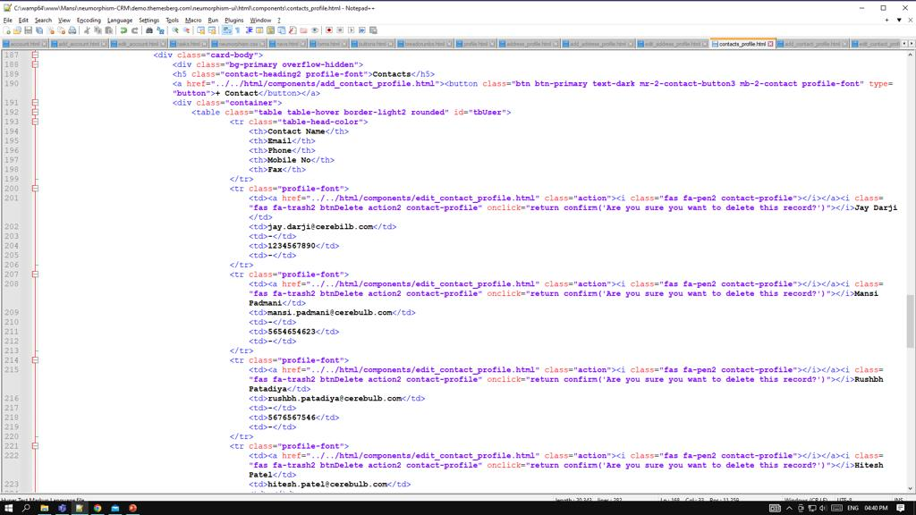

Slide 9
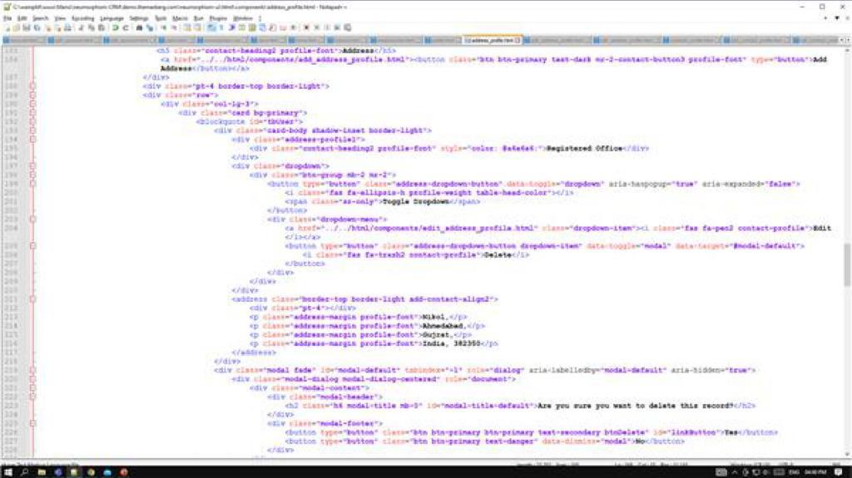

Slide 10
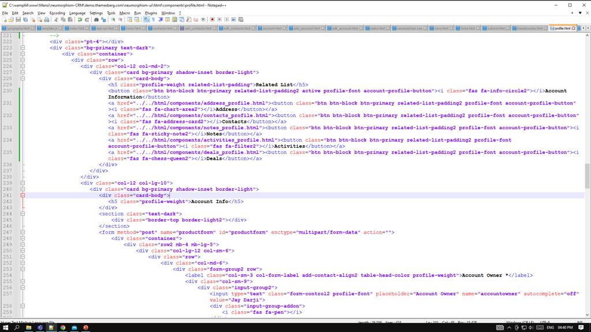

Slide 11
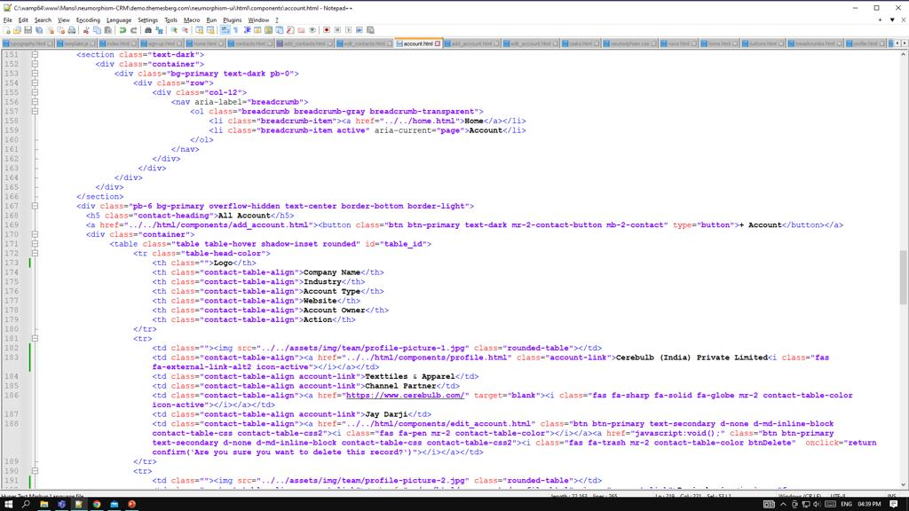

Slide 12
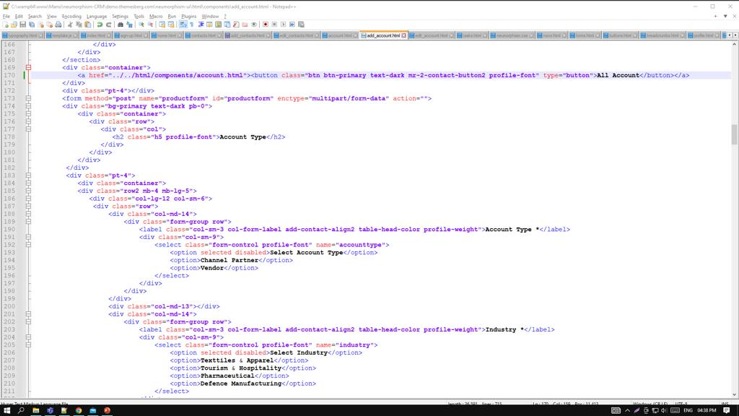

Slide 13
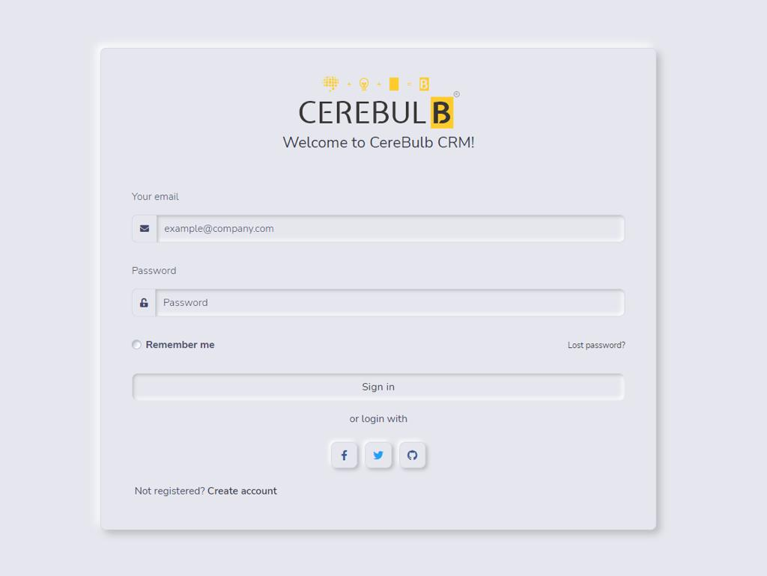

Slide 14
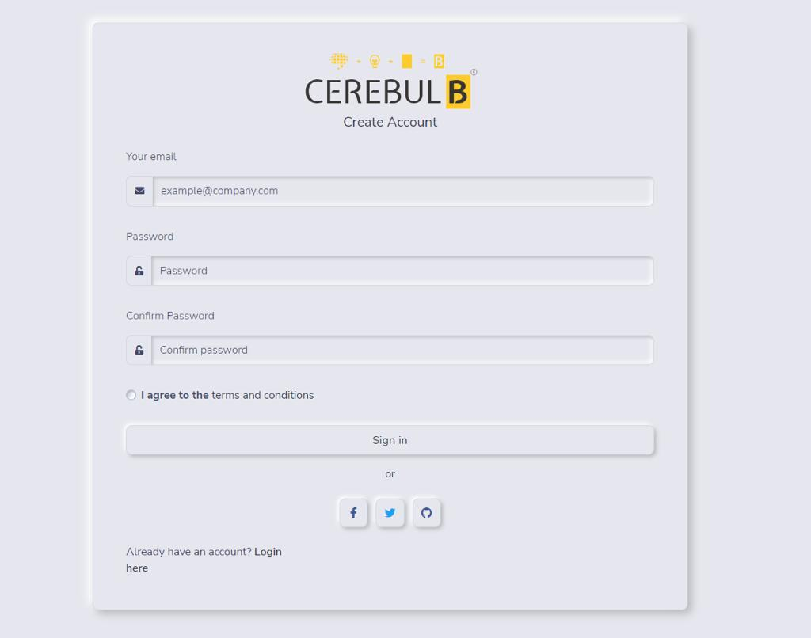

Slide 15
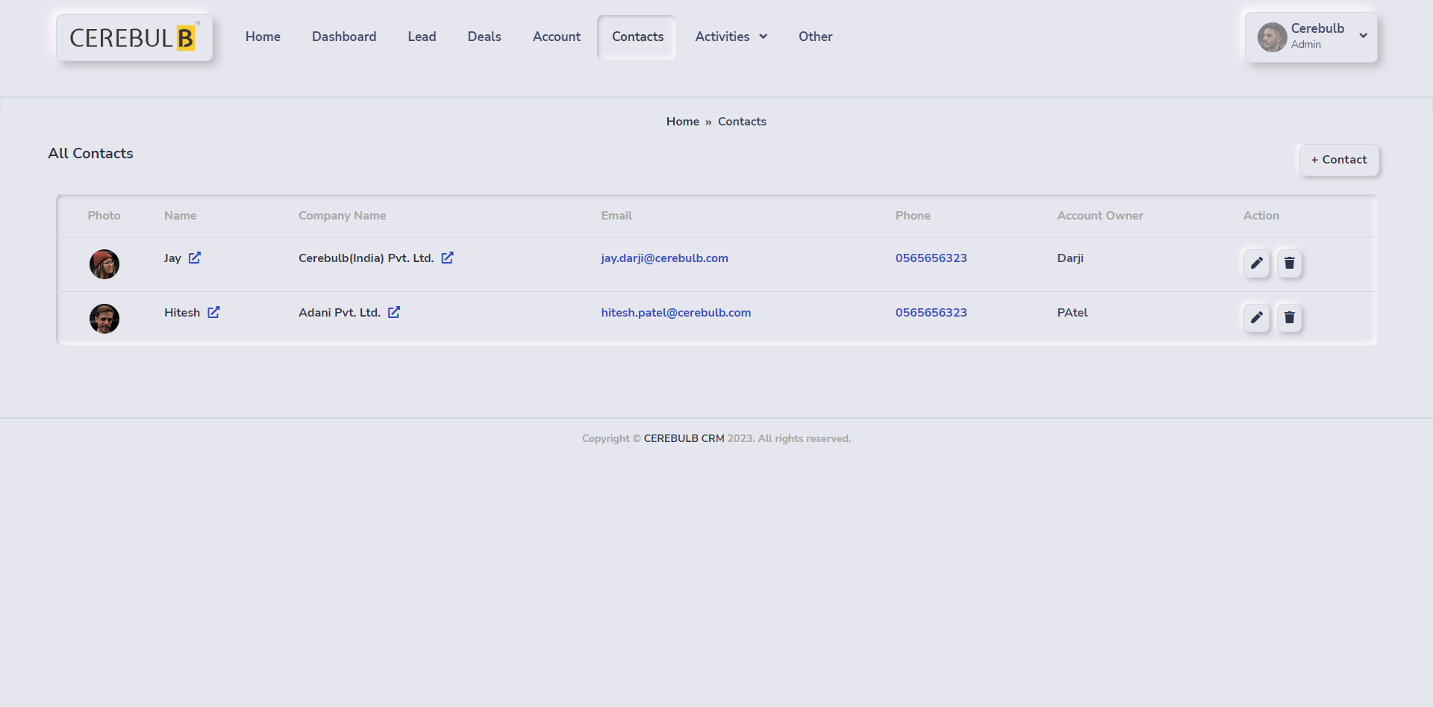

Slide 16
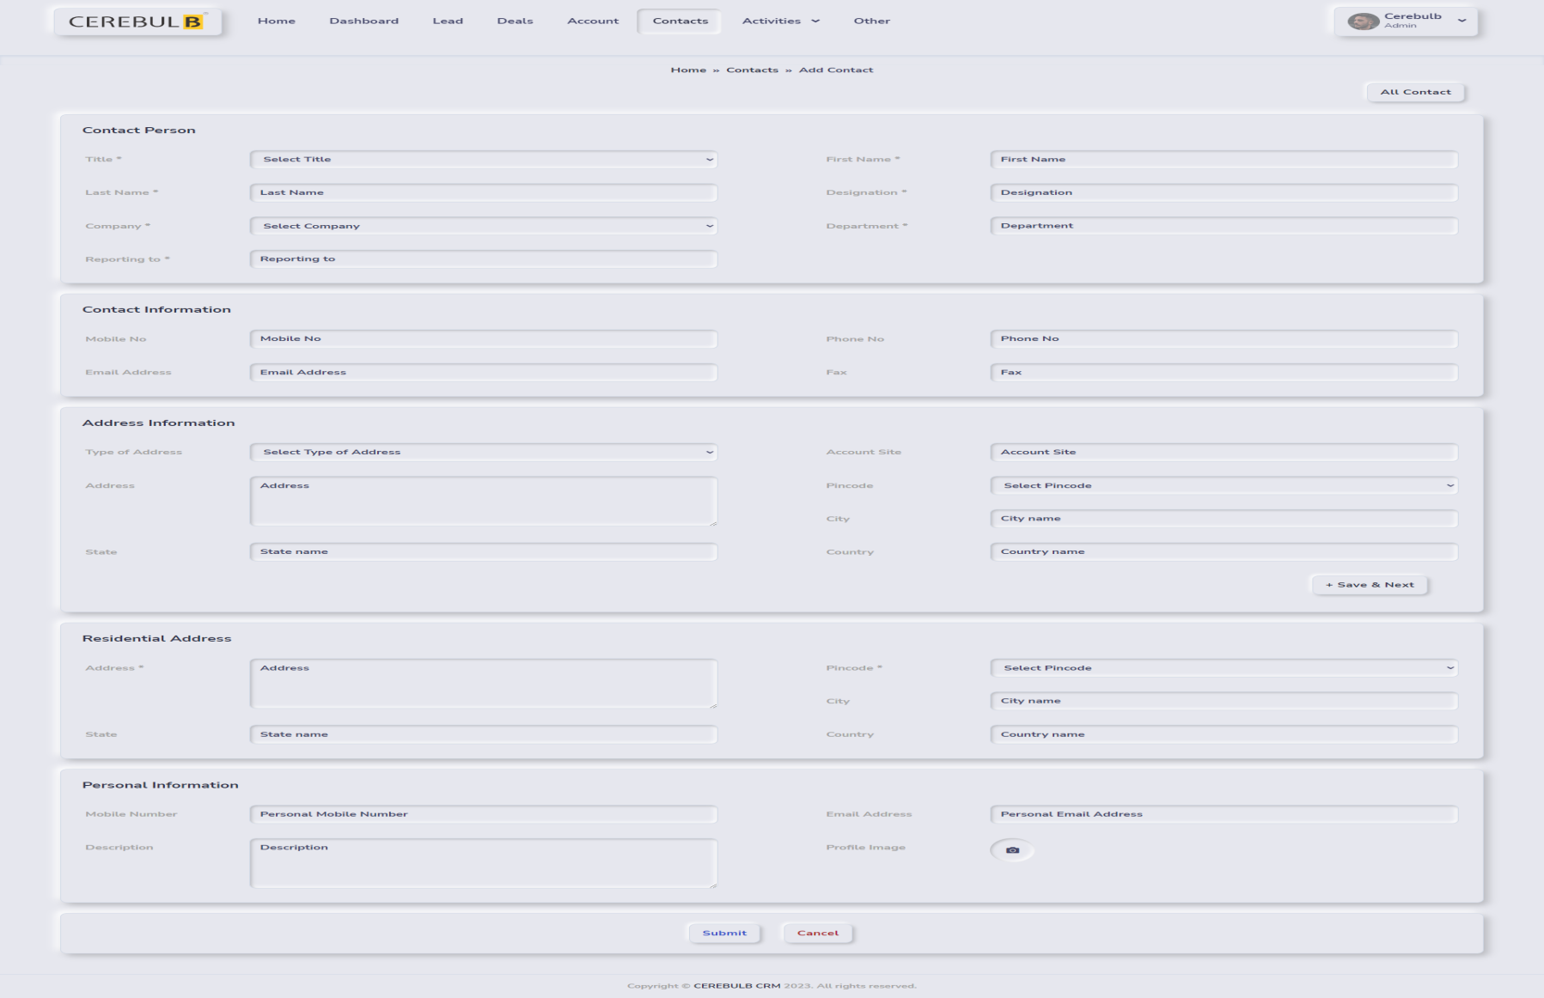

Slide 17
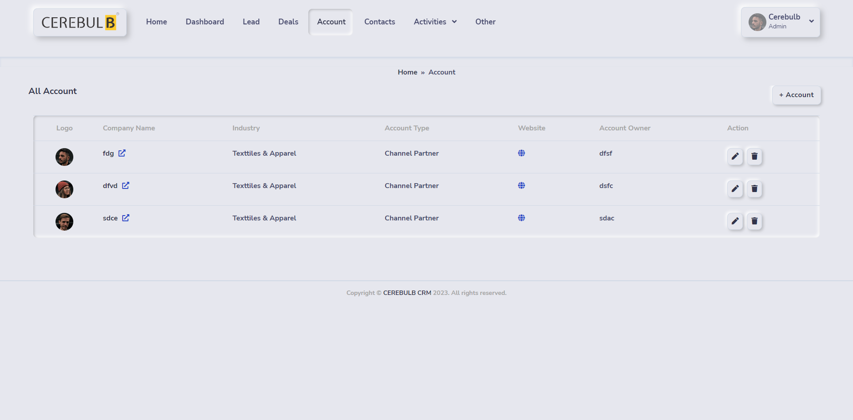

Slide 18
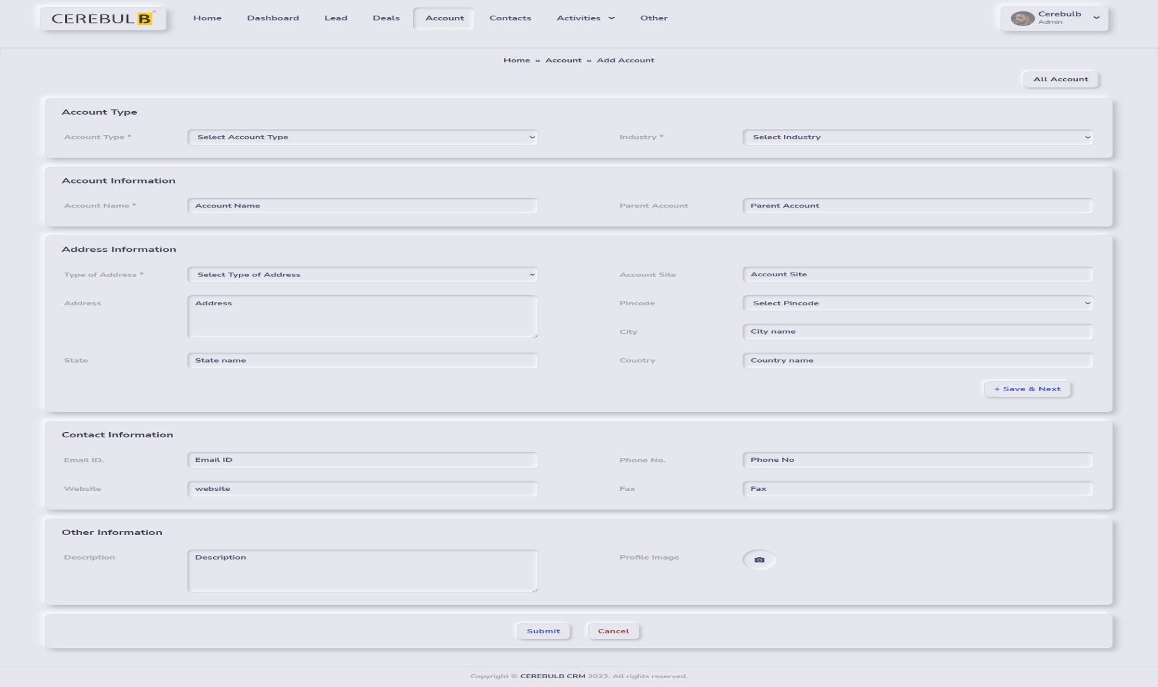

Slide 19
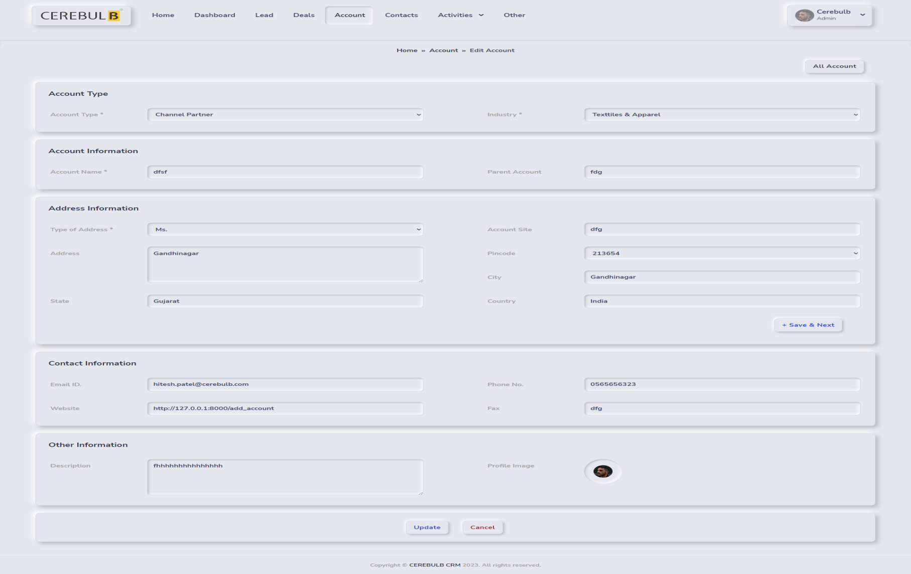

Slide 20
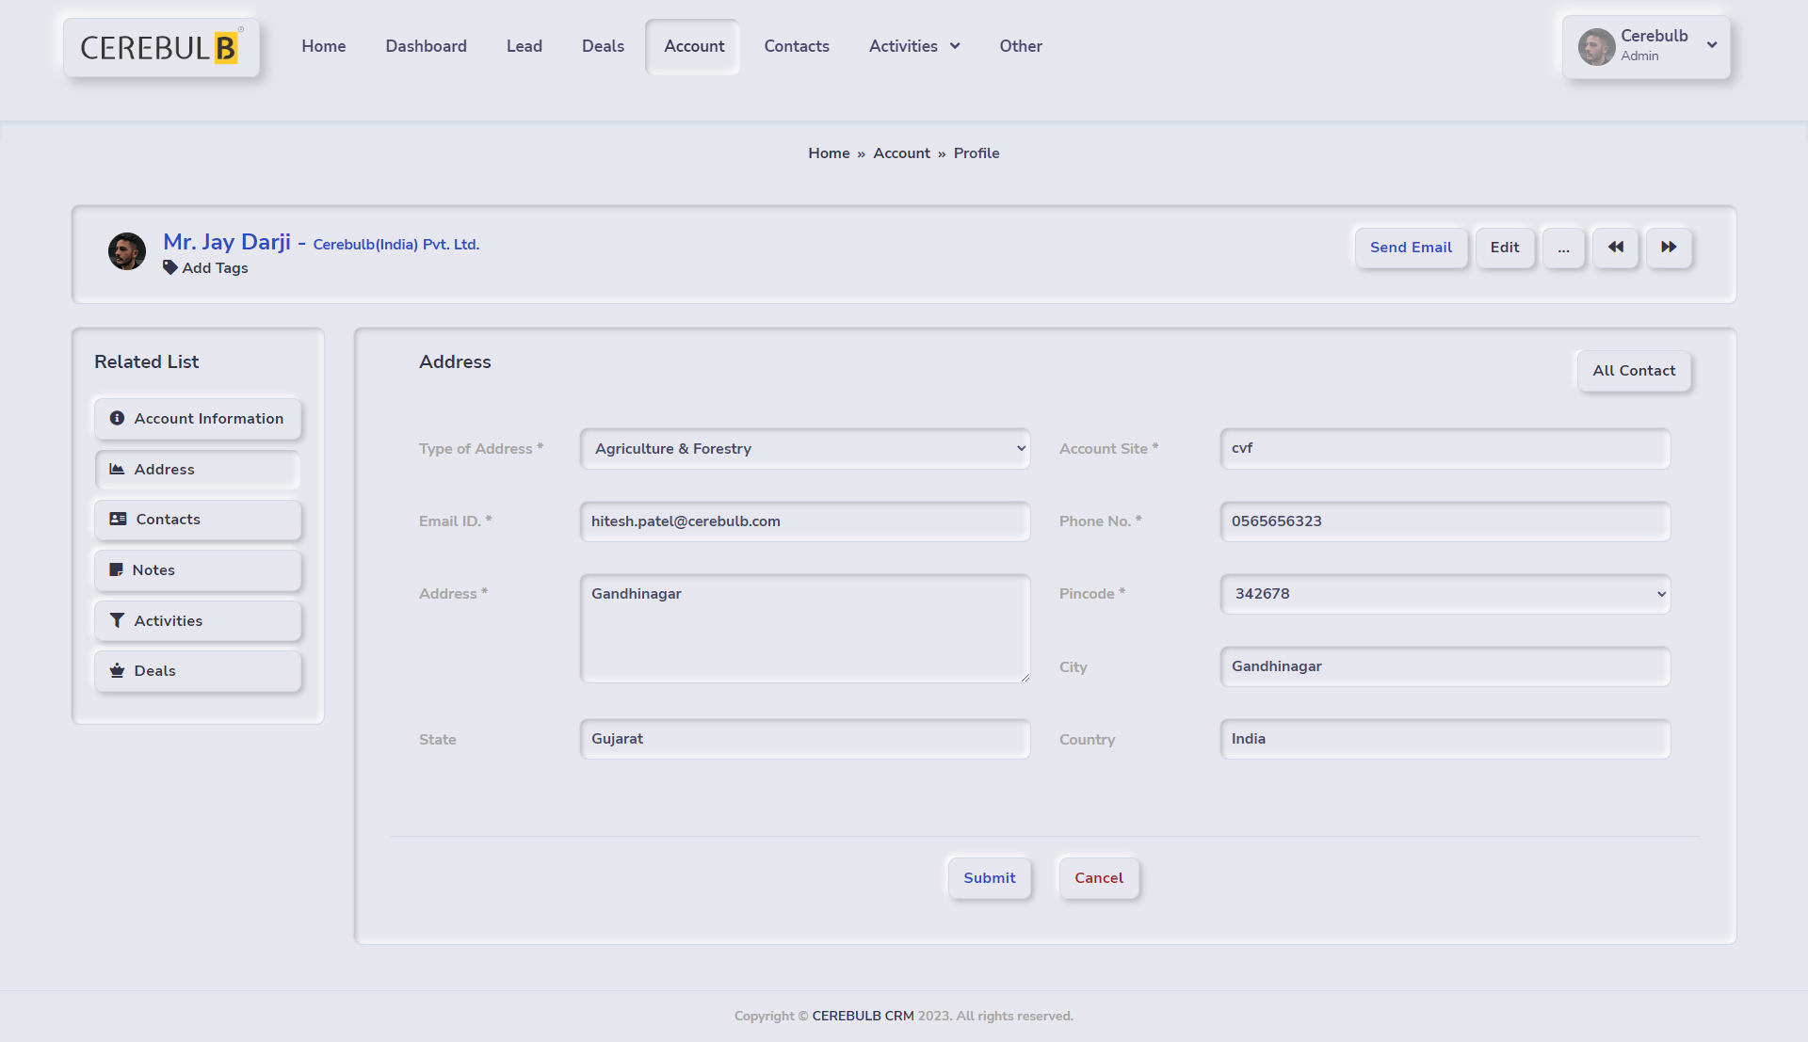

Slide 21
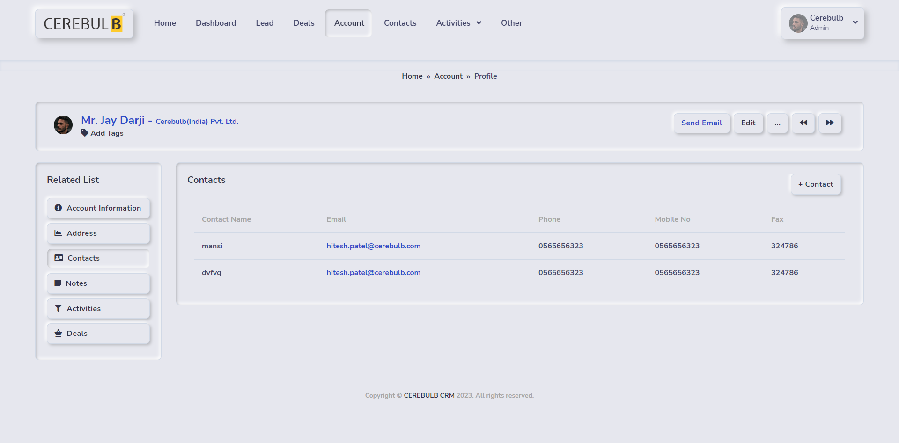

Slide 22
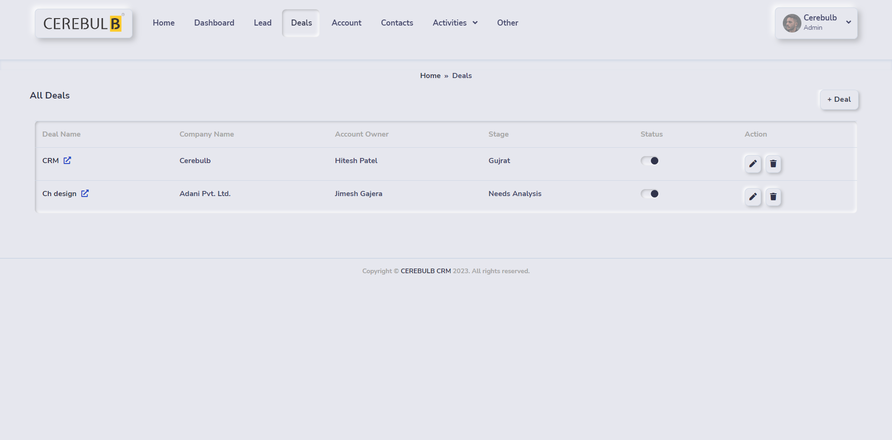

Slide 23
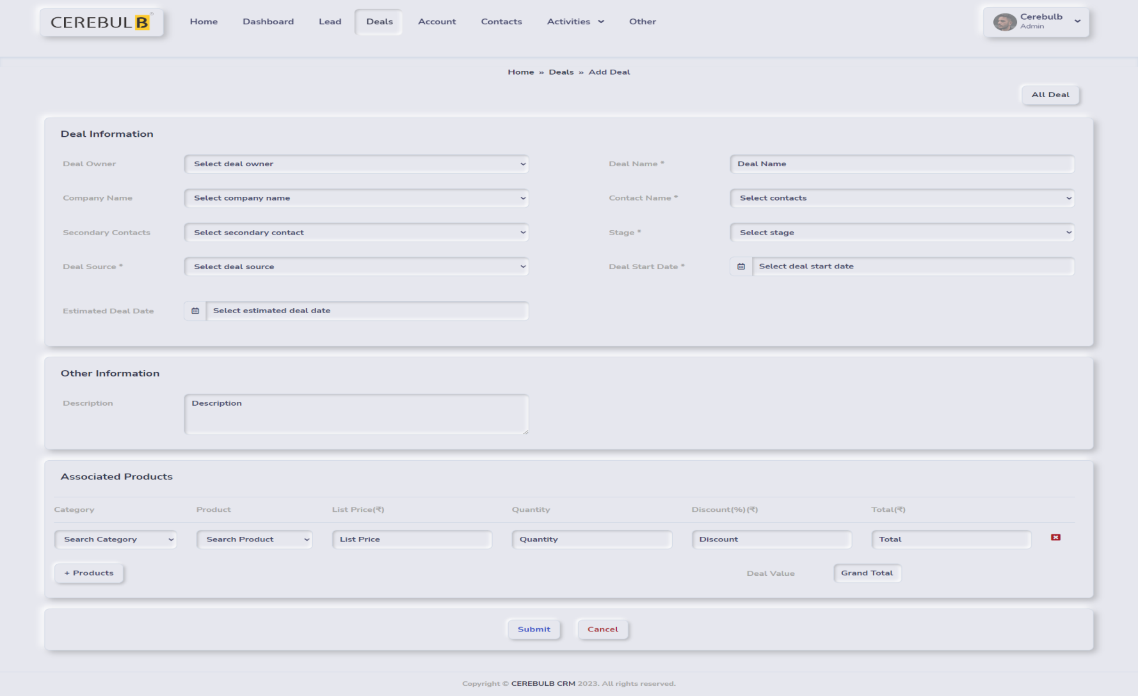

Slide 24
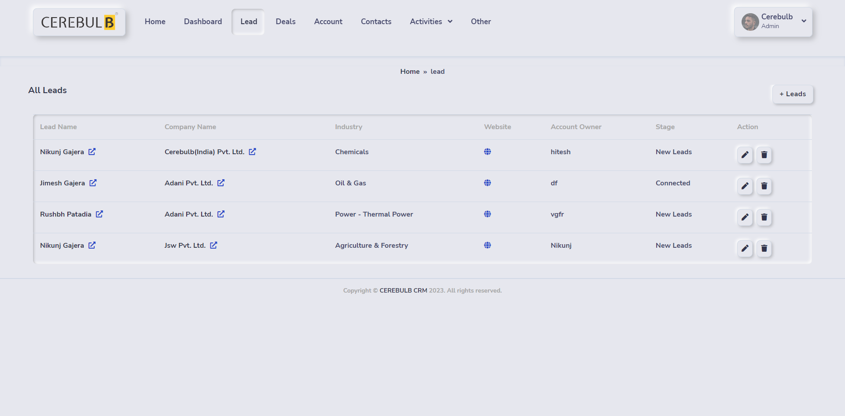

Slide 25
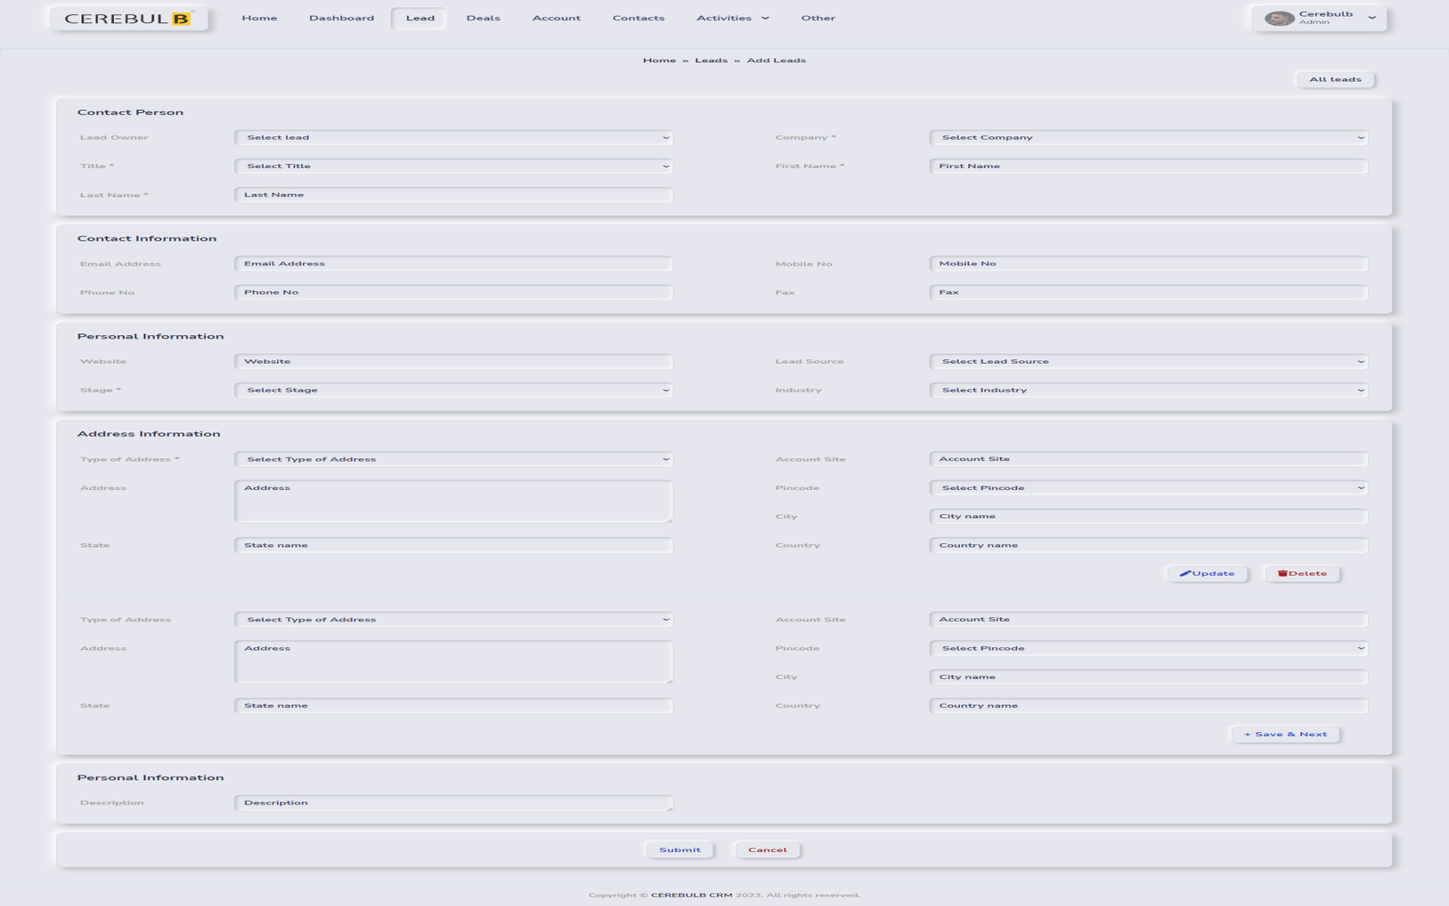

Slide 26
