Slide 1
OPTIMAL LOCATION FOR A HEALTH FOOD RESTAURANT
Bhavvya Sarna
13th April 2021

Slide 2
Introduction
Large scale social shift towards a sedentary lifestyle
People have started adopting healthier eating habits to combat this issue
Seeing an increase in demand for healthy eating options
Client aims to open a health food restaurant in Manhattan
Identify neighborhoods which would be the best fit for such a restaurant

Slide 3
Collecting Neighborhood Data
New-York borough and neighborhood data used
Filtered only to contain Manhattan neighborhoods
Foursquare API used to obtain neighborhood venue data

Slide 4
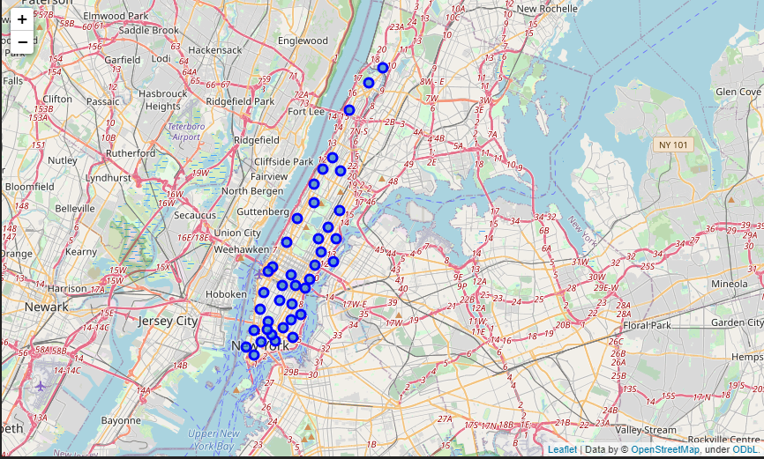
Neighborhoods of Manhattan

Slide 5
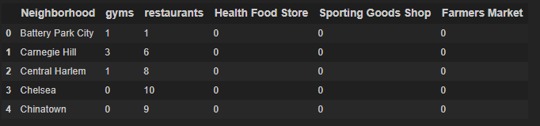
Categorizing Venues
Venues relevant to a healthy lifestyle were selected
Each neighborhood had it’s venues categorized
Compiled frequency of each category for each neighborhood

Slide 6
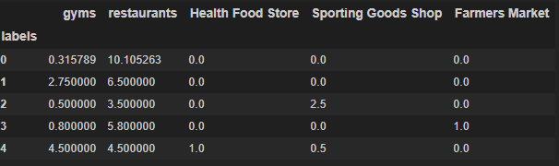
Clustering Neighborhoods
Neighborhoods classified into one of five clusters based on similarity to each other in terms of categories of venues
Expected frequency of each venue category for respective clusters used to make recommendations

Slide 7
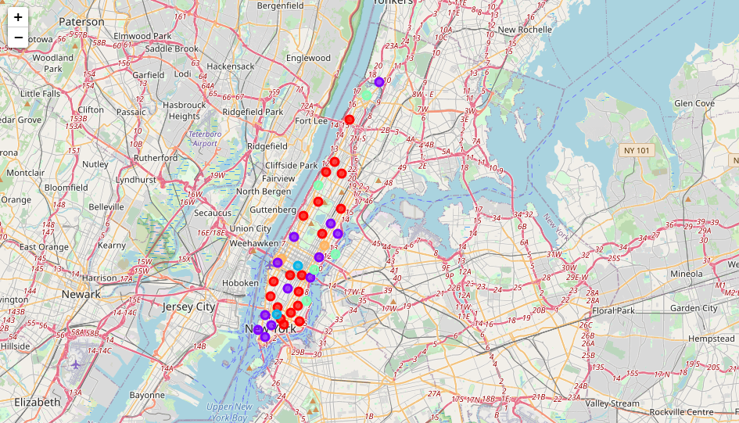
Clustered Neighborhoods of Manhattan

Slide 8
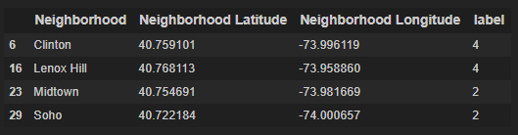
Recommendations Made
Primarily Cluster 4 because of more gyms, fewer restaurants and presence of health food and sports stores.
Secondary recommendation of Cluster 2 because of the maximum number of sport stores and minimum number of restaurants in Manhattan
Cluster 4 - Lenox Hill and Clinton
Cluster 2 - Midtown and Soho

