Slide 1
πOSEIDON Towards a global community for open climate research
Project description

Slide 2
Audience & Purpose
Audience
Researchers on climate (universities, institutes)
Climate policy makers
Those who are interested
Purpose
Provide information on project
Input for discussion
Encourage collaboration

Slide 3
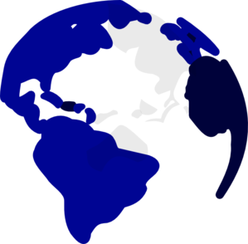
What’s wrong?
Climate is changing and growing emissions accelerate this effect. Extreme climate areas are experiencing exceptional droughts and water shortage. Climate impact of cities, areas with high emission concentration, is unknown and can endanger our health.
Currently, these areas are not well monitored and analyzed. And without research on these areas we will not understand the effects and therefore will not be able to create policies to limit the impact.

Slide 4
Our vision
We believe that better insights on our climate will prepare us for future impact. Therefore, our monitoring and research should be improved. And because climate concerns humanity all over the world, we need to collaborate, share and innovate together: Towards a global community of open climate research.

Slide 5

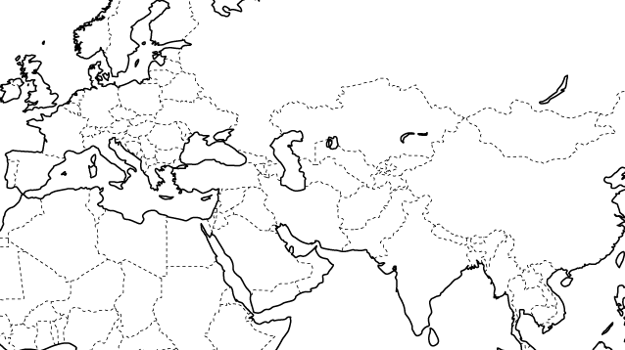
Poseidon
With Poseidon project, we provide the global community easy to use, low cost climate measurement methods and sensor platform.
To put emphasize on emissions in cities and climate change, we started collaborating with the Amsterdam Institute for Advanced Metropolitan solutions (AMS).
To stimulate research on extreme climate and extend our global community, we will do a four month mission through Central Asia visiting universities in the area.
We will educate our community to use our methods and tools in order to give them a head start in climate research. But most important of all, to open their research within the community and to challenge our community to improve our methods and sensors.

Slide 6



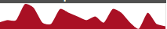
Our methods & tools
We have developed a simple sensor device measuring air pressure, moisture, dust and sound. This device is ready for use and to be plugged into our platform.
With this platform, researchers can create applications relevant for climate research. Additionally, researchers can add new sensors or connect their own devices.
Our emphasis lies on facilitating our community with tools and a central platform for sharing data and collaboration. With this basis, our goal is to challenge researchers to come up with new ideas to make us prepared for climate change.
Sensors on Arduino
Sensors on Raspberry Pi
Bluemix platform
Node-Red application
Data visualization

Slide 7

Use case: Smart agriculture in Central Asia
Farmers in Central Asia experience drought. Water for irrigation is becoming scarce and soils are turning wasted. To keep their business going and food supply intact, they need to know where farming is possible and how much water use is optimal.
Poseidon can provide farmers with simple sensor devices and ready to use models developed in our community. With sensors, they will be able to monitor the minerals in soils in order to decide which crops to grow. And the models can give irrigation schemes for optimal water use.
Farmers will now be able to perform effective and efficient growing of crops. And, they will contribute to global research community on extreme climate by creating a monitoring network of the area.
00:00
12:00
24:00

Slide 8
Use case: Smart sensoring for cities
.
It is predicted that more cities will emerge and will continue to grow. Increasing traffic within will impact air quality and the microclimate. We do not know the impact of emission on the microclimate and the high concentration could endanger the health of citizens.
Poseidon develops sensors for smart phones in collaboration with our community. Each citizen with a smart phone will measure the temperature and air quality. With this highly dense network and advanced research, policy makers will know where severe climate impact is expected and where to improve air quality. For example, by traffic diversion in areas of high emissions.
Policy makers will now be able to take conclusions from founded research in order to form climate policies and take appropriate actions. And, sharing data and findings between cities, policy makers globally can learn from each other and improve together.

Slide 9
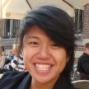
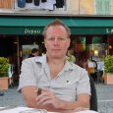
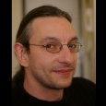
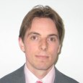
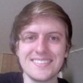
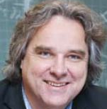

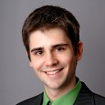
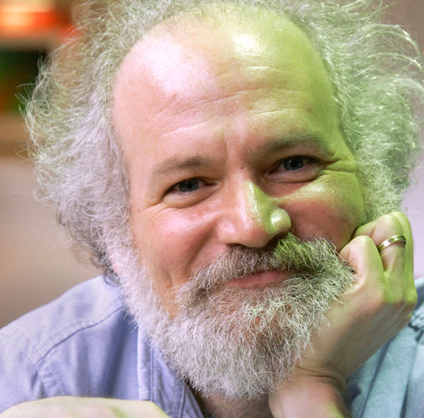
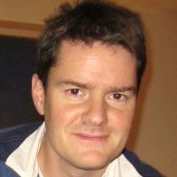
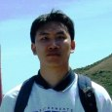
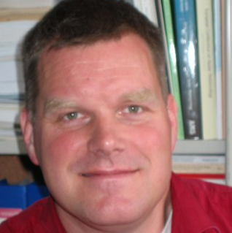






Organization
Core team
Community
Wing Yan Man
IBM – Project lead
Bill Hymas
IBM – Developer
Davy Vanherbergen
IBM – Developer
Advisory board
Robert-Jan Sips
IBM & Dutch courage – University relations
Christiaan Stierman
IBM – Developer
Nick van der Giessen
TU Delft – Professor Water management
Gert Jan Keizer
Dutch courage - Education
Kai Weller
IBM – Developer
John Cohn
IBM – Fellow
Bram Havers
IBM – Architect
Bihao Song
IBM – Developer
Remko Uijlenhoet
Wageningen University – Professor Hydrology
Dutch Courage Foundation
IBM
Technical University Delft
Amsterdam Institute for Advanced Metropolitan Solutions
Kazachstan National Technical University
Turan University
Wageningen University

Slide 10
Interested?
If you are interested to start this journey with us?
Do you have ideas you want to share?
Or do you just want to know more?
Contact us at wing@dutchcourage.org.
.

