Slide 1
File Sharing application 📁
C Bhavesh Kumar
Kaushik rishi
Karthik konyala
Srineer kaleri
Manideep reddy

Slide 2
Problem statement and motivation
Problem statement:
Need to contact the file owner on social media for the file.
The pain of showing people the directions to find a particular file.
The need of using personal accounts cloud storage for sharing small files.
No single place that is Ad-free for converting files from one format to other.
Notes:
Bhavesh
Whenever we want to share a file publicly and make it available to many people we either need to post it in forums and tell people the directions to find that file or go through a hard process of sending the file by uploading it a to a cloud service and sharing it to each and every person and also when there is a case of sharing/request a file with an unknown person we need to contact him personally on social media and request that file

Slide 3
Problem SOlution
Our aim is to develop an application to share files instantly and anonymously with a single click without the need to upload it to a personal cloud service.
Not only sharing files but we also are planning to provide embed links for images so that they can be embedded into an html document.
Providing a user friendly UI and forums for file requesting and other features like converting the files between different file formats could be done online.
We can also share the file within a certain group of people providing the user ids of the people who would be given access to the file.
Notes:
Karthik

Slide 4
Functional description / Features of APPLICATION
File sharing module : The core module of the project is the concept of sharing the files. When a user sends a post request to the server with the file he gets a link back which he can share with any other person on the internet.
Accessing the files uploaded by a certain user: When we head over to the baseurl/{username} we can see the publicly uploaded files of the user and the date and time of upload.
Authentication Module : Implement the authentication using JWT and cookies and sessions.
Notes:
Rishi

Slide 5
Functional description / Features of APPLICATION
Discussion forum module : We will have a discussion forum where users can publicly request for some files like an image of a dog etc, and other users can share the file.
File Upload based on authentication : We will restrict the size of file upload to certain mb for guest users and will make larger uploads available for authenticated users
Self destructing files module : When uploading the file we will give an option to choose from wherein user can choose the link to be invalid after a certain time.
Notes:
Rishi

Slide 6
Task name
Front end:
Design
Implementation
Database Design:
Design
Making the tables in Postgres SQL.
Backend:
Using the ORM To convert the DB into models.
Handling file uploads
Handling file downloads
Making views for user profiles
Authentication
Authorization
Deployment:
Hosting the site
Notes:
Srineer

Slide 7
Tech stack
Front End:
HTML
CSS
Materialize CSS
Javascript
Database:
MySQL / Postgres SQL
Back End:
Django / Node JS
Hosting and Deployment:
Free hosting on heroku.
Notes:
Srineer

Slide 8
DURATION and members
We aim to complete the project by the first week of april considering all the features to be implemented
Front end: (By Second Review)
Wire Framing - Kaushik Rishi
Html - Manideep
Styling - Bhavesh, Karthik
Page Animation - Srineer
Database design: (After Second Review)
Srineer will design the database and the foriegn key relations and simultaneously we will start working on the backend
Backend and Views: (By Third Review):
Model Designing : Bhavesh
User authentication and permissions - Srineer
Discussion forums - Karthik and Manideep
Serving the file based on URL - RIshi
Notes:
All

Slide 9
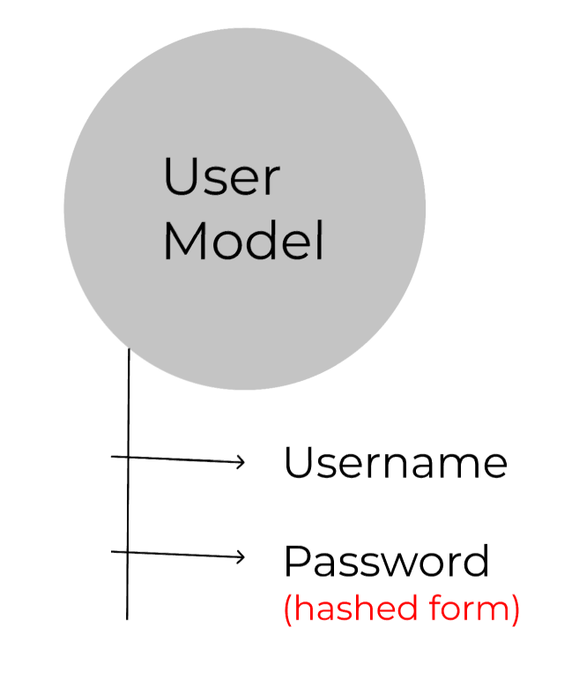
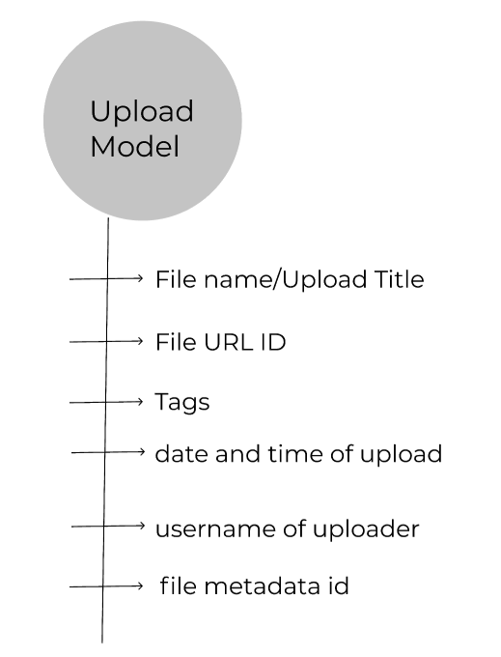
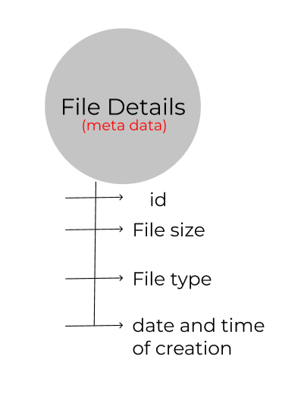
SOFTWARE COMPONENTS and models
Notes:
Rishi

Slide 10
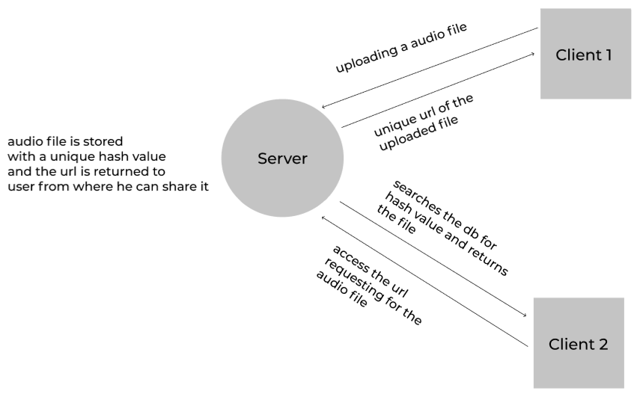
HIGH LEVEL OVERVIEW OF THE WORKING OF THE APPLICATION
This the high level overview of how the server will be accepting requests and responding to the user based on whether the user is trying to upload the file or access the file
Notes:
Rishi

Slide 11
FUTURE IMPROVEMENTS
- Make an API using REST architecture for the website and rebuild it.
- Will work on folder upload and resumable file uploads.
Notes:
Rishi

