Slide 1
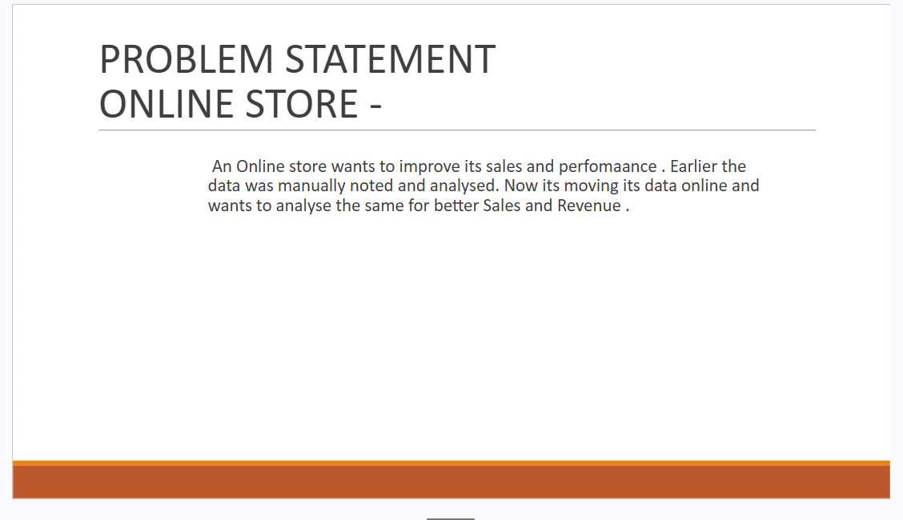

Slide 2
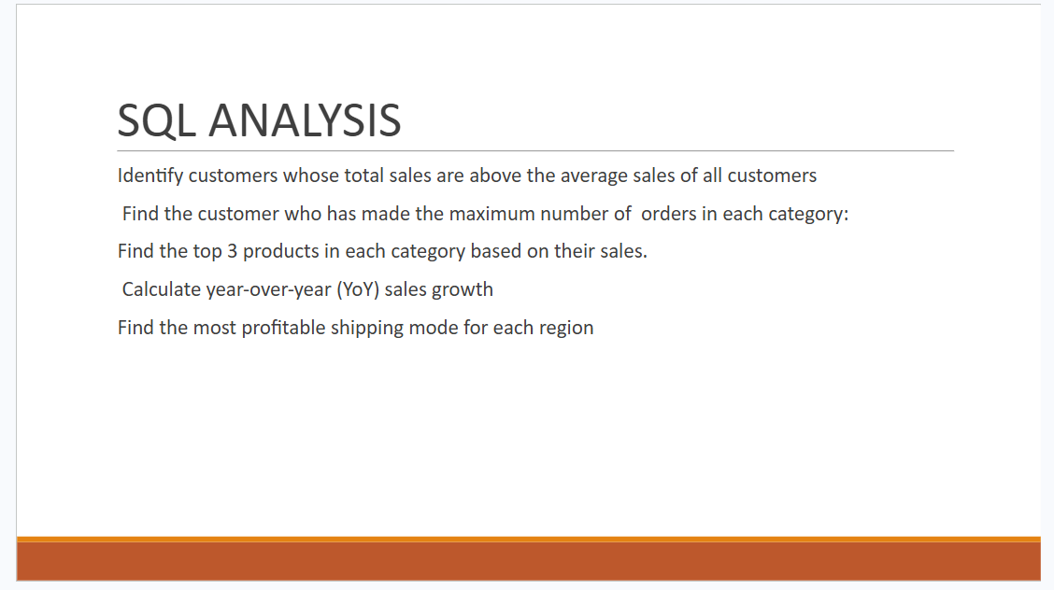

Slide 3
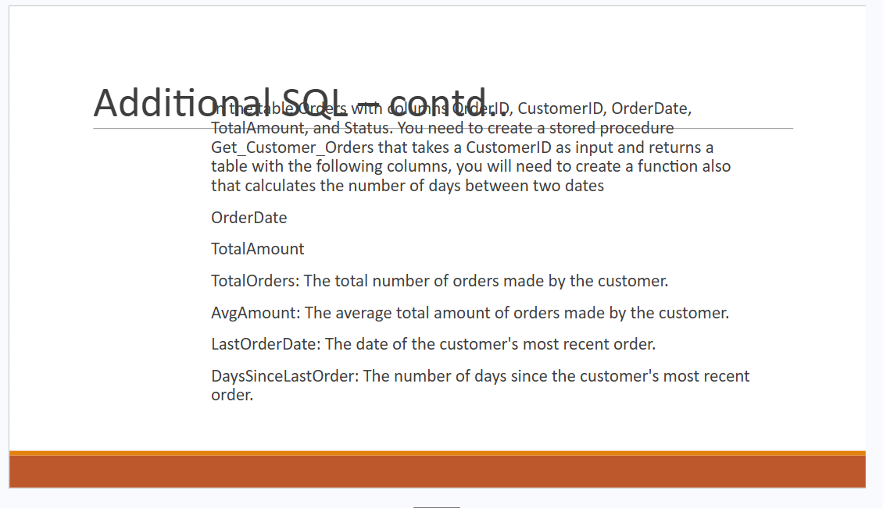

Slide 4


Slide 5


Slide 6


Slide 7


Slide 8


Slide 9


Slide 10


Slide 11
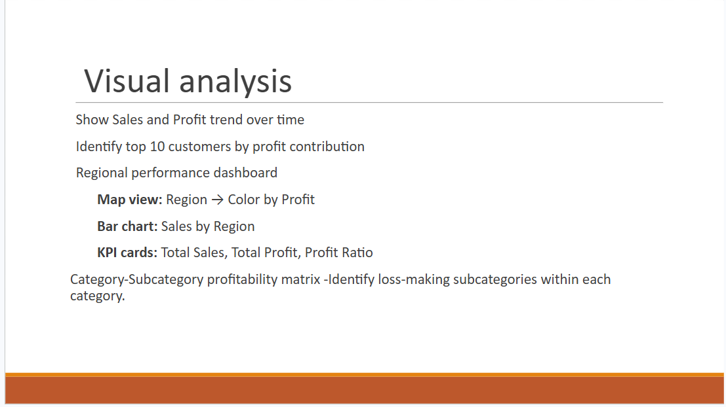

Slide 12
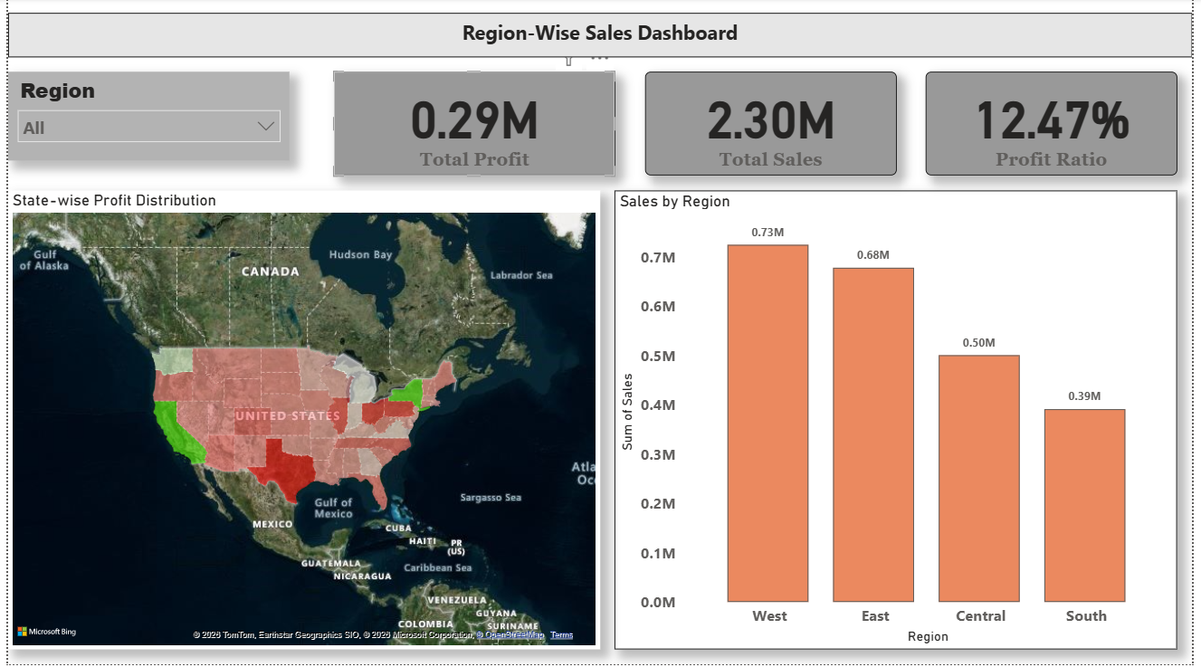

Slide 13
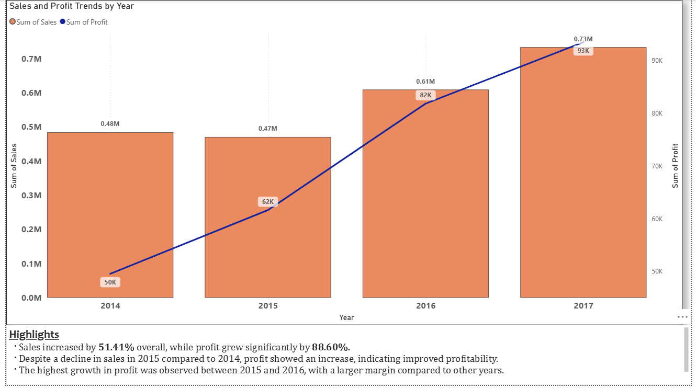

Slide 14
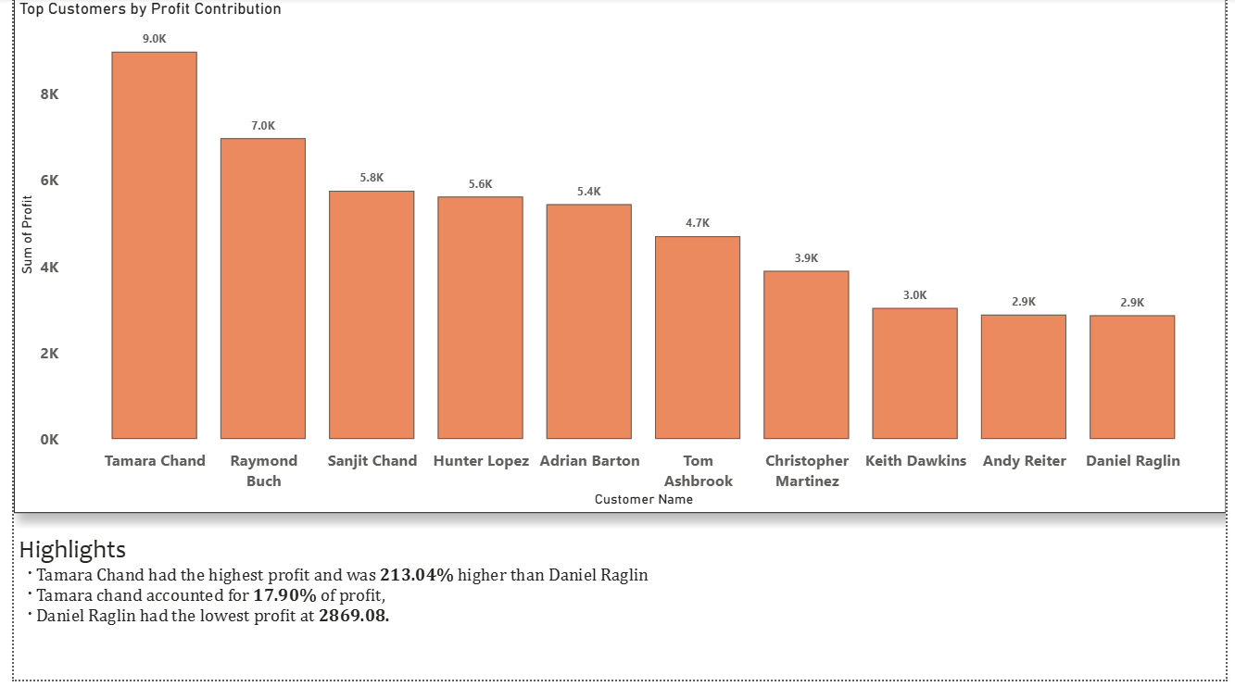

Slide 15
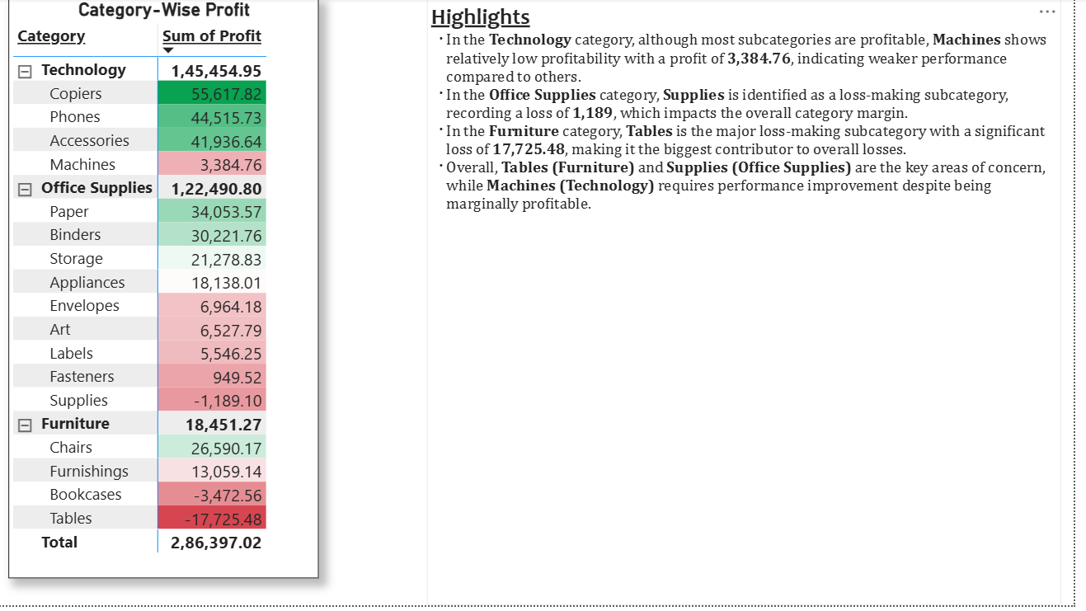

Slide 16
Insights
Despite a decline in sales in 2015 compared to 2014, profit showed an increase, indicating improved profitability.
The highest growth in profit was observed between 2015 and 2016, with a larger margin compared to other years.
Technology is the most profitable Category, while Furniture underperforms in terms of profit.
The West region contributes the highest sales and profit.

Slide 17
THANK YOU

