Slide 1

uniQuest
by Jarvis’s Javalins

Slide 2
TABLE OF CONTENTS
01
04
About the Project
Sneak Peek
02
05
Tech stacks used
Project Stages
03
07
Project Goals
Future Scope
08
Our Team

Slide 3
OUR PROJECT
uniQuest is a platform for university students to network and clarify their doubts with the benefit of privacy. Ask questions anonymously within your university and get guidance towards your path. Get unadulterated opinions and reviews from your peers and get to know about the hidden aspects of things. Share your thoughts freely and help others to go on the right path. Our project helps university students to-
Ask and answer questions anonymously
Connect with the people of your university
Get the best of your university experience
Prepare yourself for the working world

Slide 4
TECH STACKS USED
FIREBASE NODE ROUTER
REACT TAILSWIND BOOTSTRAP ICONS QS
JAVASCRIPT CSS HTML

Slide 5
PROJECT GOALS
To make doubt solving seamless
Ask questions without judgement
Connect with seniors
Answer questions of your peers
Build a community
Integration into college infrastructure
Get honest opinions and reviews with any adulteration

Slide 6
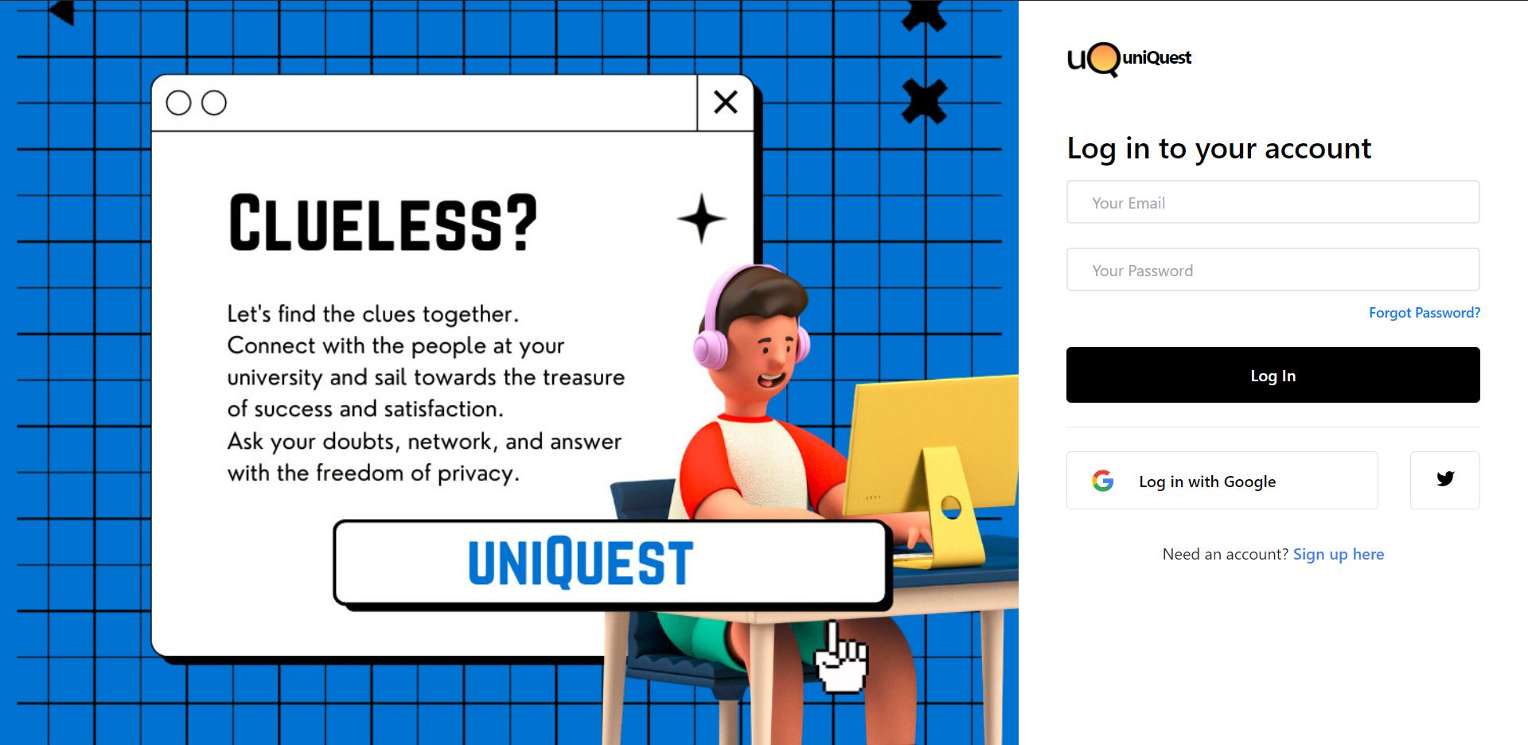
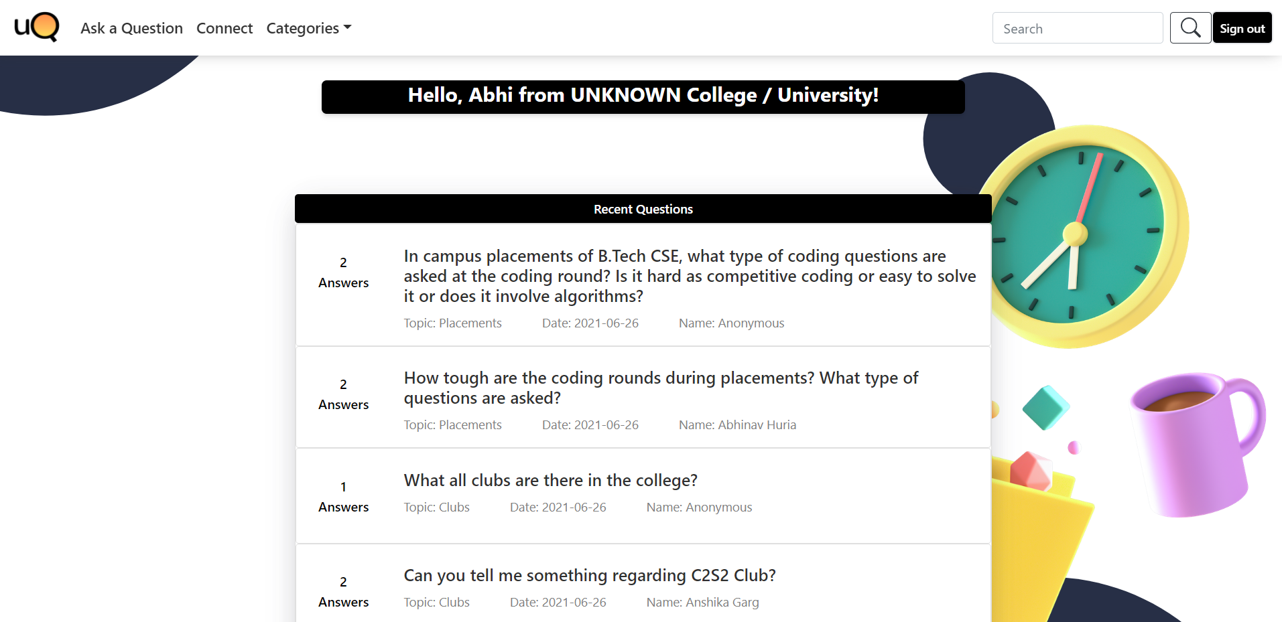
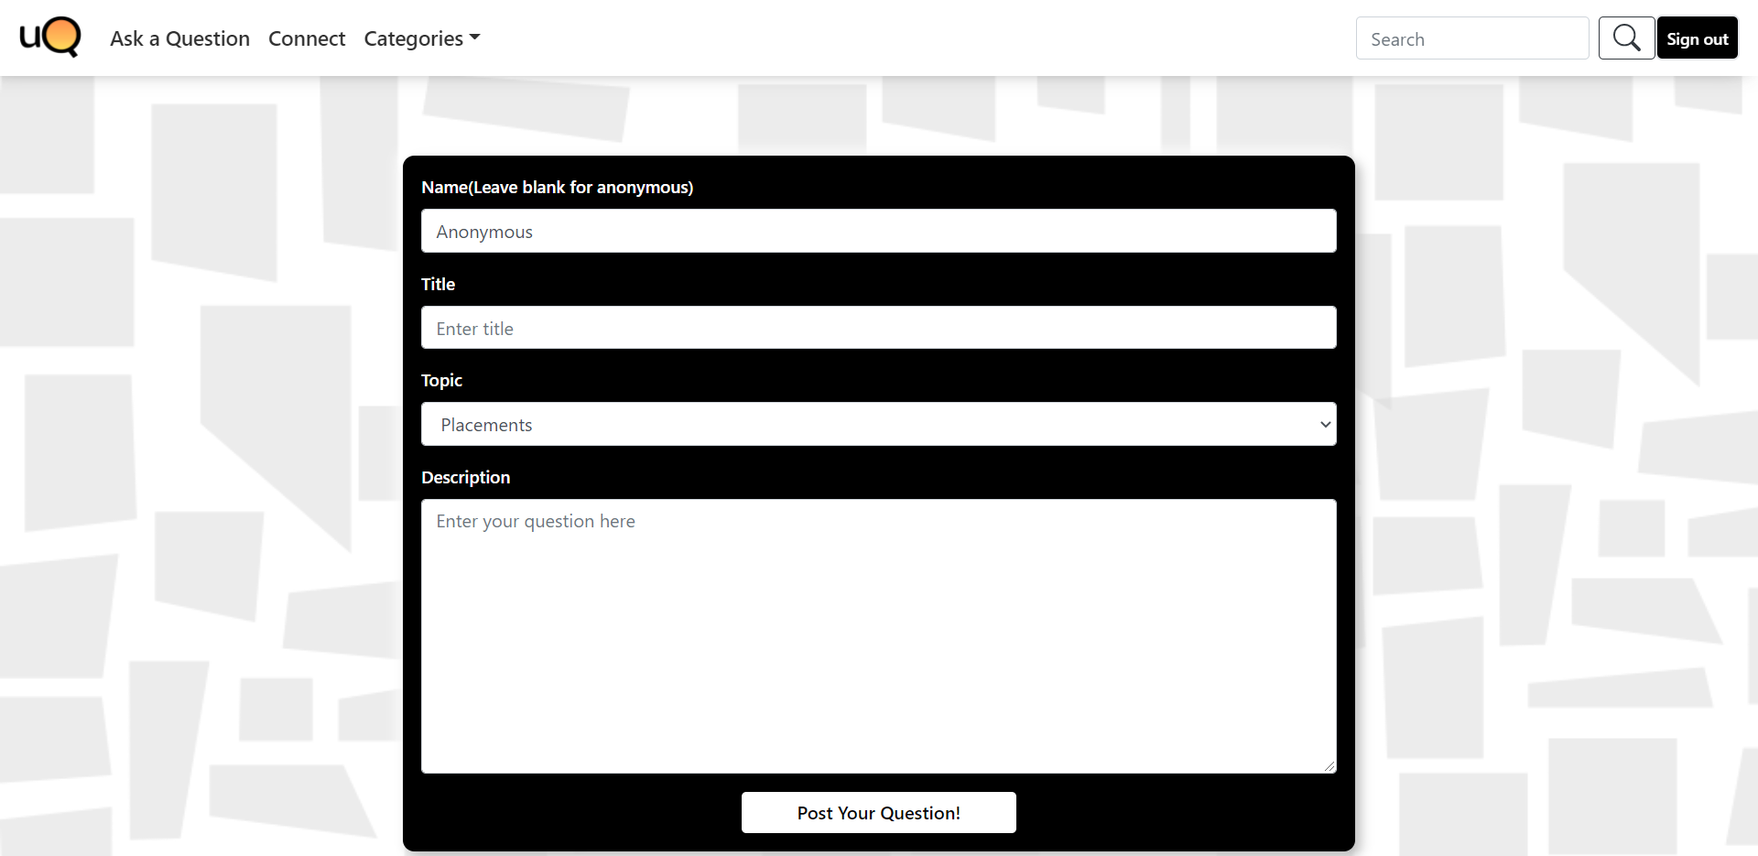

Slide 7
PROJECT STAGES
IDEATION
LOGIC DESIGN
UI DESIGN
()
IMPLEMENTATION
✔
TESTING AND FINISHING

Slide 8
FUTURE
SCALING
DATABASE
ADAPTABILITY AND UI DESIGN
ANONYMOUS DIRECT CHAT

Slide 9


THE TEAM
Abhinav Huria
Bhavesh Garg
Muskan
Nandini Gupta
Chitkara University, Punjab

Slide 10
THANKS!

