Slide 1
FINAL PROJECT REVIEW
TEAM MEMBERS
Scissor-Expanding Conveyor for Harvest Fields
Student Name | Reg No
Bhavesh A | 24BMH1048
Santhosh Kumar M | 24BMH1005
Monish K | 24BMH1001
Mithun Shankar M | 24BMH1053
Moves banana bunches, jackfruit and coconut (up to 50 kg each) from the row to the vehicle, on a belt that shortens to fit a vehicle.
Group No: G12
Review Date: 21 / 10 / 2026
Time Slot: 01:30 PM – 02:00 PM
Project Guide: Dr. Sakthivel G, School of Mechanical Engineering
B.Tech Mechatronics and Automation | School of Mechanical Engineering | VIT Chennai
Notes:
Title slide. Fill in the project title, group number, review date and slot, guide name, and all team members with register numbers. Replace the logo box with your institution logo. Delete any unused team rows.

Slide 2



Problem Statement
01
The problem
Who is affected
Banana bunches, jackfruit and coconut weigh up to 50 kg each and are carried by hand from the row to the vehicle. Carrying is slow and bruises the fruit. A conveyor long enough to help (about 4 m) is awkward to move between rows.
Banana, jackfruit and coconut harvest crews
Why it matters
Scale of the problem
Items up to 50 kg; up to 4 on the belt (200 kg)
Heavy 50 kg lifts repeat through the harvest day
Bruised fruit loses value, and hand carrying is slow
One frame that closes for transport can follow the crew from row to row
Gap in current solutions
Cableways need fixed lines; fixed 4 m conveyors are hard to move
Notes:
About 1.5 minutes. State the problem clearly before talking about your solution. Back the scale of the problem with at least one statistic and its source.

Slide 3
Objectives
02
01
Change length
02
Carry the load
Open and close on its own frame: 3840 mm between end frames when working, 2160 mm for transport (bay pitch 480 to 270 mm).
Carry up to 4 items (200 kg) at 0.20 m/s on one flat 2-ply PVC belt, 4 mm thick.
03
Support the belt
04
Drive it simply
Hold the belt on top-node cross-beams at every length. No mesh, so no pinch points for fruit.
One plug-in worm gearmotor, at least 358 W at 26.2 rpm. Design-basis target, to be re-run on rev D.
Notes:
About 1 minute. Each objective should start with a verb and be measurable, so you can check it against your results later.

Slide 4
Literature Review & Existing Solutions
03
Ref | Author & Year | Approach / Technology | Limitation | How our project improves
[1] | Liu H. et al., 2015 | Foldable conveying arm on a cane harvester; field test | Folds for road travel only; part of the harvester | Stand-alone frame; length changes by 44 %
[2] | Guo et al., 2020 | Review of banana post-harvest handling: cableway, manual, animal haulage | Cableways need fixed lines; hanging bunches swing and bruise | Bunch lies on a supported belt; frame rolls on wheels
[3] | Li et al., 2024 | Banana bunch transporter with lifting mechanism and automatic stalk fixing | Moves one bunch per trip | Continuous belt, up to 4 items on the run
[4] | Best et al., 1997 (US 5632371) | Expandable powered conveyor on lazy-tong scissor trusses | Built for cartons on rollers, not soft heavy produce | Flat belt on cross-beams; support check pending
Gap: no portable conveyor found that keeps a heavy-produce belt supported while its frame length changes by 44 %. Full citations are on the References slide.
Notes:
About 1.5 minutes. Pick 4–6 of the most relevant papers, patents or commercial products. Focus on the gap your project fills.

Slide 5





Proposed Solution & Methodology
04
Research
Concept & CAD
Fabrication
Integration
Testing
Harvest handling study and the 50 kg load case
Rev D CAD rebuilt from the prototype photo
Aluminium A-frames and scissor links built
Belt, drive and control box come next
Fold and load tests planned; none run yet
Proposed solution
Three wheeled aluminium A-frames carry a lazy-tong scissor on each side. Pulling the end frames apart opens 8 bays and lengthens the deck; pushing them together shortens it for transport. A flat 2-ply PVC belt on top-node cross-beams carries the produce, replacing the mesh surface. A scissor was chosen over a hinged fold because the belt stays supported at every length.
Notes:
About 1.5 minutes. Walk through the steps you followed from idea to working prototype. Rename or add steps to match your project.

Slide 6
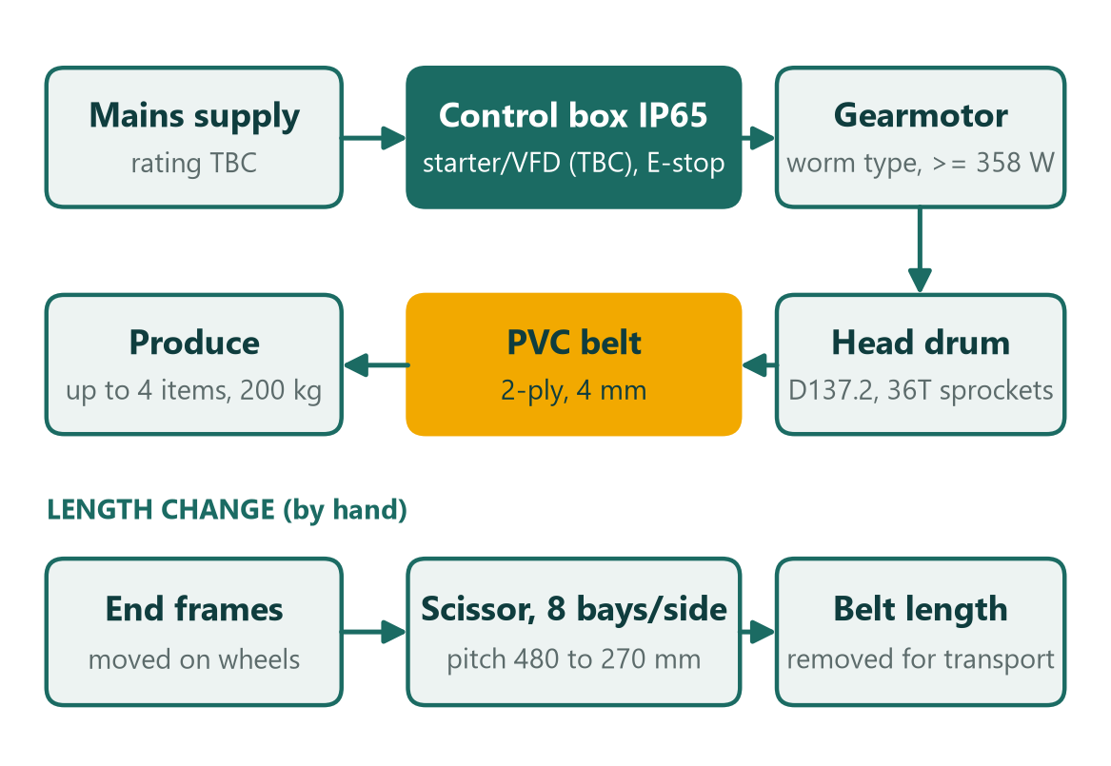



System Architecture
05
Key subsystems
Sensing
No sensors fitted; E-stop on the control box
Control
IP65 box with starter or VFD (TBC)
Actuation
Worm gearmotor on the head drum; frame opened by hand
Power
Mains supply (rating TBC)
Notes:
About 1.5 minutes. Use a clean block diagram: inputs on the left, controller in the middle, actuators and outputs on the right.

Slide 7
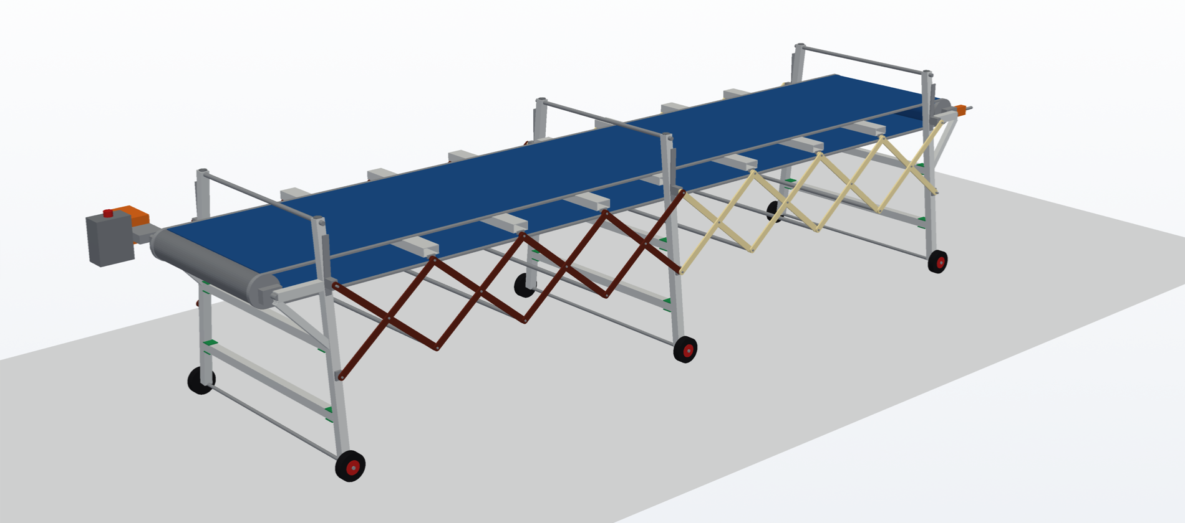
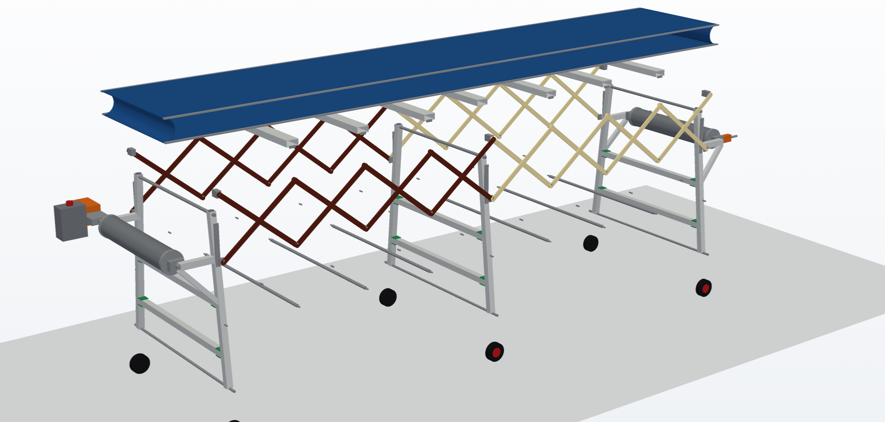
Mechanical Design (CAD)
06
Parameter | Value
Overall dimensions | 4750 x 1457 x 1104 mm working; 3070 x 1457 x 1104 mm transport (incl. motor block)
Material(s) | Al 6063-T5 RHS 40x40x3 and 80x40x3; Al 6082-T6 links 30x8
Weight | Aluminium structure about 46 kg (CAD volume); total TBC
Key mechanism | Lazy-tong scissor, 8 bays per side, link 620 mm
Load / capacity | 4 items, 200 kg (design basis)
CAD software | CadQuery (OpenCASCADE); STEP files
Design highlights
Scissors sit on top of the A-frames, as built: pitch 480 to 270 mm, deck 900 mm at working length.
Flat PVC belt rides on cross-beams at the top nodes. No mesh.
Fold check: 0 unintended overlaps at 4 pitches. Structural re-check on rev D is pending.
Notes:
About 2 minutes. Show clear CAD renders, not screenshots of the whole software window. Mention any calculations or analysis (FEA, torque, load).

Slide 8
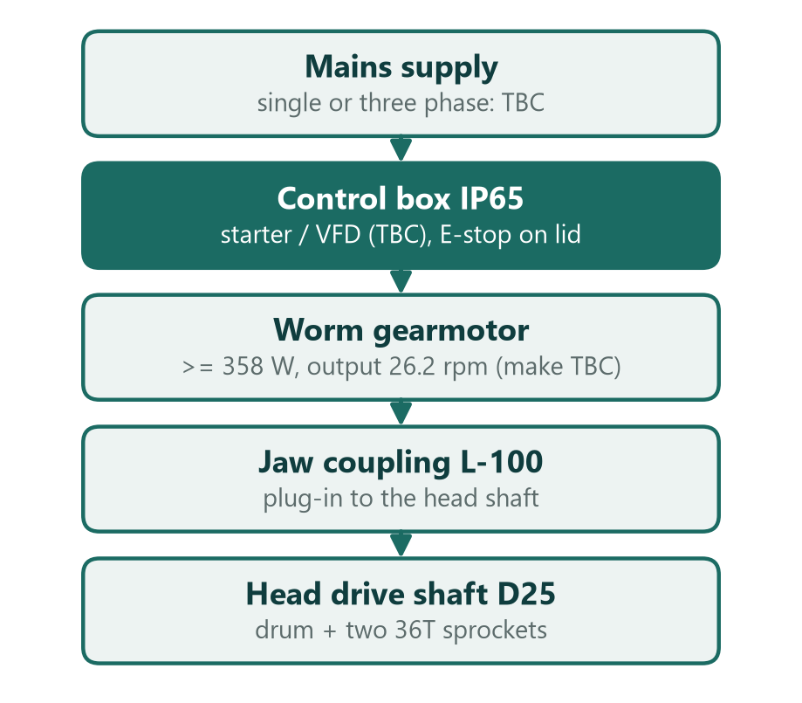
Electronics & Control System
07
Component | Model / Rating | Purpose
Gearmotor | Worm type, >= 358 W, 26.2 rpm out | Drives the head drum
Coupling | Jaw L-100, plug-in | Motor to head shaft
Control box | IP65; starter or VFD (TBC) | Start, stop, speed
E-stop | On the control box | Stops the drive
Sensors | None fitted | Loading is manual
Supply | Mains, rating TBC | Powers the drive
Gearmotor, coupling and control box are envelopes in the CAD. Make and model are to be confirmed.
Notes:
About 1.5 minutes. Show the circuit or wiring diagram (Fritzing, KiCad, EasyEDA, etc.) and list the main components with ratings.

Slide 9
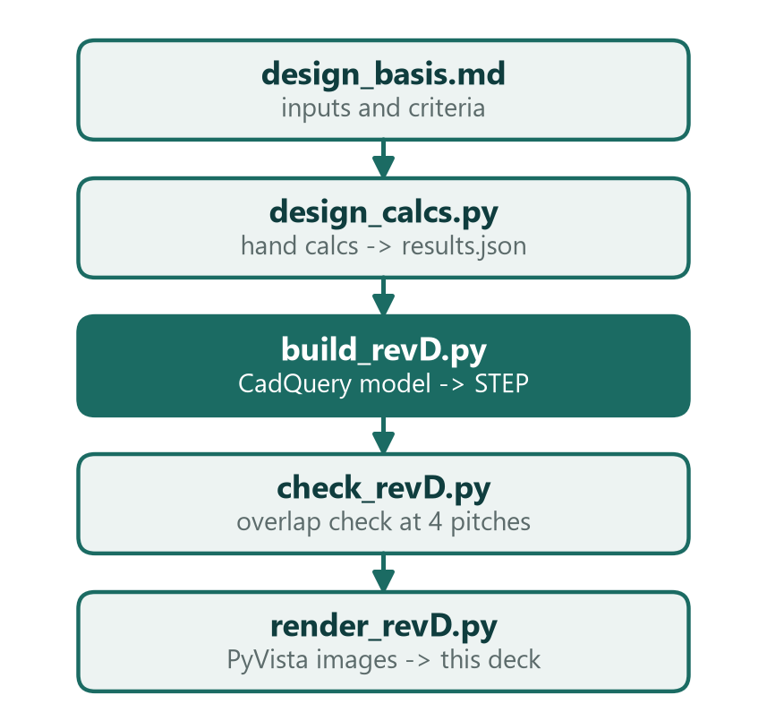



Software & Code
08
Platform & language
Python 3: CadQuery, PyVista, python-pptx
Key algorithm / logic
Hand calcs to results.json; CAD built from the same parameters; fold check at 4 pitches
Code repository
Local project folder; Drive link to be pasted before submission (TBC)
Notes:
About 1.5 minutes. Explain the program logic using the flowchart. Don't paste long code on the slide; give the repository link instead.

Slide 10
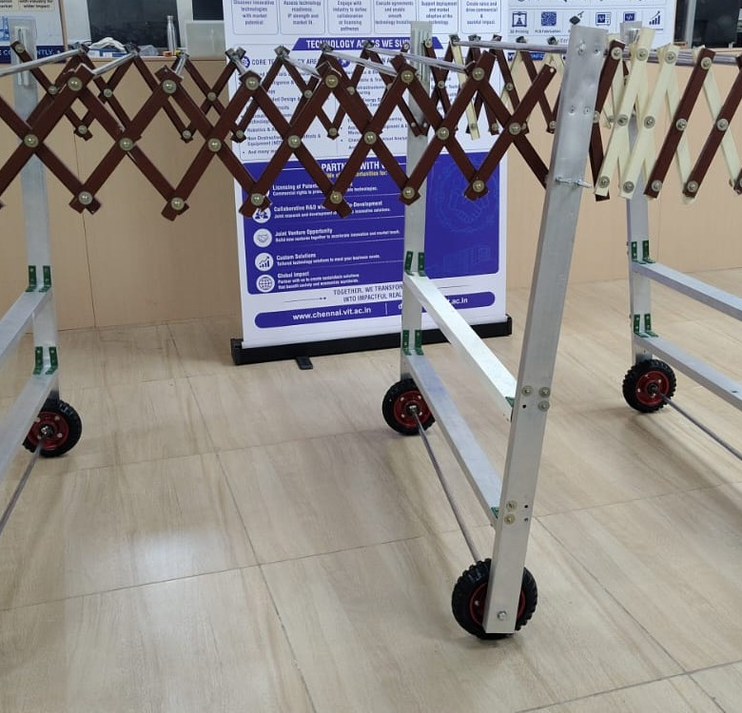
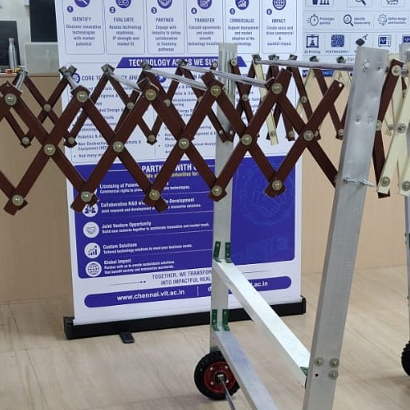
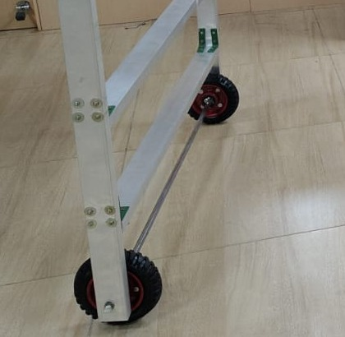
Prototype & Fabrication
09
Fig. 1 – Prototype: three A-frame sections
Fig. 2 – Scissor links between the frames
Fig. 3 – Leg, lower rails and wheel
Built from aluminium sections with bolted joints and corner plates, scissor links pinned in two layers, and wheels on cross axles. The belt, drive and control box are not fitted in this photo. CAD rev D was rebuilt from this prototype.
Notes:
About 1.5 minutes. Show real photos of the built prototype: the full assembly, key mechanisms and the electronics. Bring the prototype for the live demo.

Slide 11


Bill of Materials & Cost
10
S.No | Item | Specification | Qty | Unit cost (₹) | Total (₹)
1 | Leg, Al 6063-T5 RHS 40x40x3 | Splayed 6 deg, about 1043 mm | 6 | TBC | TBC
2 | Lower rail, RHS 40x40x3 | Between the legs of each frame | 6 | TBC | TBC
3 | Scissor link, Al 6082-T6 flat bar | 30x8, 620 mm pin to pin | 32 | TBC | TBC
4 | Top-node cross-beam, RHS 80x40x3 | Belt support (6 + 1 centre) | 7 | TBC | TBC
5 | Wheel on cross axle | D125, axle D16 | 6 | TBC | TBC
6 | Pivot pin, A2-70 | D10 | 52 | TBC | TBC
7 | Conveyor belt, 2-ply PVC | 4 mm, 758 mm clear width | 1 | TBC | TBC
8 | Drum and shaft set | D137.2 drum, two 36T sprockets, D25 shaft | 2 | TBC | TBC
9 | Worm gearmotor + coupling | >= 358 W, make TBC | 1 | TBC | TBC
10 | Control box IP65 with E-stop | Starter or VFD TBC | 1 | TBC | TBC
11 | Take-up UCT205 with M16 drawbolt | Tail end | 2 | TBC | TBC
 | Total project cost |  |  |  | TBC
TBC
Total cost of the prototype. Prices are not collected yet.
vs. market
Price of a comparable expandable conveyor: TBC. Saving is added once the BOM is priced.
Notes:
About 1 minute. List the main items with quantities and prices. Compare the total cost with a commercial alternative if one exists.

Slide 12
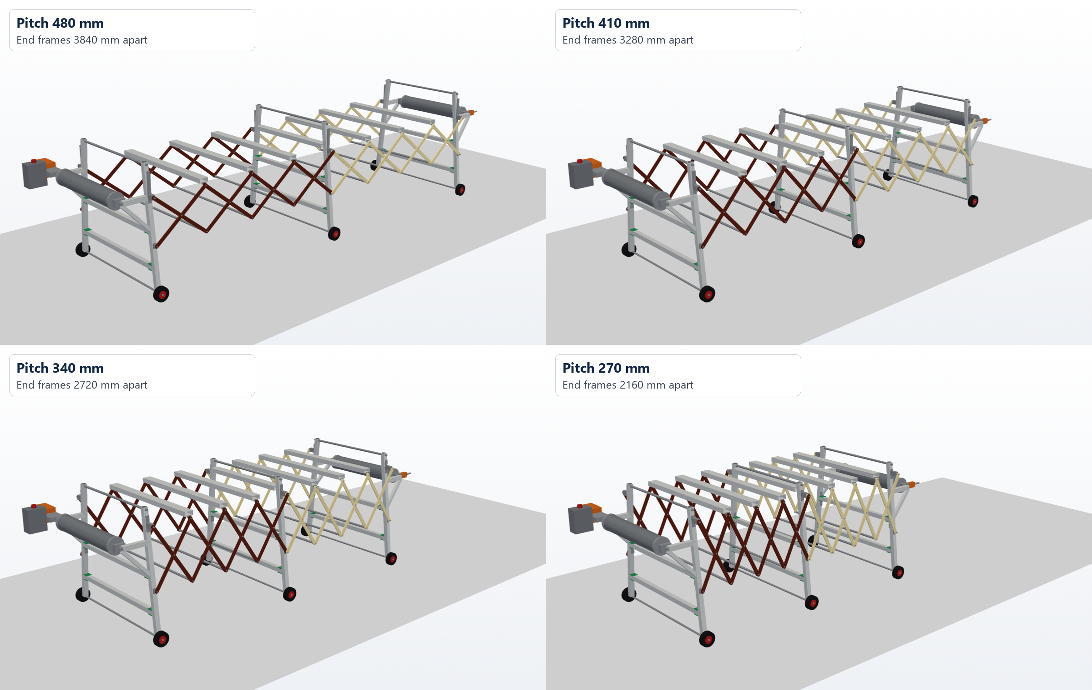
Demo Video
11
About the demo
Video link
Prototype demo: to be pasted (Drive link)
On this slide
CAD fold sequence of rev D, pitch 480 to 270 mm. It is not the prototype demo.
Duration
2–3 minutes
Notes:
Play the video during the review (Insert → Video → This Device) or keep the link ready. Keep it short: 2–3 minutes showing the prototype working.

Slide 13


Challenges & Learnings
12
Challenges faced and how we solved them
Challenge 1
Solution
Hinge fold left the belt unsupported for 396 mm and stood 2.7 m tall
Switched to a scissor frame; height stays near 1.1 m
Key learnings
Check the CAD against the built prototype early
Closed aluminium box sections stay stiff and wash clean
Keep every number traceable to a calc or CAD file
Challenge 2
Solution
Mesh surface pinched fruit and weighed about 20 kg more
Flat 2-ply PVC belt with a smooth top, 4 mm
Challenge 3
Solution
Earlier CAD placed the scissors and supports differently from the prototype
Rebuilt as A-frames with scissors on top, from the photo
Notes:
About 1 minute. Be honest about what went wrong and how you fixed it. This shows engineering judgement.

Slide 14


Conclusion & Future Scope
13
Conclusion
Future scope
Rev D CAD now matches the prototype: three A-frames, scissors on top, flat PVC belt.
The scissor closes from 3840 to 2160 mm between end frames, with 0 unintended overlaps at 4 pitches.
Structural and drive checks must be re-run on rev D. No FEA results exist yet.
1
Re-run hand calcs on rev D; add FEA once solver results exist
2
Add an incline: telescopic legs for a 350 to 1200 mm deck
3
Price the BOM, then build and load-test one belt section
Notes:
About 1 minute. Tie the conclusion back to your objectives: which were met, and by how much.

Slide 15

References
14
[1] H. Liu et al., Foldable conveying arm for a cane harvester, Sugar Cane Industries, no. 3, pp. 50–58, 2015.
[2] Guo et al., “Mechanized technology research and equipment application of banana post-harvesting: a review,” Agronomy, vol. 10, no. 3, art. 374, 2020. doi:10.3390/agronomy10030374.
[3] W. Li et al., “Design and experimental study of banana bunch transportation device with lifting mechanism and automatic bottom-fixing fruit shaft,” Agriculture, vol. 14, no. 7, art. 1161, 2024. doi:10.3390/agriculture14071161.
[4] J. W. Best, G. D. Carter, B. K. Flippo and J. D. Walker, “Expandable redundantly powered conveyors,” US Patent 5 632 371, 27 May 1997.
[5] Group 12, design basis, hand calculations and CAD rev D, VIT Chennai, 2026 (project files).
Notes:
Use one consistent citation style (IEEE recommended). Every source mentioned in the literature review should appear here.

Slide 16
Thank You
Questions?
Group G12 | Bhavesh A, Santhosh Kumar M, Monish K, Mithun Shankar M
Notes:
Closing slide. Add your group number and team member names. Be ready to answer questions and show the prototype.

