Slide 1
ISTQB Foundation Level
Chapter- 1
Fundamentals of Testing
Seethalakshmi Shankar

Slide 2

Agenda
Why is Testing Necessary ?
What is Testing ?
General Testing Principles
Fundamental Test Process
The Psychology of Testing
Notes:
Keep discussion interactive

Slide 3
What is Testing?
The word “test” is derived from the Latin word “testum” meaning a pottery vessel used to measure or assess weight
Testing is the process of evaluating/measuring a system or system component by manual or automated means to verify that it satisfies specified requirements
Testing is the process of searching for errors, with the goal of finding as many as possible so that they can be turned over to those responsible for fixing them
It is not only sufficient to demonstrate the software is doing what it is suppose to do, It is equally important to show that software is not doing what it is not suppose to do

Slide 4
What is Testing?
The process of executing a program (or part of a program) with the intention of finding errors (G. J. Myers)
Software testing is the process of testing the functionality and correctness of software by running it
Testing is the process of exercising or evaluating a system or system component by manual or automated means to verify that it satisfies specified requirements (IEEE 83a)
The process of analyzing a system to detect the difference between existing and required conditions and to evaluate the feature of the system (IEEE/ANSI, 1983 [Std 829-1983])

Slide 5
Definitions
Human beings can make an error (Mistake)
Which produces a defect (fault, bug)
When the faulty system is executed it might cause a failure
All defects might not lead to failures
Defects occur because human beings are fallible and because there is time pressure, complex code, complexity of infrastructure, changed technologies, and/or many system interactions
Rigorous testing of systems and documentation can help to reduce the risk of problems occurring during operation and contribute to the quality of the software system, if defects found are corrected before the system is released for operational use
Notes:
Keep discussion interactive

Slide 6
Testing and Quality
Testing helps to measure the Quality of software in terms of
Number of defects found
Tests also reveal important information regarding the Non functional attributes like Reliability, Security, Performance, etc.
Testing can give confidence in the quality of the software if it finds few or no defects
A properly
designed test that passes reduces the overall level of risk in a system
When testing does find defects, the quality of the software system increases when those defects are fixed

Slide 7
When to Stop Testing
Depends on the Risks faced by the system
Some factors that influence:
Time
Budget
Regulatory Laws
Competition
Quality of the system

Slide 8
Importance of Testing
Ensures that the product is usable
Ensures that Customer’s Objectives are met
Early detection of errors to prevents breakdown at a later stage
Ensures that the software is reliable
Builds Confidence in software
Increases Customer Satisfaction
Ensures effective execution in the given environment
Reduces overall cost of software
Reduces time for going live (production)

Slide 9
Causes of Software Defects
Minimal or no proper documentation of Business Requirements
Insufficient time window for development
Lack of domain knowledge
Programming Language constraints

Slide 10
Testing Paradox
“It take’s destruction to build confidence”
Purpose of testing
Find Faults
Destroys Confidence
Finding faults
Purpose of testing
Build Confidence

Slide 11
General testing principles
Testing shows presence of defects
Exhaustive testing is impossible
Early testing is better
Defect Clustering
Pesticide paradox
Testing is context dependent
Absence-of-errors fallacy

Slide 12
Testing Principles (Contd)
All tests should be traceable to customer requirement
Test should be planned long before testing begins
The Pareto principle applies to software testing
“80 percent of all the errors uncovered during testing will likely be traceable to 20 percent of all program modules”
To be most effective, testing should be conducted by an independent third party

Slide 13
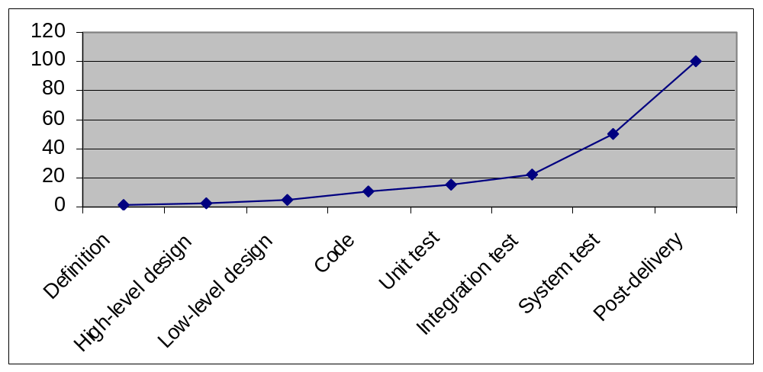
Importance of Testing Early in the SDLC
Error removal cost over SDLC
Cost

Slide 14
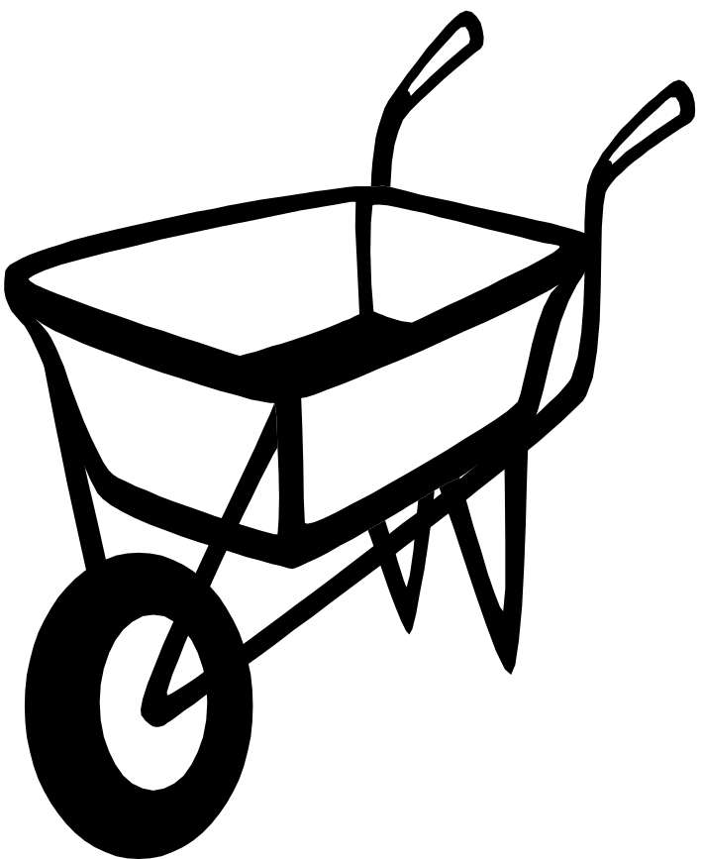
Software testing - Then ...
Ad-hoc
Need-driven
Ignored completely
No theoretical basis i.e. No mathematical models etc
Totally manual
Testing jobs perceived as low scale as compared to other discipline

Slide 15
Software testing - Now !
Organized body of knowledge
    Independent Testing teams
    Testing Models
    Testing knowledge Groups
A specialized engineering discipline in great demand
Testing industry grew by 750% from 2001 to 2003 and is expected to grow phenomenally
Commercial tools, Mathematical and scientific models available.
IEEE Standards, Certification programs like CSTE etc.
Automation solutions for the entire testing lifecycle

Slide 16
Fundamental test process
Test Planning and control
Test Analysis and design
Test Implementation and execution.
Evaluating exit criteria and reporting.
Test closure activities.

Slide 17
The psychology of testing
Tests designed by the person(s) who wrote the software under test (low level of independence).
Tests designed by another person(s) (e.g. from the development team).
Tests designed by a person's) from a different organizational group (e.g. an independent test team).
Tests designed by a person's) from a different organization or company (i.e. outsourcing or certification by an external body).

Slide 18
Attributes of a good tester
A good test engineer has a 'test to break' attitude
Need to take a different view, a different mindset (“What if it isn’t?”, “What could go wrong?”)
An ability to understand the point of view of the customer
A passion for quality and attention to detail
Notice little things that others miss/ignore (See symptom not bug)
Ability to communicate fault information to both technical (developers) and non-technical (managers and customers)
Tact and diplomacy for maintaining a cooperative relationship with developers
Work under worst time pressure (at the end)
“Patience”

Slide 19
Thank you

