Slide 1
ISTQB Foundation Level
Chapter- 2
Testing throughout the software life Cycle
Seethalakshmi Shankar

Slide 2

Agenda
Software development models
Test levels
Test types: the targets of testing
Maintenance testing
Q & A
Notes:
Keep discussion interactive

Slide 3
ISTQB-Advanced :Options Available
Models – Waterfall
V- Model
Iterative model
Rapid Application model (RAD)
RUP
Notes:
Keep discussion interactive

Slide 4
Important Components of Software Engineering
Software Engineering processes are composed of many activities, notably the following:
Requirement Analysis and Specification
  Extracting the requirements of a desired software product is the first task in creating it. Specification is the task of precisely describing the software to be written, in a mathematically rigorous way.
  Software Architecture
  The architecture of a software system refers to an abstract representation of that system. Architecture is concerned with making sure the software system will meet the requirements of the product, as well as ensuring that future requirements can be addressed. The architecture step also addresses interfaces between the software system and other software products, as well as the underlying hardware or the host operating system.
Coding
  Reducing a design to code may be the most obvious part of the software engineering job, but it is not necessarily the largest portion.
Testing
  Testing of parts of or complete software
  Implementation
  The installation of the system in production environment
Maintenance
  Maintaining and enhancing software to cope with newly discovered problems or new requirements
Notes:
Keep discussion interactive

Slide 5
Software Development Models
When different processes are arranged or combined in different ways, a lifecycle is created
Testing does not exist in isolation; test activities are related to software development activities.
Different development life cycle models need different approaches to testing.

Slide 6
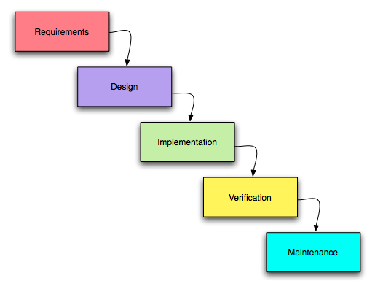
Waterfall Model
The waterfall model is a sequential software development model (a process for the creation of software) in which development is seen as flowing steadily downwards (like a waterfall) through the phases of requirements analysis, design, implementation, testing (validation), integration, and maintenance.
Reference: http://en.wikipedia.org

Slide 7
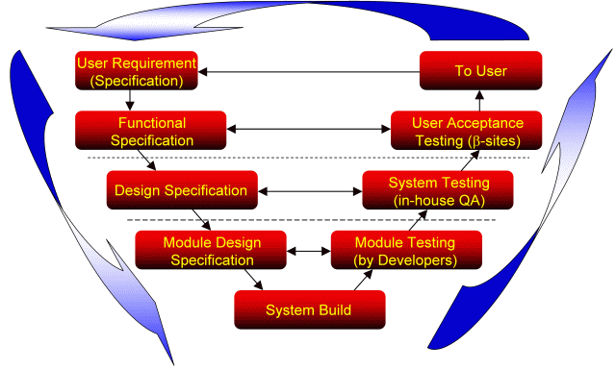
V Model
V model is the software development model which encapsulates the steps in Verification and Validation phases for each step in the SDLC. For each phase, the subsequent phase becomes the verification (QA) phase and the corresponding testing phase in the other arm of the V becomes the validating (Testing) phase

Slide 8
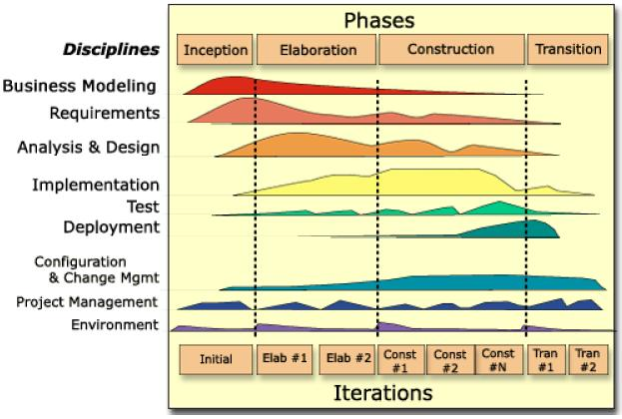
Iterative Development Models
RUP
Prescribes the construction of initially small but ever larger portions of a software project to help all those involved to uncover important issues early before problems or faulty assumptions can lead to disaster.
Example: RUP, RAD, Prototyping, Agile

Slide 9
Testing within each lifecycle
In any life cycle model, there are several characteristics of good testing
For every development activity there is a corresponding testing activity.
Each test level has test objectives specific to that level.
The analysis and design of tests for a given test level should begin during the corresponding development activity
Testers should be involved in reviewing documents as soon as drafts are available in the development life cycle.

Slide 10
Test Levels - Component testing
Component Testing searches for defects and verifies the functioning of software ( e.g. modules, programs, objects, classes, etc) that are separately testable.
Basically White Box Testing
Essentially for the verification of the code produced during coding phase.
Validates that the component performs as designed
Generally done by developers

Slide 11
Test Levels- Integration testing
Integration Testing tests interfaces between components, interactions to different parts of the system, such as O.S., file system, hardware or interfaces between systems
Two types: Component Integration testing, System Integration testing
Should be done incrementally rather than in a Big-bang
Goal to check if the modules integrate well with each other according to the system design
Normally done by independent testers

Slide 12
Test Levels - System testing
System testing is concerned with the behavior of the whole system / product.
Tested in a controlled environment to validate the software systems accuracy and completeness
Goal is to see if the software meets its requirements.
It investigates both functional and non functional requirements of the system
Generally done by Independent Testing team

Slide 13
Test Levels - Acceptance testing
It’s a formal testing conducted to determine whether or not a system satisfies its acceptance criteria and to enable the customer to determine whether or not to accept the system
Final stage in the testing process before release to production
Is done at the customer or users end or by Independent Testing team reporting to the client

Slide 14
Acceptance Testing…continued
  Typical forms of Acceptance Testing include:
  User acceptance testing
  Operational (acceptance) testing
  Contract and regulation acceptance testing
  Alpha and beta (or field) testing

Slide 15
Test Types: the targets of testing
Testing of Function i.e. Functional Testing
Testing of Software Product Characteristics i.e. Non- Functional Testing
Testing of Software Structure/Architecture
i.e. Structural Testing
Testing Related To Changes i.e. Confirmation And Regression Testing

Slide 16
Maintenance testing
Maintenance Testing is done on an existing operational system, and is triggered by modifications, migration, or retirement of the software or system
Modifications include planned enhancement changes
Migration includes operational tests of the new environment
Retirement of the system includes the testing of the data migration

Slide 17

Q & A

Slide 18
Thank you

