Slide 1
UNIX OS- Hands On Guide
Kshitij Kumar Agarwal
06/03/2019

Slide 2
Document Control
<Client>
Engagement Revision History
Date | Version | Author | Brief Description of Changes |  |  |  | Approver Signature
06/03/2019 | v0.1 | Kshitij Kumar Agarwal | Initial Draft
07/03/2019 | v0.2 | Kshitij Kumar Agarwal | Peer review incorporated

Slide 3
Table of Contents
Introduction
Summary

Slide 4
Introduction
UNIX is an operating system which was first developed in the 1960s, and has been under constant development ever since. By operating system, we mean the suite of programs which make the computer work. The Unix operating system is a set of programs that act as a link between the computer and the user.
Unix was originally meant to be a convenient platform for programmers developing software to be run on it and on other systems, rather than for non-programmers.^{[7][8]} The system grew larger as the operating system started spreading in academic circles, as users added their own tools to the system and shared them with colleagues.
Some of its features are mentioned below :-
It has a simple user interface.
It is a multi user and multi processing system.
It is written in “C”(HLL).
It supports languages like PASCAL, FORTRAN, BASIC, C++ and so on.

Slide 5
Contd…
UNIX systems also have a graphical user interface (GUI) similar to Microsoft Windows which provides an easy to use environment.
There are many different versions of UNIX, although they share common similarities. The most popular varieties of UNIX are Sun Solaris, GNU/Linux, and MacOS X.
Unix provides us with various services such as :-
Process management
File management

Slide 6
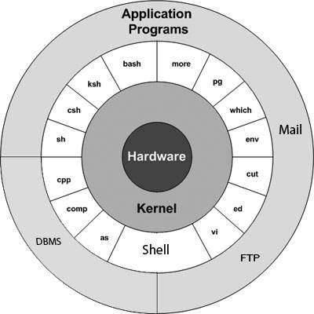
Architecture Diagram

Slide 7
Contd..
<Client>
The main concept that unites all the versions of Unix is the following four basics :-
Kernel − The kernel interacts with the hardware and most of the tasks like memory management, task scheduling and file management.
Shell − The shell is the utility that processes your requests. When you type in a command at your terminal, the shell interprets the command and calls the program that you want. The shell uses standard syntax for all commands. C Shell, Bourne Shell and Korn Shell are the most famous shells which are available with most of the Unix variants.
Commands and Utilities − There are various commands and utilities which you can make use of in your day to day activities. cp, mv, cat and grep, etc. are few examples of commands and utilities.
Files and Directories − All the data of Unix is organized into files. All files are then organized into directories. These directories are further organized into a tree-like structure called the filesystem.

Slide 8
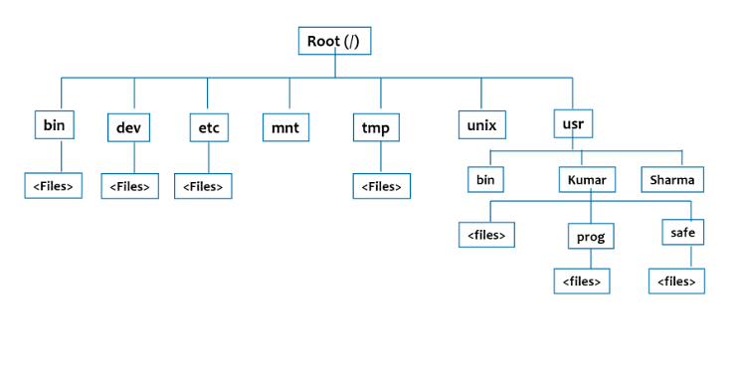
File System Structure
<Client>

Slide 9
Contd..
<Client>
Directories | Description
Root(/) | Root directory contains only the directories needed at the top level of the file structure.
/bin | This is where the executable files are located. These files are available to all users
/dev | It contains device files of all hardware devices.
/etc | It contains utilities used by administrator. Example : passwd, chmod, chown
/lib | It contains shared library files.
/home | It contains the home directory for users and other accounts

Slide 10
Commonly Used Commands
ls – Used to display file names and sub directories in a directory.
mkdir – Used to create a directory.
rm – Used to delete files or directories.
nl – Used to print file contents along with the numbers.
pwd – Used to check the current working directory.
cd – Used to change the directory.

Slide 11
File Access Permission
File ownership is an important component of Unix that provides a secure method for storing files. Every file in Unix has the following attributes −
Owner permissions − The owner's permissions determine what actions the owner of the file can perform on the file.
Group permissions − The group's permissions determine what actions a user, who is a member of the group that a file belongs to, can perform on the file.
Other (world) permissions − The permissions for others indicate what action all other users can perform on the file.

Slide 12
File Access Modes
The permissions of a file are the first line of defense in the security of a Unix system. The basic building blocks of Unix permissions are the read, write, and execute permissions, which have been described below −
Read- Grants the capability to read, i.e. view the contents of the file.
Write- Grants the capability to modify, or remove the content of the file.
Execute- User with execute permissions can run a file as a program.

Slide 13

Contd…
While using ls -l command, it displays various information related to file permission as follows −
Here, the first column represents different access modes, i.e., the permission associated with a file or a directory.
The permissions are broken into groups of threes, and each position in the group denotes a specific permission, in this order: read (r), write (w), execute (x) −
The first three characters (2-4) represent the permissions for the file's owner. For example, -rwxr-xr-- represents that the owner has read (r), write (w) and execute (x) permission.
The second group of three characters (5-7) consists of the permissions for the group to which the file belongs. For example, -rwxr-xr--represents that the group has read (r) and execute (x) permission, but no write permission.

Slide 14
Contd…
The last group of three characters (8-10) represents the permissions for everyone else. For example, -rwxr-xr-- represents that there is read (r) only permission.

Slide 15
I/O Redirections
Input Redirection :-
The commands that normally take their input from the standard input can have their input redirected from a file in this manner. For example, to count the number of lines in the file users generated above, you can execute the command as follows −
$wc -l < users.
Output Redirection :-
The output from a command normally intended for standard output can be easily diverted to a file instead. This capability is known as output redirection. If the notation > file is appended to any command that normally writes its output to standard output, the output of that command will be written to file instead of your terminal.
Check the following who command which redirects the complete output of the command in the users file.
$ who > users

Slide 16
Pipes and filters
Grep
The grep command searches a file or files for lines that have a certain pattern. The syntax is −
grep 'Unix' books.lst
The above example searches for the string Unix in the file books.lst. The lines which match the pattern will be displayed.
Cut
Cut is also a filter, it cuts or picks up a given number of character or fields from the specified file.
$ cut –f 2,7 empinfo => prints 2nd & 7th field to screen.
$ cut –f 2-7 empinfo => prints 2nd through 7th field to screen.
$ cut –c1-15 empinfo => prints First 15 characters to screen.

Slide 17
Contd…
Sort
The sort command arranges lines of text alphabetically or numerically. Default sorting is in the ascending order which can be reversed using –r option.
We can sort one or more fields by specifying the limiter using –t option.
$ sort –t”|” +1 abc.txt
+1 here means that first field can be ignored here.

Slide 18
Accessing CP sftp folder

Slide 19
Contd…

Slide 20
Contd…

Slide 21
Checking audit logs

Slide 22
Contd…

Slide 23
Contd…

Slide 24
Contd…

Slide 25
Contd…

Slide 26
Contd…

Slide 28
Contd…

Slide 29
Summary

