Slide 1


FINAL TERM REVIEW STAFF SCHEDULER
-Development Team – Group 20
- Client Team – Group 12

Slide 2
TEAM MEMBERS
Ankush Mudgal – B00886779
Meghna Kumar – B00892970
Bhavesh Lalwani – B00885318
Hrishita Samir Mavani – B00901658
Gandhi Mahendran – B00892974

Slide 3

Project Overview
Staff Scheduler application is a tool for generating the schedule for a department within an organization for managing the staff schedules effectively.
The above functionality is achieved by an algorithm that takes the availability input from the Staff for a particular week.
Three prime users for this application are – Admin, Supervisor and Staff.
Admin is responsible for creating a Staff or Supervisor and declaring any holiday or business closing day.
Only Supervisor has the permission to generate the schedule.
Staff is only required to provide their availability for the next week.

Slide 4
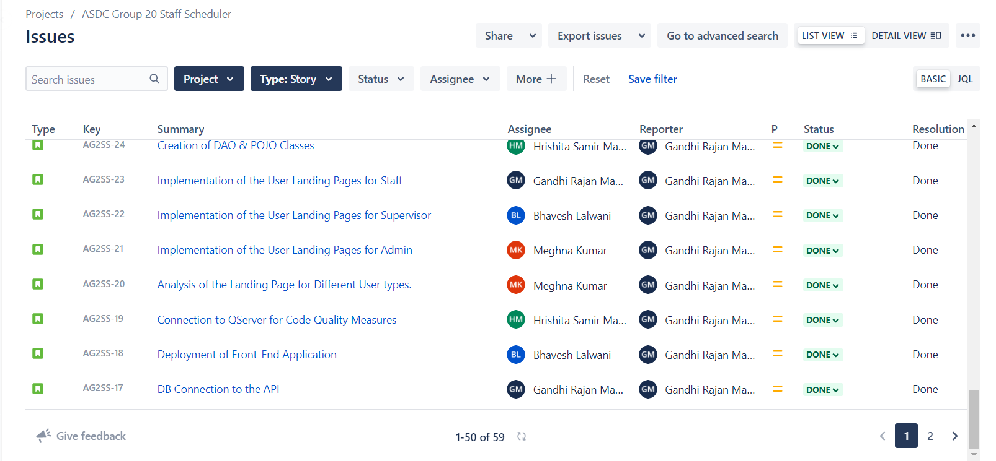
Total Stories Completed: 59

Slide 5
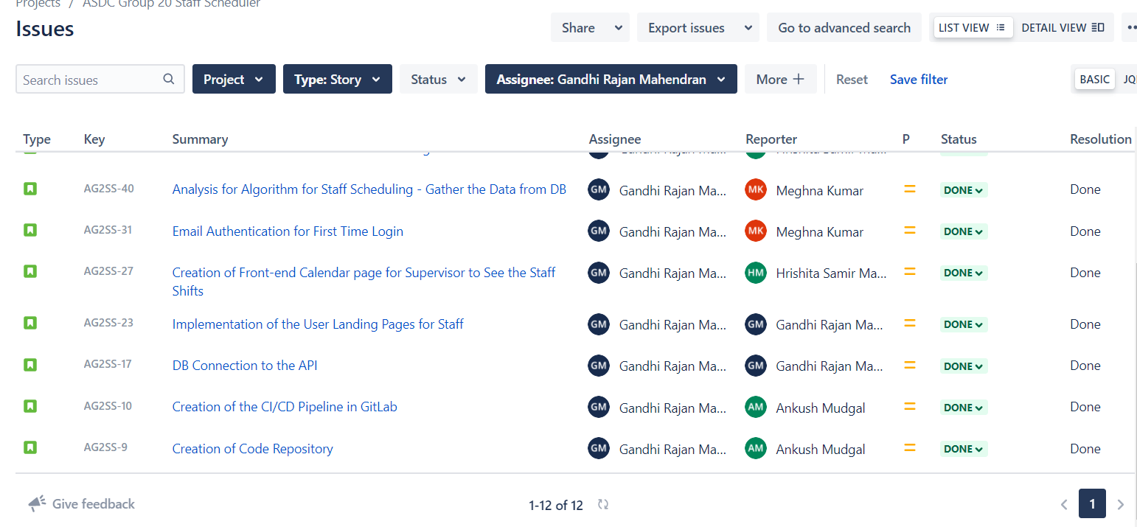
Gandhi Mahendran Board
TOTAL NUMBER OF STORY POINTS : 30
NUMBER OF STORIES WORKED ON : 12

Slide 6
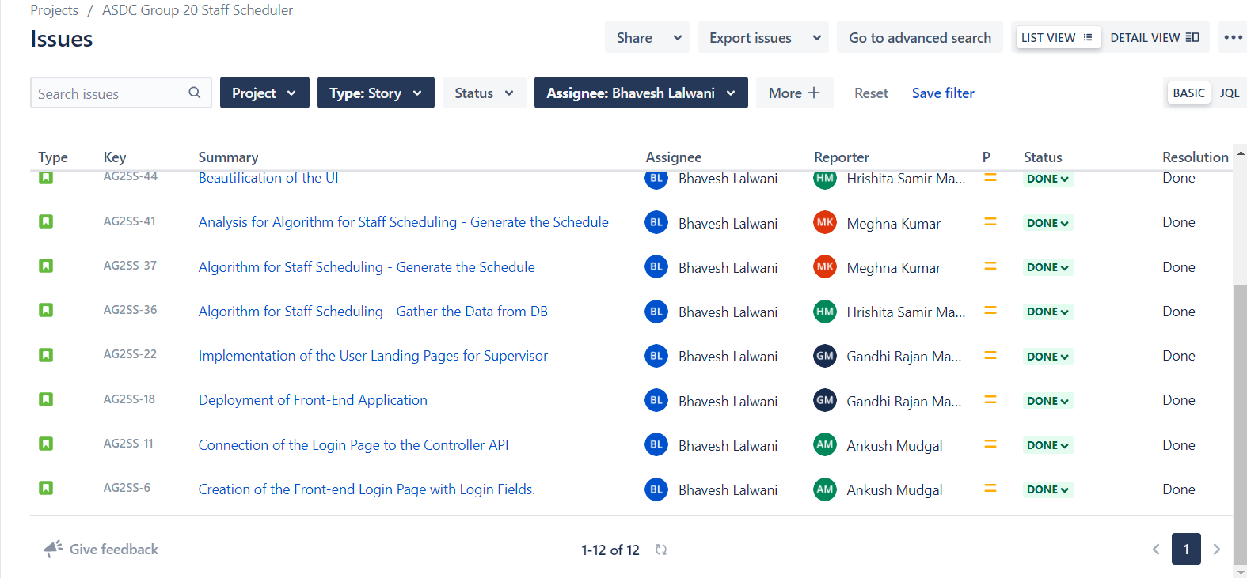
Bhavesh Lalwani Board
TOTAL NUMBER OF STORY POINTS : 30
NUMBER OF STORIES WORKED ON : 12

Slide 7
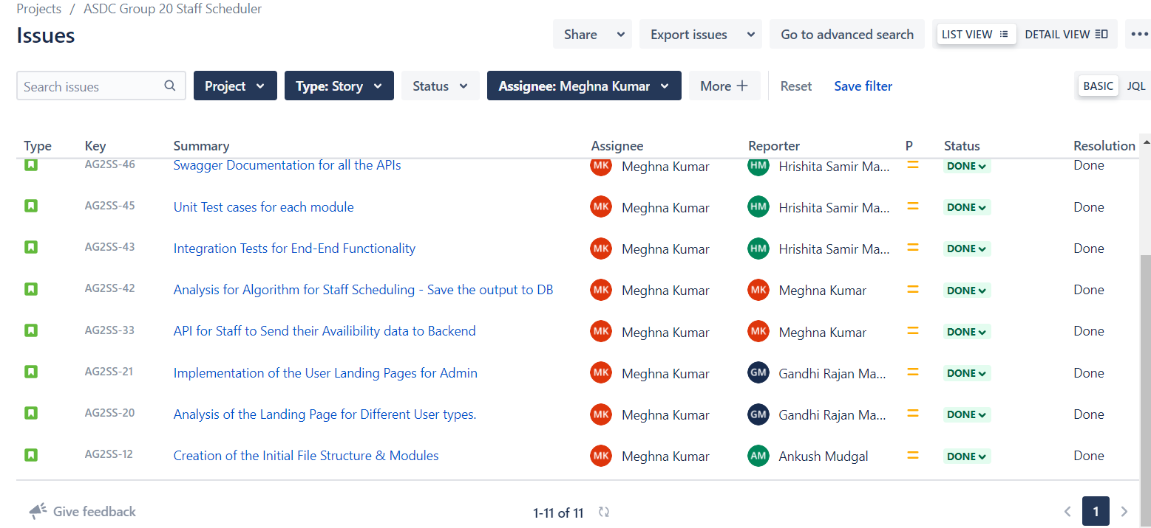
Meghna Kumar Board
TOTAL NUMBER OF STORY POINTS : 30
NUMBER OF STORIES WORKED ON : 11

Slide 8
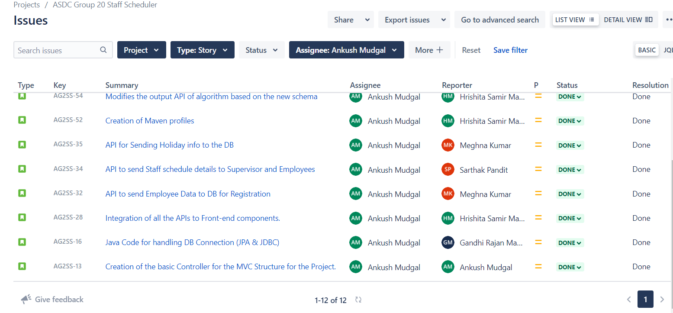
Ankush Mudgal Board
TOTAL NUMBER OF STORY POINTS : 30
NUMBER OF STORIES WORKED ON : 12

Slide 9
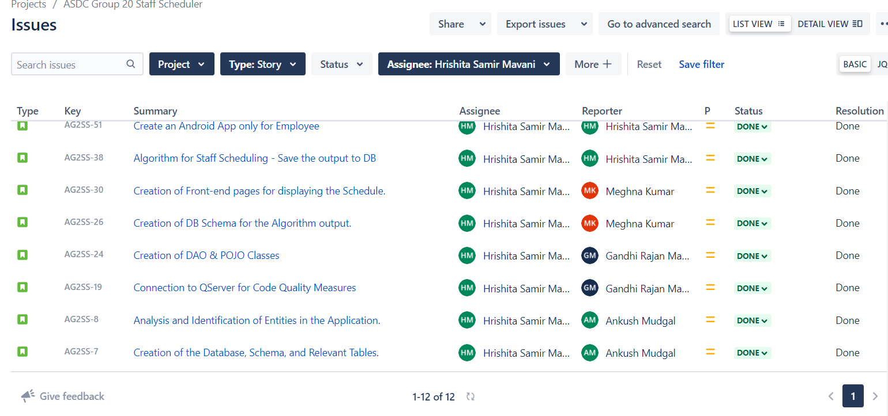
Hrishita Mavani Board
TOTAL NUMBER OF STORY POINTS : 30
NUMBER OF STORIES WORKED ON : 12

Slide 10
Project Status w.r.t Final term Goals
Login
Admin flow
Supervisor flow
Staff flow
Scheduler
Extra -
Android App
Achieved
Achieved
Achieved
Achieved
Achieved
Achieved

Slide 11
Learning from the Project
Use tools like Sonar Lint / SonarQube to maintain code quality during the development process. This will reduce the time taken to refactor the code.
Made sure to utilize appropriate Design patterns for optimizing the code functionality and avoiding smells.
Distribute work requirements in a way that we keep the technical debt as minimum as possible.
Explore more UI library and frameworks.

Slide 12





LIVE DEMO

