Slide 1



T20WC_BESTXI
View in Power BI
Last data refresh:
7/14/2023 5:44:36 PM UTC
Downloaded at:
7/14/2023 5:49:18 PM UTC

Slide 2
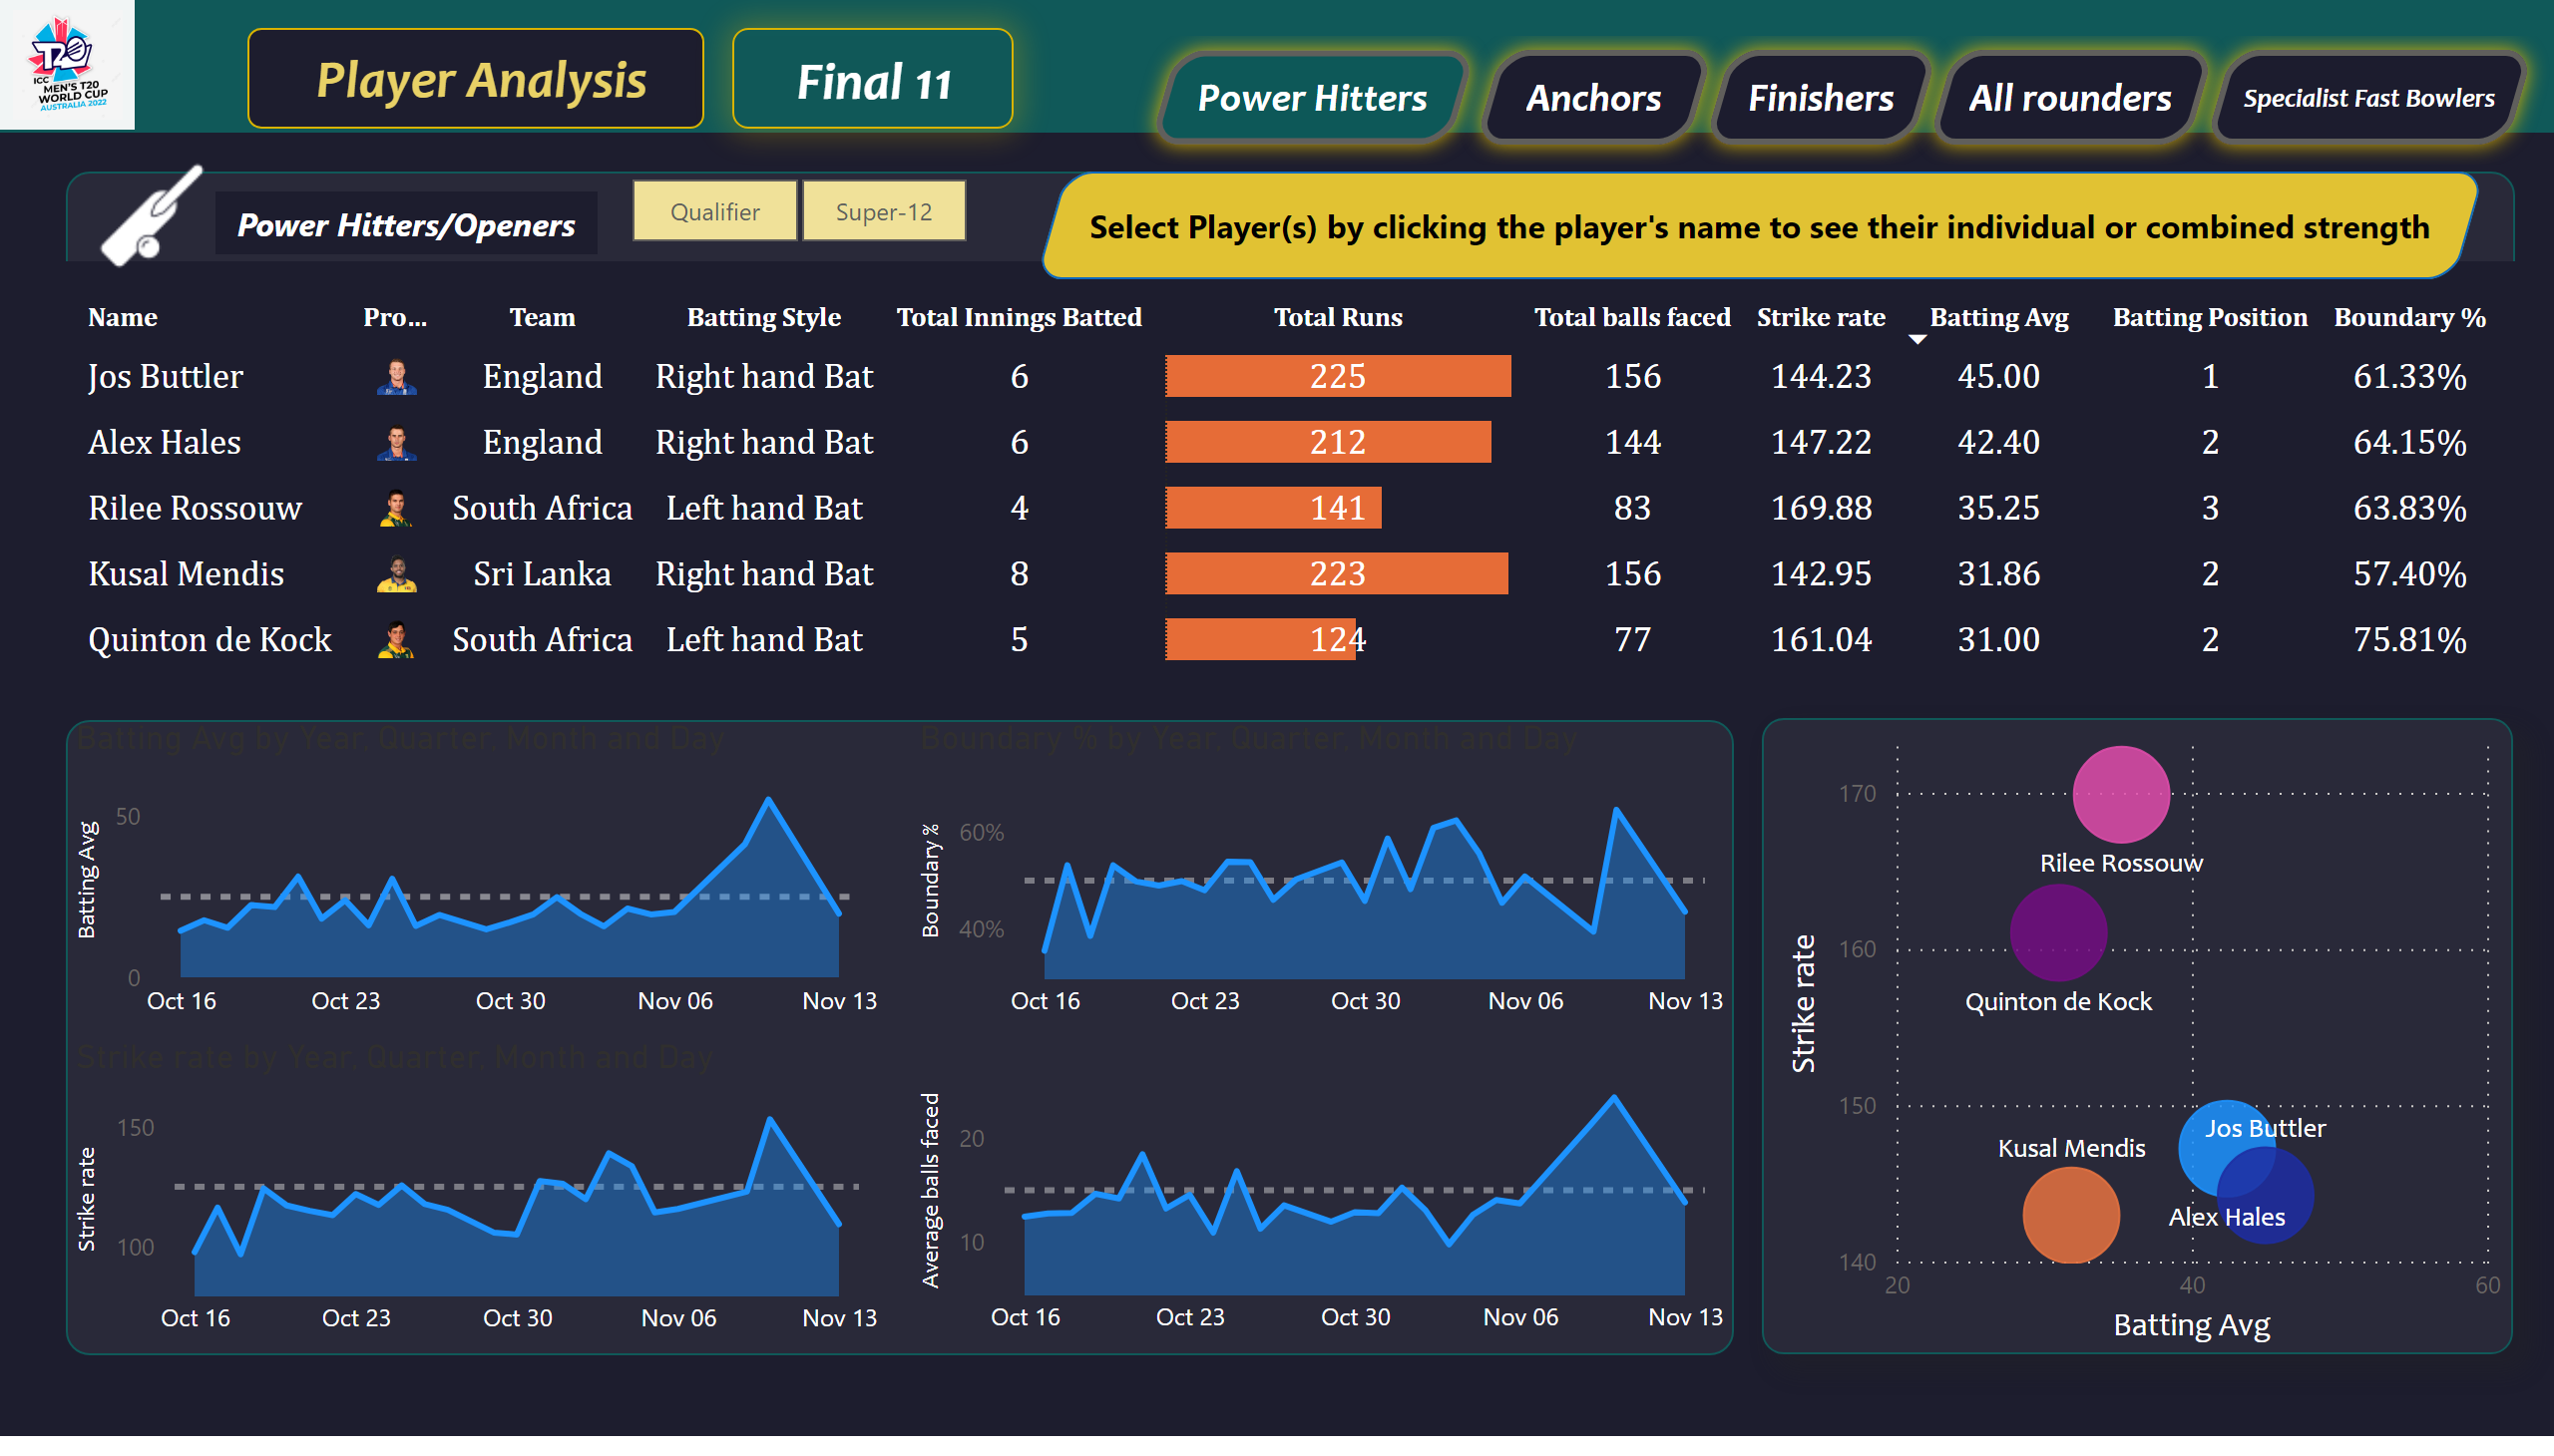
Power Hitters/Openers
Notes:
tableEx
No alt text provided
scatterChart
No alt text provided
areaChart
No alt text provided
areaChart
No alt text provided
areaChart
No alt text provided
areaChart
No alt text provided
slicer
No alt text provided
textbox
No alt text provided
textbox
No alt text provided
textbox
No alt text provided
image
No alt text provided
textbox
No alt text provided
textbox
No alt text provided
textbox
No alt text provided
shape
No alt text provided
image
No alt text provided
actionButton
No alt text provided
actionButton
No alt text provided
actionButton
No alt text provided
actionButton
No alt text provided
actionButton
No alt text provided
actionButton
No alt text provided

Slide 3
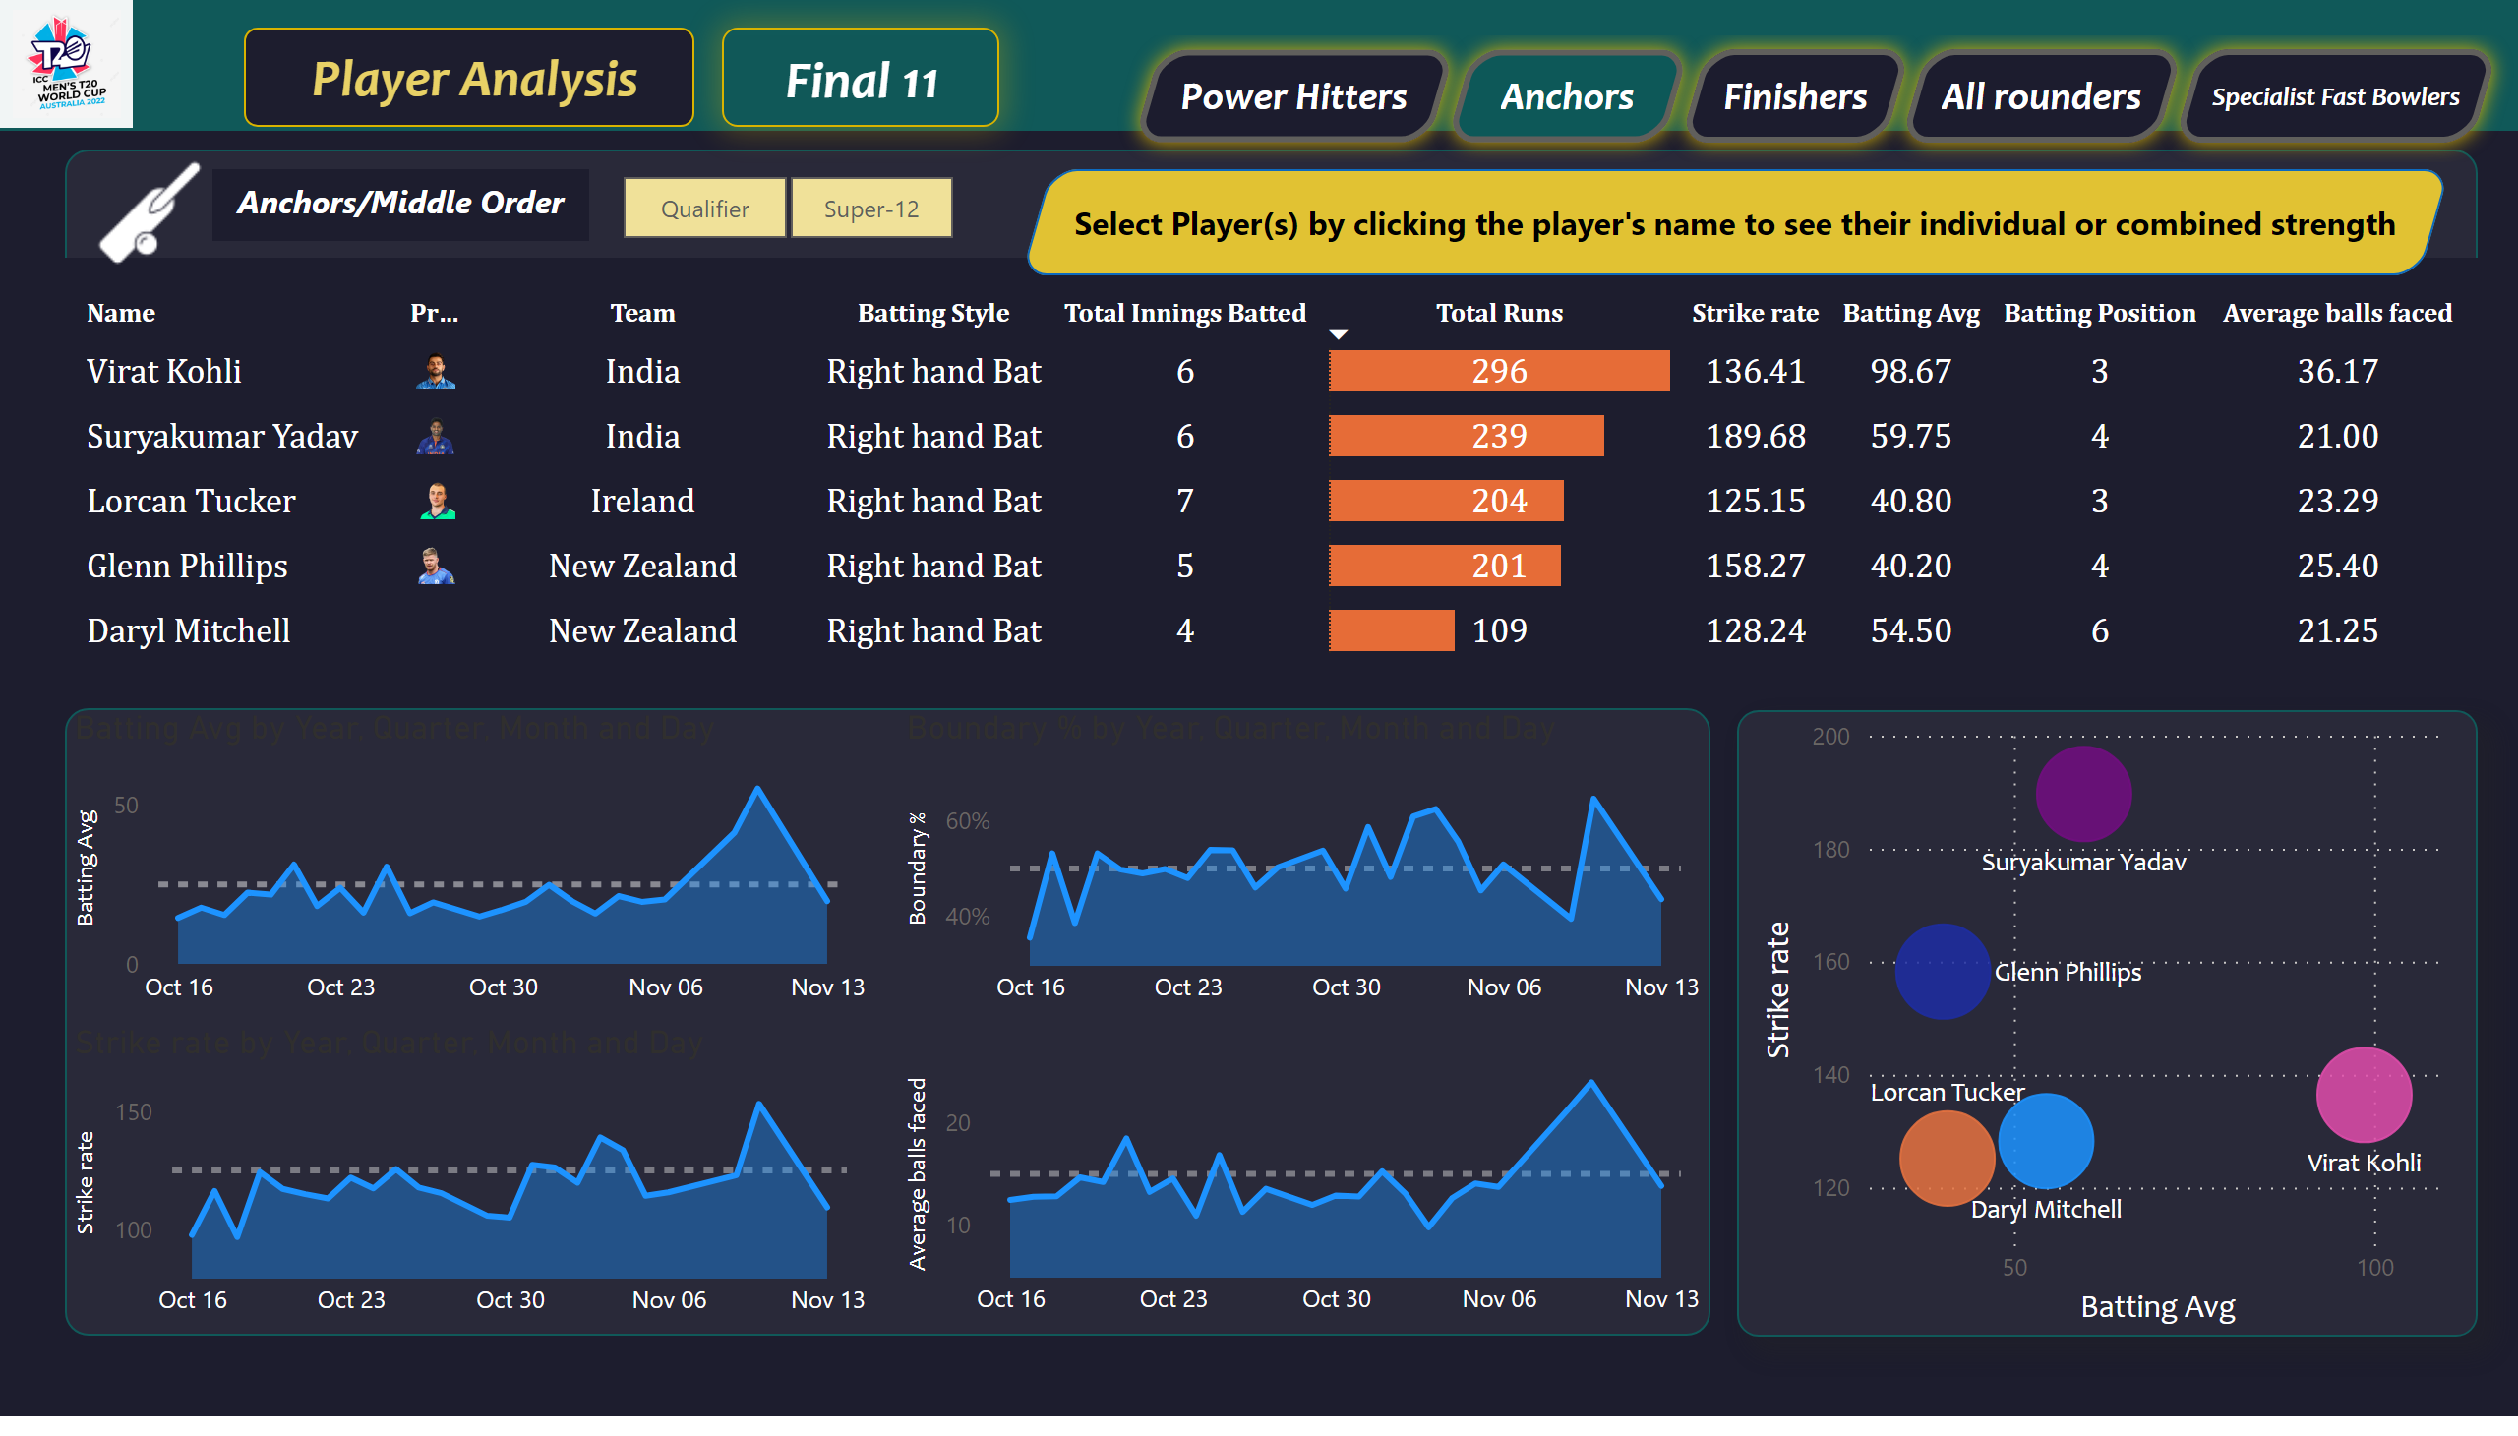
Anchors/Middle Order
Notes:
tableEx
No alt text provided
scatterChart
No alt text provided
areaChart
No alt text provided
areaChart
No alt text provided
areaChart
No alt text provided
areaChart
No alt text provided
slicer
No alt text provided
textbox
No alt text provided
textbox
No alt text provided
textbox
No alt text provided
image
No alt text provided
textbox
No alt text provided
textbox
No alt text provided
shape
No alt text provided
actionButton
No alt text provided
actionButton
No alt text provided
actionButton
No alt text provided
actionButton
No alt text provided
actionButton
No alt text provided
image
No alt text provided
actionButton
No alt text provided
textbox
No alt text provided

Slide 4
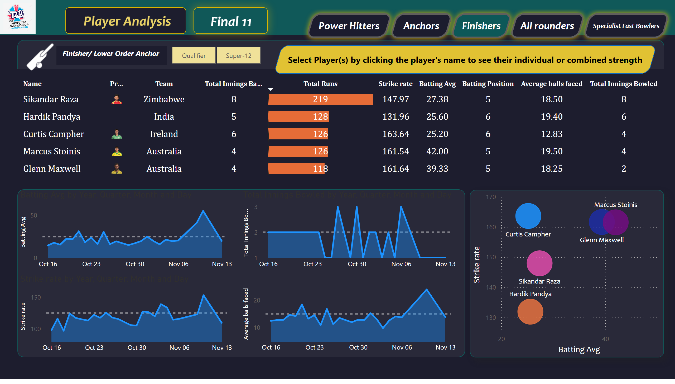
Finisher/Lower Order Anchor
Notes:
tableEx
No alt text provided
scatterChart
No alt text provided
areaChart
No alt text provided
areaChart
No alt text provided
areaChart
No alt text provided
areaChart
No alt text provided
slicer
No alt text provided
textbox
No alt text provided
textbox
No alt text provided
textbox
No alt text provided
image
No alt text provided
textbox
No alt text provided
textbox
No alt text provided
shape
No alt text provided
actionButton
No alt text provided
actionButton
No alt text provided
actionButton
No alt text provided
actionButton
No alt text provided
actionButton
No alt text provided
image
No alt text provided
textbox
No alt text provided
actionButton
No alt text provided

Slide 5
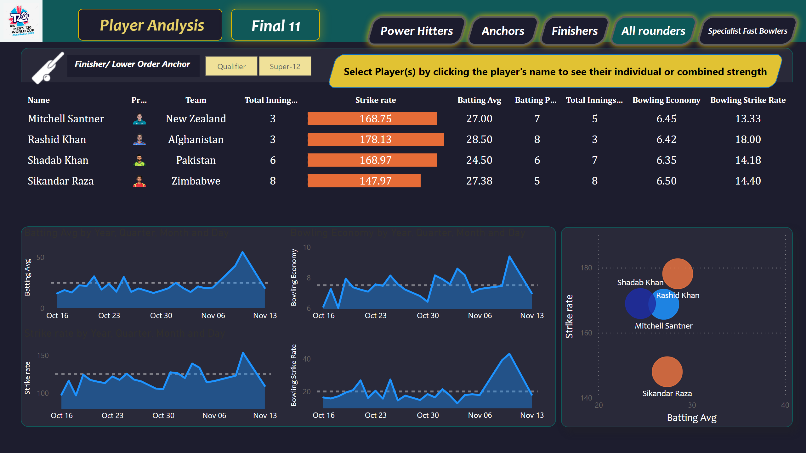
All Rounders/Lower Order
Notes:
tableEx
No alt text provided
scatterChart
No alt text provided
areaChart
No alt text provided
areaChart
No alt text provided
areaChart
No alt text provided
areaChart
No alt text provided
slicer
No alt text provided
textbox
No alt text provided
textbox
No alt text provided
textbox
No alt text provided
image
No alt text provided
textbox
No alt text provided
textbox
No alt text provided
shape
No alt text provided
actionButton
No alt text provided
actionButton
No alt text provided
actionButton
No alt text provided
actionButton
No alt text provided
actionButton
No alt text provided
image
No alt text provided
textbox
No alt text provided
actionButton
No alt text provided

Slide 6
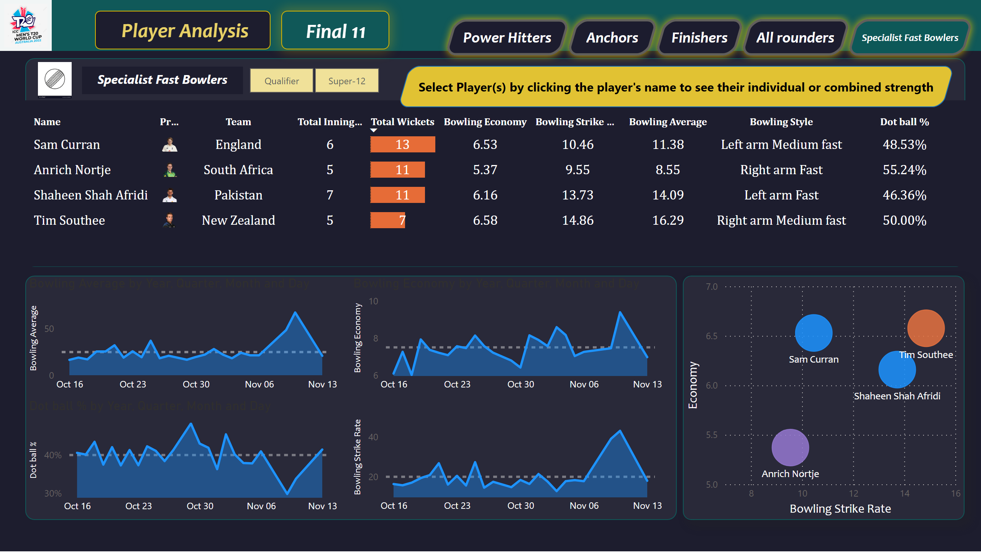
Specialist Fast Bowlers
Notes:
tableEx
No alt text provided
scatterChart
No alt text provided
areaChart
No alt text provided
areaChart
No alt text provided
areaChart
No alt text provided
areaChart
No alt text provided
slicer
No alt text provided
textbox
No alt text provided
textbox
No alt text provided
textbox
No alt text provided
textbox
No alt text provided
textbox
No alt text provided
shape
No alt text provided
image
No alt text provided
image
No alt text provided
actionButton
No alt text provided
actionButton
No alt text provided
actionButton
No alt text provided
actionButton
No alt text provided
actionButton
No alt text provided
textbox
No alt text provided
actionButton
No alt text provided

Slide 7
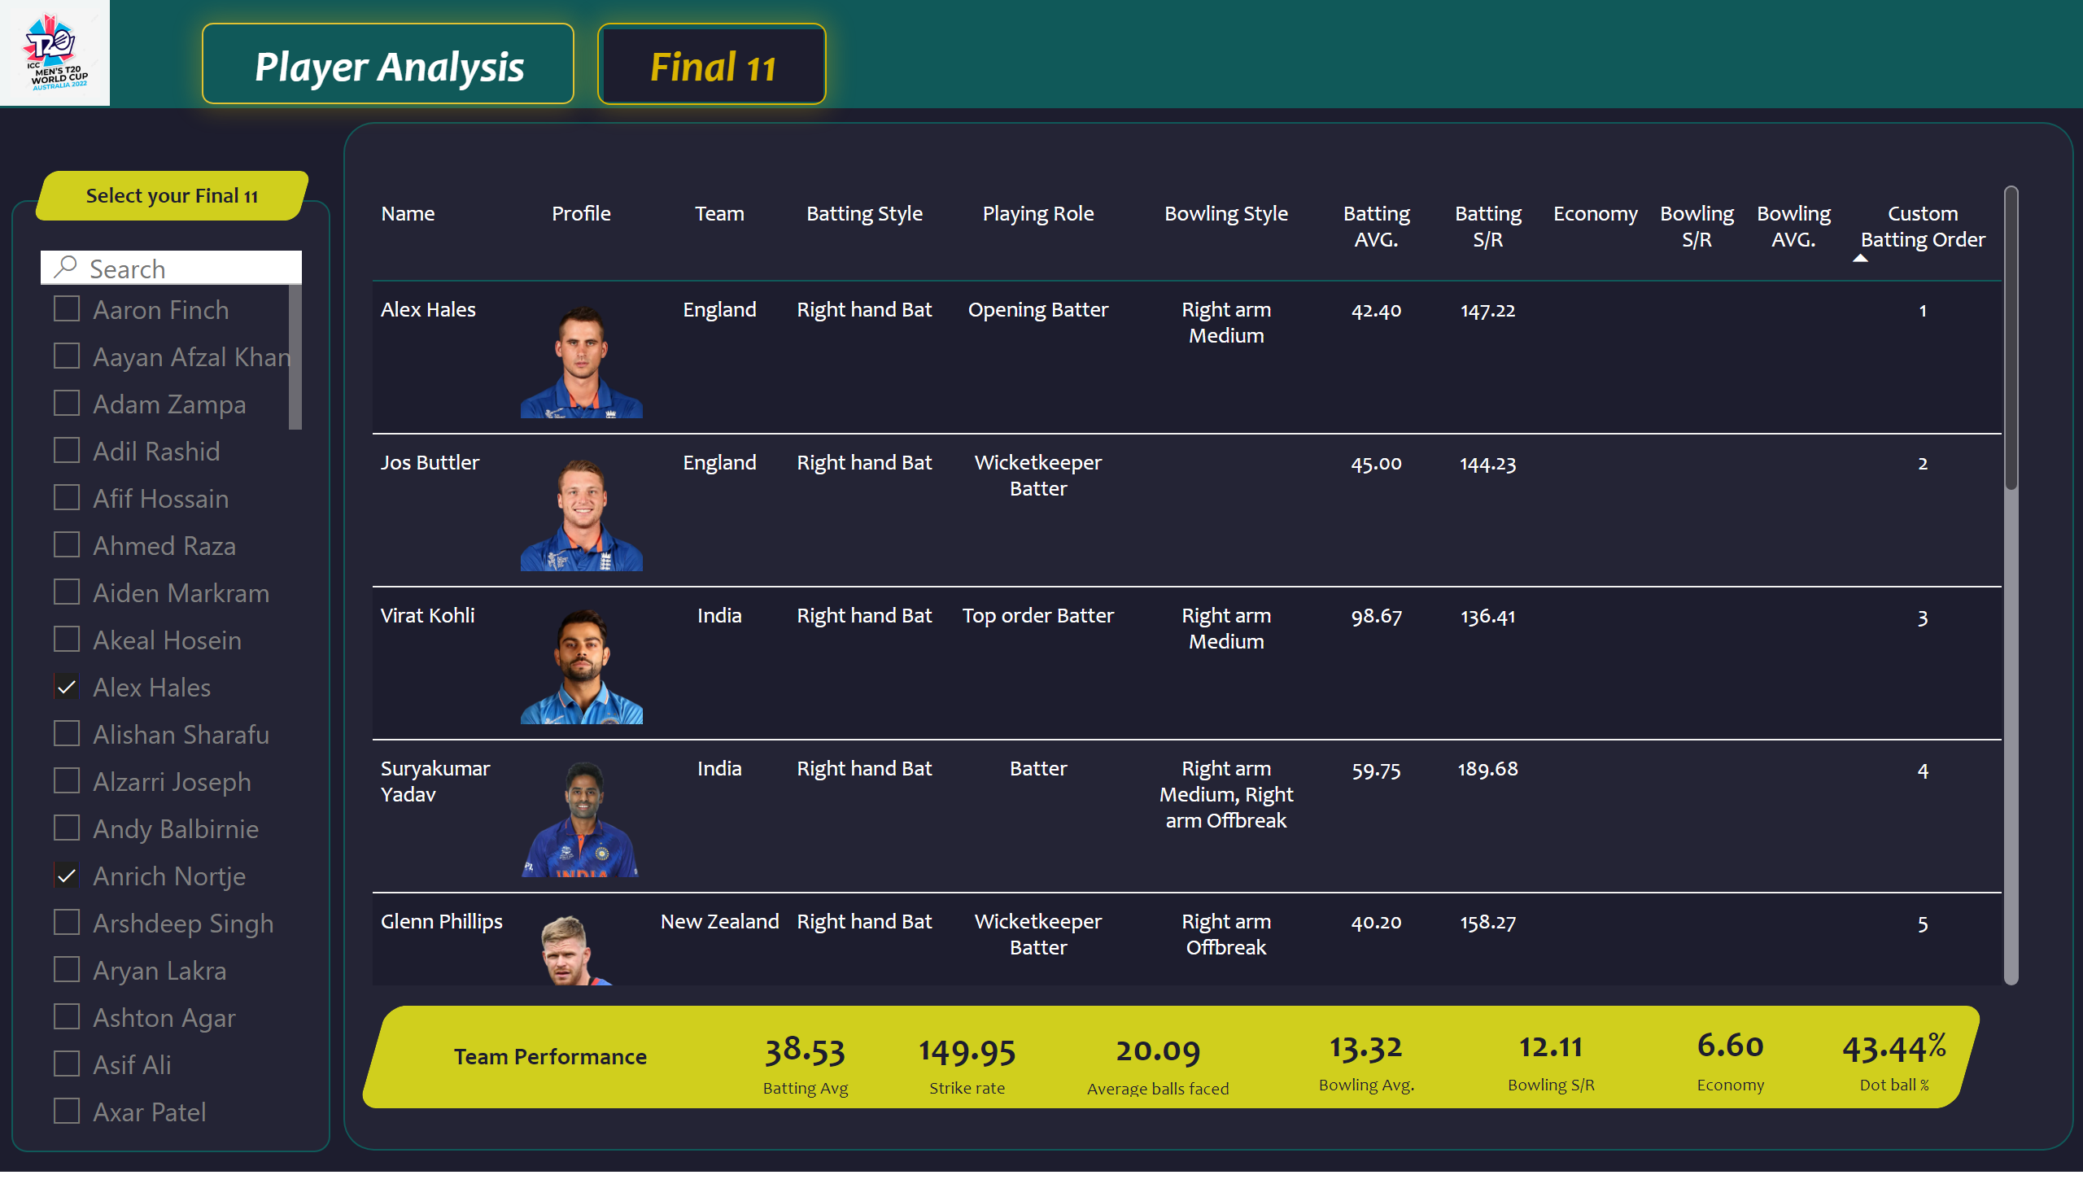
Final 11
Notes:
textbox
No alt text provided
image
No alt text provided
pivotTable
No alt text provided
slicer
No alt text provided
shape
No alt text provided
shape
No alt text provided
shape
No alt text provided
shape
No alt text provided
shape
No alt text provided
card
No alt text provided
card
No alt text provided
card
No alt text provided
card
No alt text provided
card
No alt text provided
card
No alt text provided
card
No alt text provided
actionButton
No alt text provided
actionButton
No alt text provided

Slide 8
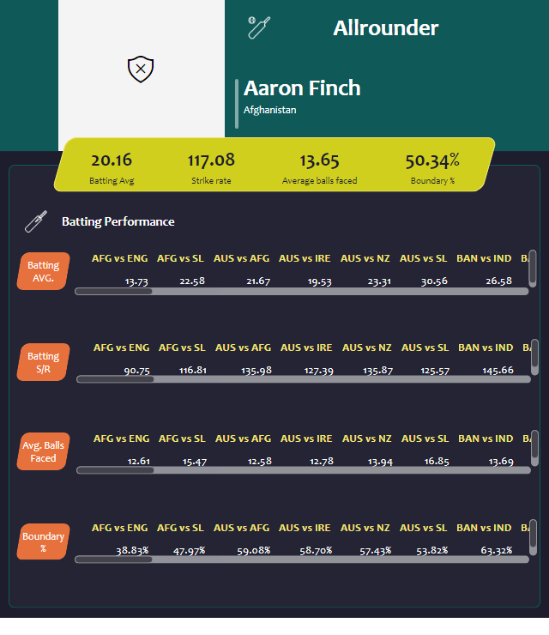
Tooltip for Openers/Middle Order
Notes:
shape
No alt text provided
card
No alt text provided
card
No alt text provided
card
No alt text provided
card
No alt text provided
shape
No alt text provided
shape
No alt text provided
image
No alt text provided
simpleImageEBC4593F96F1425FB3D84C5BF02B5075
No alt text provided
shape
No alt text provided
shape
No alt text provided
shape
No alt text provided
shape
No alt text provided
shape
No alt text provided
shape
No alt text provided
shape
No alt text provided
pivotTable
No alt text provided
pivotTable
No alt text provided
pivotTable
No alt text provided
pivotTable
No alt text provided
shape
No alt text provided
image
No alt text provided
shape
No alt text provided

Slide 9
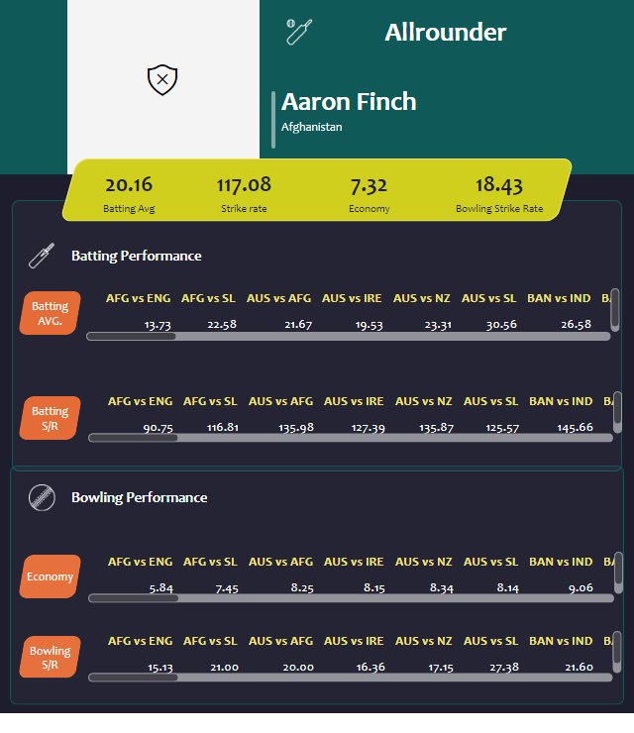
Tooltip for Finishers/Lower Order
Notes:
shape
No alt text provided
card
No alt text provided
card
No alt text provided
card
No alt text provided
card
No alt text provided
shape
No alt text provided
image
No alt text provided
simpleImageEBC4593F96F1425FB3D84C5BF02B5075
No alt text provided
shape
No alt text provided
shape
No alt text provided
shape
No alt text provided
shape
No alt text provided
shape
No alt text provided
pivotTable
No alt text provided
pivotTable
No alt text provided
card
No alt text provided
card
No alt text provided
card
No alt text provided
card
No alt text provided
shape
No alt text provided
shape
No alt text provided
image
No alt text provided
shape
No alt text provided
shape
No alt text provided
image
No alt text provided
shape
No alt text provided
shape
No alt text provided
pivotTable
No alt text provided
pivotTable
No alt text provided
shape
No alt text provided

Slide 10

Tooltip for Specialist Fast Bowlers
Notes:
shape
No alt text provided
card
No alt text provided
card
No alt text provided
card
No alt text provided
card
No alt text provided
shape
No alt text provided
image
No alt text provided
simpleImageEBC4593F96F1425FB3D84C5BF02B5075
No alt text provided
shape
No alt text provided
shape
No alt text provided
shape
No alt text provided
card
No alt text provided
card
No alt text provided
card
No alt text provided
card
No alt text provided
shape
No alt text provided
shape
No alt text provided
image
No alt text provided
shape
No alt text provided
pivotTable
No alt text provided
shape
No alt text provided
pivotTable
No alt text provided
shape
No alt text provided
pivotTable
No alt text provided
pivotTable
No alt text provided
shape
No alt text provided
shape
No alt text provided

