Slide 1
DESIGN & ANALYSIS OF ALGORITHMS (DAA)
Matrix Multiplication Paradigms
From $O(n^3)$ Naive Loops to Strassen's Divide & Conquer and Dynamic Programming for Optimal Chains.
O(n³)
→
O(n^2.81)
→
DP Chain Optimization

Slide 2
01. FUNDAMENTALS
The Matrix Multiplication Problem
Dimension Compatibility Rule
Element Computation Formula
To multiply matrix A (p × q) by matrix B (q × r), the inner dimensions must match.
C[i][j] = Σ (A[i][k] * B[k][j])
Resulting Matrix C has dimensions: (p × r)
Sum calculated for k = 1 to q for each row i and column j.

Slide 3
02. ITERATIVE BASELINE
Standard Triple-Loop Algorithm
Multiplications
void multiply(int A[][], int B[][], int C[][], int N) { for (int i = 0; i < N; i++) { for (int j = 0; j < N; j++) { C[i][j] = 0; for (int k = 0; k < N; k++) { C[i][j] += A[i][k] * B[k][j]; } } } }
N³
void multiply(int A[][], int B[][], int C[][], int N) { for (int i = 0; i < N; i++) { for (int j = 0; j < N; j++) { C[i][j] = 0; for (int k = 0; k < N; k++) { C[i][j] += A[i][k] * B[k][j]; } } } }
Exact scalar multiplications performed
Time Complexity
O(N³)
Driven by 3 nested loops

Slide 4
03. RECURSIVE STRATEGY
Standard Divide & Conquer Approach
Partitioning N×N into 4 Sub-matrices
Sub-problem Recurrence
T(N) = 8 T(N/2) + O(N²)
[ C11 C12 ] = [ A11 A12 ] × [ B11 B12 ]
[ C21 C22 ] [ A21 A22 ] [ B21 B22 ]
•
8 Recursive Calls: Sub-matrix multiplications
•
O(N²): Matrix addition overhead
Each sub-matrix is of size (N/2 × N/2)
•
Master Theorem Solution: T(N) = O(N³)

Slide 5
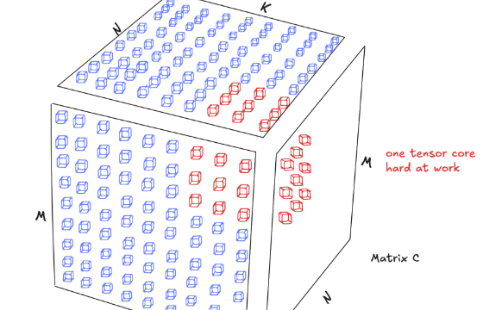
03. RECURSIVE STRATEGY
Visualizing Sub-matrix Combinations
C11 Computation
C11 = A11·B11 + A12·B21
C12 Computation
C12 = A11·B12 + A12·B22
C21 Computation
C21 = A21·B11 + A22·B21
C22 Computation
C22 = A21·B12 + A22·B22

Slide 6



04. STRASSEN'S BREAKTHROUGH
Volker Strassen's Insight (1969)
Key Idea
Reduction
New Bound
Trade expensive multiplications for cheaper matrix additions.
Reduces recursive calls from 8 to 7 per step.
Achieves O(N^log₂7) ≈ O(N^2.81) complexity.

Slide 7
04. STRASSEN'S BREAKTHROUGH
The 7 Intermediate Products (P1 to P7)
P1 = (A11 + A22) * (B11 + B22)
P2 = (A21 + A22) * B11
P3 = A11 * (B12 - B22)
P4 = A22 * (B21 - B11)
P5 = (A11 + A12) * B22
P6 = (A21 - A11) * (B11 + B12)
P7 = (A12 - A22) * (B21 + B22)

Slide 8
04. STRASSEN'S BREAKTHROUGH
Recombining Products into Matrix C
C11 Result
C12 Result
C11 = P1 + P4 - P5 + P7
C12 = P3 + P5
C21 Result
C22 Result
C21 = P2 + P4
C22 = P1 + P3 - P2 + P6

Slide 9
04. STRASSEN'S BREAKTHROUGH
Complexity Analysis of Strassen
Recurrence Formula
Solving via Master Theorem
T(n) = 7 T(n/2) + O(n²)
Comparing f(n) = O(n²) with n^(log_b a) = n^(log₂7):
log₂ 7 ≈ 2.8073
7 recursive calls on subproblems of size n/2. The O(n²) term represents 18 matrix additions/subtractions.
T(n) = O(n^2.81)

Slide 10
05. DYNAMIC PROGRAMMING
Matrix Chain Multiplication (MCM)
Why Parenthesization Matters
The MCM Problem
For matrices A (10×30), B (30×5), C (5×60):
Given a sequence of matrices A₁ × A₂ × ... × Aₙ, find the optimal parenthesization that minimizes total scalar multiplications.
•
(AB)C: (10×30×5) + (10×5×60) = 4,500 ops
•
A(BC): (30×5×60) + (10×30×60) = 27,000 ops

Slide 11
05. DYNAMIC PROGRAMMING
DP Recurrence & Complexity for MCM
Time Complexity
DP Recurrence Relation
O(N³)
m[i, j] = min { m[i, k] + m[k+1, j] + p_{i-1} · p_k · p_j }
Where split k ranges from i ≤ k < j.
Space Complexity
O(N²)

Slide 12
06. ALGORITHM COMPARISON
Comparison of Approaches
Algorithm | Approach | Time Complexity | Space Complexity
Standard Naive | Iterative (3 Loops) | O(N³) | O(1) aux
Basic Divide & Conquer | Recursive Sub-matrices | O(N³) | O(log N) stack
Strassen's Algorithm | 7 Products Optimization | O(N^2.81) | O(N²) aux
Matrix Chain (MCM) | Dynamic Programming | O(N³) | O(N²) table

Slide 13
SUMMARY & CONCLUSION
Key Algorithmic Takeaways
Strassen proves that $O(n^3)$ is not the theoretical lower bound for matrix multiplication, while MCM illustrates how optimal order drastically cuts computational overhead.
Q & A Session

Slide 14

Image Sources
https://cdn.prod.website-files.com/68c9c3107effc2ea46e1a82c/695e3eaf2167899b4b13a63b_68b7835fbda78759aa4a427f_tensor-core-3.png
Source: www.modular.com

