Slide 1
PID Controller Design for an Inverted Pendulum on a Moving Cart
Amitesh Singh(211010214)
Bhavesh Balendra(211010221)
Paras (211010240)
Guided By : Dr Debanjan Das
International Institute of Information Technology, Naya Raipur

Slide 2
Objective
The inverted pendulum on a moving cart system is a classic control problem that is commonly used to teach and test control theory. In this system, the cart moves along a track and has an inverted pendulum mounted on top. The goal is to balance the pendulum in the upright position using a control input to the cart.

Slide 3
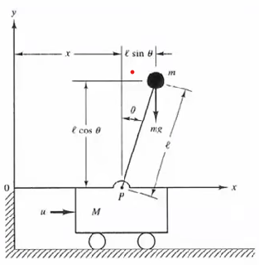
Mathematical modelling
The model should include the state variables (position and angle of the pendulum), the input (cart acceleration), and the parameters of the system (mass, length, etc.).
Linearize the model: The next step is to linearize the model around the equilibrium point (upright position of the pendulum). This can be done using linearization techniques such as Taylor series expansion or Jacobian matrix.
Design the controller: Once the linearized model is obtained, you can design the PID controller. The PID controller consists of three terms: Proportional, Integral, and Derivative. The Proportional term is proportional to the error (difference between the desired and actual position), the Integral term is proportional to the integral of the error, and the Derivative term is proportional to the rate of change of the error. The controller gains (Kp, Ki, Kd) need to be tuned to achieve the desired performance

Slide 4
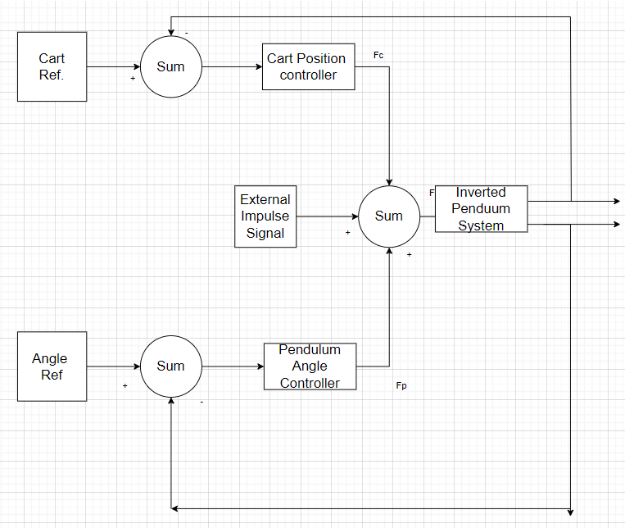
System block diagram

Slide 5
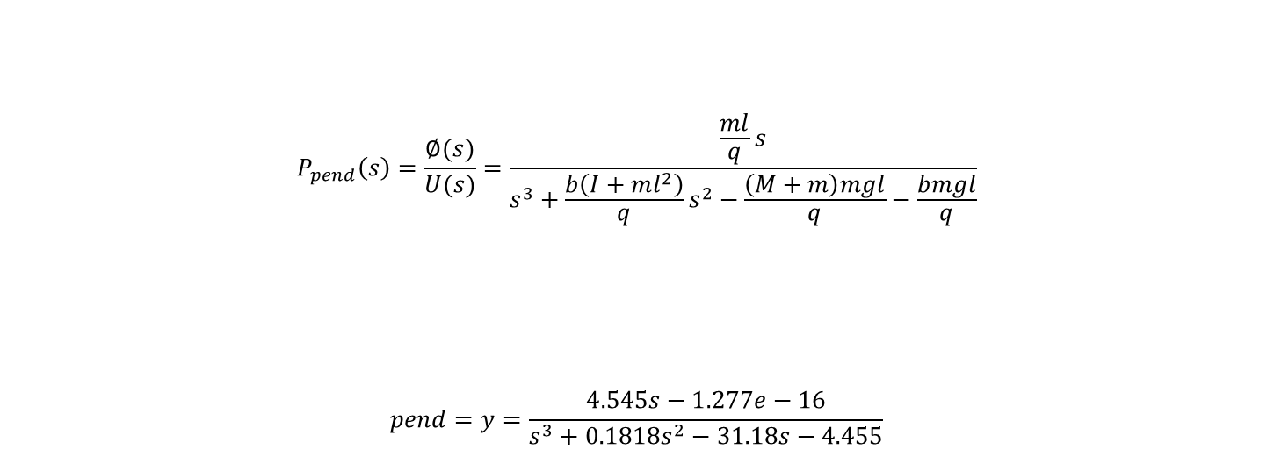
Transfer function of Pendulum

Slide 6
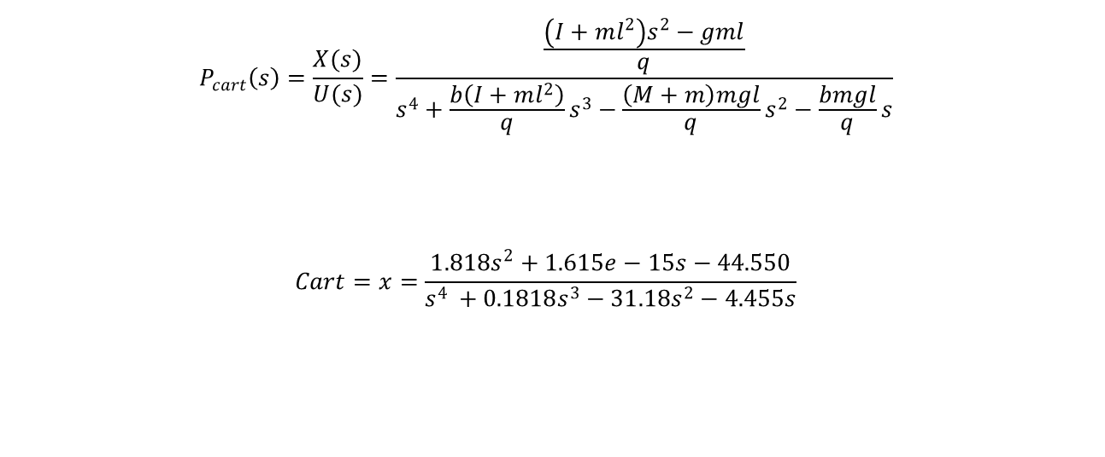
Transfer function of cart

Slide 7
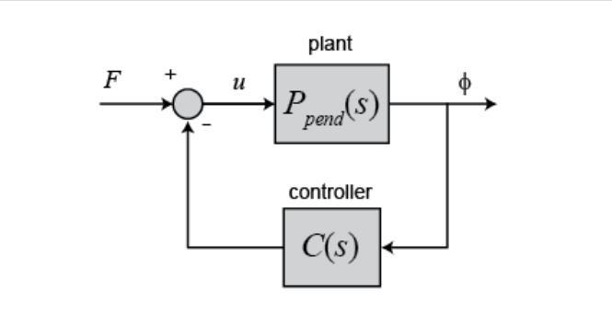
Closed loop characteristic equation of pendulum

Slide 8
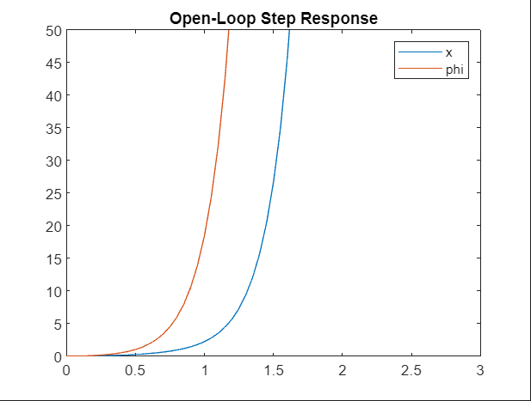
Step Response

Slide 9
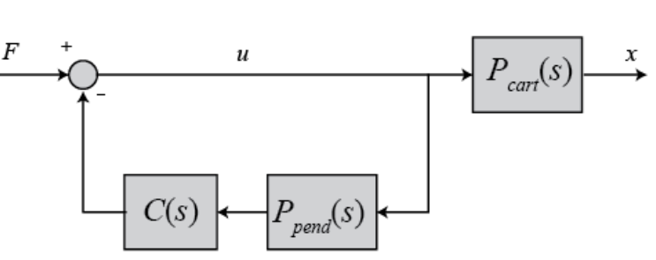
Closed loop characteristic equation of cart

Slide 10
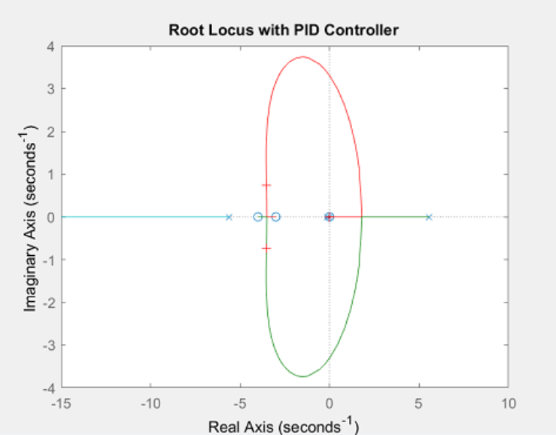
Root locus plot:

Slide 11
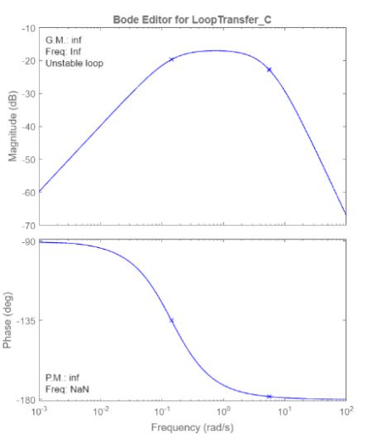
Bode plot :

Slide 12
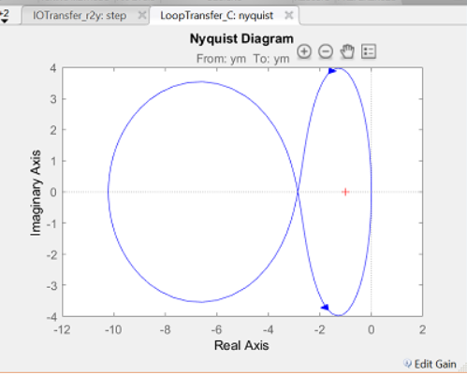
Nyquist plot:

Slide 13

Thank you
..
Dr. Shyama Prasad Mukherjee International Institute of Information Technology, Naya Raipur
*
International Institute of Information Technology, Naya Raipur
‹#›

