Slide 1
Papers’ Presentation On Intelligent Framework for Task Placement and Resource Allocation for IoT in the Fog-Cloud Scenario By Shifa Manihar
Authors of the Paper: Shifa Manihar, Dr. Ravindra Patel, Dr. Sanjay Agrawal

Slide 2
Problem Statement:
The mission critical tasks or latency sensitive tasks which has to be processed at the earliest without any delay are intended to be scheduled at fog, whereas other latency insensitive tasks are to be scheduled at cloud.
We define different contexts on the basis of which such classifications can be done. This context may be location, network requirement, task size, etc.
This research is carried out for scheduling tasks and resource allocation in the most optimal ways.

Slide 3
The Proposed Framework: ITPRAF
ITPRAF, the suggested paradigm, employs a machine learning algorithm to identify mission-critical applications and defer non-sensitive ones.
To accomplish this in this research, we used supervised training at the Intelligent Fog master node (IFMN). At this stage, the tasks are categorized based on it’s characteristics according to the neural network's training, and the IFMN decides whether to deploy the task at the fog nodes or to send it to the cloud for execution.
If the tasks are scheduled at the fog level, the IFMN's next duty is to decide where to deploy the tasks on the fog nodes (virtual machines) that fall under its purview, i.e., its worker fog nodes (WFN).

Slide 4
Proposed Mechanisms for Resource Allocaton at Fog:
Mechanism 1:
IFMN addresses the incoming tasks in the first come first out order and assigns the tasks to the least busy WFN.
Mechanism 2:
IFMN rearranges these tasks in the order of their priority based on the CPU requirements. The tasks with the large CPU requirement is assigned to the most fast computing power WFN.

Slide 5
Continued……..
Mechanism 3:
IFMN rearranges these tasks in the order of their priority based on the delay sensitivity. The tasks with the largest delay sensitivity is assigned to the most fast computing power WFN.
Mechanism 4:
IFMN pre-decides the allocation of virtual machines based on the type of the incoming task, for example, healthcare tasks to be assigned to the virtual machine 1, and surveillance tasks to be assigned to the virtual machine 2 and so on. IFMN uses machine learning to do this.

Slide 6
Implementation Details:
This study was conducted in the Aneka platform's simulation environment, which is a software development environment for cloud computing applications.
Aneka is connected to Matlab 8.0, which provides the task placement algorithm code for the delay-insensitive and mission-critical applications.
Aneka was loaded on the virtual machine built on the AWS cloud after an Aneka IFMN was locally generated with a single master and several workers to simulate a fog resulting in a fog-cloud environment.

Slide 7
Performance Evaluation:
Two distinct scenarios were developed and put to the test in order to simulate the suggested model and assess this algorithm's performance.
Additional sub-scenarios about task scheduling at the cloud only and at the fog only were developed for Scenario 1, which is the scenario without the use of machine learning.
In Scenario 2, tasks were scheduled at cloud and fog levels using machine learning.

Slide 8
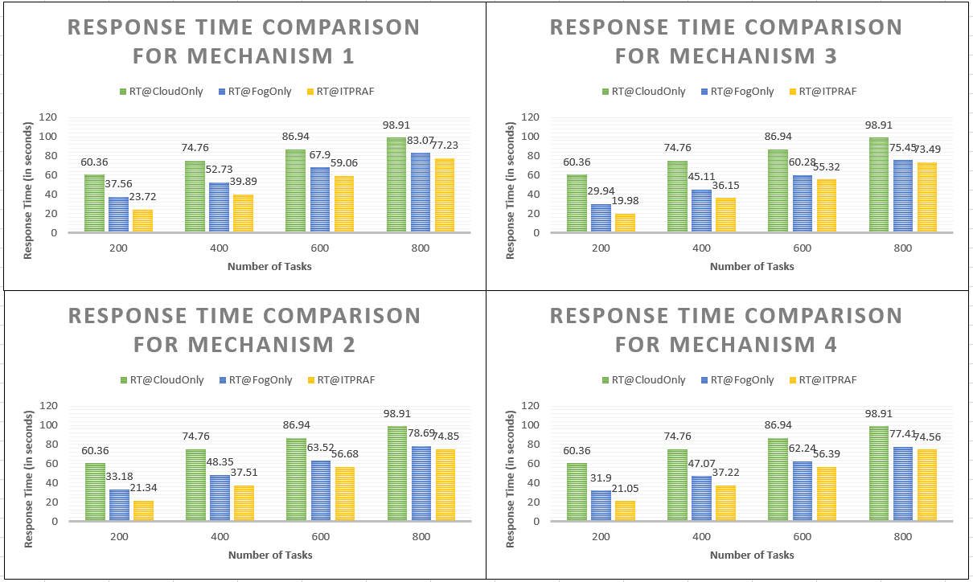
Result Analysis:
Response Time:

Slide 9
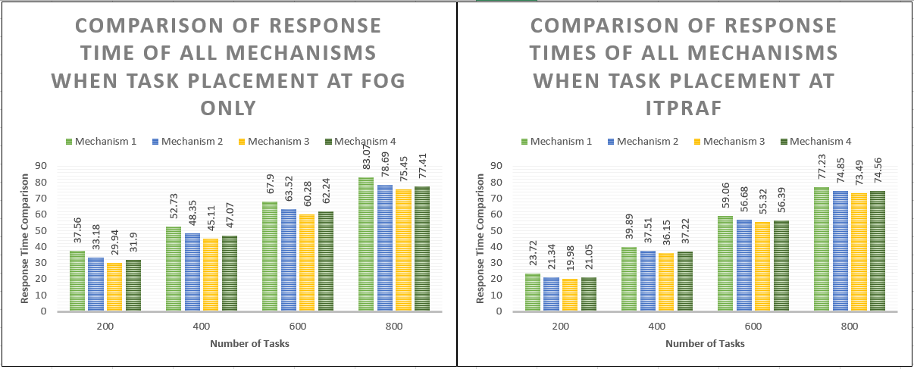
…..

Slide 10
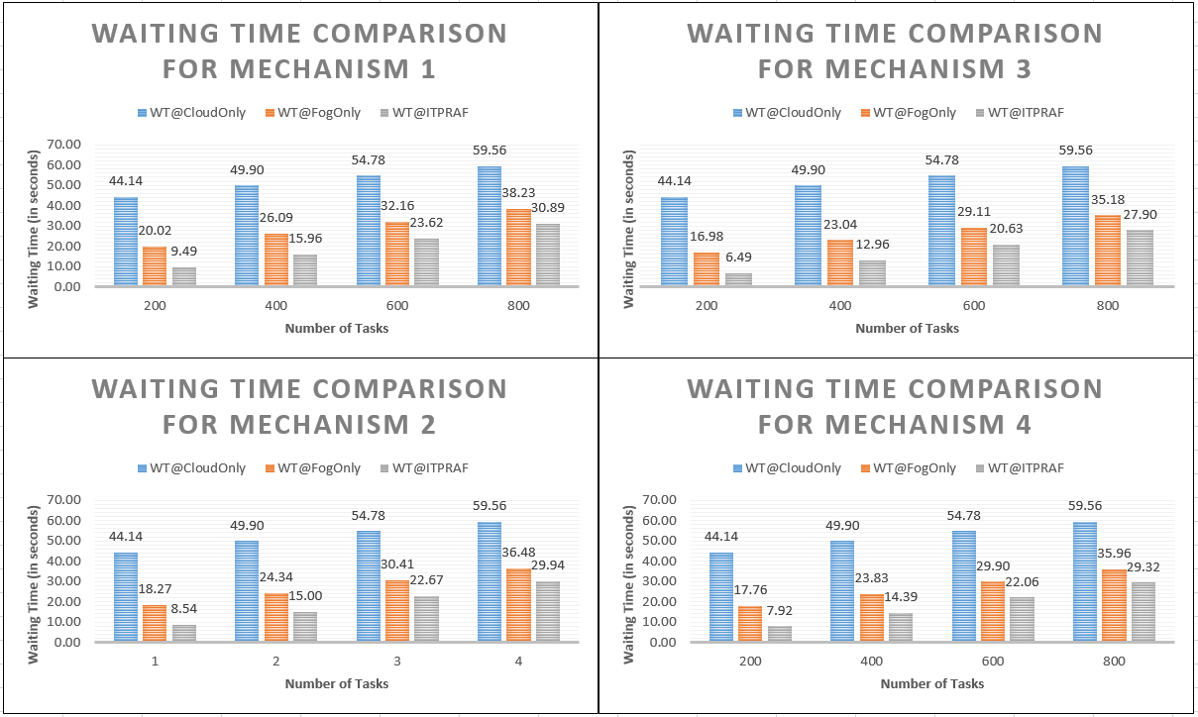
B. Waiting Time

Slide 11
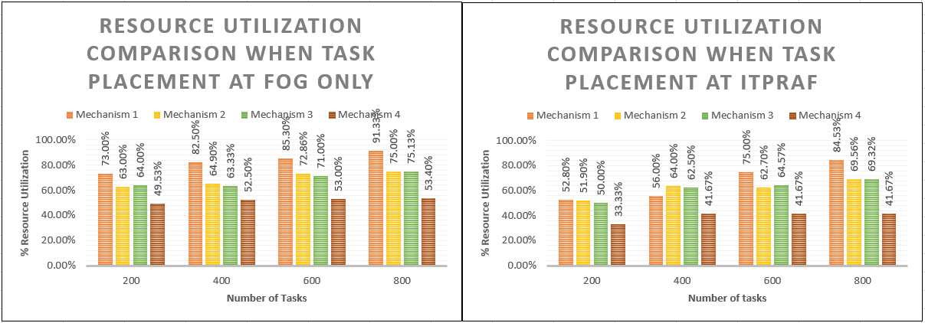
C. Resource Utilization:

Slide 12
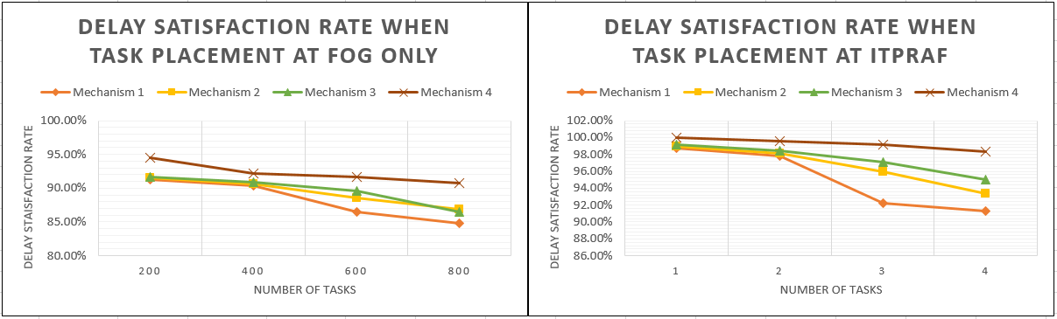
D. Delay Satisfaction:

Slide 13
Conclusion:
The results showed that the proposed approach (ITPRAF), which used machine learning, is a successful task scheduling technique. The evaluation of the performance indicators revealed that ITPRAF outperformed task scheduling without machine learning in a variety of scenarios.
To further achieve the greatest response time and resource utilisation, four techniques were included at the fog layer. Total response time, waiting times for mission-critical tasks, and resource use in the fog environment were taken into consideration as performance measures.
However, it was noted that a trade-off between response speed, waiting time, and resource use was necessary. Because inactive virtual machines require energy and raise the cost, resource utilisation is a crucial consideration. Resource use cannot be sacrificed in order to achieve faster response times. Therefore, the number of WFNs should be kept to a minimum, and ITPRAF still operates well even with few WFNs.

Slide 14
References:
E. Ahmed, I. Yaqoob, A. Gani, M. Imran, and M. Guizani, ‘‘Internet-ofThings-based smart environments: State of the art, taxonomy, and open research challenges,’’ IEEE Wireless Commun., vol. 23, no. 5, pp. 10–16, Oct. 2016.
K. Shafique, B. A. Khawaja, F. Sabir, S. Qazi and M. Mustaqim, "Internet of Things (IoT) for Next-Generation Smart Systems: A Review of Current Challenges, Future Trends and Prospects for Emerging 5G-IoT Scenarios," in IEEE Access, vol. 8, pp. 23022-23040, 2020, doi: 10.1109/ACCESS.2020.2970118.
Co-Operation With the Working Group RFID of the ETP EPOSS, Internet of Things in 2020, Roadmap for the Future, Version 1.1, INFSO D.4 Networked Enterprise RFID INFSO G.2 Micro Nanosystems, May 2008.
Gedeon, J., Jens Heuschkel, L. Wang and M. Mühlhäuser. “Fog Computing: Current Research and Future Challenges.” (2018).
S. Dustdar, C. Avasalcai and I. Murturi, "Invited Paper: Edge and Fog Computing: Vision and Research Challenges," 2019 IEEE International Conference on Service-Oriented System Engineering (SOSE), San Francisco, CA, USA, 2019, pp. 96-9609, doi: 10.1109/SOSE.2019.00023.
L. I. Carvalho, D. M. A. da Silva and R. C. Sofia, "Leveraging Context-awareness to Better Support the IoT Cloud-Edge Continuum," 2020 Fifth International Conference on Fog and Mobile Edge Computing (FMEC), Paris, France, 2020, pp. 356-359, doi: 10.1109/FMEC49853.2020.9144760.
Pengfei Hu, Sahraoui Dhelim, Huansheng Ning, Tie Qiu, “Survey on fog computing: architecture, key technologies, applications and open issues”,Journal of Network and Computer Applications, Volume 98, 2017, Pages 27-42, ISSN 1084-8045, https://doi.org/10.1016/j.jnca.2017.09.002.
Lindong Liu, Deyu Qi, Naqin Zhou, Yilin Wu, "A Task Scheduling Algorithm Based on Classification Mining in Fog Computing Environment", Wireless Communications and Mobile Computing, vol. 2018, Article ID 2102348, 11 pages, 2018. https://doi.org/10.1155/2018/2102348.

Slide 15
Continued…
Mohammad Khalid Pandit, Roohie Naaz Mir, Mohammad Ahsan Chishti, "Adaptive task scheduling in IoT using reinforcement learning", International Journal of Intelligent Computing and Cybernetics, Vol. 13 No. 3, pp. 261-282, 2020. https://doi.org/10.1108/IJICC-03-2020-0021.
Xuejing Li, Yajuan Qin, Huachun Zhou, Du Chen, Shujie Yang, Zhewei Zhang, "An Intelligent Adaptive Algorithm for Servers Balancing and Tasks Scheduling over Mobile Fog Computing Networks", Wireless Communications and Mobile Computing, vol. 2020, Article ID 8863865, 16 pages, 2020. https://doi.org/10.1155/2020/8863865.
N. Mostafaz "Resource Selection Service Based on Neural Network in Fog Environment", Advances in Science, Technology and Engineering Systems Journal, vol. 5, no. 1, pp. 408-417 (2020).
Bhatia, M., Sood, S.K. & Kaur, S. Quantumized approach of load scheduling in fog computing environment for IoT applications. Computing 102, 1097–1115 (2020). https://doi.org/10.1007/s00607-019-00786-5.
Fatma M. Talaat, Shereen H. Ali, Ahmed I. Saleh, Hesham A. Ali, “Effective Load Balancing Strategy (ELBS) for Real-Time Fog Computing Environment Using Fuzzy and Probabilistic Neural Networks”, Journal of Network and Systems Management (IF 2.250) Pub Date : 2019-02-06 , DOI: 10.1007/s10922-019-09490-3.
He Li, Kaoru Ota, and Mianxiong Dong, “Deep Reinforcement Scheduling for Mobile Crowd sensing in Fog Computing”, ACM Trans. Internet Technol. 19, 2, Article 21 (April 2019), 18 pages. DOI: https://doi.org/10.1145/3234463.
V. P. Kafle and A. H. A. Muktadir, "Intelligent and Agile Control of Edge Resources for Latency-Sensitive IoT Services," in IEEE Access, vol. 8, pp. 207991-208002, 2020, doi: 10.1109/ACCESS.2020.3038439.
Y. Dong, G. Xu, M. Zhang and X. Meng, "A High-Efficient Joint ’Cloud-Edge’ Aware Strategy for Task Deployment and Load Balancing," in IEEE Access, vol. 9, pp. 12791-12802, 2021, doi: 10.1109/ACCESS.2021.3051672.
Shifa Manihar, Tasneem Bano Rehman, Ravindra Patel and Sanjay Agrawal, “Intelligent and Scalable IoT Edge-Cloud System” International Journal of Advanced Computer Science and Applications (IJACSA), 11(8), 2020. http://dx.doi.org/10.14569/IJACSA.2020.0110846..

Slide 16
…
THANK YOU

