Slide 1

COVID-19 PANDEMIC
1
Achieve useful records of COVID-19 to get good measures for further analysis

Slide 2
Description
2
In this project, we will get latest datasets to prepare them for an Analysis.
we are going to work with the COVID19 dataset, published by John Hopkins University, which consists of the data related to the cumulative number of total confirmed cases, deaths, recovers, critical, tests in each Country and timeseries datasets of each Country.
Also, we have another dataset consist of various states in the USA and store them in our RDBMS.
We are going to separately achieve top most confirmed cases, deaths, recovers, critical, tests country wise and state wise from the USA country with timeseries.

Slide 3
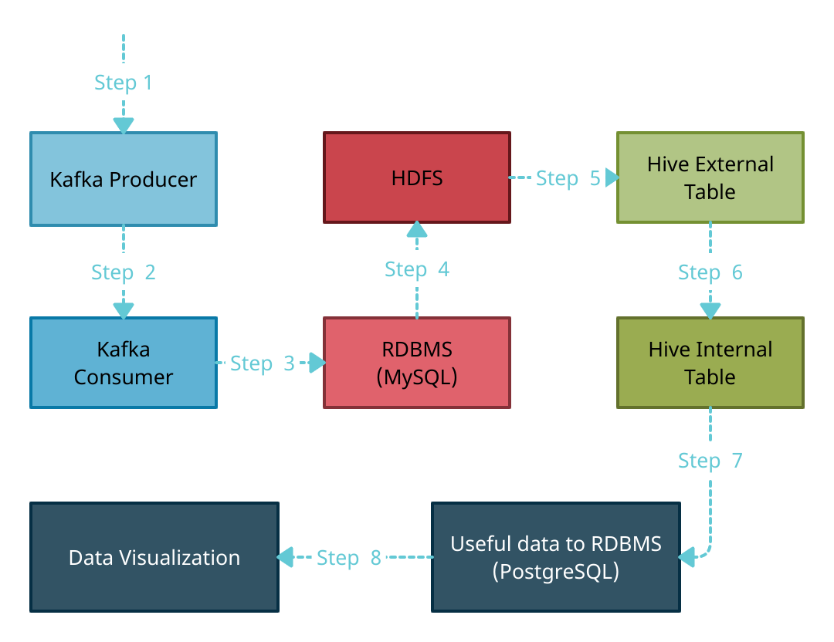
Basic Design
3
Step 1: Kafka producer will fetch three datasets from an API and filter columns of datasets as needed.
Step 2: Kafka producer will make filtered datasets available for Kafka consumer to consume those
Datasets.
Step 3: Kafka consumer will consume datasets from Kafka producer and save them into RDBMS (MySQL).
Step 4: Using PySpark, all the datasets from RDBMS will be ingested to the HDFS as a CSV file.
Step 5: By enabling support of Hive to PySpark, we will create Hive External table from HDFS data lakes.
Step 6: From Hive External table we will get data, aggregate those data as our needs and create ten new
Internal tables within Hive.
Step 7: Store all tables of useful data to RDBMS (PostgreSQL) for further analysis.
Step 8: Visualizing all useful data from PostgreSQL database using Django Application.
Apache Airflow

Slide 4
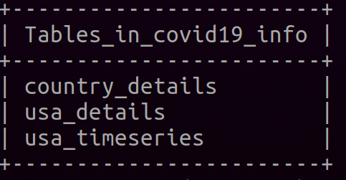
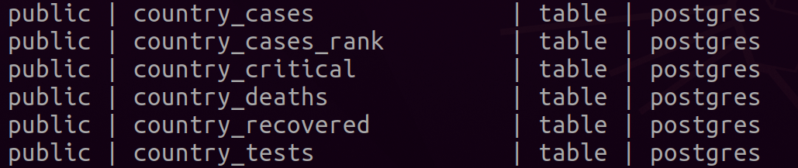
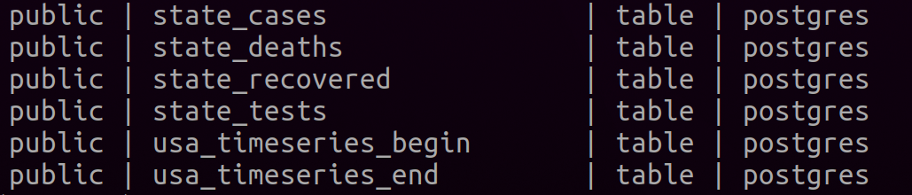
API Datasets to Tables
4
Gathered three Datasets from an API
And stored in MySQL database.
After aggregations, we achieved useful information in PostgreSQL database
for visualization and further analysis.

Slide 5
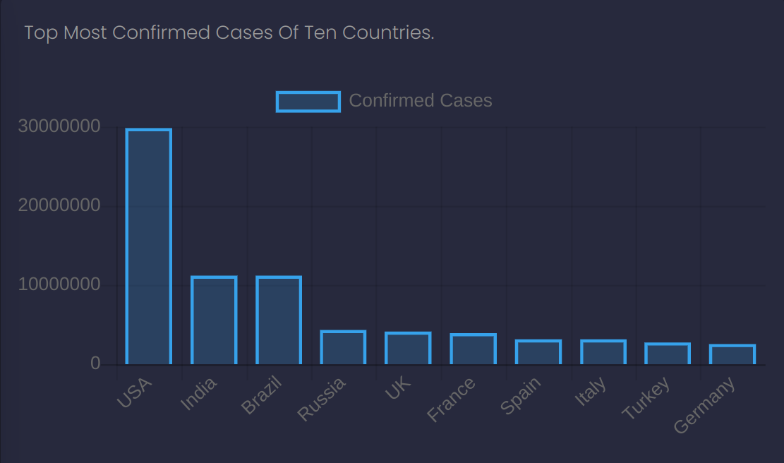
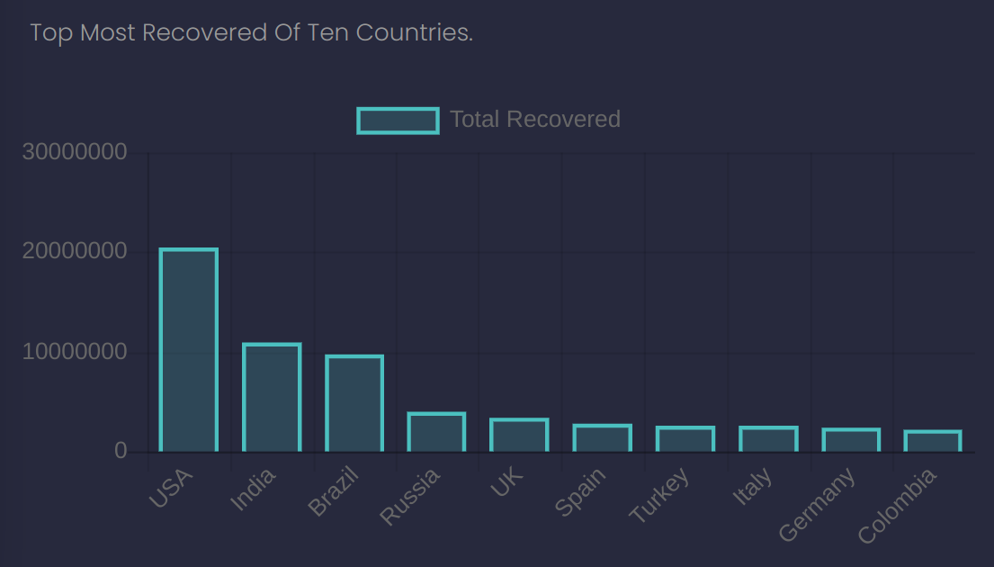
Countries (Cases & Recovered)
5
Displays as a bar chart of top most confirmed cases of ten countries. When hover on each bar, it will display exact figure.
Displays as a bar chart of top most recovered of ten countries. When hover on each bar, it will display exact figure.

Slide 6
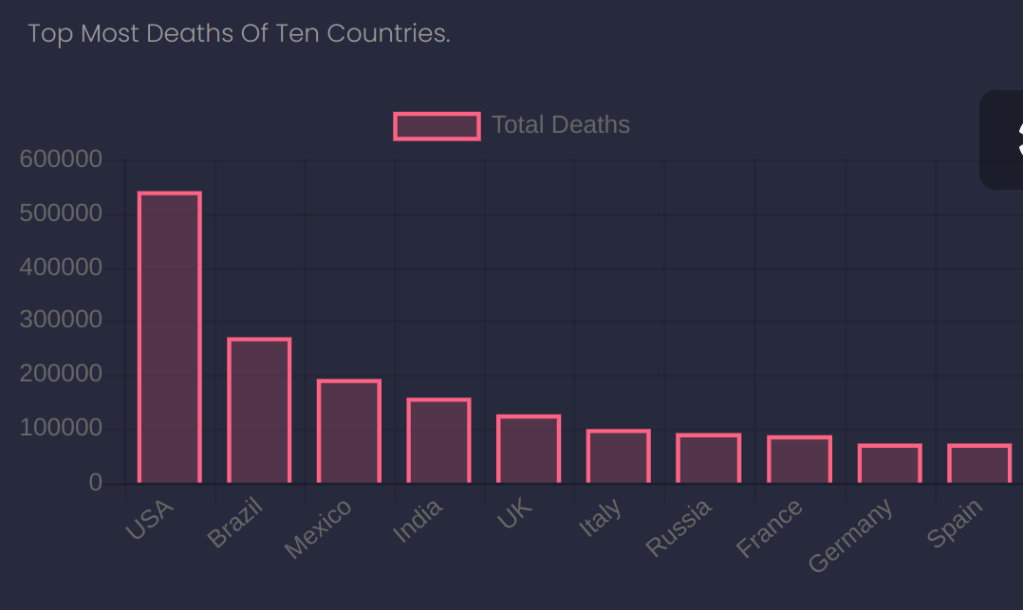
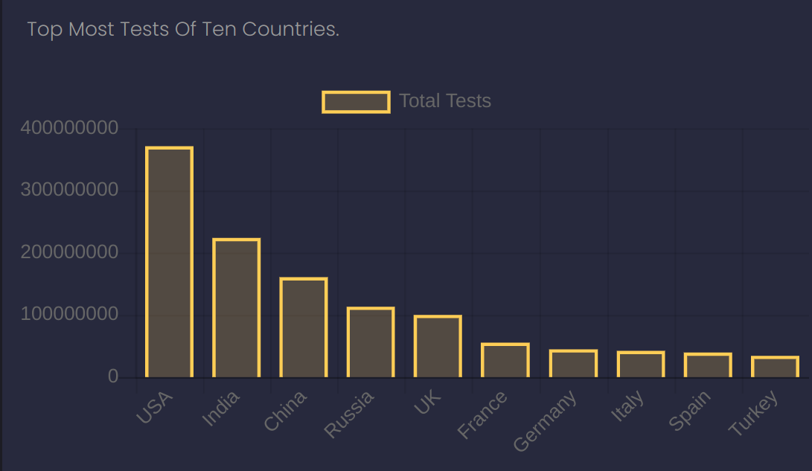
Countries (Deaths & Tests)
6
Displays as a bar chart of top most deaths of ten countries. When hover on each bar, it will display exact figure.
Displays as a bar chart of top most tests of ten countries. When hover on each bar, it will display exact figure.

Slide 7
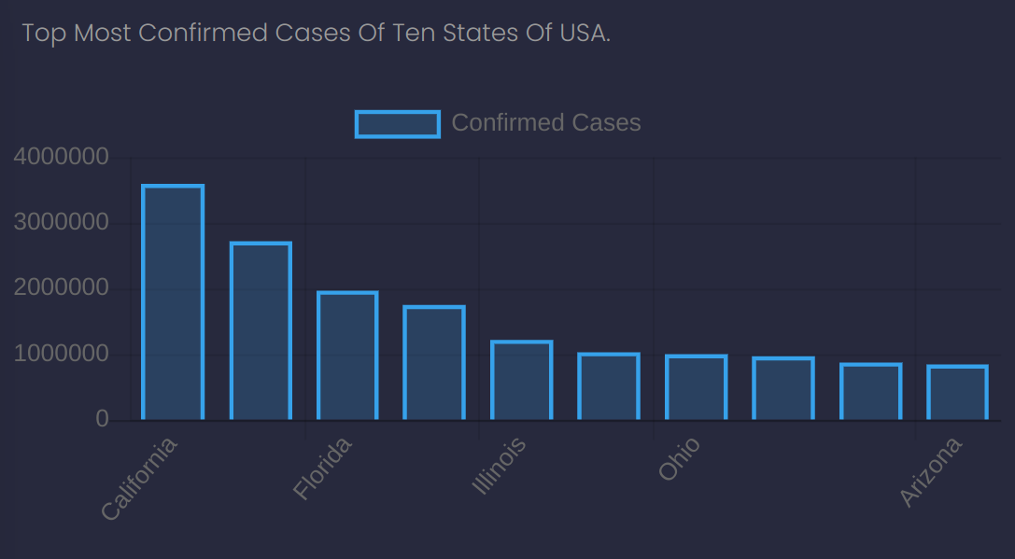
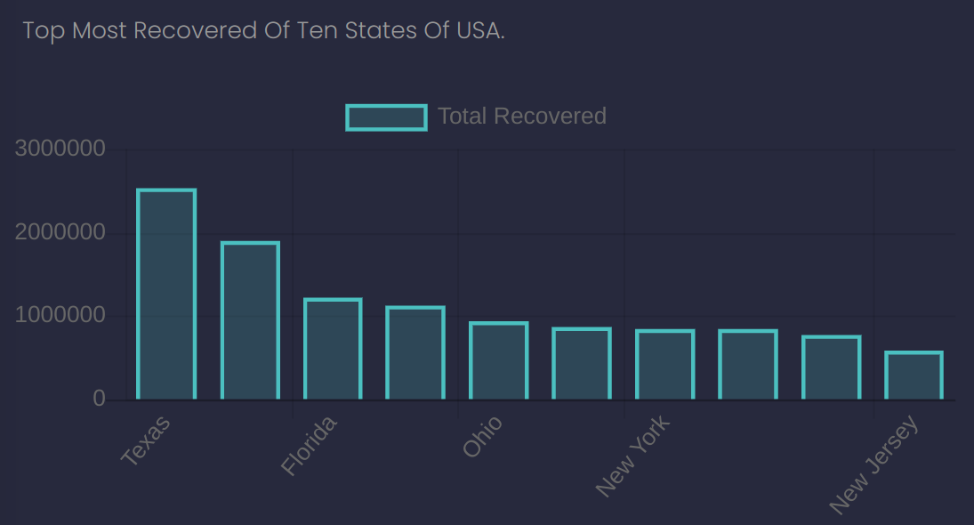
USA States(Cases & Recovered)
7
Displays as a bar chart of top most confirmed cases of ten USA States. When hover on each bar, it will display exact figure.
Displays as a bar chart of top most recovered of ten USA States. When hover on each bar, it will display exact figure.

Slide 8
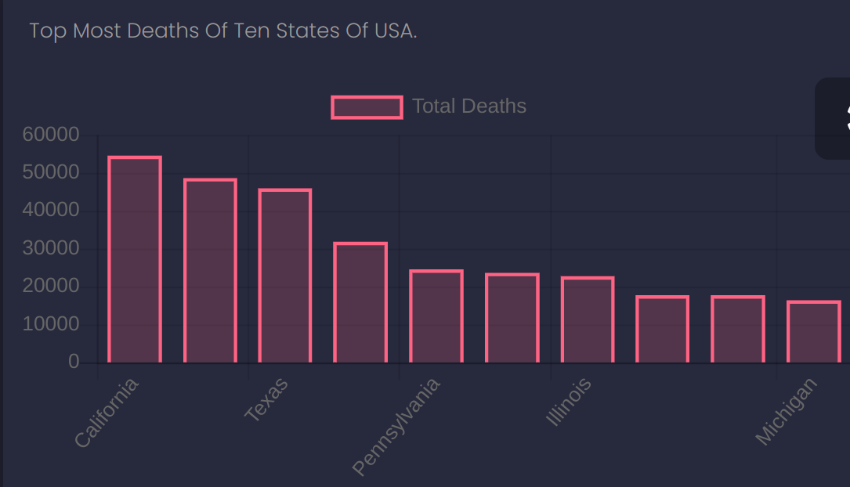
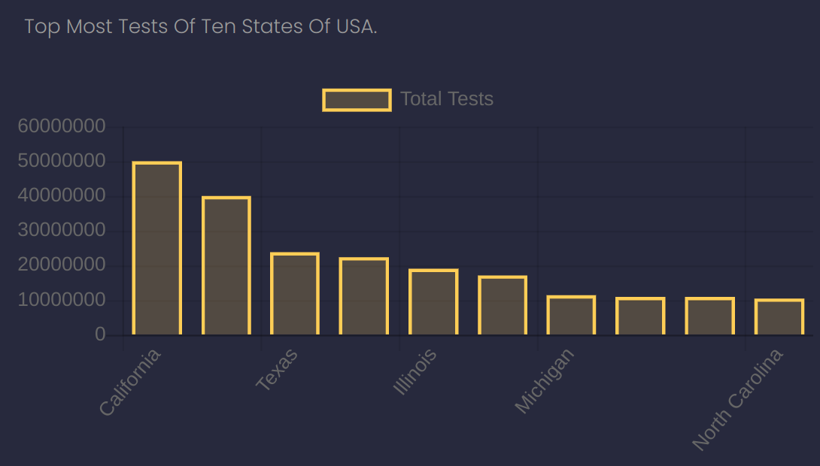
USA States (Deaths & Tests)
8
Displays as a bar chart of top most deaths of ten USA States. When hover on each bar, it will display exact figure.
Displays as a bar chart of top most tests of ten USA States. When hover on each bar, it will display exact figure.

Slide 9
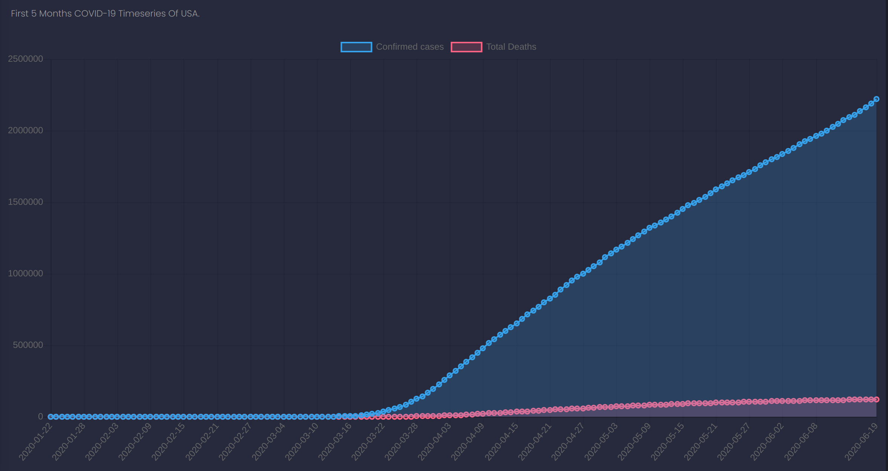
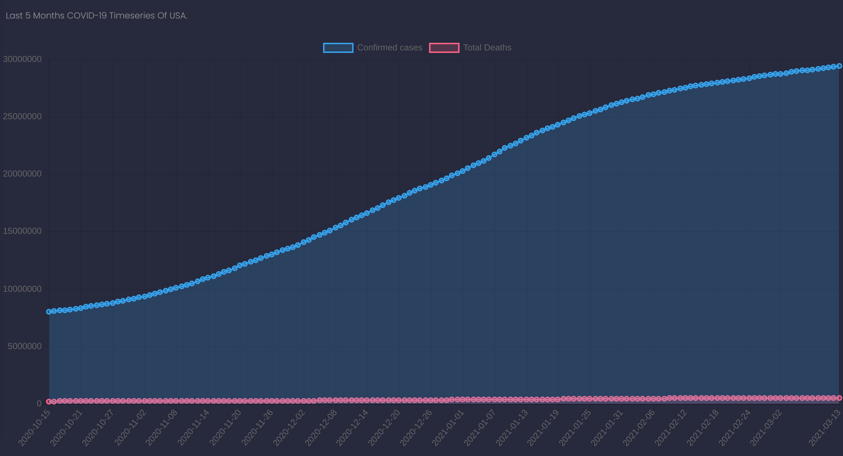
USA Country Timeseries
9
Displays as a line chart of first five month's confirmed cases and deaths of USA Country. When hover on each line, it will display exact figure.
Displays as a line chart of last five month's confirmed cases and deaths of USA Country. When hover on each line, it will display exact figure.

Slide 10
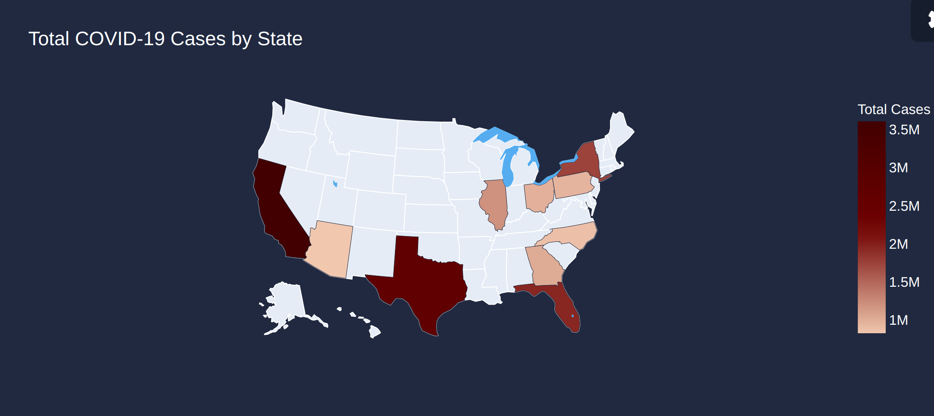
USA Choropleth Map
10
Displays as a choropleth map of top most confirmed cases of ten USA States. When hover on each plot, it will display exact figure.

Slide 11
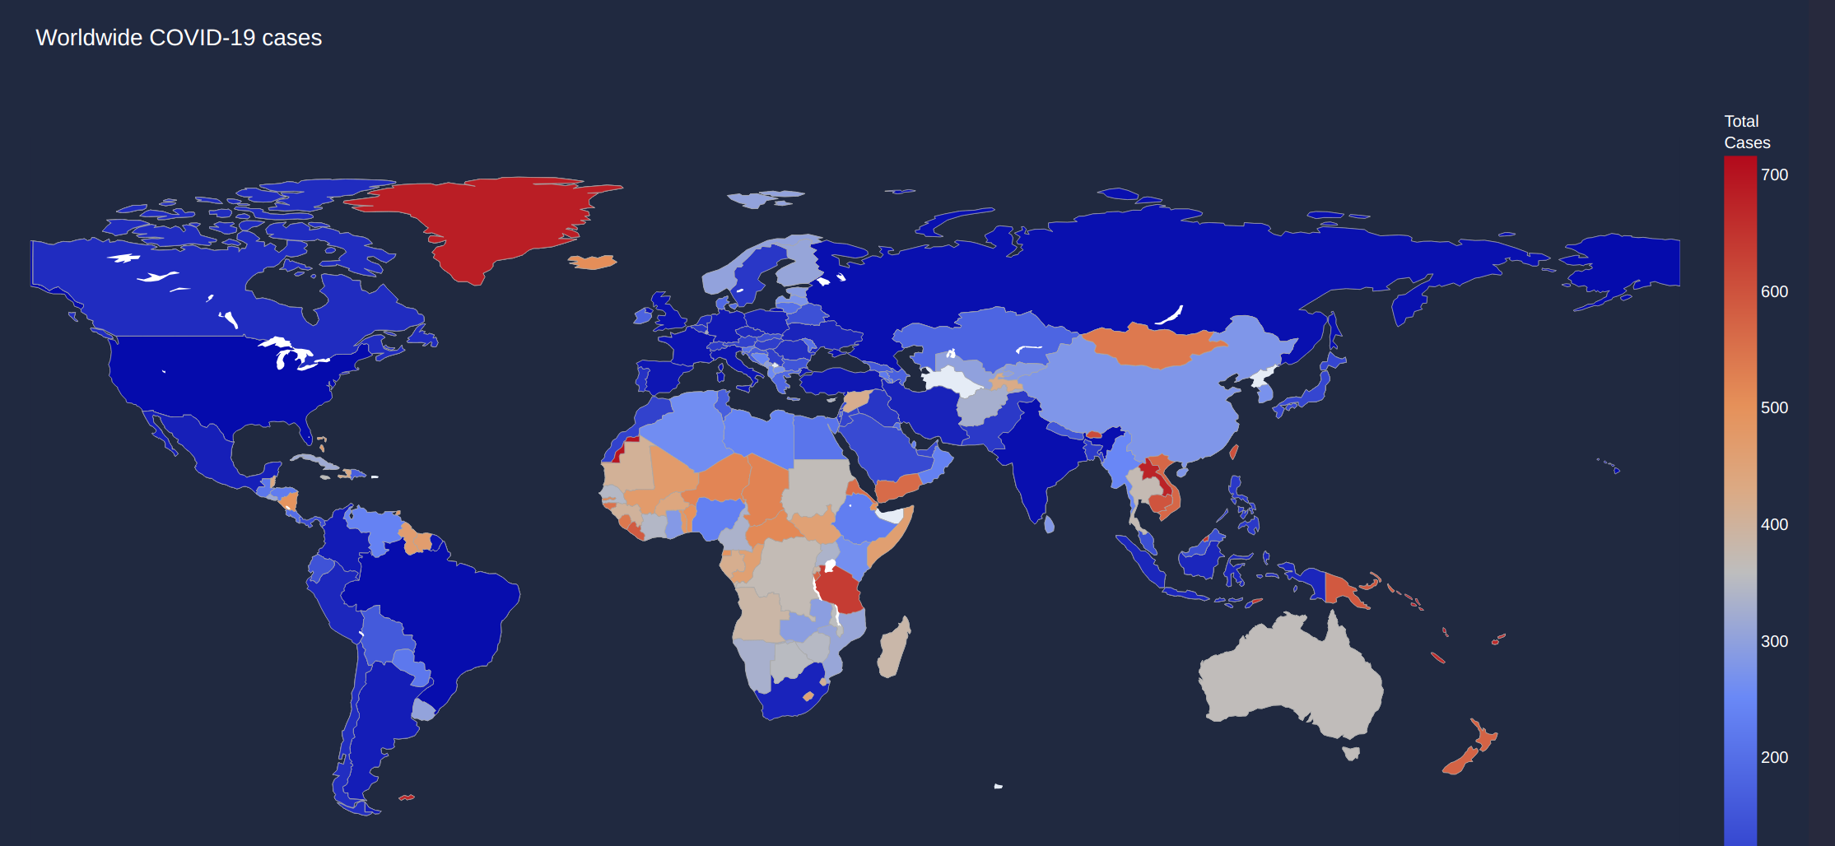
World's Choropleth Map
11
Displays as a choropleth map with Ranks on confirmed cases of each Country. When hover on each plot, it will display rank number.

Slide 12
Benefits
12
Achieving top most confirmed cases, deaths, recovers, critical, tests of each country, we can have good measures and will be useful for further analysis to make decision in each country.
For each state from the USA country, by achieving top most confirmed cases, deaths, recovers, tests, we can have good measures and will be useful for further analysis to make decision in each state of the USA country.
By achieving COVID-19 timeseries of the USA country, we can have comparison on first five months and last five months of confirmed cases increased day by day and how many are getting recovered daily.
Get ranks for all the countries based on confirmed cases of each country.
Visualising (On Django Application) all the achieved data with automated pipeline within Apache Airflow, we will have good visual understanding with Bar chart, Line chart and map plots.

