Slide 1

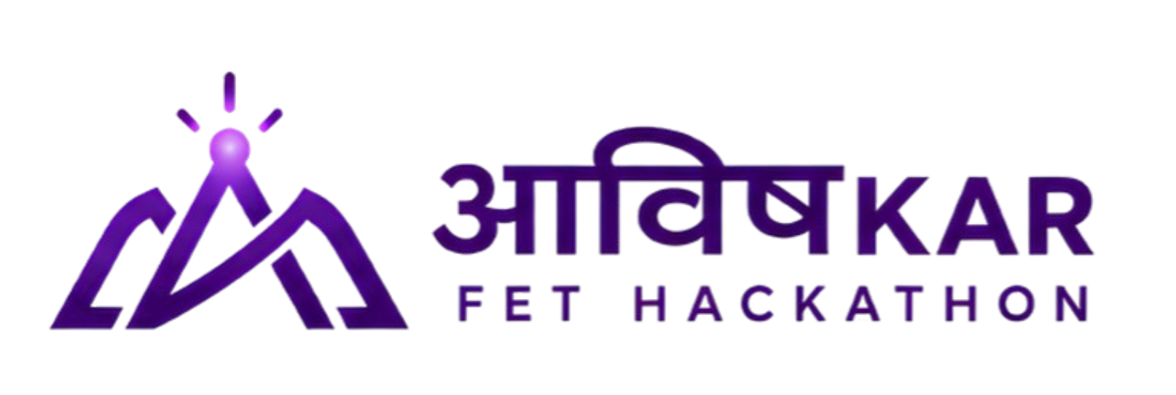





SIGNFORGE
From a few native signs to a model-ready corpus
Low-resource sign-language corpus builder · Round 2: the working build
10
app pages, live
33
signs · ISL + ASL
78%
ISL, held-out
83
automated tests
Team Claude's Clan — Tashvi Adhlakha (Team Leader), Bhavesh Lakhmani, Reuben Raju, Aakarshi Dwivedi
Live demo bhaveshlakhmani25-ui.github.io/signforge
Notes:
SIGNFORGE is a data-generation workbench for under-resourced sign languages, not a translator. Everything in this deck is built and running; the live demo opens on any laptop.

Slide 2




01 · THE PROBLEM
Problem Statement
“
Low-resource sign-language corpus builder using motion-capture transfer learning
Official problem statement · Aavishkar FET Hackathon
WHY IT IS HARD TODAY
Scarce, scattered data
Labels don't line up
Too few signers
Consent is an afterthought
120 datasets across 35 sign languages, in different formats and licences.
No shared standard for glosses, splits or quality, so results aren't comparable.
One or two signers per sign; models break on new people and regional variants.
Raw video of real people kept without clear permission or withdrawal.
70M+
Deaf people worldwide, using 300+ sign languages (UN / WFD)
ISL
Has datasets (INCLUDE, iSign), but they are small, uneven and hard to extend
?
What data should we collect next? No tool answers this today.
Notes:
Our brief: build a corpus builder for low-resource sign languages. The bottleneck is usable, consented, well-covered data, not the absence of any data. Collecting blindly wastes signers' time.

Slide 3




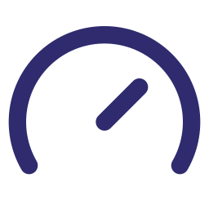




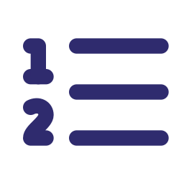

02 · WHAT WE BUILT
Solution
Consent
pseudonymous, per use
WHAT IT PRODUCES
A model-ready corpus
Landmarks + manifest, with consent, licence and review status per clip.
Record next
gaps + uncertainty
Capture
webcam or upload
SIGNFORGE
the model decides
what to record next
Models you can trust
Frozen test set, macro-F1 and calibration; 'not sure' when unsure.
Train & measure
frozen test set
Landmarks
video never uploaded
A plan for what to record
Signs ranked by coverage, signer and model gaps, each with a reason.
Human review
a person decides
Auto check
every flag explained
8 working pages: Capture · Corpus · Queue · Models · Interpret · Learn · Export · Dashboard
Model check
calibrated score
Notes:
Read the wheel clockwise from the top. Steps 1-3 run in the browser; the hub is the idea: model uncertainty and corpus gaps choose the next sample. The right side is what a team walks away with.

Slide 4
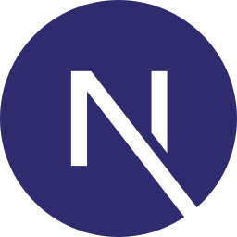









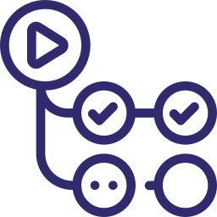




03 · HOW IT WORKS
Tech Stack + Workflow
Next.js
React
TypeScript
Tailwind
MediaPipe
Python
FastAPI
PyTorch
NumPy
SQLite
GH Actions
IN THE BROWSER · VIDEO STAYS ON DEVICE
BACKEND · FASTAPI + PYTORCH
Camera / video
MediaPipe Holistic
75 landmarks
QC + duplicates
SQLite + .npz
GRU train / eval
Queue + review
MODEL PIPELINE · IDENTICAL FOR TRAINING, LIVE CAMERA AND THE IN-BROWSER PORT
Frames
camera
Landmarks
33 + 2×21
27 points
x, y
30 frames
10 fps
Normalise
shoulders
GRU 128
dropout 0.3
Calibrate
temperature
Privacy by pose: only landmarks leave the browser. The hosted demo runs the same model and QC in TypeScript, checked against Python.
Notes:
No hardware: a laptop webcam is enough. Teal arrow = the privacy boundary. 83 pytest tests plus browser-vs-backend parity checks (16/16 readings, 33/33 QC results) keep both paths identical.

Slide 5
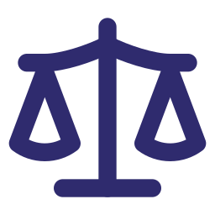




04 · WHAT IS NEW
Innovation
A model check that admits doubt
Same-language model, calibrated scores, 'not sure' below 55%, no auto-accept until reliable.
Model-guided collection
our core innovation
Privacy by pose, real consent
Landmarks only; withdrawing consent deletes clips and models trained on them.
Instead of recording more of everything, SIGNFORGE ranks every sign by how much a new clip would help, and says why.
Runs without a server
Model, quality check and retraining run in the browser, verified clip for clip.
Model uncertainty
40%
Coverage gap
35%
Teach it new signs
Add a sign, record 3+ approved clips, retrain in seconds; Interpret knows it.
Signer gap
25%
Output: “Record ‹sign› from a new signer: only 1 signer represented, model unsure.” One click opens Capture.
Learners grow the corpus
Practise against real dataset clips; opted-in attempts go to review.
Notes:
Weights are the shipped ranker defaults (0.35 / 0.25 / 0.40), configurable, and each component is shown in the app. Annotation tools record what you have; collection apps gather more; our emphasis is deciding what to collect next.

Slide 6




05 · WHAT IT CHANGES
Impact
Better data
consented, checked, reviewed
Better models
measured on frozen test sets
Accessible apps
built on documented corpora
56% → 78%
ISL accuracy on the same 59 held-out clips
0.11 → 0.07
calibration error, now passes the 0.10 check
22 clips
from 8 consenting team signers
Who benefits: Deaf communities steer what is collected; researchers get reusable data; learners practise free. Downstream impact is not yet measured.
Notes:
Same data, better training: ISL rose from 56% to 78%; THANK-YOU and THEY went from never recognised to 75-100%. Limits: INCLUDE has no signer IDs, so this is not signer-independent; ALRIGHT is still 0 of 4.

Slide 7






06 · WHO IT IS FOR
Target Audience / Market
WHO
THEIR PROBLEM
WHAT SIGNFORGE GIVES THEM
PAGES THEY USE
Research labs
Small, inconsistent datasets; results can't be compared
A documented corpus and a frozen-split benchmark, exportable
Models
Export
Accessibility startups
Need the exact signs their product uses
A ranked collection queue, with consent tracked per clip
Capture
Queue
Deaf organisations
Data taken from the community without a say
Run collection and review; consent and withdrawal built in
Review
Consent
Public institutions
ISL access in hospitals, transport, offices
Domain vocabularies built and validated with signers
Capture
Corpus
AI companies
Need licensable, provenance-clean data
Licence and provenance per clip; landmarks, not raw video
Export
Beachhead: Indian Sign Language with INCLUDE as the open benchmark. ASL already runs, so any under-resourced sign language can be added as a project.
Notes:
Our users are dataset creators and reviewers, not end-user translation customers. Deaf organisations are highlighted because community control over data is the reason the consent features exist.

Slide 8




07 · HOW IT SUSTAINS ITSELF
Revenue Model
Data services
Enterprise
Pro
Per project
Research
Licence
Consented corpus building; contributors paid
Community & academic
Subscription
Private deployment, governance, SSO
Support plan
Hosted collection, review, model runs
Free
Setup, data audits, benchmarks
Open-source, self-hosted
more hosting, support and services →
Open core, paid hosting and services. Contributors are credited and paid; their data is never free labour. Billing is not part of the prototype.
Notes:
Unchanged from Round 1 by design: the build focused on the data loop.

Slide 9

08 · WHAT COMES NEXT
Future Improvements
Now (built)
Next
Later
More data
✓ 835 clips: 17 ISL + 16 ASL signs, 22 team clips
Import INCLUDE People: 10 signs, archives checksummed; more signers per sign
Community collection at scale; regional variants
Better accuracy
✓ ISL 78% on held-out clips, calibrated
Verify a pretrained checkpoint for real transfer; target weak signs (ALRIGHT 0/4)
Signer-independent and continuous-signing evaluation
Platform & community
✓ Full loop, browser demo, new signs
Shared hosted backend; Deaf and native reviewer onboarding
Mobile capture, ELAN export, more sign languages
Notes:
Two levers for a better model: more data (People archives already inspected by Aakarshi) and better methods (a verified pretrained checkpoint). Platform work makes collection possible beyond our laptops.

Slide 10
Thank You
Questions?
Model uncertainty → next sample → better data
Try it bhaveshlakhmani25-ui.github.io/signforge
Team Claude's Clan · Tashvi Adhlakha · Bhavesh Lakhmani · Reuben Raju · Aakarshi Dwivedi
Notes:
Close on the loop and invite judges to open the live demo on their own laptop.

