Slide 1


Career Guidance System
Vivekananda Education Society’s Institute of Technology, Computer Department
Team Members:
Bhavesh Lohana(Team Leader)
Tina Rajpal
Aakash Chauhan
06 March 2020

Slide 2
Abstract.
Students after 10th/12th, face problems in terms of choosing a field from a vast collection of choices. The choice doesn't end at Science, Arts and Commerce, there are various branches under each. Hence, The major problem faced during career guidance is seeking correct guidance. The consulting would not just remain to a particular field, our assessment would help student to choose a stream first and there on, get the guidance under that stream. Our solution to this, is a web portal where the student can create his account to keep track of the assessments. The student would take an assessment consisting of 30-40 questions under each category. Django and Postgres will be used to handle backend and bootstrap for frontend. Another problem that is to be tackled, is to make the student understand the result efficiently, hence graphs will be used.
06 March 2020

Slide 3
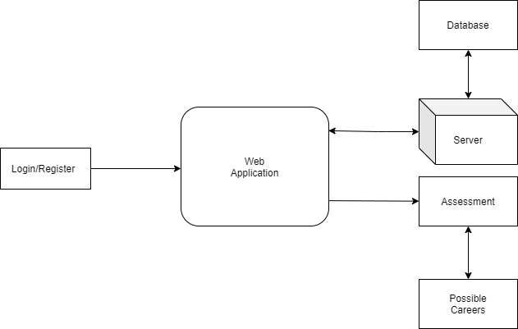
Proposed Architecture/Diagram
06 March 2020

Slide 4
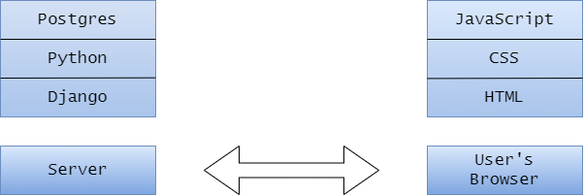
Technology Stack
06 March 2020

Slide 5
Conclusion
Our web application would get the possible careers for the student in accordance to the assessment.
The student would be able to store the data.
Also, the Career Book contains the list of all the careers where student can explore the vast range of choices under each branch.

