Slide 1

TRAFFIC VIOLATION
Traffic Data Geeks
Lissette
Bhavesh
Chris
Viral

Slide 2
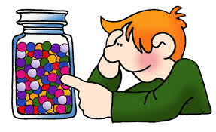
196 Million
41 Million
112,000
No. 3 Cause

Slide 3
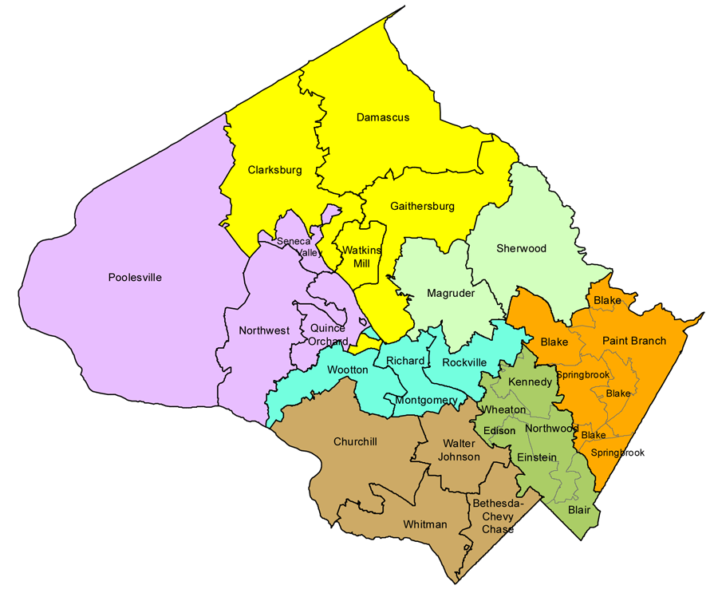
Dataset
We obtained the Traffic Violation dataset from Kaggel website
The dataset contains information from all traffic violations issued in the Montgomery County of Maryland.
The data contains identifiers like the time of stop, location, accident, injury (if any), alcohol and/or drug (if any), make/model of car, violation type, race, gender, and charge.
The data set contains approximately one million objects, each with thirty-five attributes, and is being updated every fifteen minutes.
Lets see what we can find….

Slide 4
Who gets more tickets (Males v. Female)
What Race tends to get more violation tickets?
What month of the year most violations happens?
What time of the day most violations happens?
The most common types of violations

Slide 5
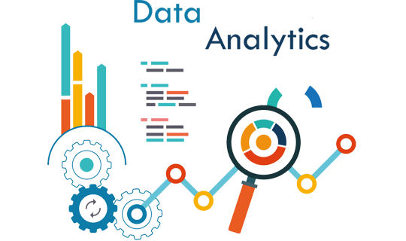
TOOLS AND PLATFORMS AND METHODS
The primary language for programming in this project we used is Python.
Another Python tool that we used are Matplotlib and Seaborn, which is used to create various charts and graphs to represent the data that has been mined.
For Data Manipulation and Analysis, we used Pandas environment.

Slide 6
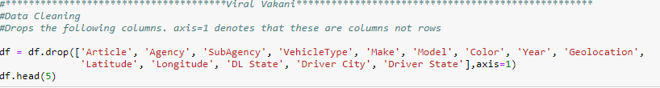
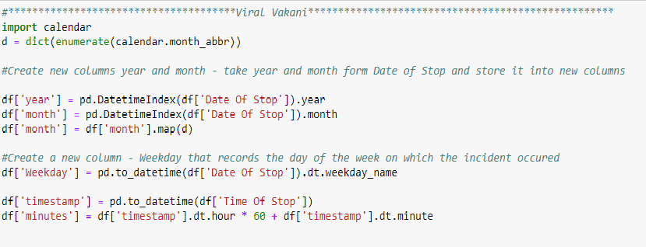
DATA MINING PROCESS
Read and Observe the data set - Columns and Rows
Check data for missing values
Drop Unnecessary Columns
Clean Data of Nan/Null Values – using drop NaNs function
Extracted ‘year’, ‘month’ and ‘Weekday’ from Date Of Stop and timestamp and minutes from Time Of Stop to generate new columns

Slide 7

Who tends to get more tickets on average, Male or Female?

Slide 8
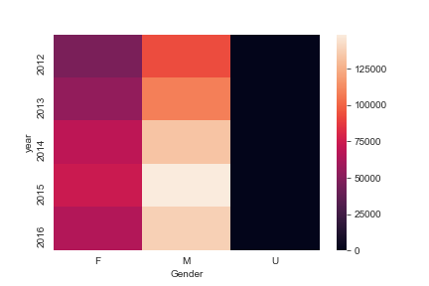
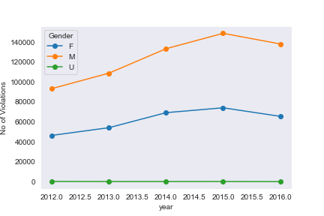
Gender Analysis
Number of violations by grouped by gender and year
Our data showed that many more warnings and citations were given to men than they are to women.
Mining this data with regards to gender gives insurance companies a great deal of information. Insurance companies give lower rates to drivers who are thought to be less likely to drive recklessly.

Slide 9

Which Race is more likely to get a traffic violation ticket?

Slide 10
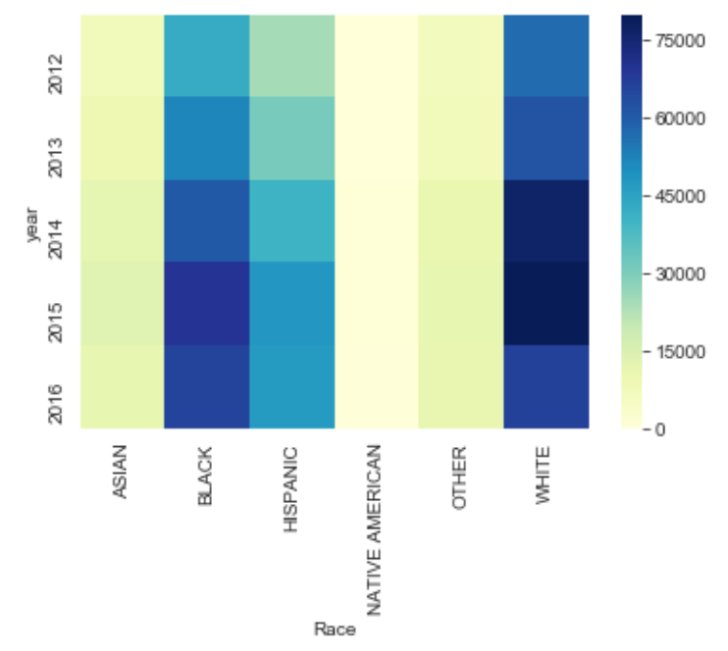
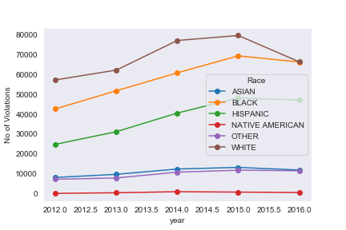
RACE ANALYSIS
White and Black are more likely to get more violations then any other race. White population has higher rates of getting violation in MD

Slide 11
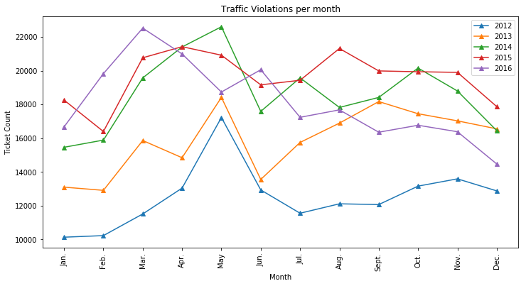
TICKETS PER MONTH (2012 – 2016)
May was busiest month for years 2012-2014, while it moved to April in 2015 and March in 2016.
Lowest amount of tickets seem to be given early in the year (January or February) from 2012-2015. The exception was 2016 when December became the year with the lowest ticket count (Happy Holidays!).

Slide 12
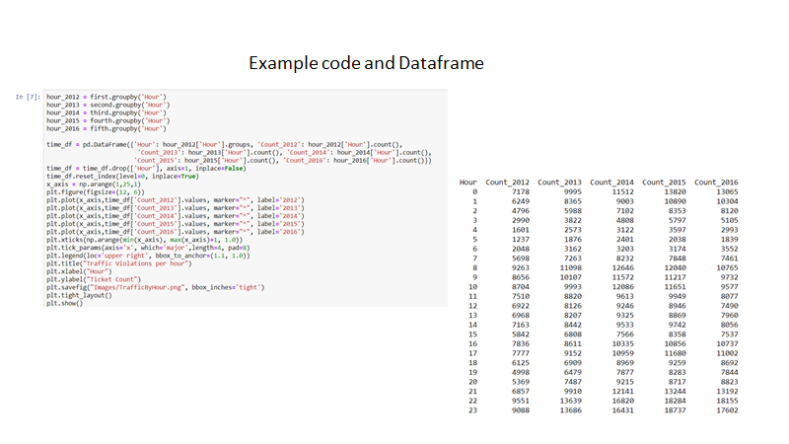

Slide 13
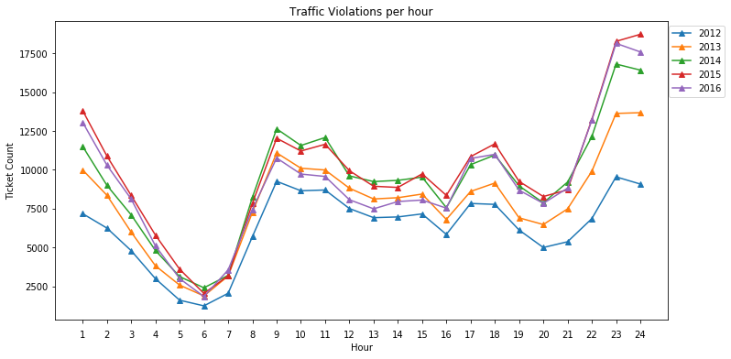
TICKETS PER HOUR (2012 – 2016)
We see a consistent trend where the busiest time for giving traffic tickets is 10PM – 12:00AM. Meanwhile, 6:00 AM was the least busy time for traffic tickets throughout all years.

Slide 14
TOP 10 VIOLATIONS
More than half of all violations are for speeding, followed by other moving violations and equipment violations.
1. FAILURE TO OBEY A TRAFFIC CONTROL DEVICE | 65295
2. FAILURE TO DISPLAY REGISTRATION CARD | 38540
3. SUSPENDED REGISTRATION | 30890
4. FAILURE TO DISPLAY LICENSE | 22779
5. FAILURE TO STOP AT STOP SIGN | 20651
6. EXPIRED REGISTRATION PLATE ISSUED BY ANY STATE | 19317
7. USE HANDHELD TELEPHONE WHILE MOTOR VEHICLE IS IN MOTION | 18303
8. SUSPENDED LICENSE | 17013
9. OPERATOR NOT RESTRAINED BY SEATBELT | 13274
10. EXCEEDING THE POSTED SPEED LIMIT OF 30 MPH | 13005

Slide 15
PERCENTAGE OF VIOLATIONS BY GENDER
About two-thirds of female traffic stops are for speeding,
whereas stops for male driver are more balanced among other violation categories.
This doesn't mean that females speed more often than males.
M | 67%
F | 33%
U | 1%

Slide 16
TRAFFIC STOP BY RACE
According to our data, about 10% traffic stop by race are Native Americans followed by Asian 9.6% in our top ten list.
NATIVE AMERICAN | DRIVER FAILURE TO OBEY PROPERLY PLACED TRAFFIC CONTROL DEVICE INSTRUCTIONS | 10.36%
ASIAN | DRIVER FAILURE TO OBEY PROPERLY PLACED TRAFFIC CONTROL DEVICE INSTRUCTIONS | 9.63%
WHITE | DRIVER FAILURE TO OBEY PROPERLY PLACED TRAFFIC CONTROL DEVICE INSTRUCTIONS | 9.29%
OTHER | DRIVER FAILURE TO OBEY PROPERLY PLACED TRAFFIC CONTROL DEVICE INSTRUCTIONS | 9.01%
HISPANIC | DRIVER FAILURE TO OBEY PROPERLY PLACED TRAFFIC CONTROL DEVICE INSTRUCTIONS | 7.30%
BLACK | DRIVER FAILURE TO OBEY PROPERLY PLACED TRAFFIC CONTROL DEVICE INSTRUCTIONS | 7.28%
ASIAN | FAILURE TO DISPLAY REGISTRATION CARD UPON DEMAND BY POLICE OFFICER | 5.95%
BLACK | DRIVING VEHICLE ON HIGHWAY WITH SUSPENDED REGISTRATION | 5.18%
 | FAILURE TO DISPLAY REGISTRATION CARD UPON DEMAND BY POLICE OFFICER | 5.18%
OTHER | FAILURE TO DISPLAY REGISTRATION CARD UPON DEMAND BY POLICE OFFICER | 5.05%

Slide 17
ADDITIONAL OBSERVATIONS
For all other types of violations, the stop rate is higher for males than for females, disproving our hypothesis. The stop rate varies by violation type, and the difference in stop rate between male and female is because they tend to commit different violations.
The rate of Alcohol-related stops is very minimal and did not meet our top ten, disproving our hypothesis that alcohol played a significant role in speeding.
Most of the arrest made were initiated by mark patrol cars.

Slide 18
CONCLUSION
We were expecting to see more tickets issued during the summer (June-August), since school is out. This was disproven when we saw the largest quantities were issued during March - May, depending on the year.

Slide 19
POST-MORTEM
Challenges

Slide 20

QUESTIONS?

