Slide 1
Smart City Water Leakage Detection & Waste Water Accounting
-Bhavesh patel

Slide 2
Problem Statement:
Every year millions of gallons of water are lost through leaks in aged water pipes which is never billed.
So, Massachusetts water department has designed a system to address water sustainability and protect the water system from threats like water theft or water leakage.
Finding the threats and establishing better predictive major water repair scheduling system at the correct time would benefit the society or so called city from saving millions of dollars in terms of revenue which would otherwise had gone unmeasurable.

Slide 3
User Roles
No. | Entity | Real Time References | Supervised By
1 | Ecosystem | System Configuration | System admin
2 | Network | Massachusetts Water Management System | System admin
2 | Enterprise | Water Enterprise Repair Enterprise Financial Enterprise | System admin System admin System admin
3 | Organizations | Water Supply Organization Sensor Monitoring Organization Complaints Organization Customer Organization Repair Manager Organization Repair Staff Organization Accounts Organization | Water Admin Water Admin Water Admin Water Admin Repair Admin Repair Admin Finance Admin
4 | Employee | Water Supply Admin Sensor Monitoring Employee Complaints Employee Customer Repair Manager Repair Staff Accounting Employee | Water Organization Water Organization Water Organization Water Organization Repair Manager Organization Repair Staff Organization Accounts Organization

Slide 4
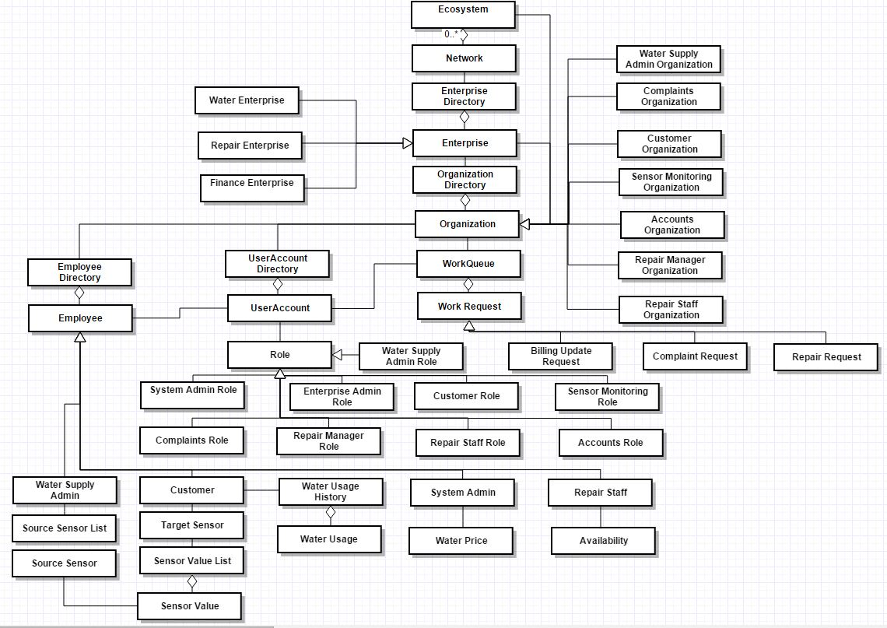
Object Model

Slide 5
Features
Implemented chat system for two way communication
Email the staff when a repair request is assigned
Implemented SMS system for two way communication
Customers and admins can save the chat in a notepad file
Exported the customer data reports into excel sheets so that admin can open the sheet from the java swing application
Use of different jFreeCharts (pie , bar and line charts)
Implemented pull as well as pull model
Randomly assigning billing update request from customer to an accounts employee
Notification center for broadcasts and alerts from system admin
Implemented media player for general water information for employees

Slide 6
Use Cases:
1) System Admin :
Creation of networks , enterprises namely Water Enterprise , Repair Enterprise , Finance Enterprise and their respective admin user accounts
Send Broadcast messages to all the customers in the ecosystem regarding water related issues.
Real time interaction with the customer at any time over the chat system designed.
Access to system reports.
2) Enterprise Admin:
An Enterprise Admin creates different Organization, Employee and their user account.
Repair Enterprise admin creates staff profiles along with their availability
Water Enterprise admin have access to water usage stats of every customer in the network.

Slide 7
Use Cases continued…
3) Water Supply admin:
Regulates the supply of water for all the customers in the network
Responsible to start the supply of water by setting the initial sensor value like flow rate and pressure
4) Customer:
Start using the water if available along with getting the updates of waters usage.
Real time interaction with the system admin through a chat system designed
Create a leakage by changing the flow rate of the sensor(Acting as a leakage creator)
Place a complaint regarding specific issue and provide a feedback to the complaint staff through a well designed chat system.
5) Sensor Monitoring Team:
Monitor all the sensors values(flow rate and pressure) for the source and target sensors
Request for a repair after finding a particular leakage at any water supply line
6) Complaints Employee:
Interact with customer over a chat system designed and resolve the requests

Slide 8
Use Cases continued…
7) Repair Manager:
Assign pending repair requests to one of the available repair staff
When no repair staffs are available, then email a particular repair staff in case of emergency
Manage all the resolved repair request and check for cost of repair
8) Repair Staff:
Go to site and repair the leakage of the repair requests assigned and send it to accounts team for leakage
Manage its profile for availability
9) Accounts Team:
Manage Customer accounts by calculating total bill for water usage
Manage Leakage accounts by calculating total leakage cost
Resolve the request received from customer regarding the updated bill request

Slide 9
Assumptions:
All the user accounts are securely created.
Source sensor values are always fixed
Repair Manager is aware of the efficiency of the repair staff before assigning any request
Customers can do the payment for the water bills later.
Customer for time being is a thief as well
Financial enterprise is a government approved trustworthy enterprise
Once supply is available, customers gets 24x7 available water unless there is a leakage

