Slide 1
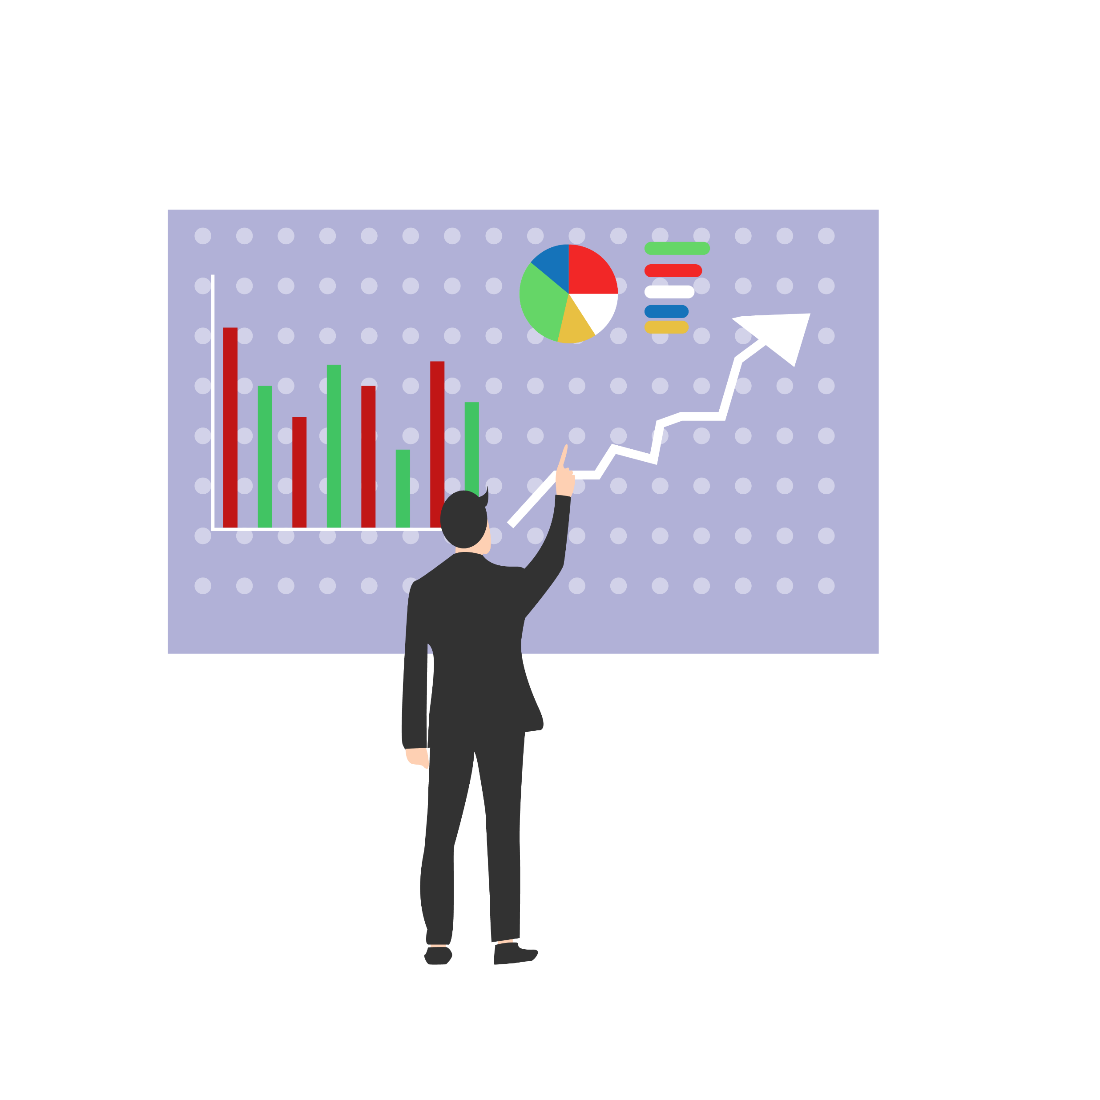
Micro-Segmentation (Marketing)
Presented By
Dhruv Pithwa, Bhavesh Singh, Sampras D’souza

Slide 2
Table of Contents
Introduction
What is Marketing Segmentation ?
Need of Micro-Segmentation in Marketing
What is Micro-Segmentation ?
Process Flow Diagram for Micro-Segmentation
Technical Architecture for Micro-Segmentation
Summarization of the Outcome
Pros & Cons of the Implementation

Slide 3
Introduction
What is Marketing Segmentation ?
Market segmentation is the process of dividing a market of potential customers into groups, or segments, based on different characteristics.
Types of Market Segmentation:
Demographic segmentation( age, gender, income, etc.)
Psychographic segmentation( interests, lifestyle, etc.)
Behavioral segmentation( purchase & spend habits, brand interactions, etc.)
Geographic segmentation( city, country, etc.)

Slide 4
Introduction
Need of Micro-Segmentation
Segments created due to marketing segmentation consists of limited number of customers, so it is not possible to produce products in mass scale for every segment
What is Micro-Segmentation ?
More advanced form of market segmentation
It is the practice of dividing a company’s customers into groups relevant to a particular business
Goal of segmenting customers is to decide how to relate to customers in each segment in order to maximize the value of each customer to the business

Slide 5
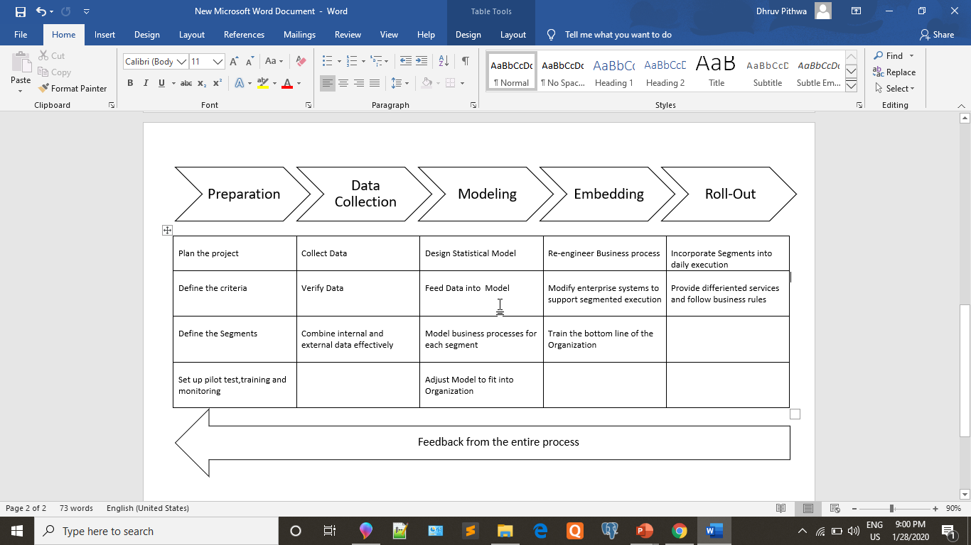
Process Flow Diagram

Slide 6
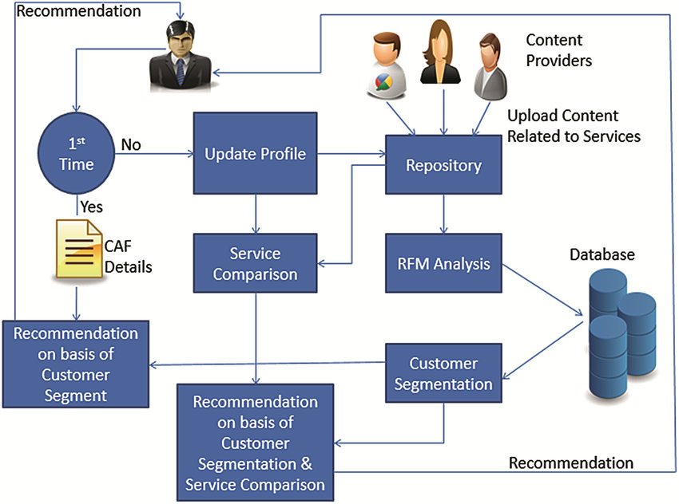
Technical Architecture Diagram

Slide 7
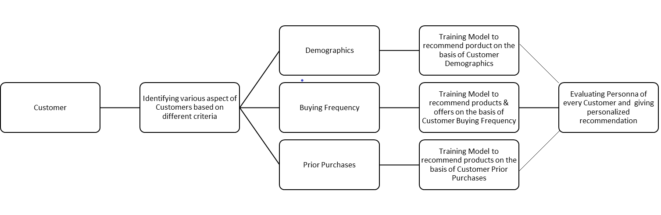
Technical Architecture Diagram

Slide 8
Summarization of Outcome
Fewer users, Better Control
Easy to carry out predictive analysis
Easy to understand campaign effectiveness
Reduces time taken to finalize right approach
Cost Effective
Drives up Brand Loyalty

Slide 9
Pros & Cons of the Implementation
Pros
It will be easier for the company to narrow down their target users depending upon the respective product
User would be divided into various categories, on various aspects such that each user would lie in at least one of the categorized class
There would be different persona associated with different classes
Cons
Limited training data thus targeting only limited category of products
Also, Demographics of each users are limited
Time consuming

Slide 10
Learnings
Learnt how one should solve unsupervised problem through supervised approach by extracting and analyzing various patterns from the dataset and forming clusters accordingly
Deploying machine learning models through “flask” becomes comparatively easy than other methods

