Slide 1
Web Based ML
Model Evaluator
Team 13 · PES University
Software Engineering · Semester V
9 November 2026
TEAM 13 | 1 / 13
Notes:
Sources: Team13_SRS_SAD_STP.pdf; docs/TSMP-23_FINAL_REPORT.md; docs/TSMP-23_DEMO_EVIDENCE.md. Baseline 3f11b12. Implementation and validation links are in the demo evidence index. Rehearsal timing follows the fifteen-minute plan in the demo runbook.

Slide 2
The evaluation problem
Students and researchers repeat model-loading and scoring scripts.
We provide one workflow to validate inputs, isolate inference, compare results and export reports.
TEAM 13 | 2 / 13
Notes:
Sources: Team13_SRS_SAD_STP.pdf; docs/TSMP-23_FINAL_REPORT.md; docs/TSMP-23_DEMO_EVIDENCE.md. Baseline 3f11b12. Implementation and validation links are in the demo evidence index. Rehearsal timing follows the fifteen-minute plan in the demo runbook.

Slide 3
Users and scope
Students and researchers evaluate trained tabular models.
Course evaluators inspect submissions and workspace results.
Supported inputs are scikit-learn pickle/joblib, ONNX and CSV.
Version 1 covers classification and regression.
TEAM 13 | 3 / 13
Notes:
Sources: Team13_SRS_SAD_STP.pdf; docs/TSMP-23_FINAL_REPORT.md; docs/TSMP-23_DEMO_EVIDENCE.md. Baseline 3f11b12. Implementation and validation links are in the demo evidence index. Rehearsal timing follows the fifteen-minute plan in the demo runbook.

Slide 4
Requirements and acceptance
27 functional, 10 security and 11 non-functional requirements.
Trace each requirement through architecture, code and tests.
Evaluate the STP release criteria on the final build.
Preserve actual outcomes, known defects and unrun cases.
TEAM 13 | 4 / 13
Notes:
Sources: Team13_SRS_SAD_STP.pdf; docs/TSMP-23_FINAL_REPORT.md; docs/TSMP-23_DEMO_EVIDENCE.md. Baseline 3f11b12. Implementation and validation links are in the demo evidence index. Rehearsal timing follows the fifteen-minute plan in the demo runbook.

Slide 5
System architecture
React / Nginx → Django REST API → PostgreSQL
Django → Redis → Celery worker → per-job Docker sandbox
Labels and trusted scoring stay outside the sandbox.
ReportLab renders PDF exports.
TEAM 13 | 5 / 13
Notes:
Sources: Team13_SRS_SAD_STP.pdf; docs/TSMP-23_FINAL_REPORT.md; docs/TSMP-23_DEMO_EVIDENCE.md. Baseline 3f11b12. Implementation and validation links are in the demo evidence index. Rehearsal timing follows the fifteen-minute plan in the demo runbook.

Slide 6
Evaluation sequence
Upload model + CSV → choose target → check compatibility.
Submit → QUEUED → RUNNING → SUCCEEDED or sanitized failure.
Enforce resource limits, private temporary storage and a 120-second timeout.
Reap stale jobs and remove job containers.
TEAM 13 | 6 / 13
Notes:
Sources: Team13_SRS_SAD_STP.pdf; docs/TSMP-23_FINAL_REPORT.md; docs/TSMP-23_DEMO_EVIDENCE.md. Baseline 3f11b12. Implementation and validation links are in the demo evidence index. Rehearsal timing follows the fifteen-minute plan in the demo runbook.

Slide 7
Live demo · evaluate
Register and sign in through React.
Upload a compatible model and CSV, then run evaluation.
Show polling, trusted metrics and charts.
Use the prepared fixtures and identify the running commit.
TEAM 13 | 7 / 13
Notes:
Sources: Team13_SRS_SAD_STP.pdf; docs/TSMP-23_FINAL_REPORT.md; docs/TSMP-23_DEMO_EVIDENCE.md. Baseline 3f11b12. Implementation and validation links are in the demo evidence index. Rehearsal timing follows the fifteen-minute plan in the demo runbook.

Slide 8
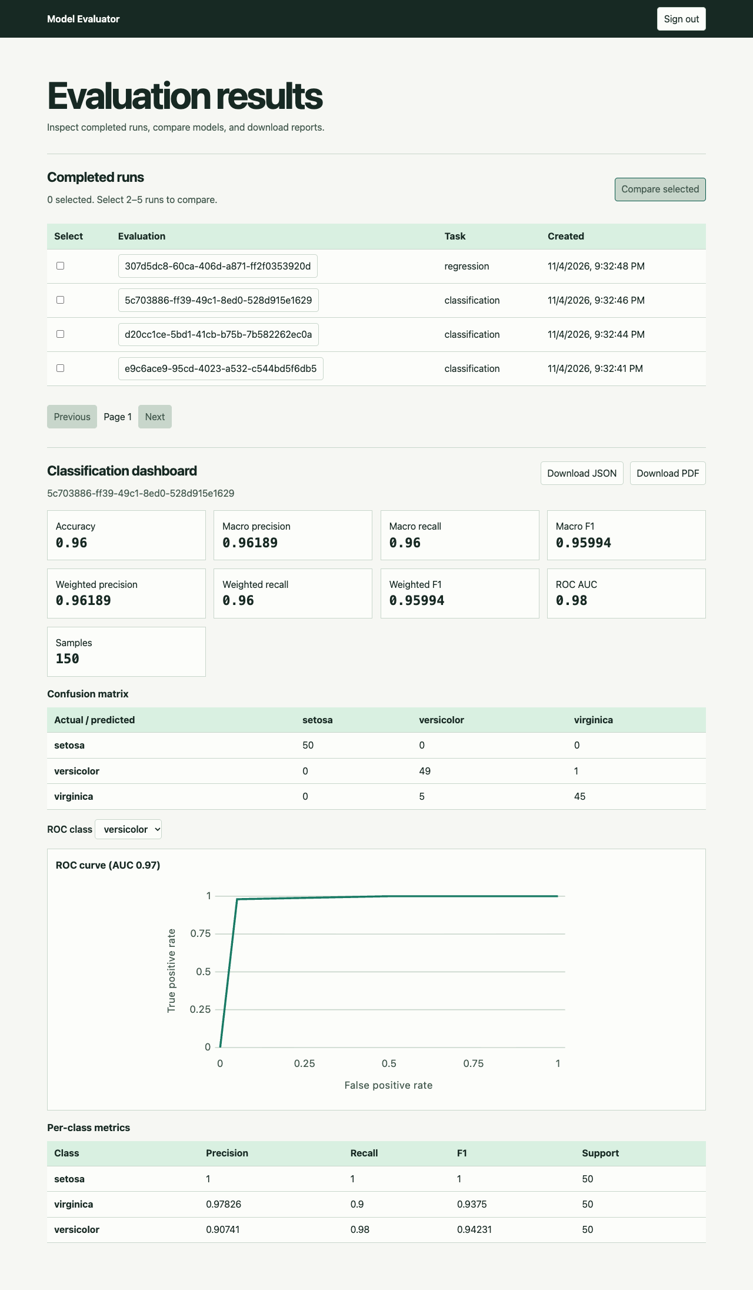
Classification and regression
Inspect classification metrics, confusion matrix and ROC.
Then show regression errors and residual plots.
Capture shown is the earlier /results validation.
TEAM 13 | 8 / 13
Notes:
Sources: Team13_SRS_SAD_STP.pdf; docs/TSMP-23_FINAL_REPORT.md; docs/TSMP-23_DEMO_EVIDENCE.md. Baseline 3f11b12. Historical /results capture from docs/evidence/tsmp-21/screenshots/03-classification-dashboard.png Rehearsal timing follows the fifteen-minute plan in the demo runbook.

Slide 9
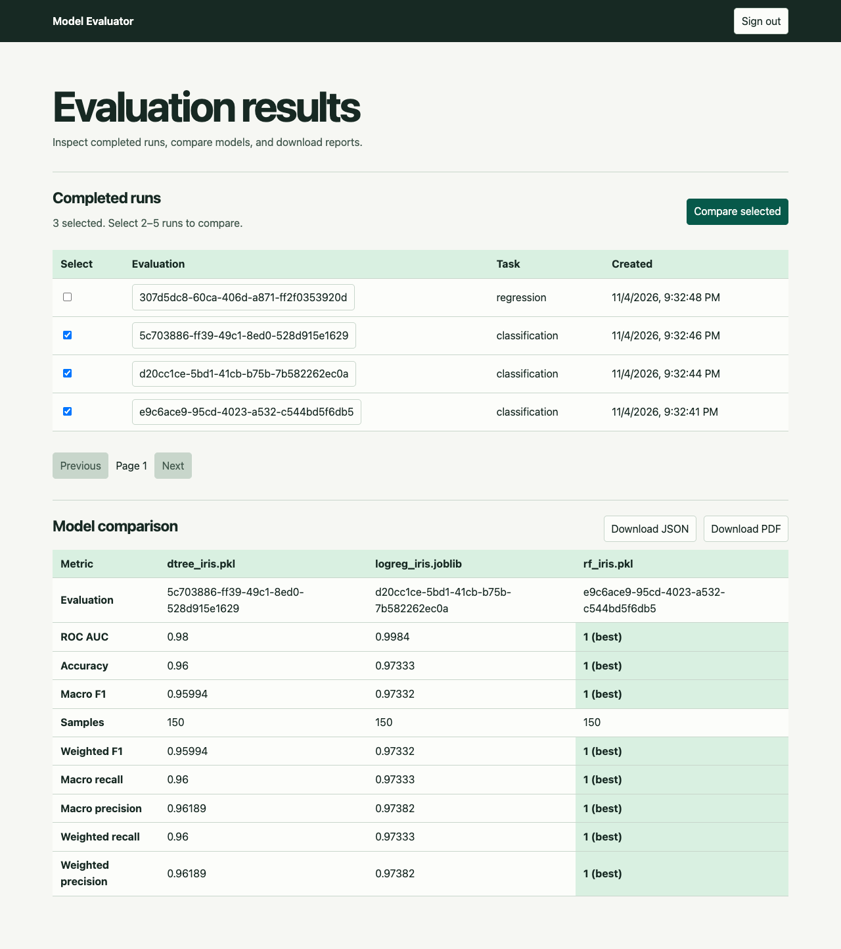
Comparison and export
Compare 2–5 successful runs on the same dataset and task.
Show best values, reject a mismatch and open JSON/PDF.
Capture shown is the earlier /results validation.
TEAM 13 | 9 / 13
Notes:
Sources: Team13_SRS_SAD_STP.pdf; docs/TSMP-23_FINAL_REPORT.md; docs/TSMP-23_DEMO_EVIDENCE.md. Baseline 3f11b12. Historical /results capture from docs/evidence/tsmp-21/screenshots/06-comparison.png Rehearsal timing follows the fifteen-minute plan in the demo runbook.

Slide 10
Agile work and contribution
Atharva Anand: M1, tasks 01-04 and 19-20
Atharva Rakesh Bidre: M2, tasks 05-08 and 17-18
Ayush M Shetty: M3, tasks 09-12 and 21-22
Bhavesh Velluru: M4, tasks 13-16 and 23-24
Show actual feature PRs/reviews and final local test evidence.
TEAM 13 | 10 / 13
Notes:
Sources: Team13_SRS_SAD_STP.pdf; docs/TSMP-23_FINAL_REPORT.md; docs/TSMP-23_DEMO_EVIDENCE.md. Baseline 3f11b12. Implementation and validation links are in the demo evidence index. Rehearsal timing follows the fifteen-minute plan in the demo runbook.

Slide 11
Testing and validation
416 backend tests passed · no skips or expected failures.
97.36% backend lines · 92.67% branch destinations.
121 unit/service cases · 15 live checks · 11 Chrome scenarios.
SonarQube gate passed · zero blocker/critical findings.
Five-person usability, platform evidence and team videos remain.
TEAM 13 | 11 / 13
Notes:
Sources: Team13_SRS_SAD_STP.pdf; docs/TSMP-23_FINAL_REPORT.md; docs/TSMP-23_DEMO_EVIDENCE.md. Baseline 3f11b12. Implementation and validation links are in the demo evidence index. Rehearsal timing follows the fifteen-minute plan in the demo runbook.

Slide 12
Maintenance and remaining work
Review dependencies and rehearse backup, restore and rollback.
Purge expired uploads and preserve active/shared inputs.
HTTPS deployment and private sandbox storage are verified.
The retained ADMIN hierarchy is documented for the viva.
Complete participant, platform, video and team review evidence.
TEAM 13 | 12 / 13
Notes:
Sources: Team13_SRS_SAD_STP.pdf; docs/TSMP-23_FINAL_REPORT.md; docs/TSMP-23_DEMO_EVIDENCE.md. Baseline 3f11b12. Implementation and validation links are in the demo evidence index. Rehearsal timing follows the fifteen-minute plan in the demo runbook.

Slide 13
Questions and contribution
Demonstrate the code and decisions each member owns.
Repository, CI snapshot, captioned evidence and demo runbook
are linked in docs/TSMP-23_DEMO_EVIDENCE.md.
TEAM 13 | 13 / 13
Notes:
Sources: Team13_SRS_SAD_STP.pdf; docs/TSMP-23_FINAL_REPORT.md; docs/TSMP-23_DEMO_EVIDENCE.md. Baseline 3f11b12. Implementation and validation links are in the demo evidence index. Rehearsal timing follows the fifteen-minute plan in the demo runbook.

