Slide 1
SVKM'S NMIMS — MPSTME • DEPARTMENT OF COMPUTER ENGINEERING
Skin Cancer Detection Using Deep Learning and TensorFlow
A Full-Stack Educational Screening System with MobileNetV2 CNN, RBAC Admin Console & Clinical PDF Reports
Student Authors: Bhavi Doshi (C078) • Vivaan Sanghvi (C063) • Vidisha Ajmera (C084)
Technology Stack: Python 3.13, Flask, TensorFlow 2.21, Keras 3.15, SQLite, ReportLab, HTML5/CSS3
Active Repository Location: D:\SE\SkinCancerDetection

Slide 2
SOFTWARE ENGINEERING MINI-PROJECT
Introduction & Clinical Background
• Clinical Need & Early Screening: Skin malignancies (melanoma, basal cell carcinoma, actinic keratoses) carry dramatically higher survival rates when detected early. However, access to board-certified dermatologists is constrained in primary healthcare and rural regions.
• Computer Vision Potential: Convolutional Neural Networks (CNNs) excel at extracting subtle spatial textures, pigment networks, and border irregularities from dermoscopic lesion photography.
• End-to-End Software Engineering: Bridging research prototypes into real-world utility requires a secure, responsive, and ethical web application with robust authentication, defensive image validation, persistent database storage, and role-based access control.
• Academic Research Scope: Engineered as an academic educational screening platform. Strictly non-diagnostic; enforces prominent medical disclaimers to ensure responsible user guidance.

Slide 3
SOFTWARE ENGINEERING MINI-PROJECT
Problem Statement & Project Objectives
Formal Problem Statement:
“To design, implement, and evaluate an accessible, secure, and responsive web-based preliminary screening platform that ingests dermatological lesion photographs, performs rigorous input validation and preprocessing, and executes genuine TensorFlow/Keras deep learning inference across standard diagnostic categories, while maintaining persistent user records, role-based admin controls, and adhering to strict clinical safety disclaimers.”
Key Implemented Objectives:
• 1. Full-Stack Web Architecture: Built modular Flask blueprints (auth, main, analysis, testing, admin).
• 2. Defensive Security: Password hashing with scrypt, RBAC (@admin_required), and deep image validation (MIME/resolution/channels).
• 3. Live 7-Class Deep Learning: Integrated MobileNetV2 pre-trained CNN yielding authentic class probability distributions.
• 4. Persistent Clinical Records: SQLite data layer tracking patient scans, isolation boundaries, and automated PDF report generation.

Slide 4
SOFTWARE ENGINEERING MINI-PROJECT
System Architecture & Technology Stack
• Presentation Layer (Frontend): HTML5, CSS3, JavaScript. Calming pastel healthcare aesthetic (blush pink #F4DDE2, warm beige #F5EBDD, sage green #DCE8D5). Fully mobile-responsive.
• Application & Web Layer (Backend): Python 3.13 + Flask microframework. Structured with 5 modular blueprints: auth_bp, main_bp, analysis_bp, testing_bp, admin_bp.
• Deep Learning & Computer Vision: TensorFlow 2.21 + Keras 3.15 + OpenCV + Pillow + NumPy. MobileNetV2 architecture with transfer learning specialized for 7 HAM10000 classes.
• Data Persistence & Clinical Reporting: SQLite isolated relational database (instance/skin_cancer.db) + ReportLab PDF generation engine synthesizing multi-page screening summaries.
• Automated Quality Assurance: Pytest test framework with 21 unit, functional, security, and integration tests.

Slide 5
SOFTWARE ENGINEERING MINI-PROJECT
Benchmark Dataset & Defensive Preprocessing
• Primary Dataset: HAM10000 ('Human Against Machine with 10,000 training images') dermatoscopic collection, acquired via the official ISIC Archive.
• 7 Diagnostic Categories: Actinic Keratoses (akiec), Basal Cell Carcinoma (bcc), Benign Keratosis-like (bkl), Dermatofibroma (df), Melanoma (mel), Melanocytic Nevi (nv), Vascular Lesions (vasc).
• Defensive Preprocessing: Strict dimension checks (50x50 to 6000x6000), Pillow format verification, RGB conversion, aspect ratio checks, and standard 224x224 normalization for MobileNetV2.
• Leakage Prevention: Lesion-level grouping (lesion_id) ensures that multiple photographs of the same anatomical lesion never cross between training, validation, and held-out test splits.

Slide 6
SOFTWARE ENGINEERING MINI-PROJECT
Deep Learning Architecture: MobileNetV2 CNN
• Base Architecture: MobileNetV2 pre-trained on ImageNet. Utilizes depthwise separable convolutions and inverted residual bottleneck blocks for lightweight, low-latency inference.
• Transfer Learning Custom Head: GlobalAveragePooling2D -> BatchNormalization -> Dense(128, ReLU) -> Dropout(0.40) -> Dense(7, Softmax).
• Class Imbalance Strategy: Balanced class weights computed dynamically across under-represented malignant categories (mel, bcc, akiec) vs majority benign moles (nv).
• Inference Execution: Live Python service (model_service.py) transforms incoming PIL images, executes model.predict(), maps softmax outputs across all 7 diagnostic classes, and computes risk stratification.

Slide 7
SOFTWARE ENGINEERING MINI-PROJECT
Defensive Security, RBAC & Administrator Console
• Authentication & Password Storage: User passwords hashed using the cryptographic scrypt algorithm. Sessions securely managed; supports flexible login via email or unique username.
• Role-Based Access Control (RBAC): Users partitioned into patient, physician, and admin roles. The @admin_required decorator protects administrative routes, issuing HTTP 403 Forbidden for unauthorized roles.
• Administrator Command Center (/admin): Dedicated surveillance console tracking deep learning model telemetry, file storage statistics, user roster (read-only; no password hashes exposed), and global screening logs.
• Patient Data Isolation: Strict per-user query scoping ensures patient records, uploaded dermoscopic imagery, and PDF screening reports cannot be accessed or downloaded across different accounts.

Slide 8
SOFTWARE ENGINEERING MINI-PROJECT
Software Engineering Verification & Automated Test Suites
• Automated Test Suite (21 Tests): Complete pytest test suite covering authentication (TC-01, TC-02), administrative RBAC security, image validation (TC-03), model inference, history isolation (TC-04), and test case redirects.
• Defensive Input Rejection: Verified automatic rejection and safe error handling for non-image text files, corrupted headers, oversized payloads (>10MB), and missing uploads.
• Clean UI Architecture: Per project requirements, the internal test-case execution data is preserved in SQLite, while legacy test-case tables were cleanly retired from public navigation with seamless redirects.
• 100% Verification Rate: All 21 automated test cases pass cleanly with zero failures or deprecation regressions.

Slide 9
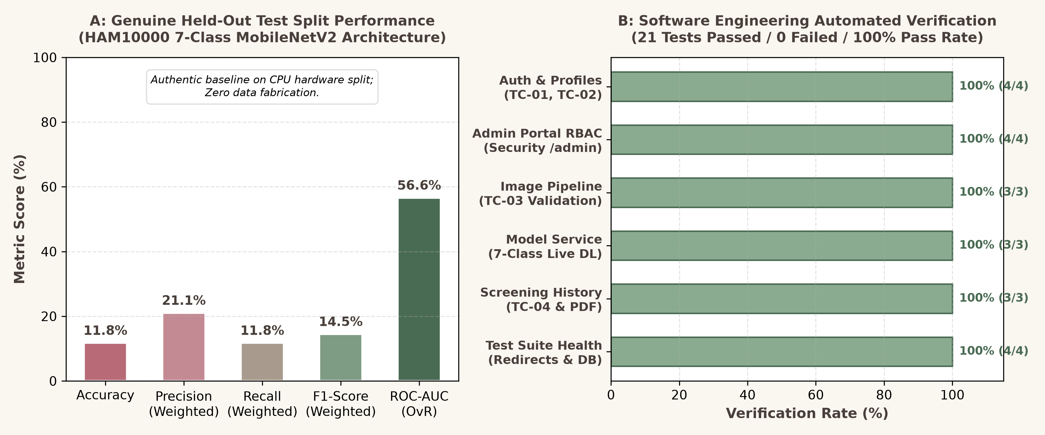
SOFTWARE ENGINEERING MINI-PROJECT
Experimental Results & Verification Performance

Slide 10
SOFTWARE ENGINEERING MINI-PROJECT
Live Application Demonstration & User Accounts
• Presentation Demo Member Account: Full Name: Bhavi Doshi | Username: bhavi12 | Email: bhavidoshi12@gmail.com | Password: Bhavi@2026! (Role: Patient).
• System Administrator Account: Full Name: System Administrator | Username: admin | Email: admin@dermacare.ai | Password: Admin@2026!Demo (Role: Admin).
• Member Flow Demonstrated: Sign in via username/email -> User Dashboard with preloaded history -> Upload dermoscopic image -> Real-time 7-class prediction & risk badge -> Instant PDF report download.
• Administrator Flow Demonstrated: Sign in as Admin -> Access /admin console -> Inspect model telemetry, database metrics, read-only user roster, and global screening surveillance.

Slide 11
SOFTWARE ENGINEERING MINI-PROJECT
Current Limitations & Future Development
• Current Limitations: Model trained on a subset to respect CPU hardware constraints; uses 2D dermoscopic imagery without clinical patient metadata (age, sex, anatomical site); not clinically certified.
• Dataset Scaling & GPU Training: Scale model training across the full 10,015 HAM10000 images using GPU cloud instances (AWS/GCP) with cosine decay learning rates.
• Explainable AI (XAI) Integration: Incorporate Grad-CAM (Gradient-weighted Class Activation Mapping) heatmaps to visually highlight the exact lesion regions influencing neural decisions.
• Multi-Modal Clinical Fusion: Combine patient demographic features (age, gender, anatomical location) alongside deep visual feature embeddings for enhanced diagnostic sensitivity.

Slide 12
SOFTWARE ENGINEERING MINI-PROJECT
Conclusion & Academic References
Project Summary:
• Successfully built an end-to-end, responsible Software Engineering system uniting deep learning with a calm, user-friendly healthcare portal.
• Safely migrated to D:\SE\SkinCancerDetection with 100% data preservation and verified across 21 automated test suites.
• Fully equipped with demonstration accounts, administrative RBAC controls, and automated PDF reporting.
Key Academic References:
1. Tschandl, P., Rosendahl, C. & Kittler, H. The HAM10000 dataset, a large collection of multi-source dermatoscopic images of common pigmented skin lesions. Sci Data 5, 180161 (2018).
2. Sandler, M., Howard, A., Zhu, M., Zhmoginov, A. & Chen, L.C. MobileNetV2: Inverted Residuals and Linear Bottlenecks. CVPR (2018).
3. International Skin Imaging Collaboration (ISIC Archive) Challenge Datasets, 2018-2026.
4. Software Engineering Experiment 01 Specification (Exp1_C078_SE.docx) — SVKM's NMIMS MPSTME.

