Slide 1
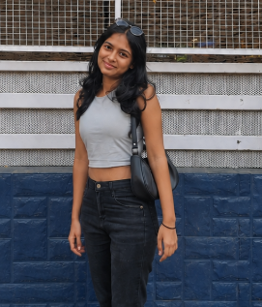
“Good outfits catch my eye, but a good interface keeps me shopping.”
Goals
Discover trendy outfits before they sell out.
Find products quickly using smart filters.
Complete purchases without unnecessary steps.
Receive personalized recommendations based on style preferences.
Frustrations
Homepages filled with too many advertisements.
Poor filtering that makes searching time consuming.
Slow loading during sale events.
Hidden shipping charges shown only at checkout.
Missing size availability after selecting a product.
Bhavika Rane
Age:
Education:
Hometown:
Family:
Occupation:
19
B. Tech Student
Nagpur
Lives with Parents
College Student
Bhavika usually shops during seasonal sales and before college events. She often compares products between AJIO and Savana before making a purchase. She prefers apps that are visually clean, load quickly, and make it easy to filter products by size, colour, brand, and price. While attractive offers grab her attention, excessive promotional banners and cluttered screens often distract her from finding what she actually wants. A smooth browsing experience, detailed product information, and quick checkout influence her final shopping decision.

