Slide 1
MyCollegeCompass
Team Members:
Nallamothu Akash – 20B81A3306
Bhavik Goyal – 20B81A3313
Ganta Rajashekar – 20B81A3331
Name of the Supervisor: Dr.R.Raja
Designation: Associate Professor
Department: ET-CSIT

Slide 2
Problem Statement
In our educational system, students are required to take standardized tests, such as EAMCET (Engineering, Agriculture and Medical Common Entrance Test), to gain admission to colleges and universities. Each college may have specific cutoff ranks for different categories (e.g., OC, BC, SC, ST, EWS) and genders (boys, girls).
The goal of this project is to develop a mobile application that assists students in finding colleges based on their EAMCET rank, caste, and gender preferences.

Slide 3
Proposed Solution
The application aims to simplify the college selection process for students by allowing them to input their EAMCET rank, caste, and gender.
The application will then filter and display a list of colleges that match the user's preferences and meet the minimum rank criteria for their chosen caste and gender.
Users can scroll through the list, tap on colleges for more information.

Slide 4
Technology Stack
Android Studio as the IDE(Integrated Development Environment)
Flutter toolkit for the cross-platform mobile app development.
Dart language for application logic.
CSV parsing library (e.g., csv package in Dart) for data processing.
Material Design for a modern and intuitive user interface.

Slide 5
Phases of Development
1. Project Planning and Requirements Gathering:
Define the project's objectives, scope, and success criteria.
Identify and prioritize key features based on user needs.
Gather requirements, including the data format (CSV structure), user interface design, and functionality.
2. Design and Prototyping:
Design the user interface (UI) for the input screen, results screen, and any additional screens.
Create prototypes to visualize the app's layout and flow.
Design the app's color scheme, typography, and designing.
Review and refine the UI design based on feedback.

Slide 6
3. Data Preparation and Integration:
Collect and prepare the college data to be used in the app.
Set up a data integration pipeline to load and parse the CSV data.
4. App Development - User Interface (UI):
Develop the input screen for users to enter their EAMCET rank, caste, and gender.
Implement dropdown menus for caste and gender selection.
Create a "Submit" button to trigger the filtering process.
5. App Development - Data Processing and Logic:
Develop the logic for loading and parsing CSV data.
Implement the filtering algorithm based on user input.
Ensure the app accurately processes and displays the college data.

Slide 7
6. Post-launch Monitoring and Maintenance:
Monitor the app performance after the launch.
Address any issues and bugs promptly.
Plan and release regular updates to improve functionality and user experience.
Consider adding new features based on user feedback and evolving requirements.

Slide 8
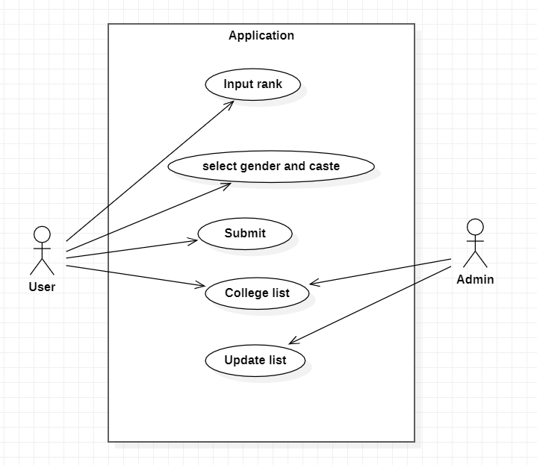
Use Case Diagram

Slide 9
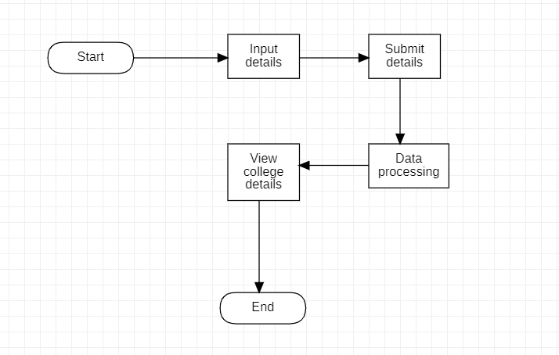
Flow Diagram

Slide 10
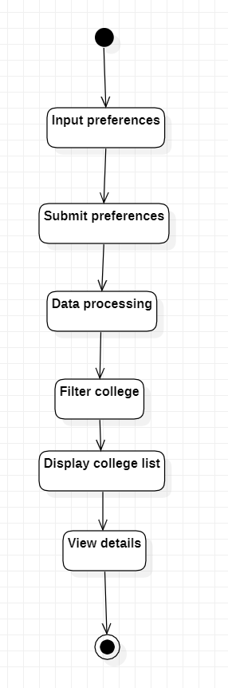
Activity Diagram

Slide 11
Contribution of Akash
Design and develop the user interface (UI) components and frontend of the College App.
Design the UI layout, including the input screen, results screen.
Develop the input screen for users to input their EAMCET rank, caste, and gender preferences.
Implement dropdown menus for caste and gender selection.
Design and develop the results screen to display filtered colleges.

Slide 12
Contribution of Bhavik
Develop the backend components responsible for data processing and integration.
Set up a data integration pipeline to load and parse the CSV data containing college information.
Implement data validation mechanisms.
Create functions for filtering, sorting, and processing college data based on user input.

Slide 13
Contribution of Rajashekar
Manage the collection of data, deployment of the application, and its ongoing maintenance.
Data Gathering: Gather and maintain the dataset containing college information (e.g., cutoff ranks, names, details).
Ensure compatibility with Android and iOS platforms.
Address and resolve issues and bugs(if found any.)

Slide 14
Conclusion
The user interface is intuitive and user-friendly, featuring well-designed input screens, dropdown menus, and informative results screens.
In conclusion, this application successfully addresses a crucial need in the education sector by simplifying the college selection process.
With its accurate data processing, user-friendly interface, and commitment to ongoing improvement, it empowers students to make informed decisions about their higher education journey.

Slide 15
Thank you!

