Slide 1

Aura
Your Home's AI Energy Pilot. Aura doesn't just watch your energy; it conducts it.
The Problem for Users:
Energy bills are high and confusing.
You want to reduce your carbon footprint, but it's difficult to know how and when.
Existing "smart" tools are passive trackers, not active helpers.
The Problem for Utility Company:
Grid instability caused by demand spikes (e.g., 6 PM rush).
Heavy reliance on "dirty" fossil fuels during peak hours.
Inability to control or influence residential energy use at scale.

Slide 2
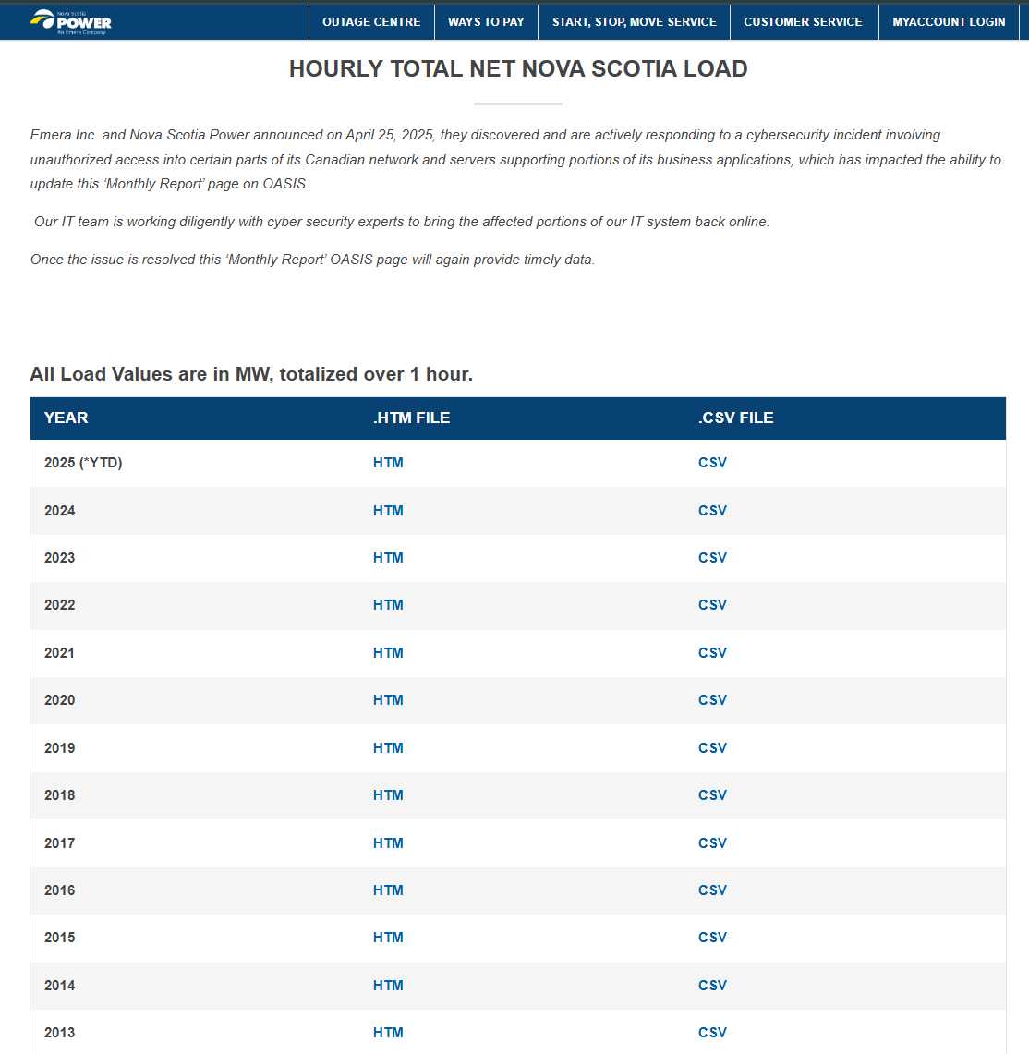
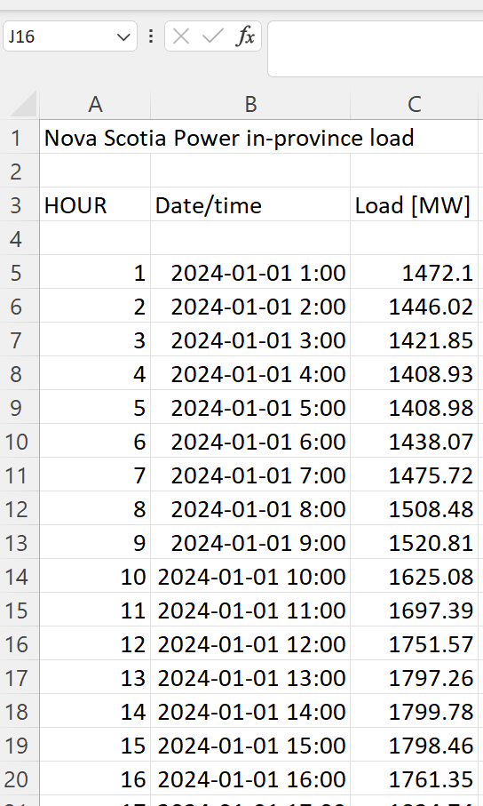
Data Source (1) : NS Power Net Hourly Grid LOAD

Slide 3
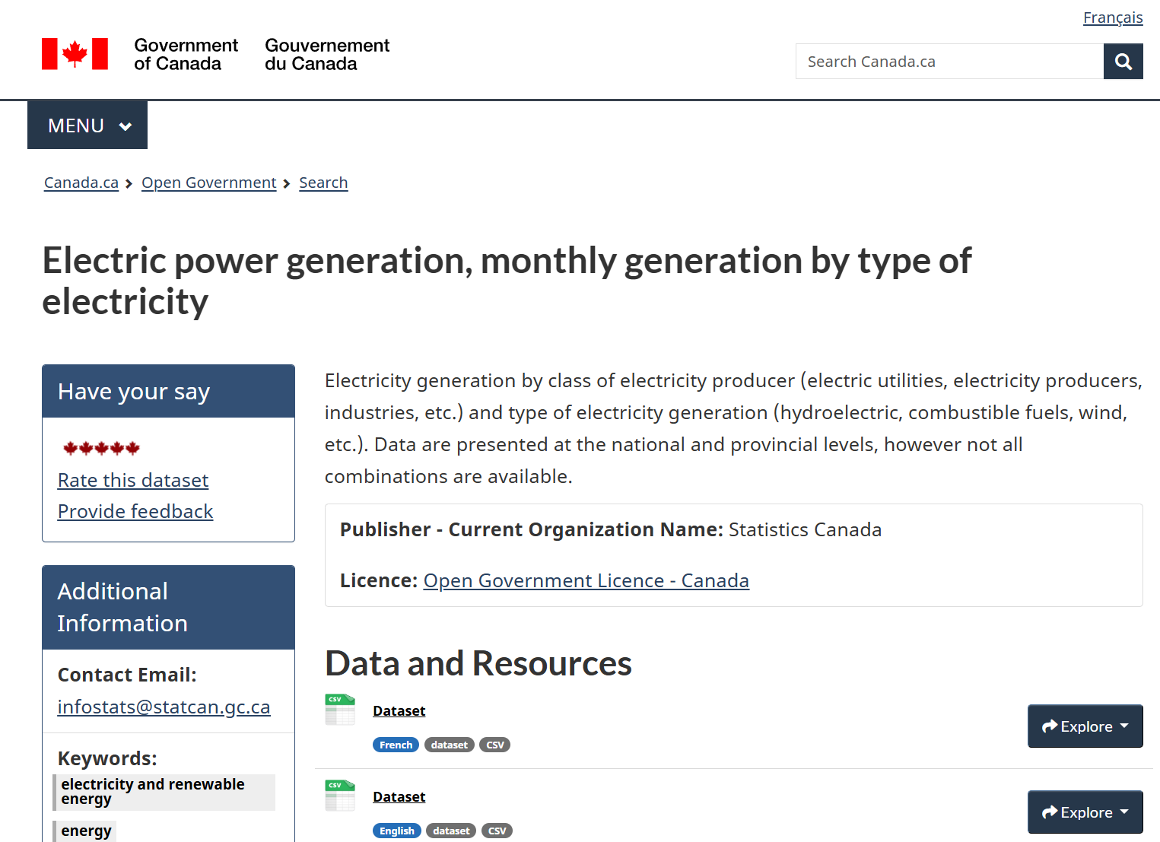
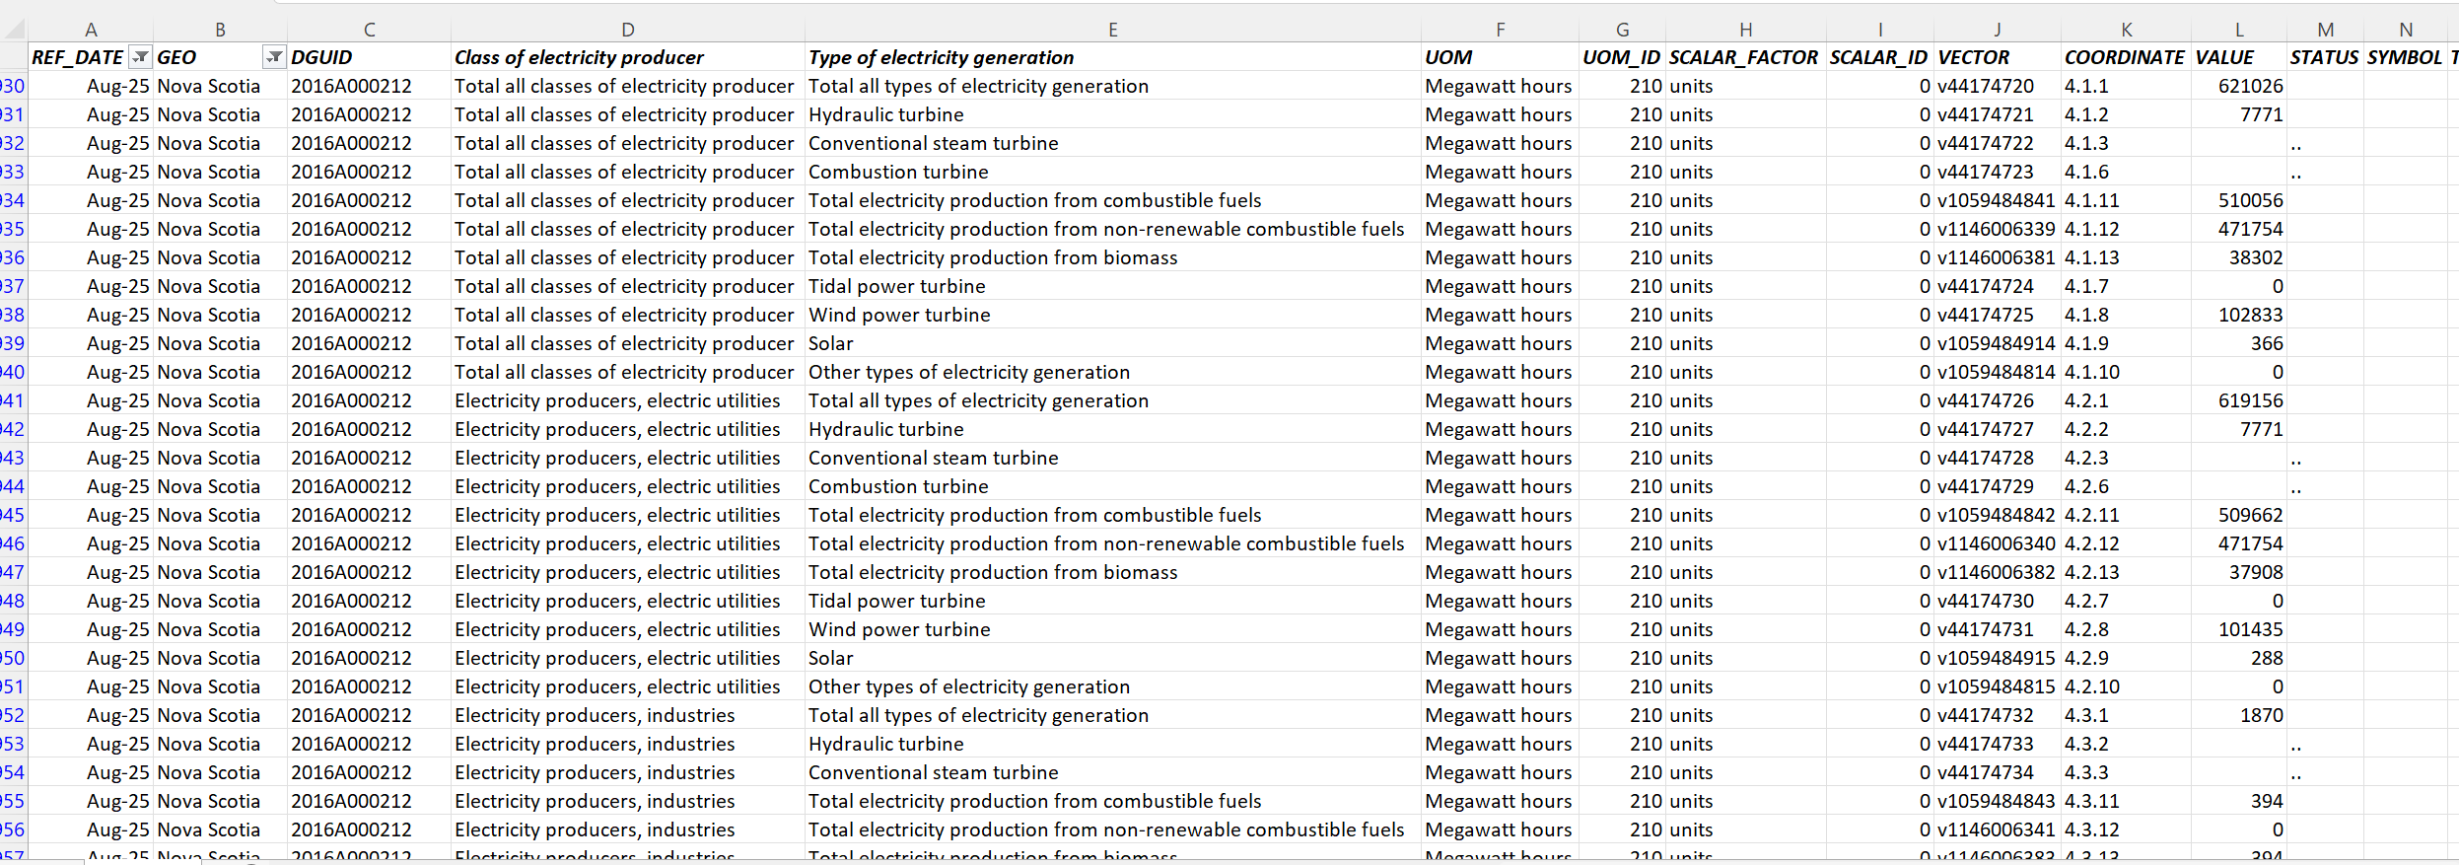
Data Source (2) : Provincial Electric power generation, monthly generation by type of electricity

Slide 4
What is Aura?
Aura is an intelligent web application that acts as the "brain" for a household’s and Utility company’s energy use. It’s not a passive tracker; it's an active, forward-looking orchestrator.
How it Works:
FORECASTS: Aura's AI engine predicts the carbon intensity (gCO2/kWh) of the Halifax grid for the next 24 hours.
OPTIMIZES: It automatically schedules your high-energy appliances (dryer, dishwasher, EV) to run during the absolute "greenest" and "cheapest" times.
ADAPTS: It understands your real-life needs. Just say, "I need the dryer to be done by 7 AM," and Aura finds the optimal time to do it.
The "AI Brain": The Green Window Engine:
Demand Forecaster (SARIMAX): A time-series model trained on grid data to predict total energy load of next 24 hours.
Supply Forecaster (Custom Algorithm): A dynamic, seasonal model that estimates the renewable vs. fossil fuel mix on the grid.
The "Green Window": The engine identifies the precise hours with the lowest carbon intensity and cost.
AI Assistance:
Aura understands plain English commands, including task dependencies and deadlines, and automatically schedules them to minimize both cost and carbon intensity.

