Slide 1

Applied Machine Learning (CSCI-P 556) Final Project: Home Credit Default Risk- Phase III
Group 21
Sri Veera Sesha Sai Bhavik Kollipara
Aditya Shekhar Camarushy
Pradeep Reddy Rokkam
Sai Prajwal Reddy
Indiana University, April 2022.
Notes:
fdgsdfg

Slide 2
Contents
Team Profile
Four P's
Final Project : Feature Selection
Final Project : Hyperparameter Tuning
Final Project : PyTorch Deep Learning Models
Results and Discussion
Conclusion and Next Steps

Slide 3
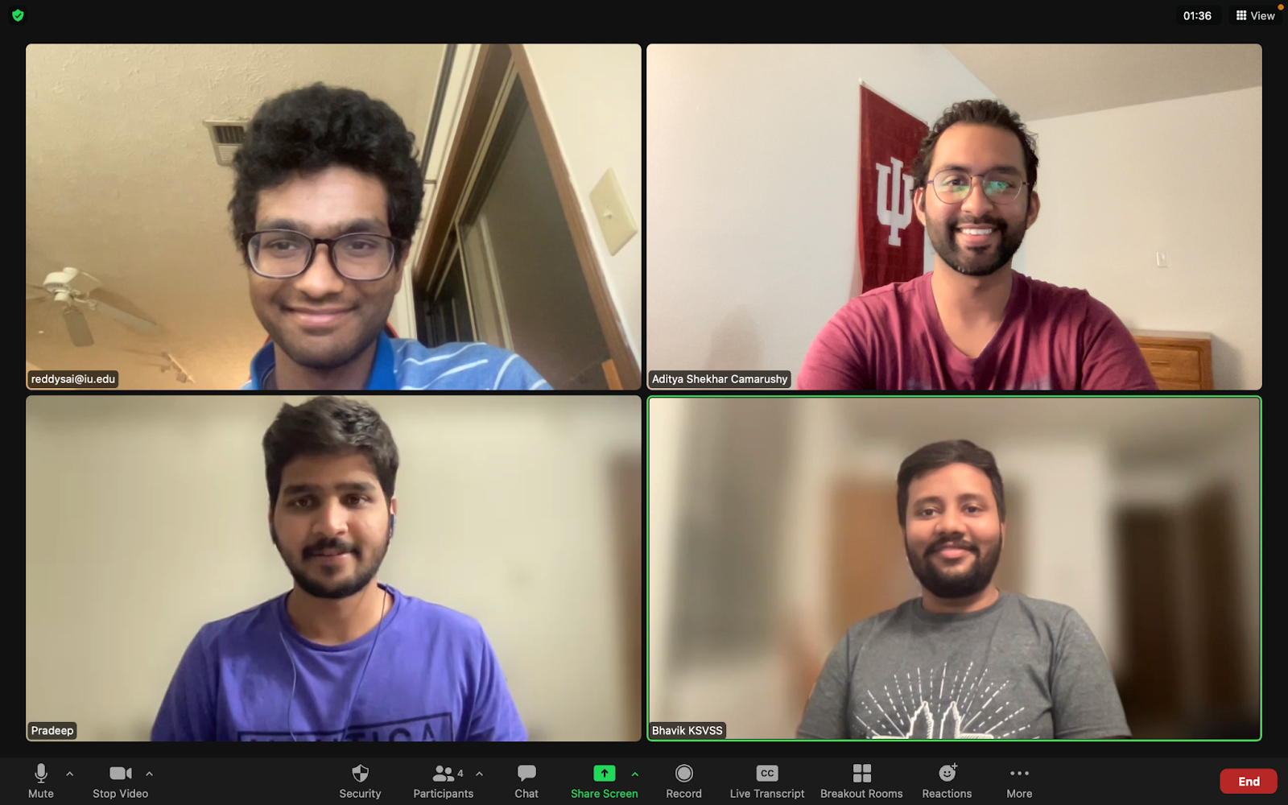
Team Members:
Sai Prajwal Reddy
Aditya Shekhar Camarushy
Pradeep Reddy Rokkam
Sri Veera Sesha Sai Bhavik Kollipara

Slide 4
Four P's
Past:
We selected the project Home Credit Default Risk, in which we predict whether a client will repay a loan with high accuracy using telco, transactional data, payment behavior etc.,
In phase-1 and phase 2, we performed EDA and built models using logistic regression, Decision Trees and Gradient Boosting Algorithms like Light GBM and XGBoost
Present:
We have selected more relevant features and took care of missing values using imputation and also worked on anomalies in the data
We implemented a Deep Learning Model (MLP) in PyTorch. We tuned the hyperparameters of the model and, visualized the performance metrics using TensorBoard

Slide 5
Four P's
Planned
As a stretch goal, we would develop and implement new multitask loss function in PyTorch
We will build another PyTorch model for regression (using a multilayer perceptron (MLP)) with at least one target value corresponding to, say, the length of time or percentage of repayment period before the borrower defaults
We will also build a multi-headed load default system using the OOP API in PyTorch with a combined loss function: CXE + MSE
Problems:
We did not observe a significant improvement of AUC scores for the MLP model when compared to Gradient Boosting Algorithms

Slide 6
Final Project: Description
The main object of the project is to predict whether a given customer can repay a given loan using the data sources that has been provided from Kaggle.
We use data like previous credit information, type of credit, remaining days for repaying the previous credit, the payments made, the previous application details and much more.
We use both the numerical data like credit taken etc. and categorical data like gender, contract type by Label Encoding the categorical variables. We then use EDA and then build a proper dataset that can be used for building a good machine learning model.

Slide 7
Final Project: Modelling Pipelines
We developed a Multilayer Perceptron model (MLP) for binary classification
The model predicts the probability of class 1 by using the ReLU activation function
One of the important steps of data preparation is embedding which is a better representation of categorical column values as N-dimensional vector instead of single integer
Our model was trained on 70% of the data, and the remaining 30% was used for validation
We optimized the model using stochastic gradient descent, and leveraged the binary cross-entropy loss metric
Finally, the model performance was evaluated on the test dataset

Slide 8
Final Project : Feature Engineering
In this phase, we have worked on creating some new features
The following are the features we engineered :
total_amt_req_credit_bureau
has_job
has_children
cluster_days_employed
house_variables_sum

Slide 9
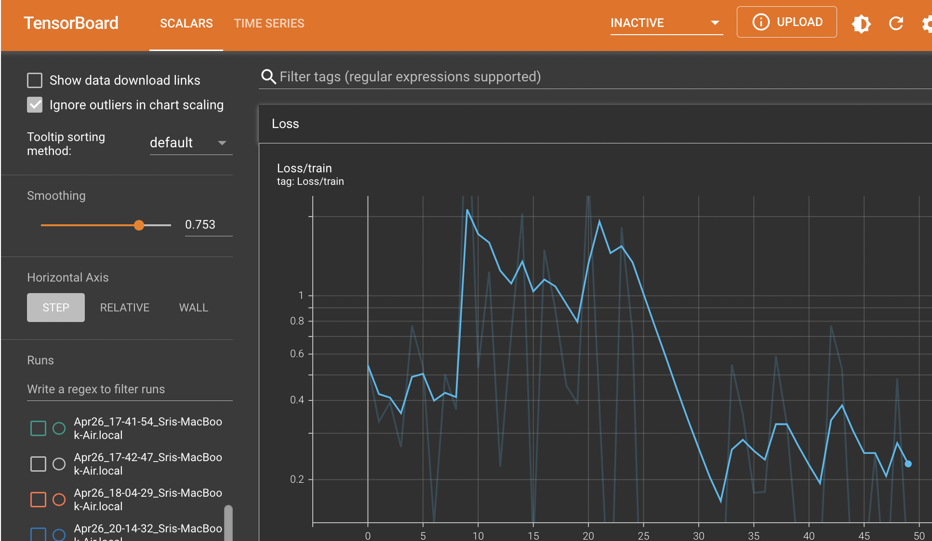
Final Project: TensorBoard Visualization

Slide 10
Final Project : Hyperparameter Tuning
Initially we built an MLP model with one hidden layer and default parameters
The following are the hyperparameters that were tuned and parameters that gave the best performance during the training are the following:

Slide 11
Final Project: MLP and Past Results
Past Results
Current Results
Notes:
In the past we found that the Light GBM Model
performed the best with an AUC score of 0.748,
in this phase of the project we used an MLP model with 1 & 3 hidden layers
yielding test AUCs of 0.55 and 0.724 respectively.

Slide 12
Final Project: Conclusion and Next Steps
Conclusion:
We developed deep learning models using PyTorch.
Of all the ML models that we built, we see LightGBM and MLP performed the best.
We fine-tuned our MLP using Hyper-parameter tuning and submitted the results to kaggle with public and private scores of 0.72408 and 0.72666 respectively.
Next Steps:
The ideal next step would be to improve the deep learning model further using various neural networks such as Deep Neural Networks and Convolutional Neural Networks.
Notes:
To conclude, in this phase we developed deep learning models using PyTorch.
LightGBM and MLP were the best performing models.
We fine-tuned our MLP using Hyper-parameter tuning and submitted the results to kaggle
with public and private scores of 0.724 and 0.726 respectively.
The ideal next step would be to improve the deep learning model further using various neural networks
such as DNN and CNN's.

Slide 13
Thank You!
Notes:
Lastly, on behalf of my team I would like to thank Professor Shanahan
and the wonderful team of TAs for giving us this excellent learning opportunity.

