Slide 1
SMART SUPPLY CHAINS · MCA SEMESTER 3 PROJECT
ChainShield
Transportation System
Resilient Logistics & Dynamic Supply Chain Optimization
Group No. 59
Bhavik A. Visani (D51) · Diya Shah (D36) · Shruti Somani (D42)
Guided by Prof. Dhaval Shah
LJ Institute of Computer Application | LJK University
Notes:
Opening slide. Introduce the project name, the track (Smart Supply Chains), and the team before moving to the problem statement.

Slide 2
THE PROBLEM
Disruptions are found only after it's too late
Reactive monitoring
1
Managers learn about a delay only after a customer reports a missed delivery.
Siloed signals
2
Weather, congestion, cargo risk, and delay history are never fused into one score.
Ad-hoc rerouting
3
When a disruption is found, the reroute decision relies on guesswork, not data.
ChainShield Transportation System | MCA Semester 3 | Group 59
2
Notes:
Set up the pain point in three concrete failure modes, before showing the solution on the next slide.

Slide 3
OBJECTIVE
Catch disruptions before they cascade
Continuously score every active shipment's disruption risk
GOAL
Reactive
→
Preemptive
Auto-flag disruptions the instant a risk threshold is crossed
Instantly propose ranked, optimised route alternatives
Notify managers, then field operators, the moment a decision is made
Give each role — admin, manager, operator — its own focused dashboard
ChainShield Transportation System | MCA Semester 3 | Group 59
3
Notes:
Five concrete objectives, then the one-line framing on the right: moving the org from reactive to preemptive.

Slide 4
PROPOSED SOLUTION
How ChainShield works
1
2
3
4
MONITOR
DETECT
REROUTE
NOTIFY
→
→
→
Every active shipment is scored on a recurring interval using live weather, congestion, cargo, and history signals.
Crossing a risk threshold auto-creates a disruption and alerts the manager — no manual checking required.
Two ranked alternatives (reroute vs. hold) are generated with time, cost, and residual-risk trade-offs.
The manager's choice is pushed instantly to the assigned field operator's dashboard.
ChainShield Transportation System | MCA Semester 3 | Group 59
4
Notes:
Walk through the four-step loop left to right — this is the core mechanic of the whole system.

Slide 5
RISK ENGINE
A transparent, weighted risk score
COMPOSITE SCORE THRESHOLDS
≥ 70
HIGH / CRITICAL
Disruption auto-created, solutions generated, manager alerted
≥ 50
MEDIUM
Disruption flagged, ranked solutions provided
≥ 30
AT-RISK
Shipment marked at-risk and monitored closely
< 30
LOW
No action — risk score updated silently
ChainShield Transportation System | MCA Semester 3 | Group 59
5
Notes:
The pie chart shows how the four signals are weighted into one composite score; the right column shows what the system does at each threshold.

Slide 6
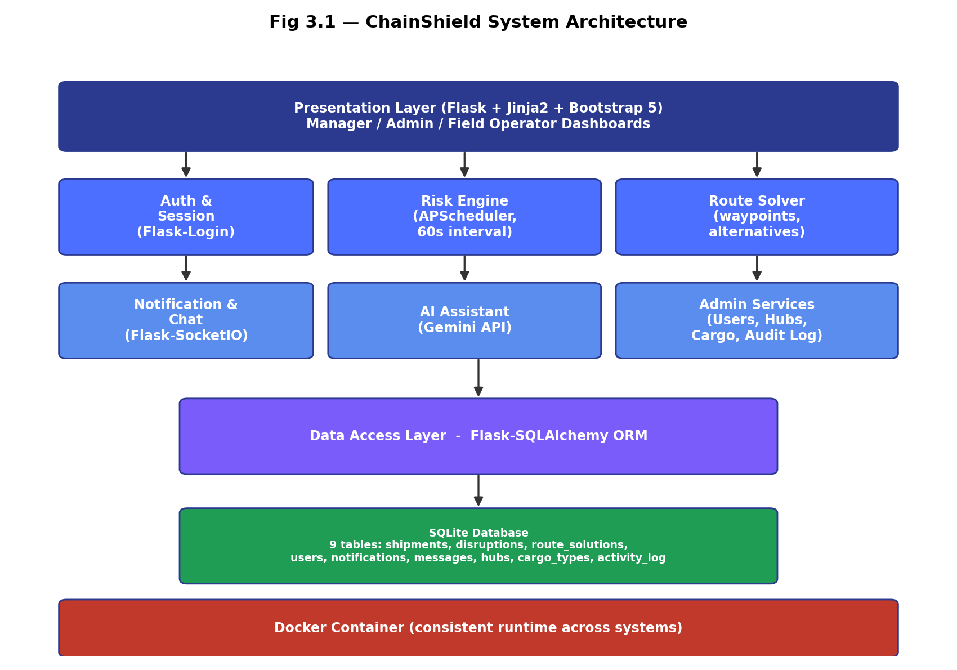
SYSTEM DESIGN
System architecture
ChainShield Transportation System | MCA Semester 3 | Group 59
6
Notes:
Layered architecture: Flask/Jinja2 presentation layer, core services in the middle, SQLAlchemy data layer, SQLite database, all packaged in Docker.

Slide 7
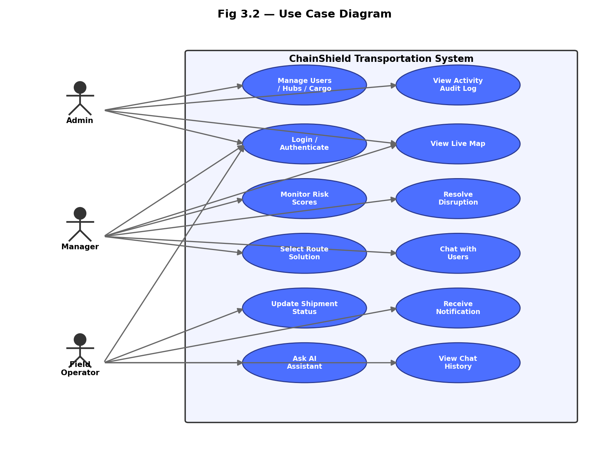
SYSTEM DESIGN
Use case diagram
ChainShield Transportation System | MCA Semester 3 | Group 59
7
Notes:
Three roles — Admin, Manager, Field Operator — each with a distinct set of use cases inside the system boundary.

Slide 8
CORE COMPONENTS
What ChainShield does
RE
Risk Engine
RS
Route Solver
NC
Notify & Chat
Scores every shipment on a recurring schedule
Ranked reroute / hold alternatives with cost & time
In-app alerts and direct messaging between users
AP
Admin Panel
AI
AI Assistant
LM
Live Map
Users, hubs, cargo types, and an activity audit log
Natural-language Q&A over the supply chain (Gemini)
Leaflet map of shipment positions & disruption zones
ChainShield Transportation System | MCA Semester 3 | Group 59
8
Notes:
Six core components map directly to the six service/blueprint modules in the codebase.

Slide 9
TECHNOLOGY
Technology stack
BACKEND
FRONTEND
DATA & INFRA
EXTERNAL APIS
Python 3
Flask
Flask-SQLAlchemy
Flask-Login
Flask-SocketIO
APScheduler
Jinja2 Templates
Bootstrap 5
JavaScript
Leaflet.js
Chart.js
SQLite
Docker
Docker Compose
Git / GitHub
Google Gemini API
OpenWeatherMap API
ChainShield Transportation System | MCA Semester 3 | Group 59
9
Notes:
Same stack confirmed for the rebuild: Flask + SQLite + Docker, kept deliberately simple and self-contained for an academic build.

Slide 10
PROGRESS
Current status & roadmap
✓
Requirement Analysis & System Design
DONE
✓
Environment Setup & Docker
DONE
✓
Authentication (Login / Register)
DONE
4
Risk Engine & Disruption Detection
PLANNED
5
Dashboards (Manager / Admin / Operator)
PLANNED
6
Testing & Final Submission
PLANNED
ChainShield Transportation System | MCA Semester 3 | Group 59
10
Notes:
Three milestones complete — documentation, environment/Docker, and authentication. Next: the risk engine and the three role-based dashboards.

Slide 11
CONCLUSION
From reactive tracking to preemptive logistics
ChainShield turns scattered weather, congestion, cargo, and history signals into one transparent risk score per shipment — and pairs every detected disruption with a ranked, actionable route solution, so delays are caught before they cascade.
4
3
9
60s
Weighted risk factors
User roles
Database tables
Risk scan interval
ChainShield Transportation System | MCA Semester 3 | Group 59
11
Notes:
Close on the headline reframing — reactive to preemptive — backed by four quick stats that summarise the system's scope.

Slide 12
Thank You
Questions & Discussion
Bhavik A. Visani · Diya Shah · Shruti Somani
Group No. 59 | Guided by Prof. Dhaval Shah
Notes:
Invite questions from the guide.

